Slide 1
Join ifadeleri
NBP124 Veri tabanı yönetim sistemleri
Öğr. Gör. Mahmut KILIÇASLAN

Slide 2
Uygulama Tablosu
OrderID | CustomerID | OrderDate
10308 | 2 | 1996-09-18
10309 | 37 | 1996-09-19
10310 | 77 | 1996-09-20
CustomerID | CustomerName | ContactName | Country
1 | Alfreds Futterkiste | Maria Anders | Germany
2 | Ana Trujillo Emparedados y helados | Ana Trujillo | Mexico
3 | Antonio Moreno Taquería | Antonio Moreno | Mexico
OrderID | CustomerName | OrderDate
10308 | Ana Trujillo Emparedados y helados | 9/18/1996
10365 | Antonio Moreno Taquería | 11/27/1996
10383 | Around the Horn | 12/16/1996
10355 | Around the Horn | 11/15/1996
10278 | Berglunds snabbköp | 8/12/1996

Slide 3
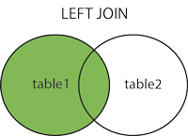
JOİN İfadeleri

Slide 4
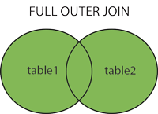
JOIN İfadeleri

Slide 5
INNER JOIN
SELECT column_name(s)
FROM table1
INNER JOIN table2
ON table1.column_name = table2.column_name;

Slide 6
INNER JOIN
SELECT Orders.OrderID, Customers.CustomerName FROM Orders INNER JOIN Customers ON Orders.CustomerID = Customers.CustomerID;

Slide 7
INNER JOIN
SELECT Orders.OrderID, Customers.CustomerName, Shippers.ShipperName FROM ((Orders INNER JOIN Customers ON Orders.CustomerID = Customers.CustomerID) INNER JOIN Shippers ON Orders.ShipperID = Shippers.ShipperID);

Slide 8
KAYNAKLAR
[1] https://www.w3schools.com/sql/default.asp
[2]Yazılımcılar için SQL Server ve Veritabanı Programlama,2014, Seçkin Yayıncılık

