Slide 1
Lecture 5: What CDC Is Doing These Days?

Slide 2
CDC works worldwide 24/7 to protect the U.S. from disease threats.
Disease knows no borders. In today’s interconnected world, a disease threat anywhere can become a health threat in the U.S. We know that disease exploits even the smallest gap to spread and grow. With the ease and speed of global travel, along with rapidly expanding commerce and trade, the need to shut down the expressways available to infectious disease into the U.S. is more important today than ever before.
The most effective – and cost effective – way to protect Americans from known and unknown health threats that begin overseas is to stop them before they spread to our shores.
CDC’s global activities protect Americans from major health threats such as Ebola, Zika, and pandemic influenza.
CDC detects and controls outbreaks at their source, saving lives and reducing healthcare costs. Importantly, CDC helps other countries build capacity to prevent, detect, and respond to their health threats through our work. The goal is to stop diseases where they occur as soon as they start. The knowledge and lessons learned from CDC’s work abroad are critical to our public health efforts at home, and to protect Americans.

Slide 3
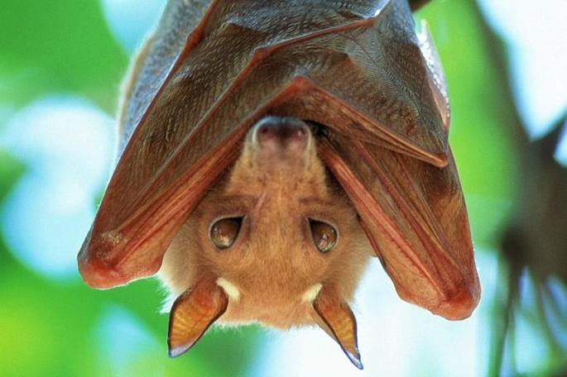
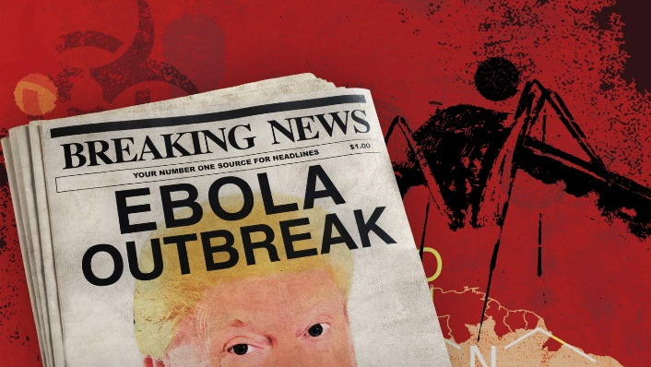
Ebola
Ebola Virus Disease (EVD) is a rare and deadly disease in people and nonhuman primates.
The viruses that cause EVD are located mainly in sub-Saharan Africa.
People can get EVD through direct contact with an infected animal (bat or nonhuman primate) or a sick or dead person infected with Ebola virus.
There is no approved vaccine or treatment for EVD.
Research on EVD focuses on finding the virus’ natural host, developing vaccines to protect at-risk populations, and discovering therapies to improve treatment of the disease.

Slide 4
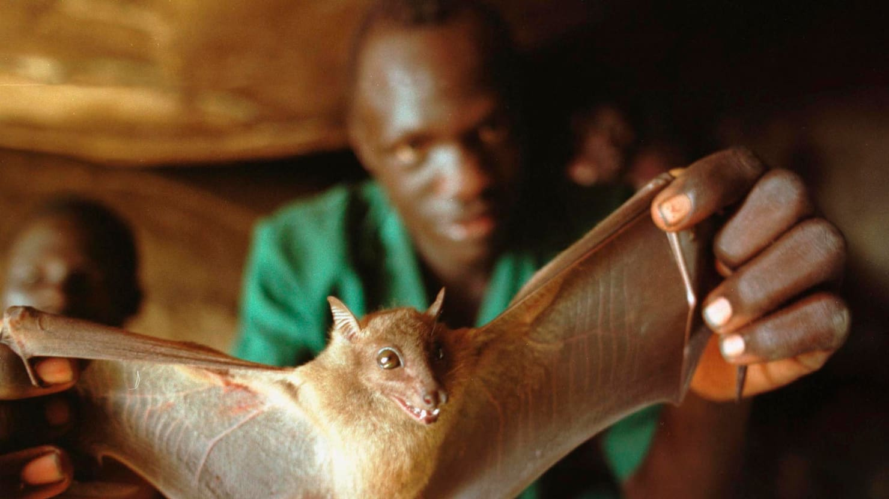

Slide 5
What is Ebola Virus Disease?
It is caused by an infection with a group of viruses within the genus Ebolavirus:
Ebola virus (species Zaire ebolavirus)
Sudan virus (species Sudan ebolavirus)
Taï Forest virus (species Taï Forest ebolavirus, formerly Côte d’Ivoire ebolavirus)
Bundibugyo virus (species Bundibugyo ebolavirus)
Reston virus (species Reston ebolavirus)
Bombali virus (species Bombali ebolavirus)
Of these, only four (Ebola, Sudan, Taï Forest, and Bundibugyo viruses) are known to cause disease in people.
Reston virus is known to cause disease in nonhuman primates and pigs, but not in people.
It is unknown if Bombali virus, which was recently identified in bats, causes disease in either animals or people.

Slide 6
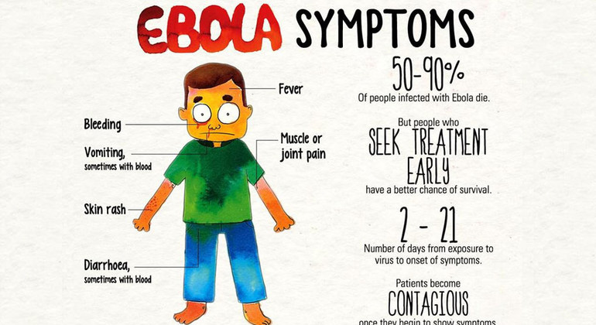
Symptoms
Ebola survivors may experience difficult side effects after their recovery, such as tiredness, muscle aches, eye and vision problems and stomach pain.

Slide 7
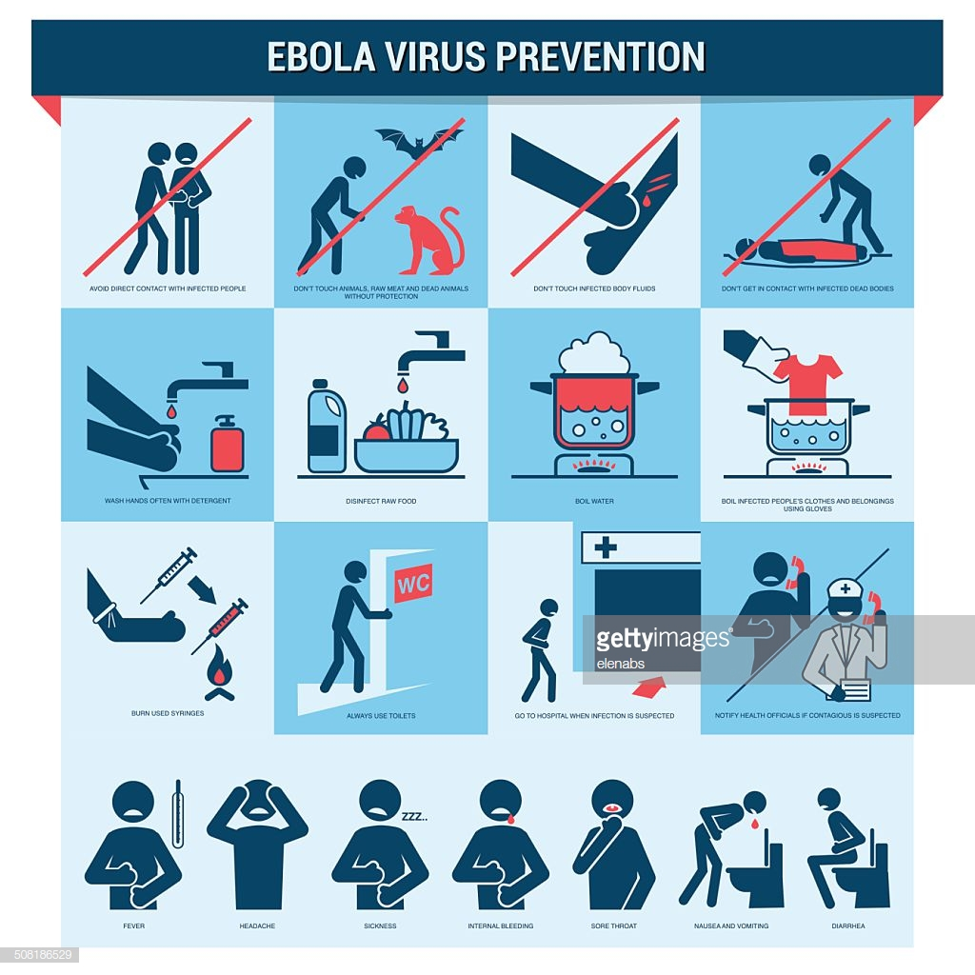
After returning from an area affected by Ebola, monitor your health for 21 days and seek medical care immediately if you develop symptoms of EVD.

Slide 8
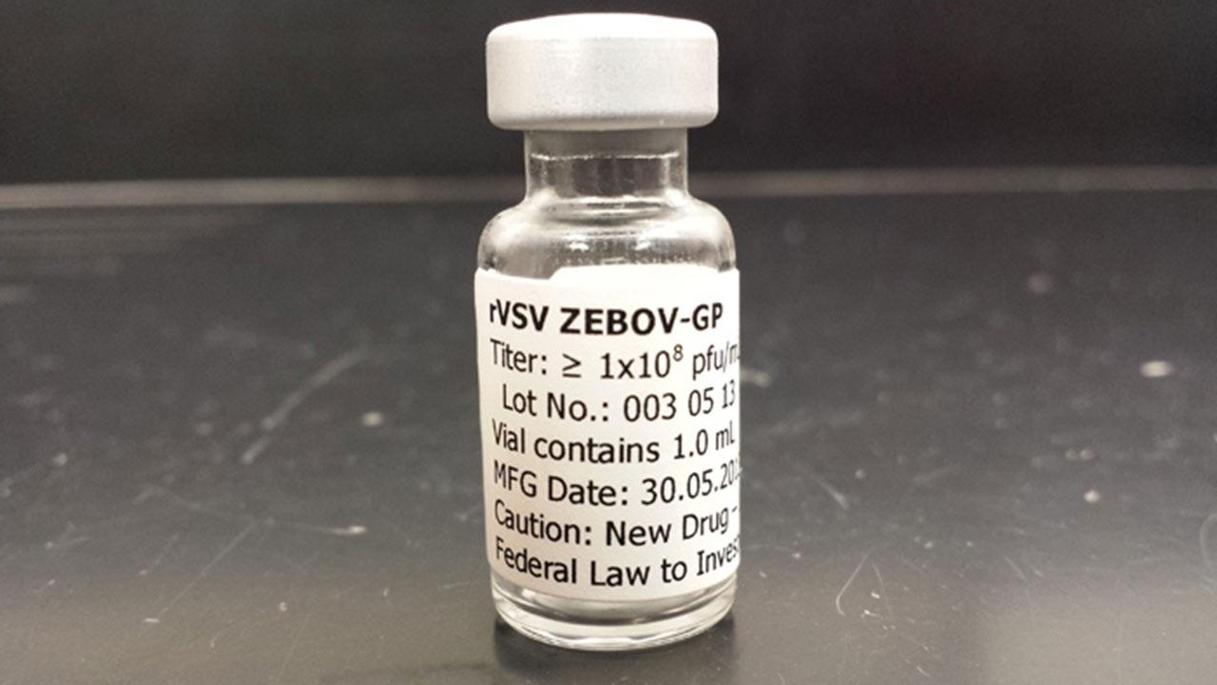
Ebola Vaccine
There is currently no vaccine licensed by the FDA to protect people from Ebola virus.
An experimental vaccine called rVSV-ZEBOV was found to be highly protective against the virus in a trial conducted by the WHO and other international partners in Guinea in 2015.
FDA licensure for the vaccine is expected in 2018.
In the meantime, 300,000 doses have been committed for an emergency use stockpile under the appropriate regulatory mechanism (Investigational New Drug application [IND] or Emergency Use Authorization [EUA]) in the event an outbreak occurs before FDA approval is received.

Slide 9
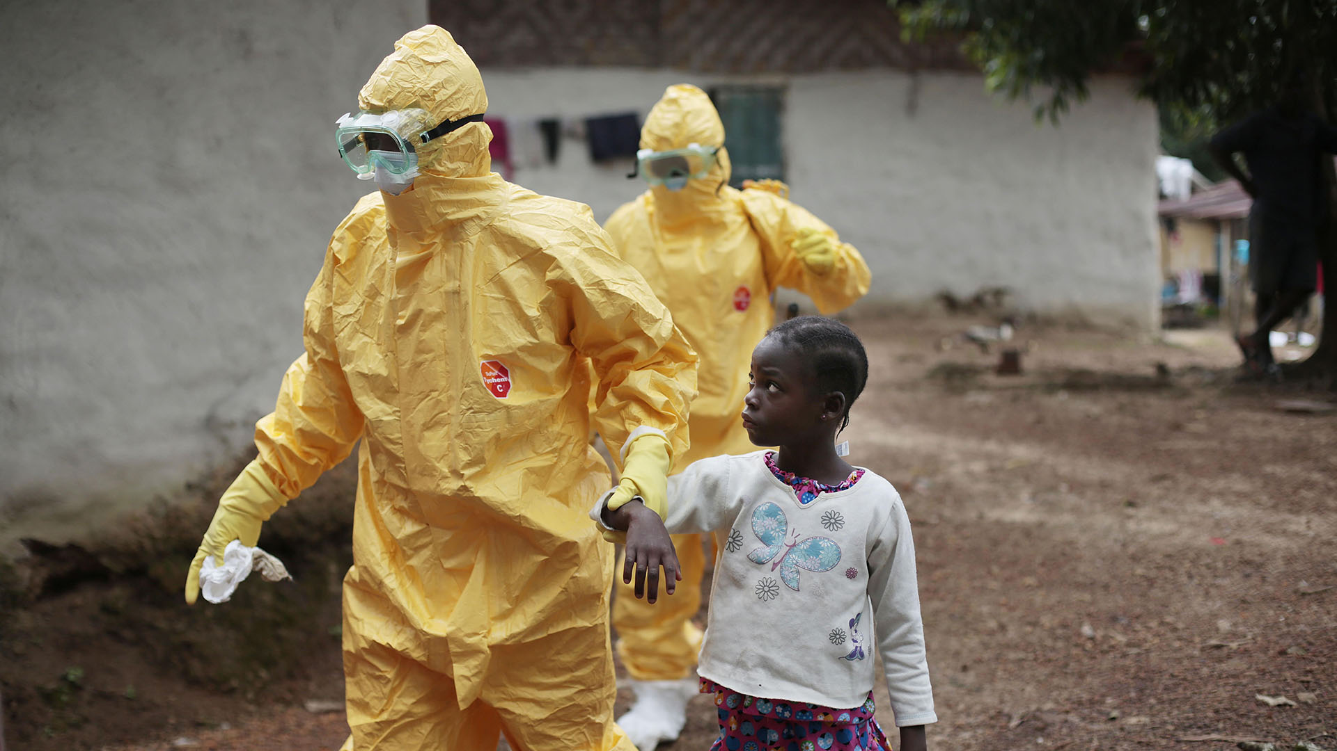
Ebola Vaccine
Scientists continue to study the safety of this vaccine in populations such as children and people with HIV.
Another Ebola vaccine candidate, the recombinant adenovirus type-5 Ebola vaccine, was evaluated in a phase 2 trial in Sierra Leone in 2015.
An immune response was stimulated by this vaccine within 28 days of vaccination, the response decreased over six months after injection. Research on this vaccine is ongoing.

Slide 10
Influenza How Influenza Pandemics Occur?
https://www.youtube.com/watch?v=DdFCx8jbesQ&list=PL9rasaw-kjnzq6gz7bkMg8TQPMVKv7Bjl

Slide 11
1918 Flu Pandemic
https://www.youtube.com/watch?v=U6Ccdk5wPvk

Slide 12
How Is Pandemic Flu Different from Seasonal Flu?

Slide 13
How Is Pandemic Flu Different from Seasonal Flu?

