Slide 1
Stereochemistry

Slide 2
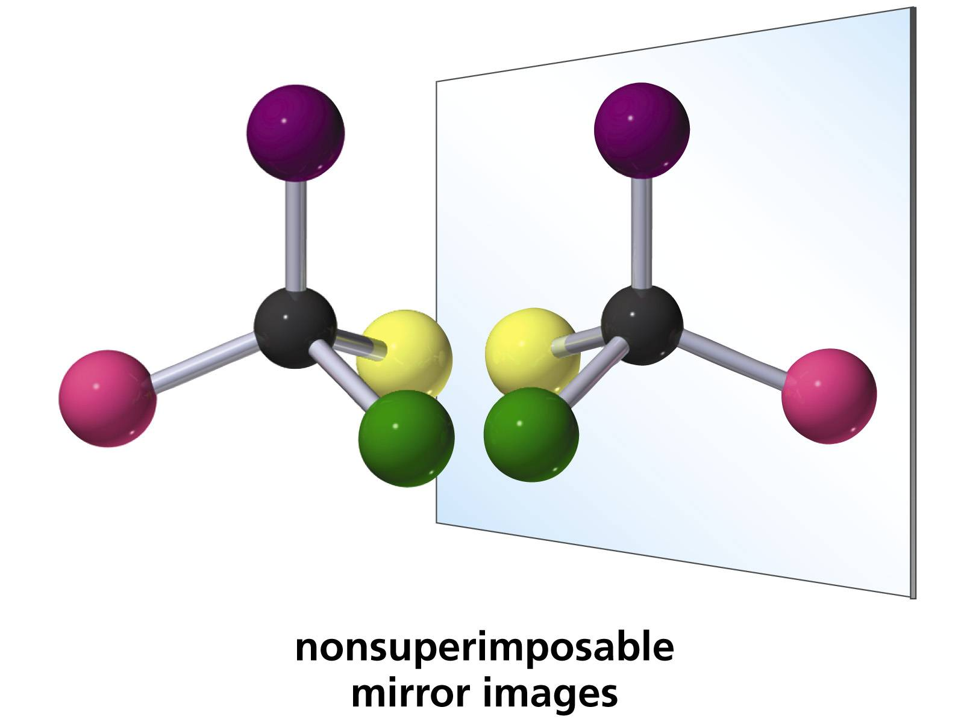
stereochemistry
It’s the study of three-dimensional structure of molecules.

Slide 3
Why we need stereochemistry?
Cis, butanoic acid “maleic acid” essential for plants and animals
trans, butanoic acid “fumaric acid” toxic to tissue

Slide 4
contents
1- isomers types
2- stereoisomers
3- chirality center
4- Cahn-Ingold-Prelog R/S system
5- optical activity
6- Fischer projections

Slide 5
isomers
Compounds that have the same molecular formula but different chemical structures .
isomers contain the same number of atoms of each element, but have different arrangements of their atoms
Isomers are classified to different types depending on what differences there are between the structures

Slide 6
Isomers types
constitutional
stereoisomers

Slide 7
Isomers types
Constitutional : isomers differ in the order in which the atoms are connected so they can contain different functional groups and / or bonding patterns (e.g. branching)
example: 1-propanol, 2-propanol and ethyl methyl ether (C₃H₈O)

Slide 8
Stereoisomers: have the same functional groups and the same atoms order, they differ only in the arrangement of atoms and bonds in space.

Slide 9
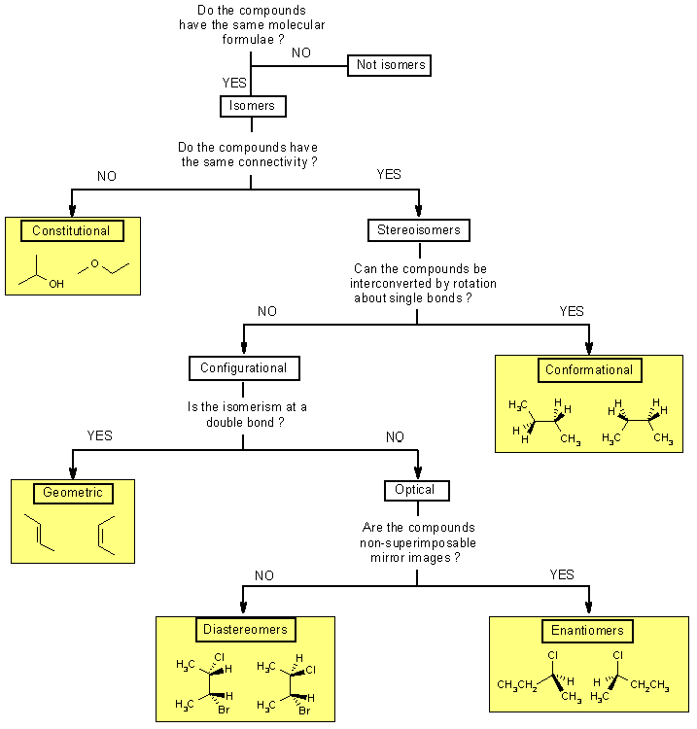
Do the compounds have the same atoms order?

Slide 10
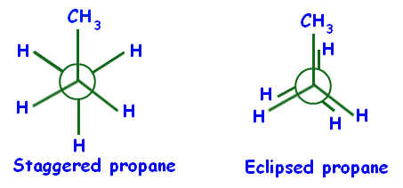
Conformational isomers
stereoisomers that are produced by rotation about  bond( single bond) , and are often rapidly interconverted at room temperature
Example :

Slide 11
Butane conformational isomers

Slide 12
Do the compounds have the same atoms order?

Slide 13
Configurational isomers
stereoisomers that do not readily interconvert at room temperature and can be separated.
Geometric isomers
Optical isomers

Slide 14
Geometric isomers
(also named cis-trans isomers) : These isomers occur where you have restricted rotation somewhere in a molecule ( ex double bond) or across a ring system

Slide 15
Optical isomers
Configurational isomers that differ in the 3D relationship of the substituent about one or more atoms
Enantiomers
Diastereomers

Slide 16
If you don't know :
mirror images are the reflections of an object.
If two objects are superimposable, it means you can not tell them apart, they are identical.
If two objects are non-superimposable, then you can always distinguish them.
Bring these together, and it means we are comparing an object with it's mirror image to see if the object can be distinguished from it's mirror image or not.

Slide 17
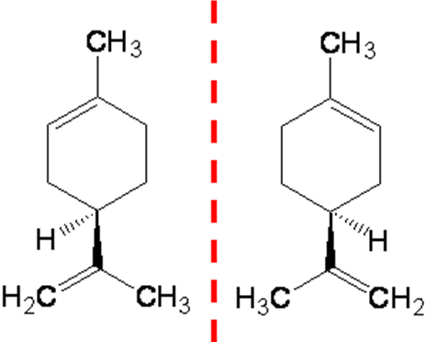
Enantiomers
any pair of stereoisomers that are
non-superimposable mirror images of each other. A molecule that can exist as a pair of enantiomers has the property of chirality (described as chiral)

Slide 18
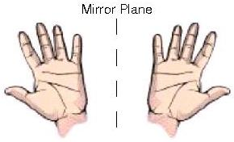
Left hand and right hand
enantiomers can not be superimposed, you can always tell a left from a right (I hope !).
Therefore, since your left
and right hands are
non-superimposable
mirror images,
then they are a pair of enantiomers

Slide 19
Diastereomers
can be superposed ( no difference between original object and it’s mirror image) (not an enantiomers).
They have quite different physical and chemical properties from one another. This is important as it allows them to be separated

Slide 20
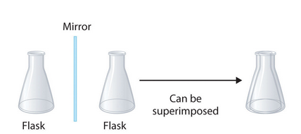
Diastereomers
superimposable objects are achiral
(a molecule that has a plane of symmetry)

Slide 21
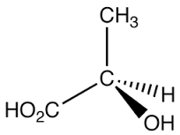
The Chirality Centre
for an atom Also named asymmetric, stereogenic or chiral center . chiral center is defined as a carbon atom bearing 4 different atoms or group of atoms

Slide 22
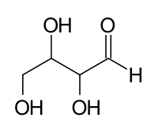
Examples of chiral centers

Slide 23
The Cahn-Ingold-Prelog system
it is a system that is used for the naming of enantiomers and diastereomers . It is also known as R & S naming system.

Slide 24
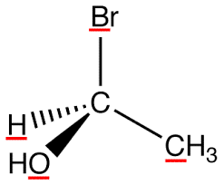
How R & S naming system works?
Step 1: find your stereocenter
the carbon with four different substituents
F

Slide 25
Step 2 : assign a priority to the four groups bonded to the chiral center
a- look at the first atom of the group higher atomic number = higher priority
F
1
4
3
2

Slide 26
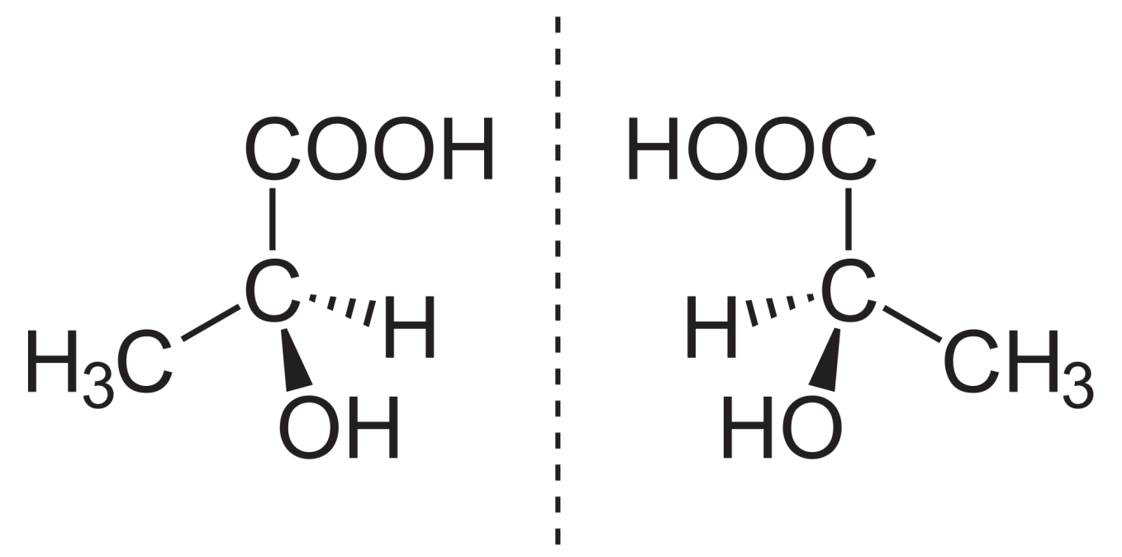
b- if there is a tie , you keep going out one bond at a time until you break the tie.

Slide 27
c- isotopes atoms have the same atomic number, if you have isotopes higher atomic weight = higher priority
D
3
4
1
2

Slide 28
Step 3 : Position the lowest priority group away from you, as if you were looking along the C-(4) s bond.
Step4 : For the other 3 groups, determine the direction of high to low priority (1 to 3)
If this is clockwise,
then the center is R (Latin= right)
If this is counter clockwise,
then it is S (Latin = left)

Slide 29
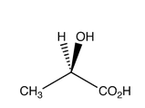
F
1
S
4
3
2
4
1
R
3
2

Slide 30
The Chirality Centre
For Molecules With More Than One Chiral Center
If there are two chiral centers in a single molecule, there are four possible stereoisomers. This is because each carbon atom can be in one of two possible forms (R or S).
If a molecule is symmetric (have the same substituents on both chiral atoms ) so that two of the four possible stereoisomers are identical (the S,R is identical to the R,S) this form of the molecule is called the meso form

Slide 31
How to determine Whether Molecules Are Enantiomers, Diastereomers or Meso Compounds ?
1- determine whether the chiral center is R or S ( using the previous explained method )

Slide 32
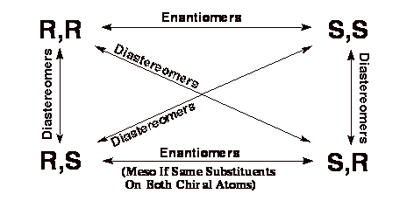
2- Use the following table to determine relationship.

Slide 33
3- If the molecule have symmetry (same substituents on both chiral centers ) , check for meso compound only the R,S or S,R molecules can be meso (the S,S and R,R forms of even symmetric molecules are not meso compounds, they are enantiomers).

Slide 34
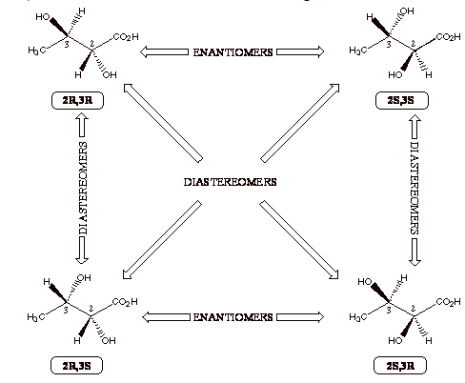
2,3-dihydroxybutanoic acid

Slide 35
Optical Activity
it is the ability of a chiral molecule to rotate the plane of plane-polairsed light, measured using a polarimeter.
A simple polarimeter consists of : 1- a light source 2- polarizing lens 3- sample tube 4- analyzing lens.

Slide 36
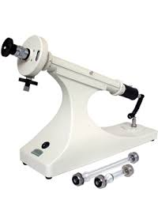
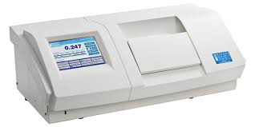
Polarimeter

Slide 37
Polarimeter principle
light passes through a sample that can rotate plane polarized light
the light appears to dim because it no longer passes straight through the polarizing filters.
The amount of rotation is quantified as the number of degrees that the analyzing lens must be rotated by so that it appears as if no dimming of the light has occurred.

Slide 38
The rotation is affected by two factors : 1- path length (l, the time the light travels through a sample) 2- concentration (c, how much of the sample is present that will rotate the light) When these effects are eliminated a standard for comparison of all molecules is obtained, the specific rotation []

Slide 39
the quantified rotation determined using polarimeter is known as observed rotation
[] = 100 / c*l concentration is expressed as: g sample /100ml solution
Enantiomers will rotate the plane of polarisation in exactly equal amounts (same magnitude) but in opposite directions.
Dextrorotary : d or (+), clockwise rotation (to the right) Levorotary : l or (-), anti-clockwise rotation (to the left)

Slide 40
sample
More than one enantiomer
enantiomer excess
One enantiomer
optically pure
racemic mixture
Optically inactive
enantiomeric excess (ee%)

Slide 41
enantiomeric excess (ee%)
The optical purity or the enantiomeric excess (ee%) of a sample can be determined as follows:
% enantiomeric excess = % enantiomer₁ - % enantiomer₂ = 100 []_{mixture} / []_{pure sample}
ee% = 100 ([major enantiomer] - [minor enantiomer]) / ([major enantiomer] + [minor enantiomer])
where [major enantiomer] = concentration of the major enantiomer [minor enantiomer] = concentration of the minor enantiomer

Slide 42
Example of optical activity
Consider that (S)-bromobutane has a specific rotation of +23.1º and (R)-bromobutane has a specific rotation of -23.1º 1- Determine the optical purity of a racemic mixture.
Answer: The specific rotation, [], of the racemate is expected to be 0, since the effect of one enantiomer cancel the other .
Optical purity, % = 100 []_{mixture} / []_{pure sample} = 100 (0) / +23.1º = 0%

Slide 43
2- Which isomer is dominant and what is the optical purity of a mixture, of (R)- and (S)-bromobutane, whose specific rotation was found to be -9.2º?
Answer: The negative sign tells indicates that the R enantiomer is the dominant one.
Optical purity, % = 100 []_{mixture} / []_{pure sample} = 100 (-9.2) / -23.1º = 40% this indicates a 40% excess of R over S!

Slide 44
3- What is the percent composition of the mixture?
Answer: The 60% leftover, which is optically inactive, must be equal amounts of both (R)- and (S)-bromobutane. The excess 40% is all R so there is a total of 70% (R) and 30% (S).

Slide 45
Newman projection
A representation of a molecule in which the atoms and bonds are viewed along the axis about which rotation occurs.
the molecule is viewed along an axis containing two atoms bonded to each other and the bond between them, about which the molecule can rotate. Carbon-carbon bond the "substituents" of each atom , can then be viewed both in front of and behind the carbon-carbon bond

Slide 46
Fischer Projection
representation of a 3D molecule as a flat structure where a tetrahedral carbon is represented as two crossed lines.
the atoms that are pointed toward the viewer would be specified with a wedged
and the ones pointed away from the viewer are specified with dashed lines.
(4)

Slide 47
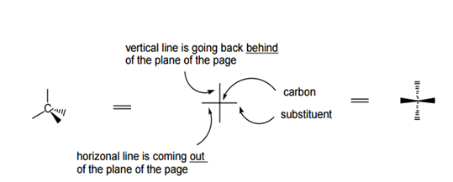
The Fischer Projection consists of : 1- horizontal lines represent the wedged 2- vertical line represents the dashed . The point of intersection between the horizontal and vertical lines represents the central carbon.

Slide 48
Fischer projection for structures with more than one chiral center
In this case the tetrahedral carbons are "stacked" on top of one another The carbons are numbered from top to bottom (starting with highly oxidized carbon on he top )

Slide 49
Rotation of Fischer projection
Fischer Projection can be rotated by 180ᵒ only! (Rotation by 90 ° or -90 ° (270 °) invert the stereochemistry) = change it from S to R or from R to S

Slide 50
references
1- L. G. Wade Jr, Organic chemistry , 169-210
2- Ann Van Eeckhaut, Yvette Michotte,Chiral Separations by Capillary Electrophoresis, pp 11
3- John Wiley & Sons, Organic Chemistry I For Dummies, pp 89
4- Shore, N. (2007). Study Guide and Solutions Manual for Organic Chemistry (5th Ed.). New York: W.H. Freeman. (182-186)
5- INDAH PURNAMA SARYa,*, SISWANDONOb, TUTUK BUDIATIb ,International Journal of Pharmacy and Pharmaceutical Sciences ISSN- 0975-1491 ,Vol 7, Issue 3, 2015

