Slide 1
SOLUTIONS OF THE NUMERICAL DIFFERENTIATION
METHOD EXAMPLES IN PYTHON

Slide 4
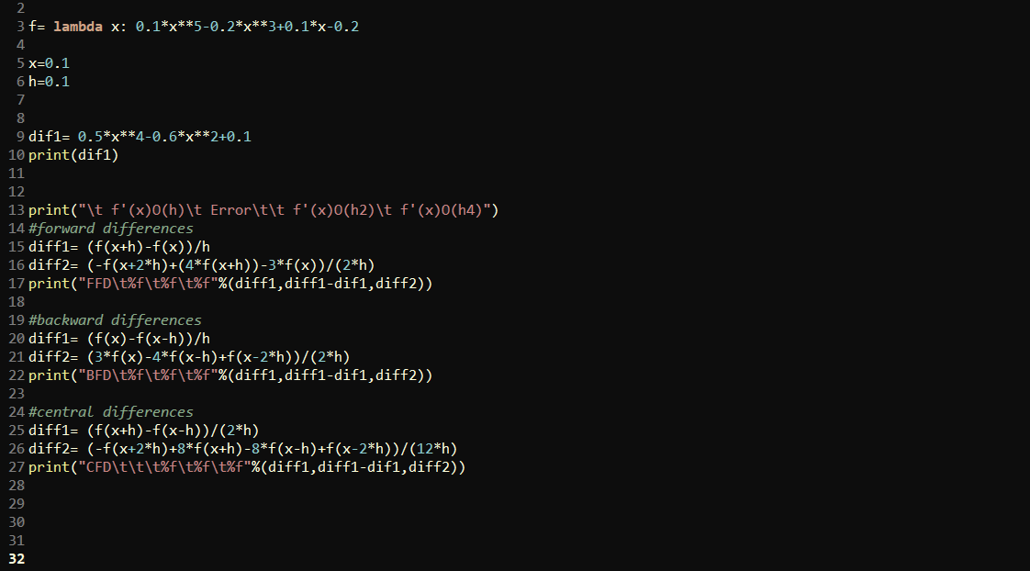

Slide 5
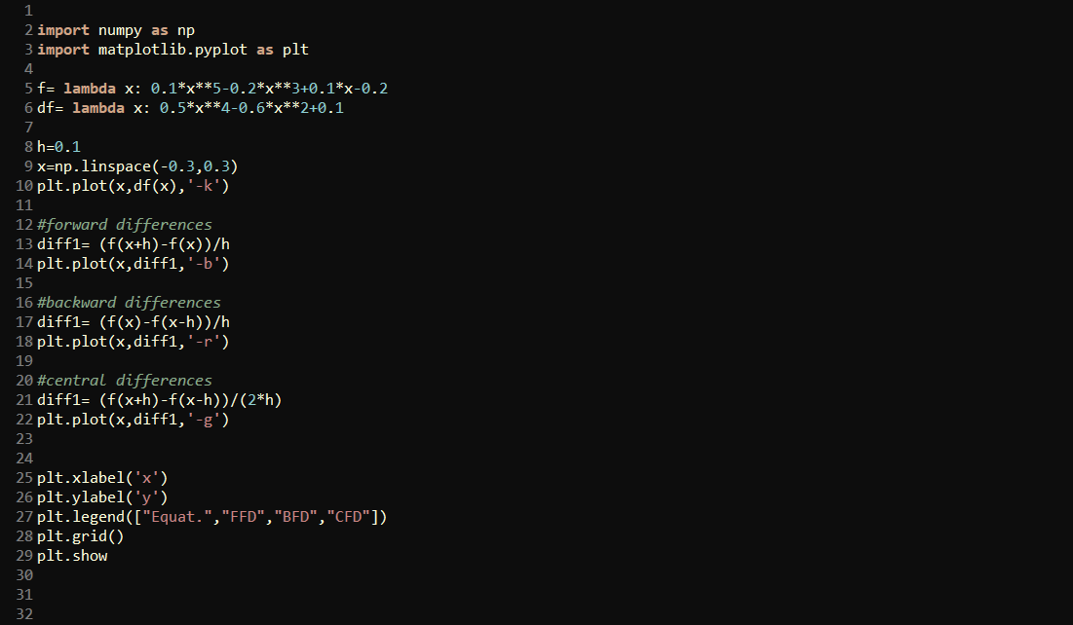

Slide 7
