Slide 1
Diversity And Classification of Flowering Plants: Eudicots: Rosids

Slide 2
ROSIDS

Slide 3
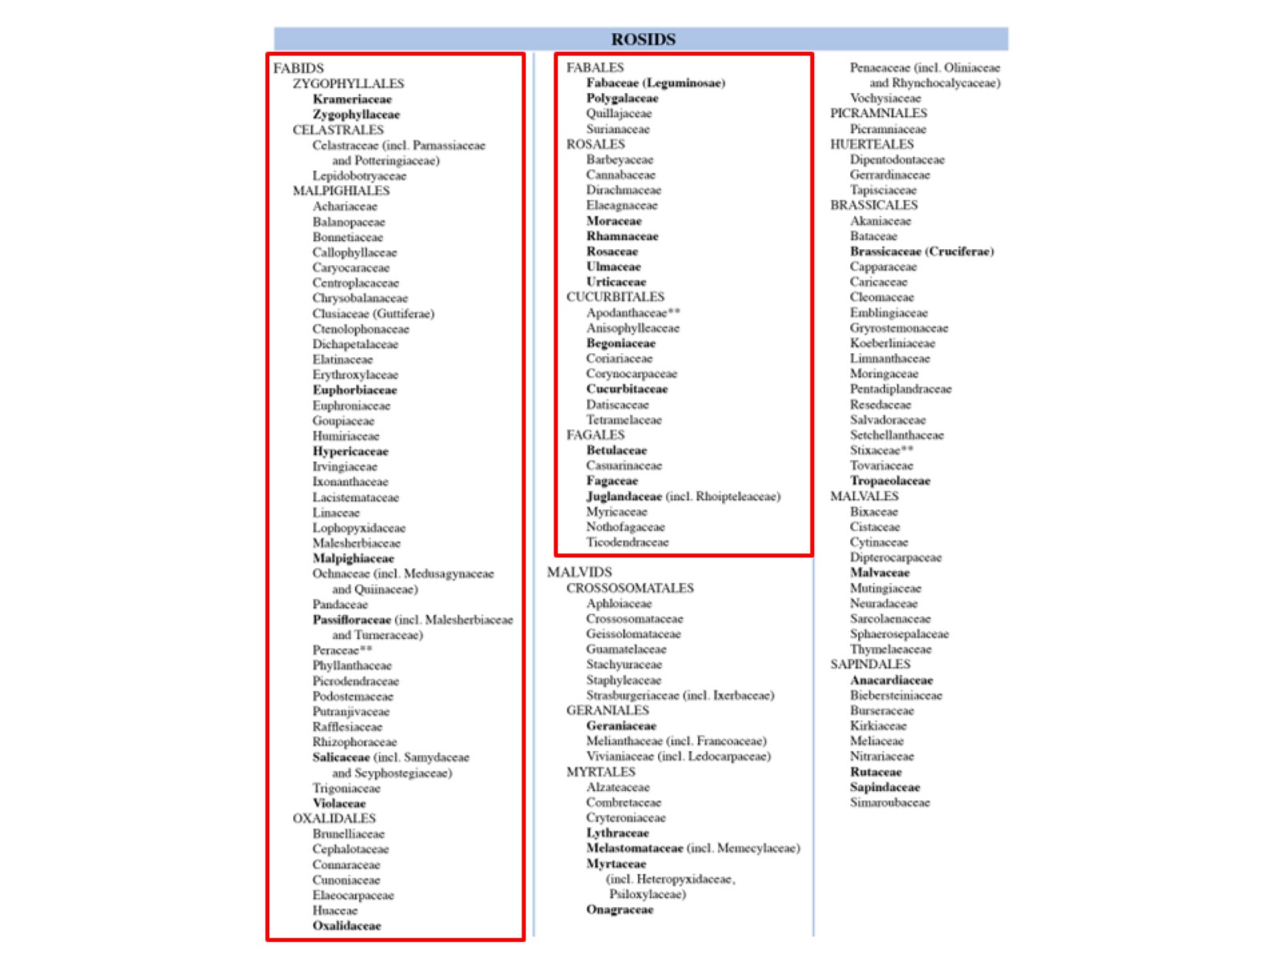

Slide 4
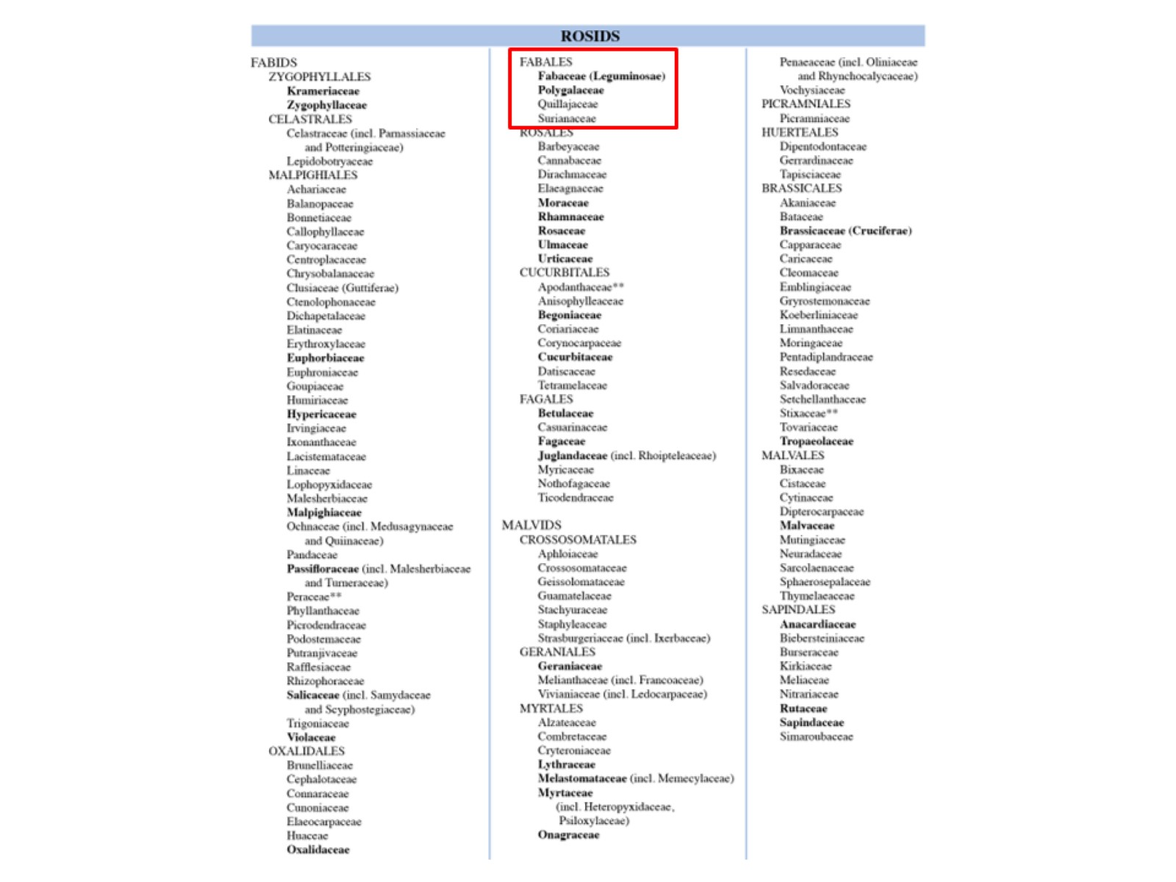

Slide 5
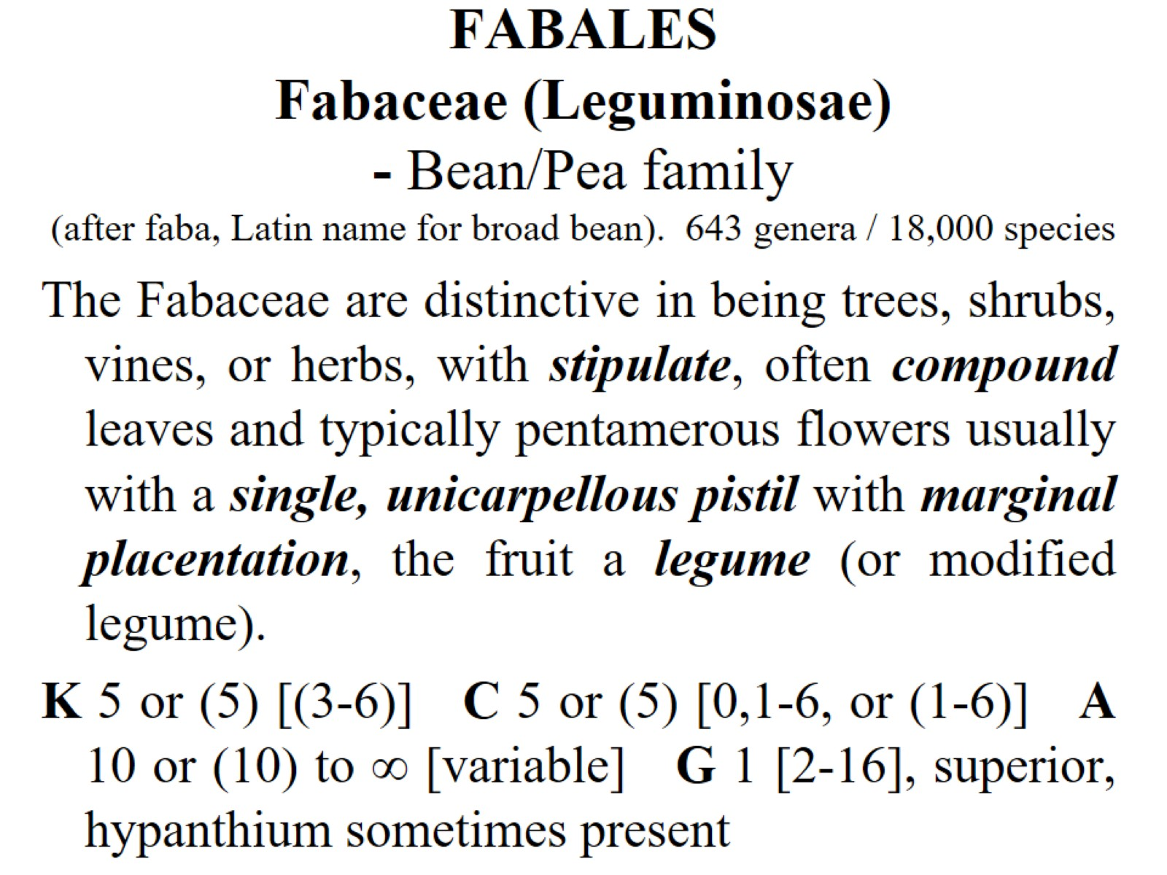
FABALES Fabaceae (Leguminosae) - Bean/Pea family (after faba, Latin name for broad bean). 643 genera / 18,000 species

Slide 6
stipulate

Slide 7
Fabaceae: 3 subfamilies

Slide 8
Caesalpinioideae

Slide 9
Mimosoideae

Slide 10
Faboideae (Papilionoideae)

Slide 11
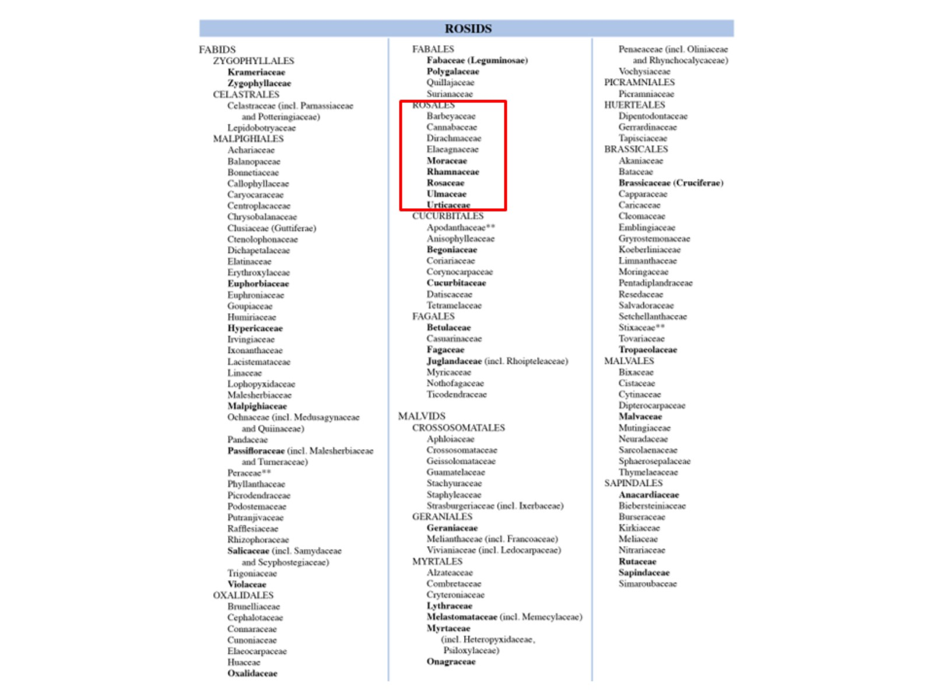

Slide 12
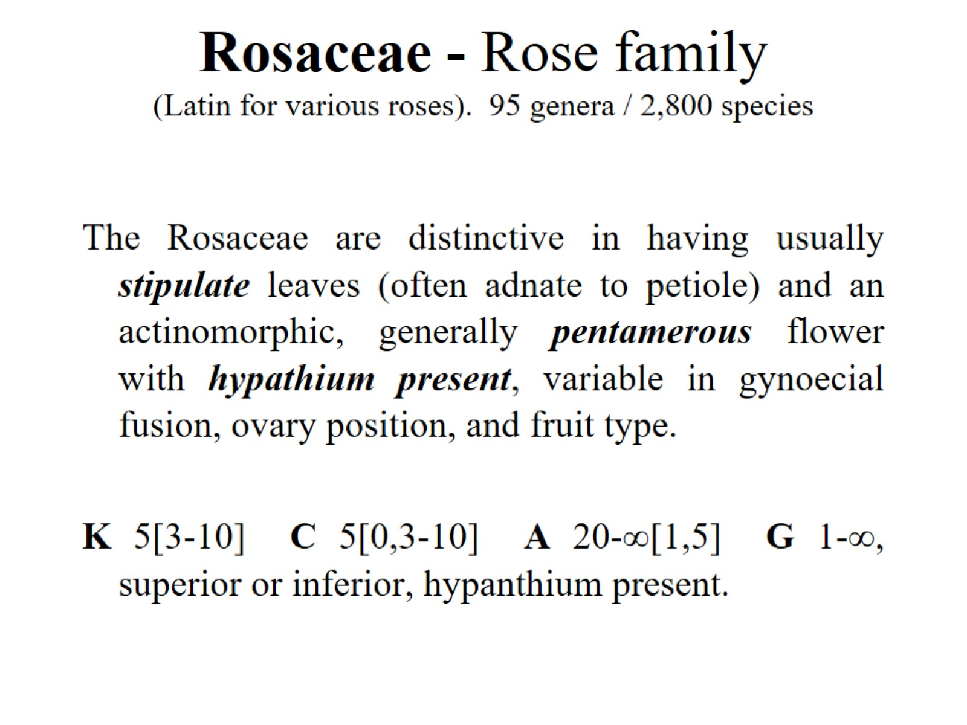
Rosaceae - Rose family (Latin for various roses). 95 genera / 2,800 species

Slide 13
pentamerous flower

Slide 14
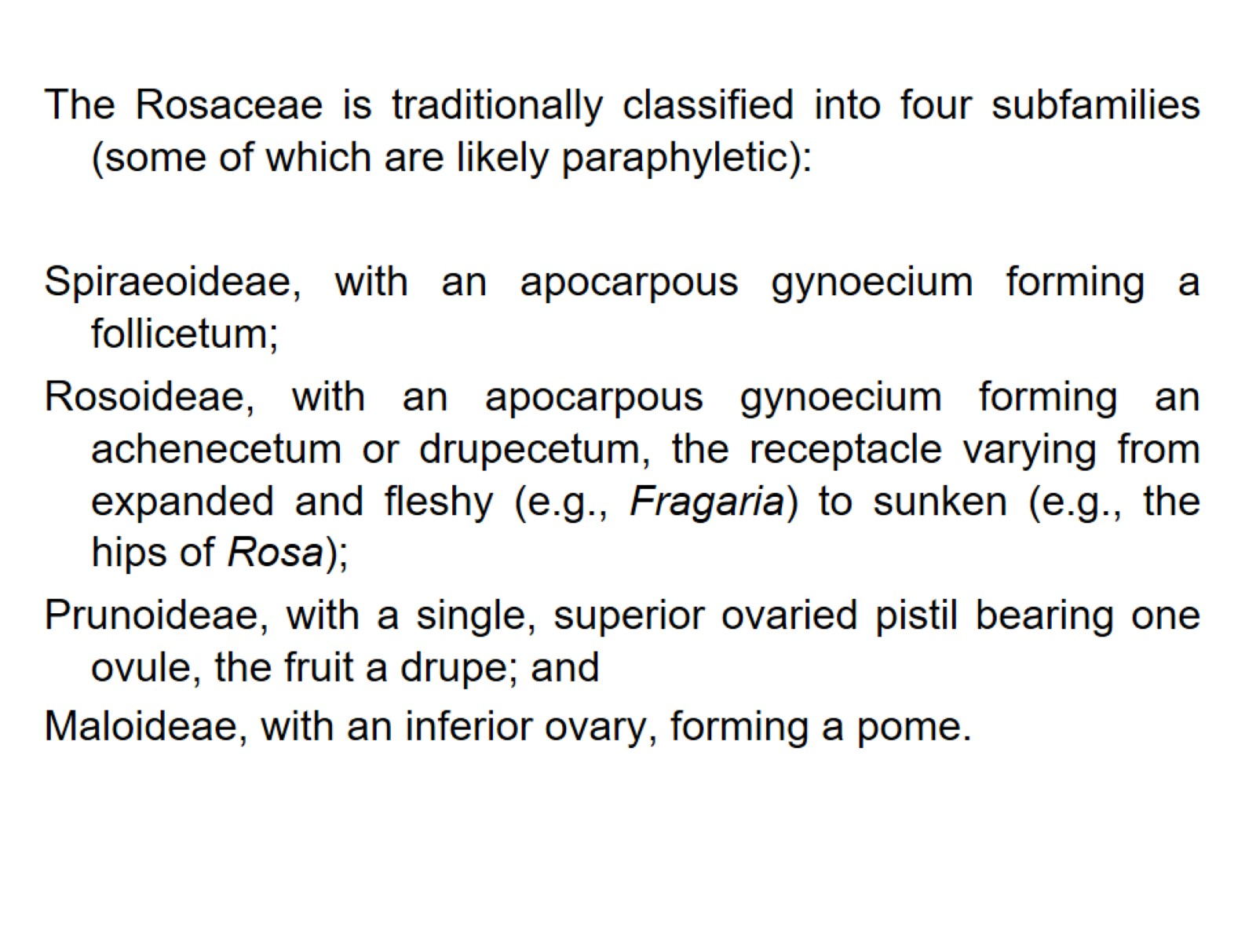

Slide 15
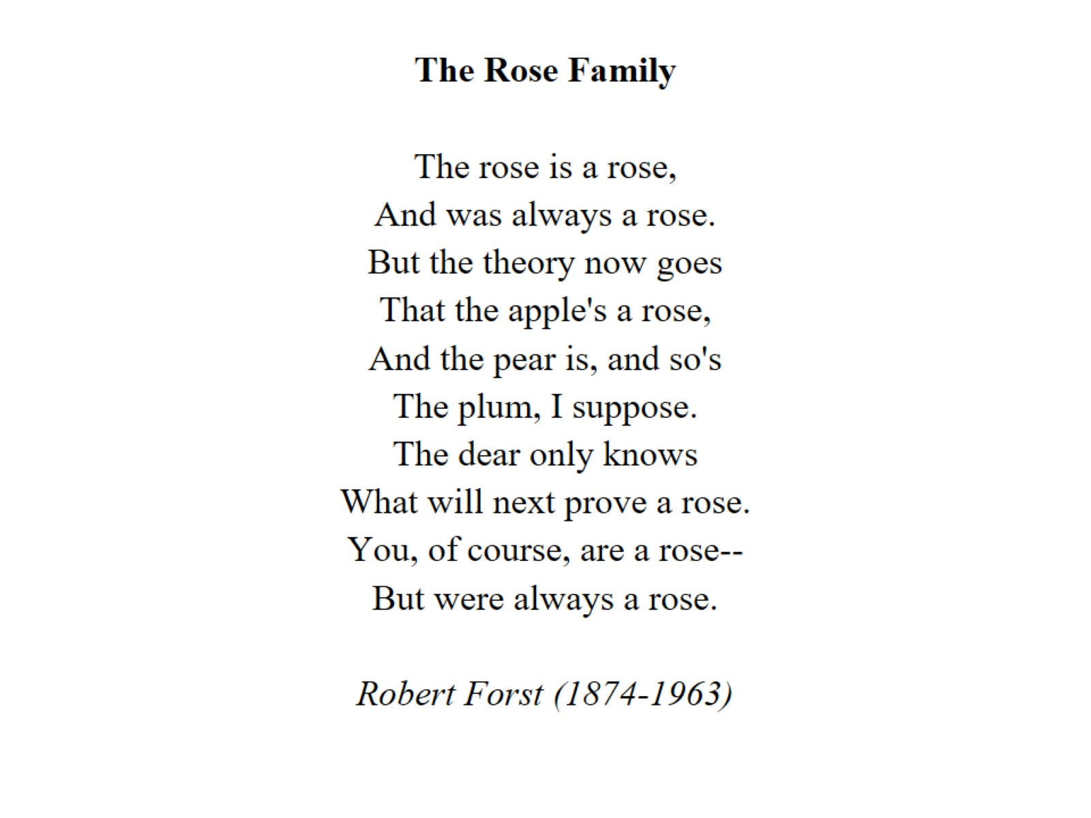

Slide 16
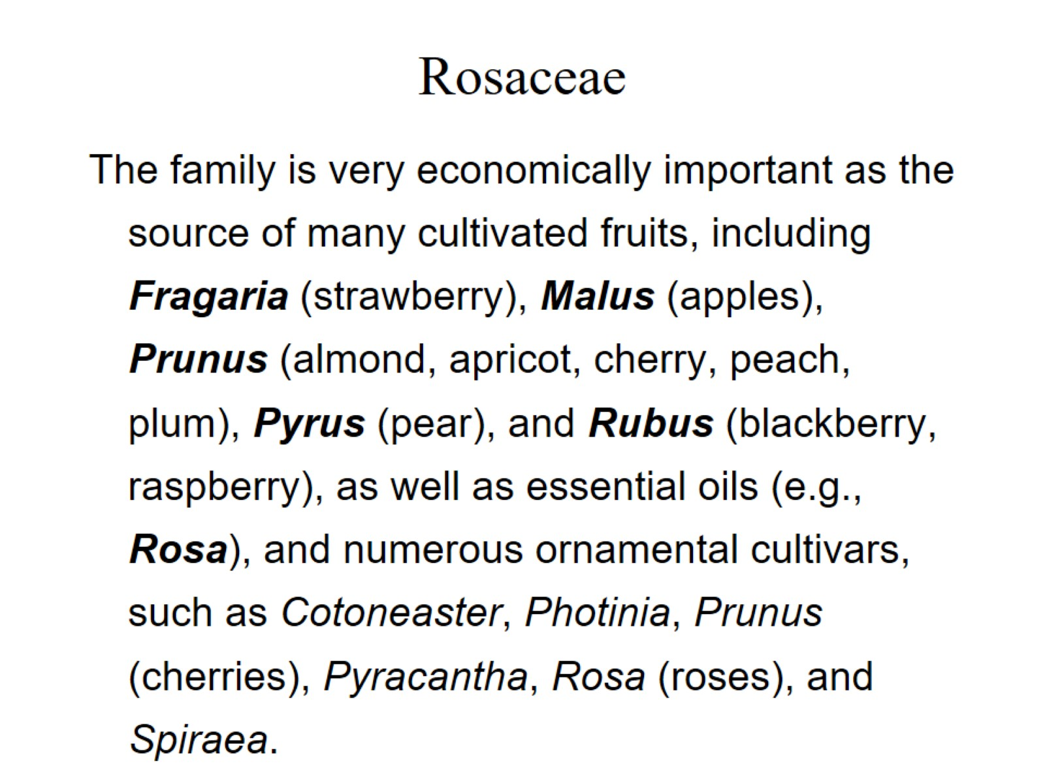
Rosaceae

Slide 17
Cucurbitaceae Cucumber / Gourd family (L. for gourd). 120 genera / 775 species.

Slide 18
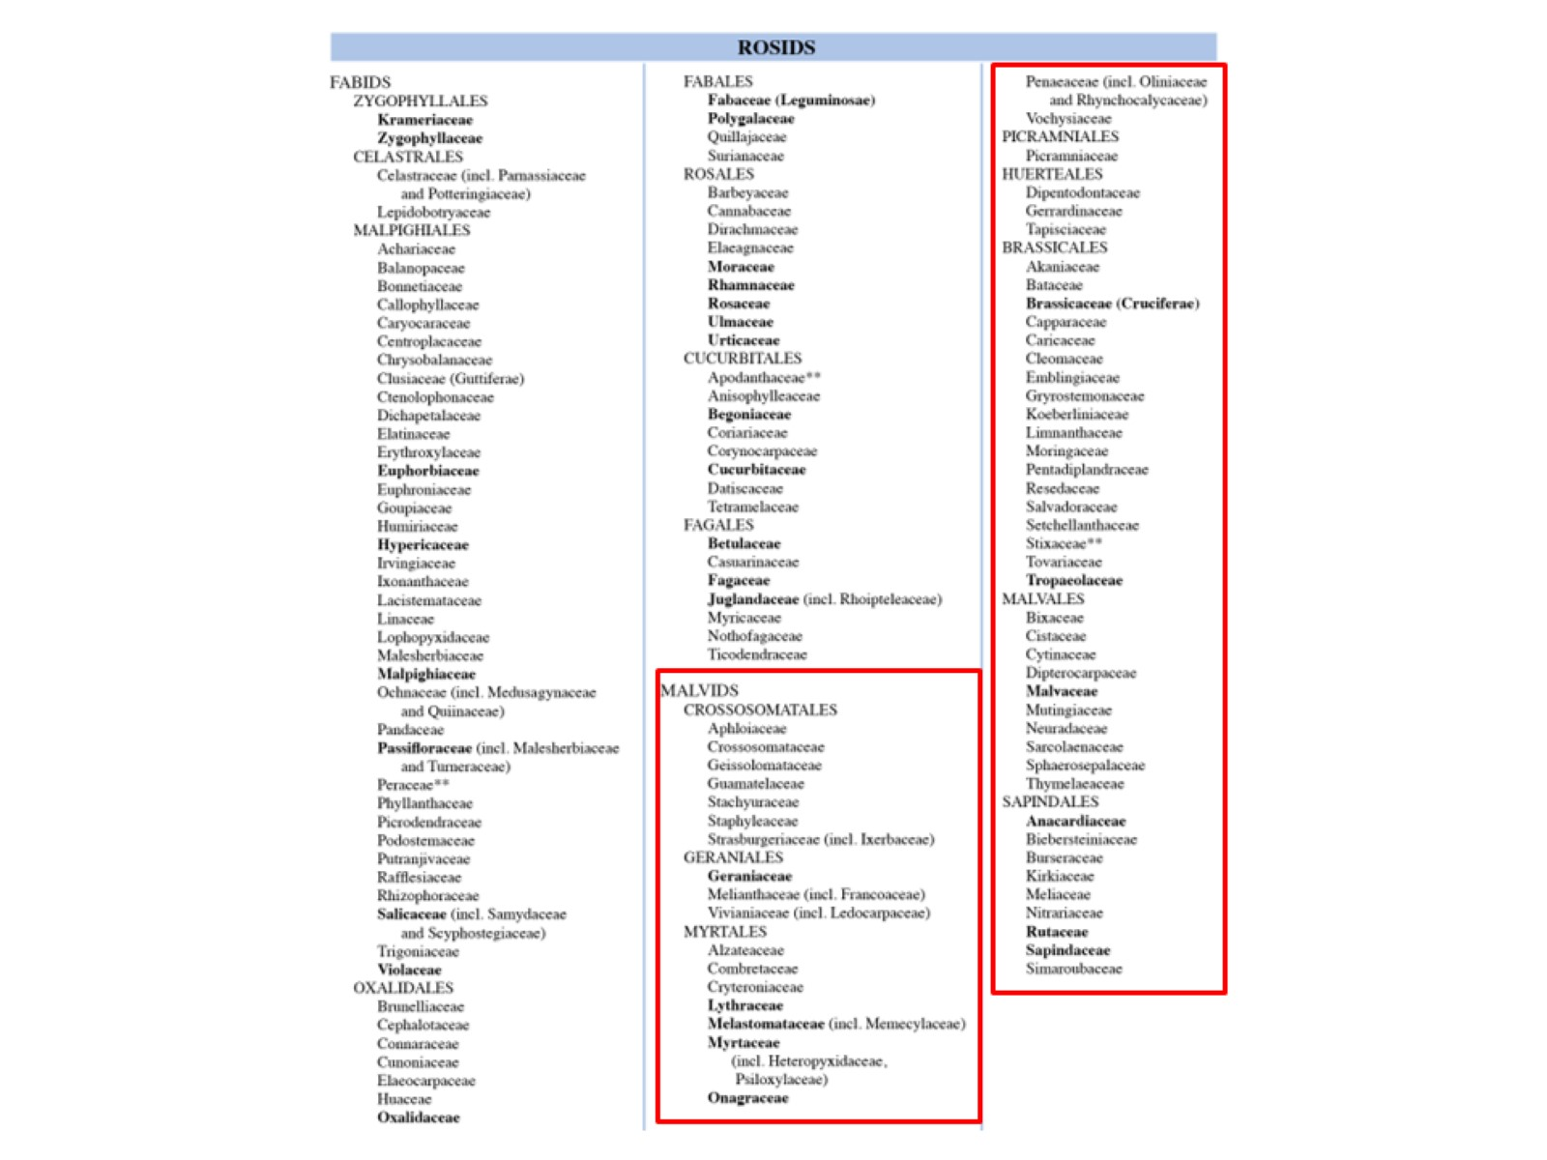

Slide 19
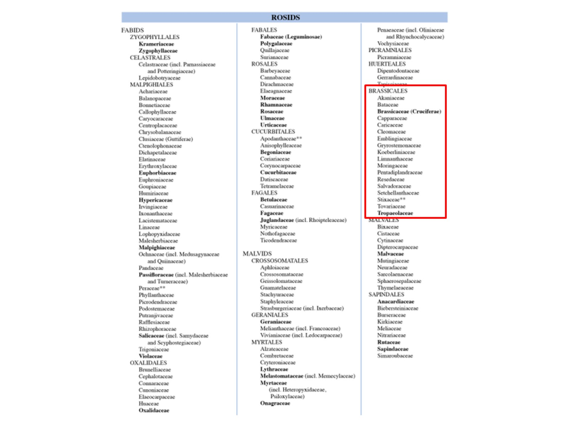

Slide 20
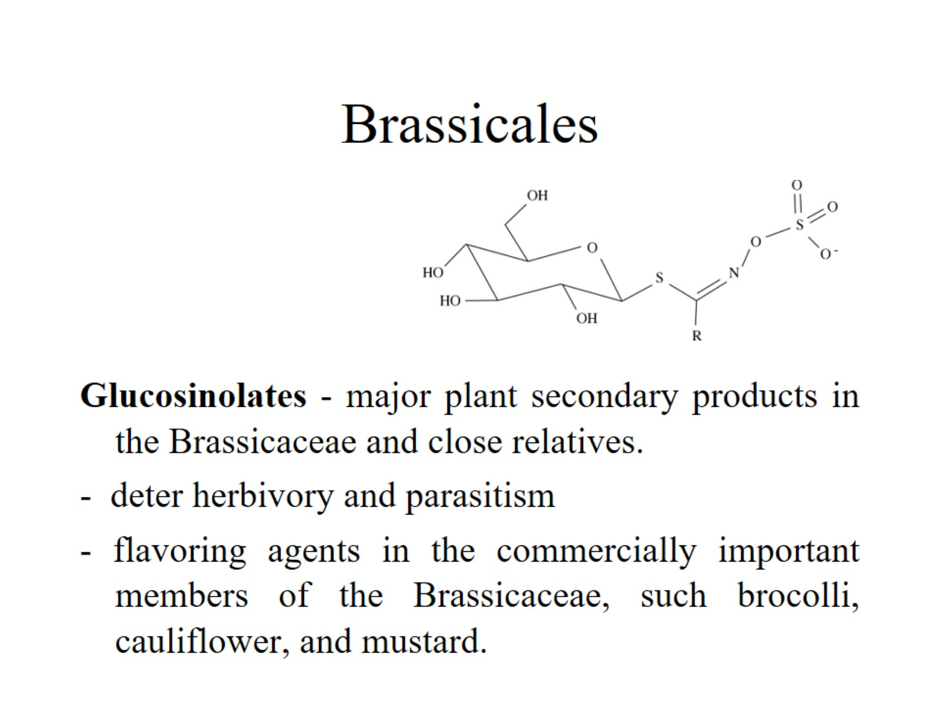
Brassicales

Slide 21
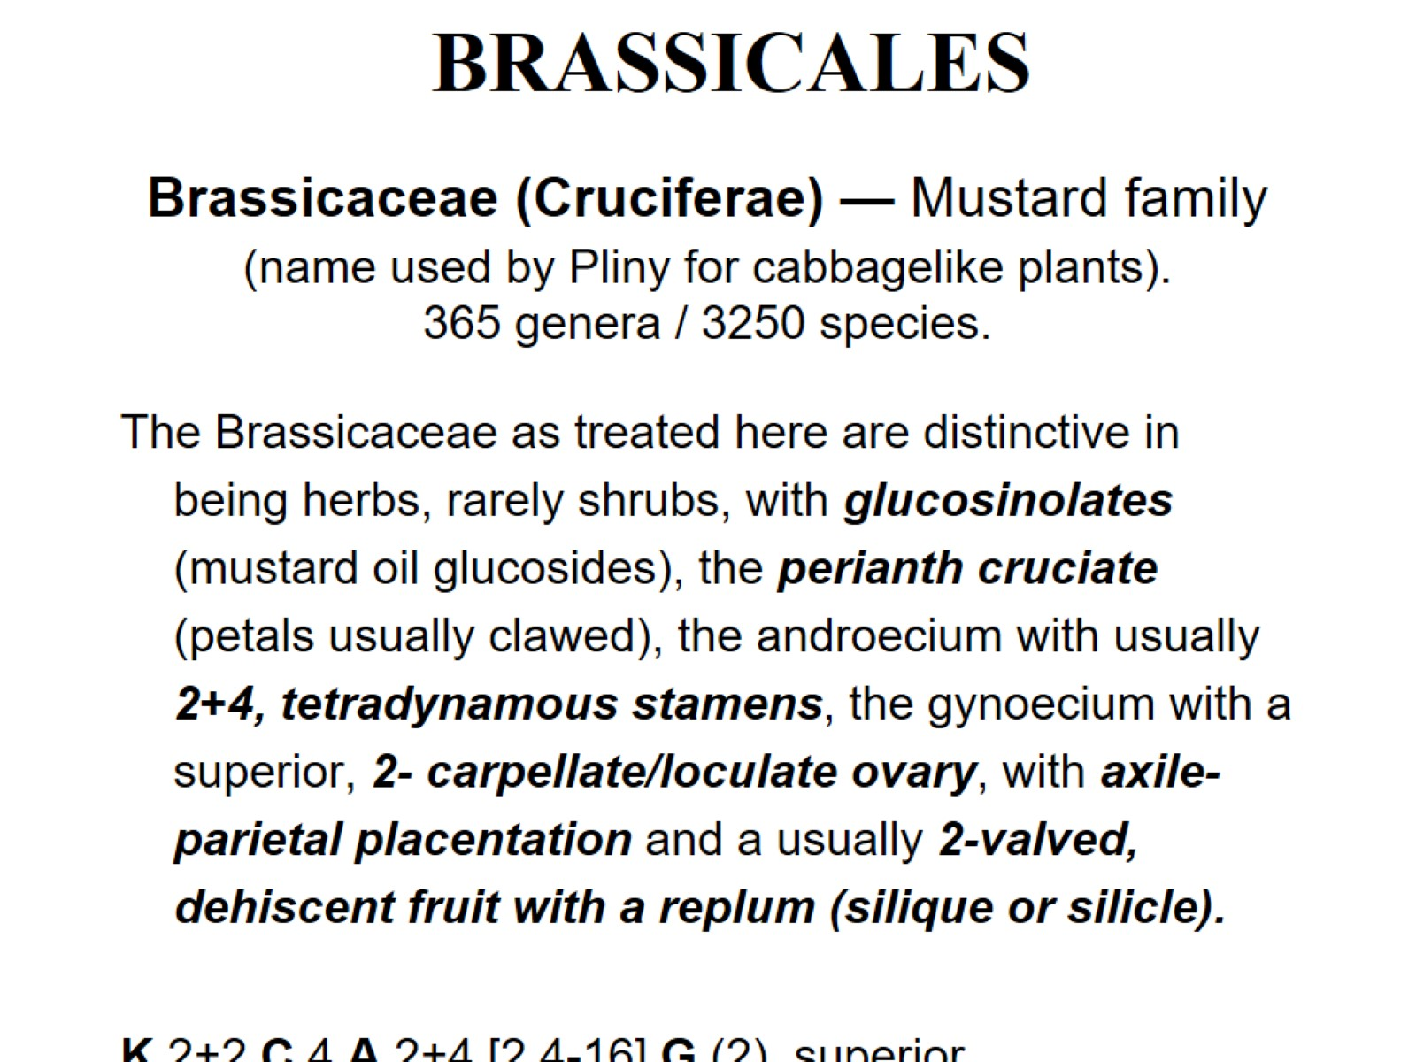
Brassicaceae (Cruciferae) — Mustard family (name used by Pliny for cabbagelike plants). 365 genera / 3250 species.

Slide 22
perianth cruciate

Slide 23
axile-parietal placentation

Slide 27
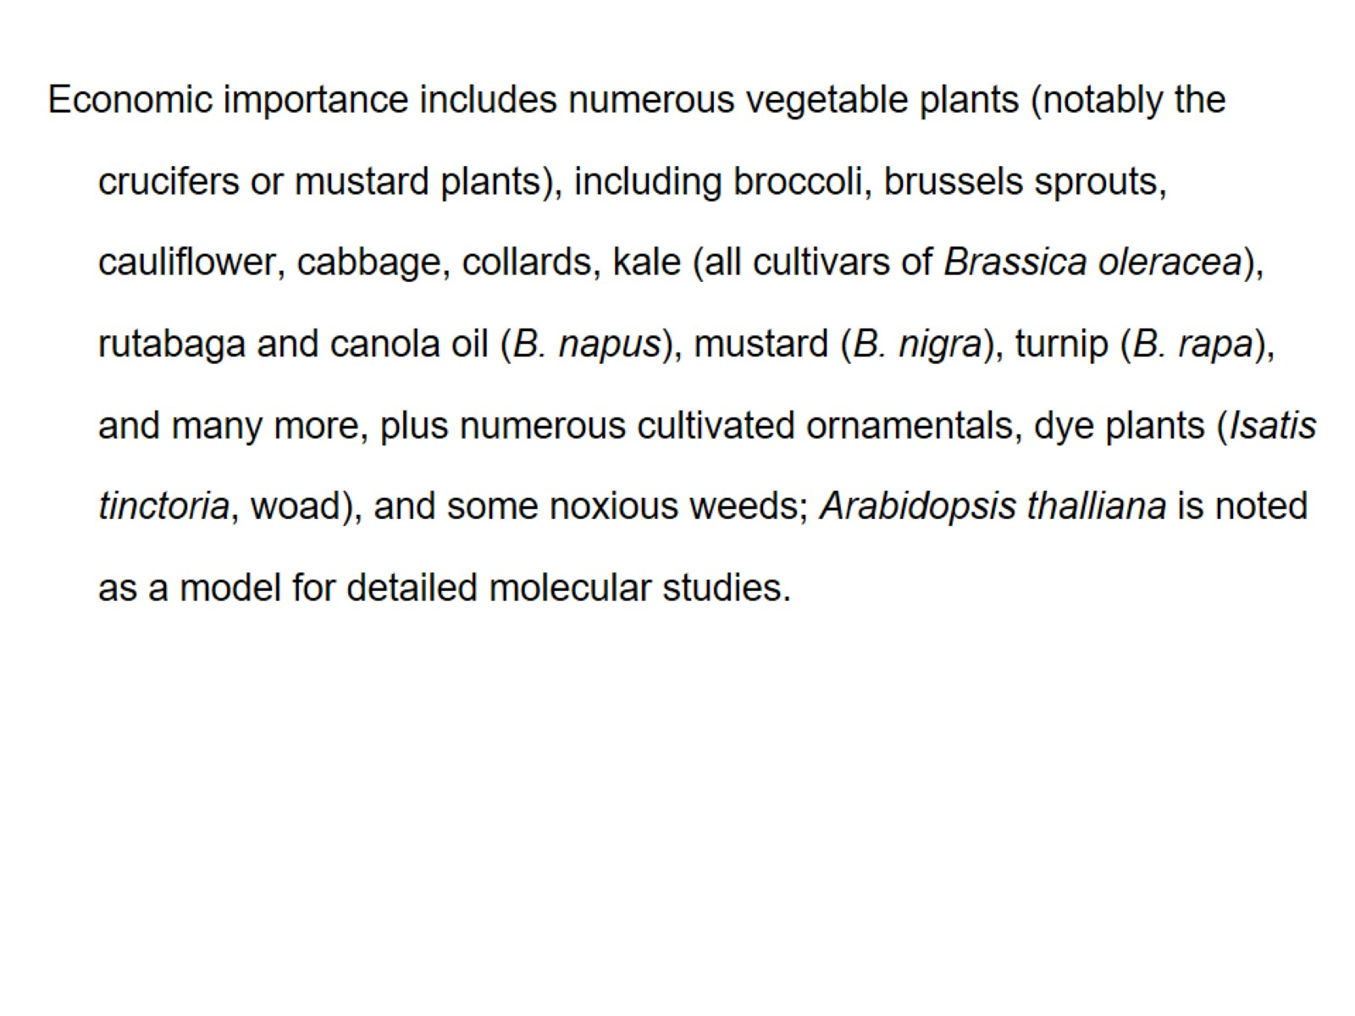

Slide 28
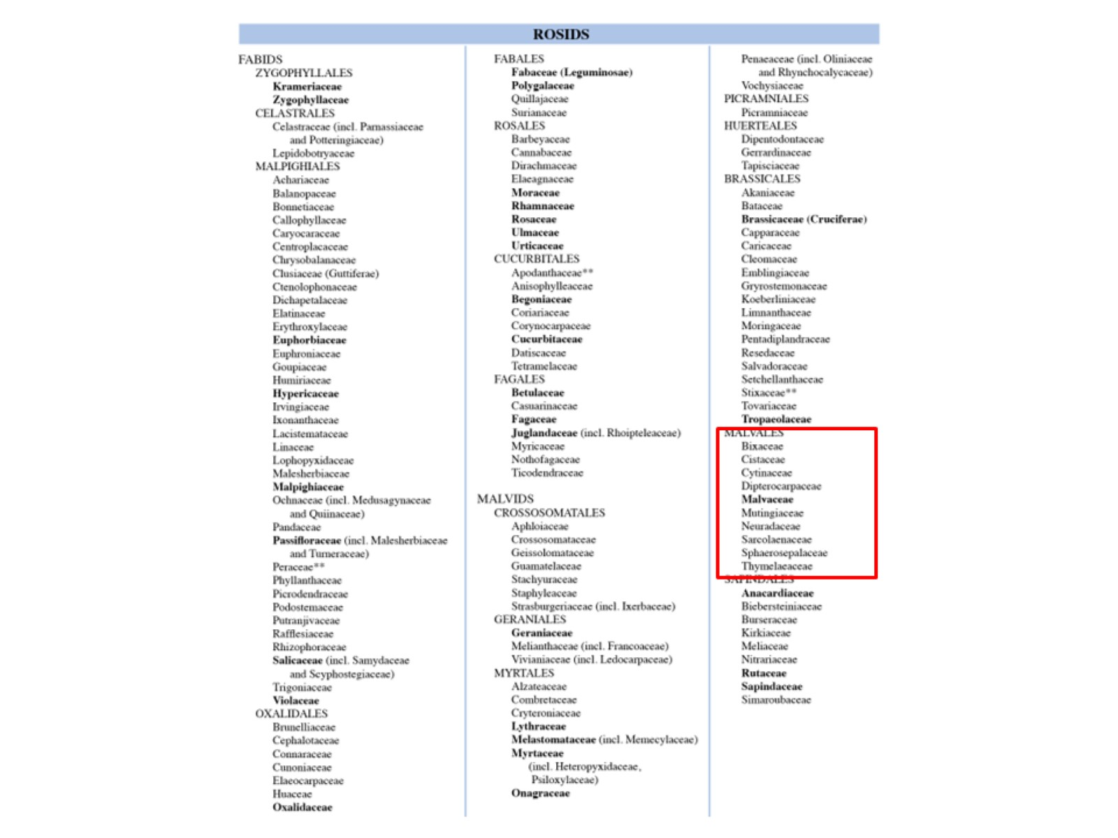

Slide 29
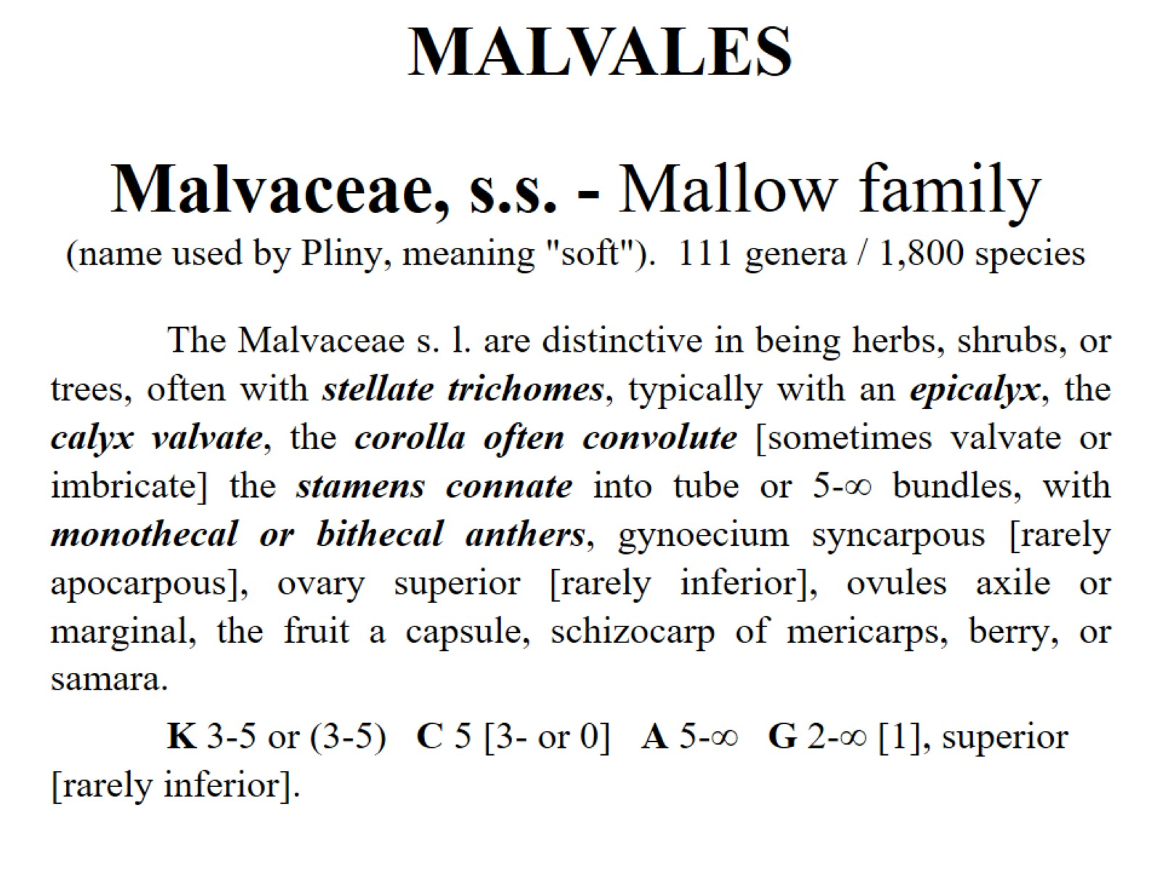
Malvaceae, s.s. - Mallow family (name used by Pliny, meaning "soft"). 111 genera / 1,800 species

Slide 30
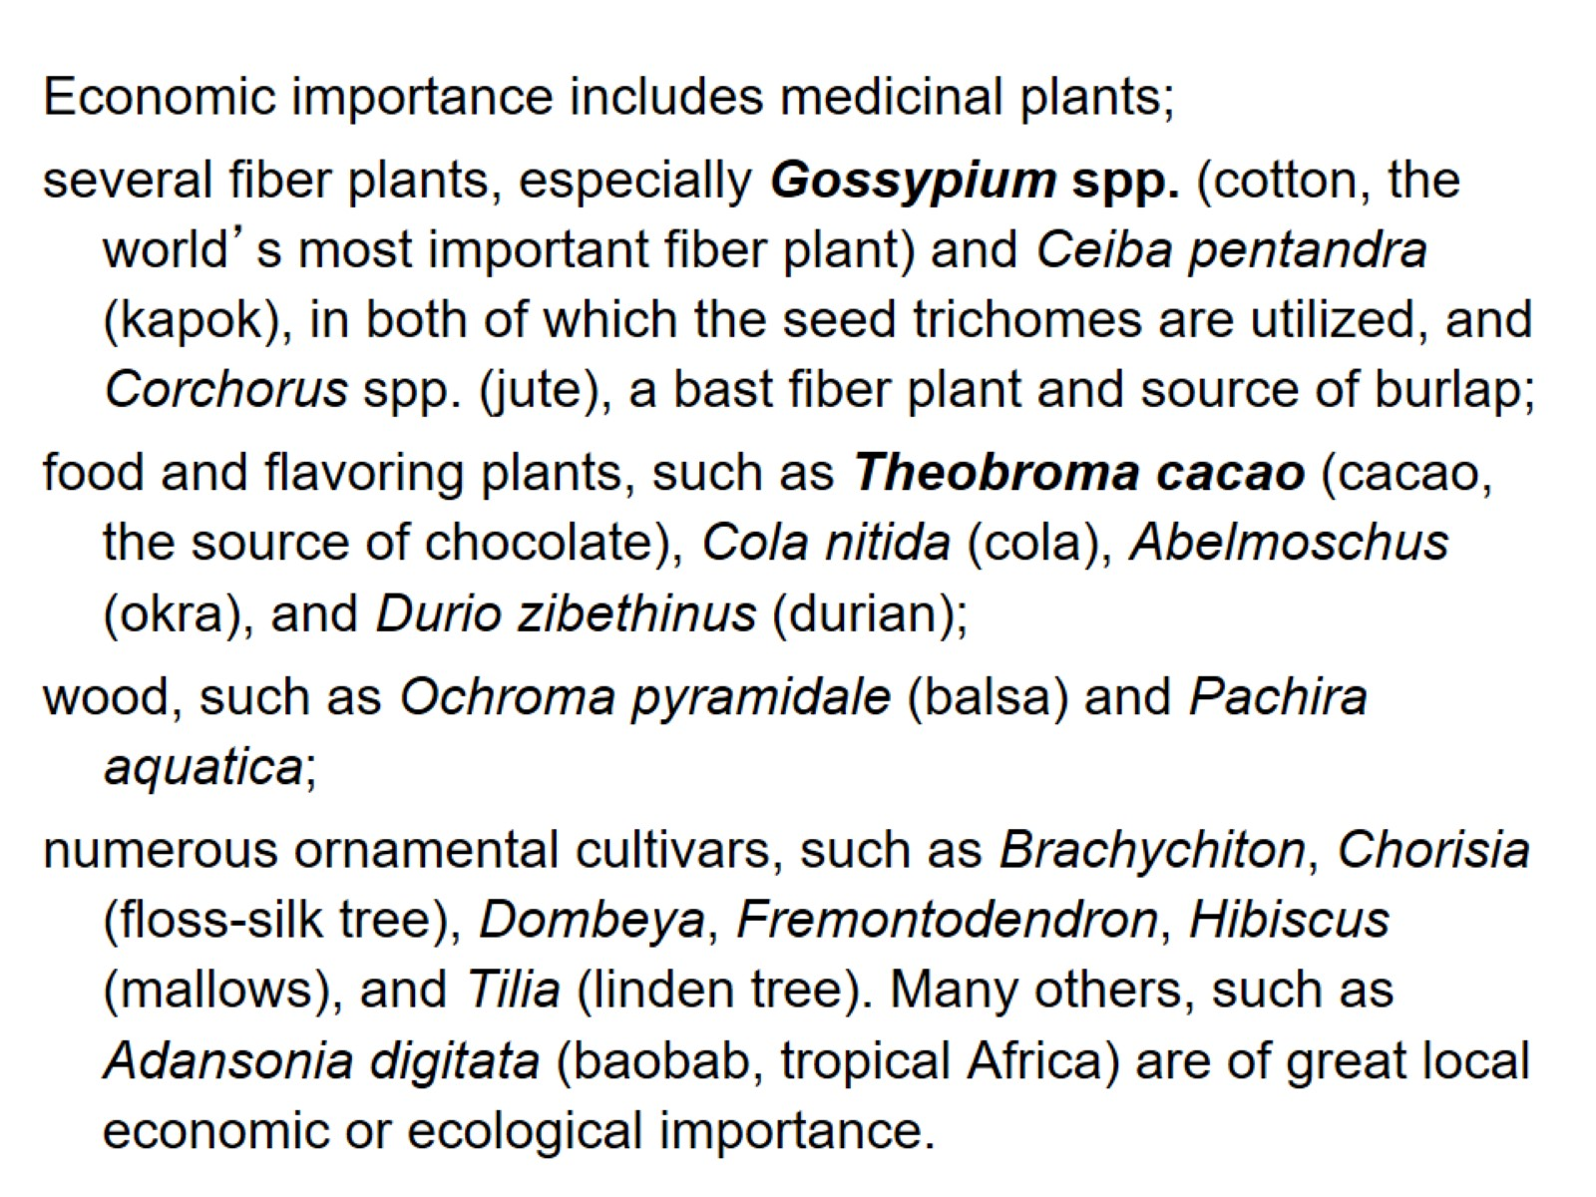

Slide 31
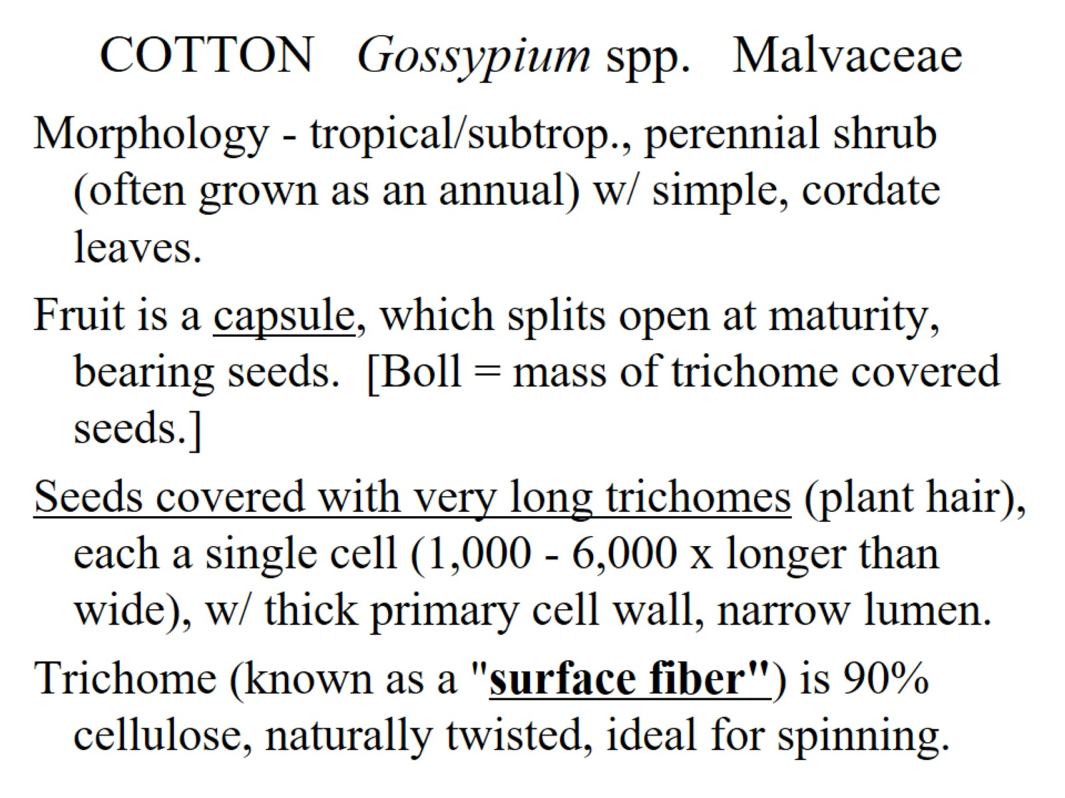
COTTON Gossypium spp. Malvaceae

Slide 32
Old World diploids (2n=26)

Slide 33
Apomorphies of Malvaceae

Slide 34
Epicalyx

