Slide 1
NERVOUS SYTEM WEEK 4
Doç. Dr. Yasemin SALGIRLI DEMİRBAŞ

Slide 2
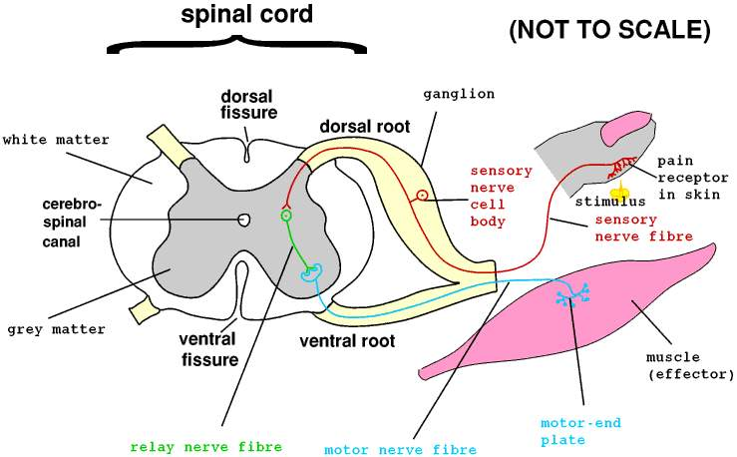
SPINAL CORD
The spinal cord lies within the bony vertebral column.
It is a slender cylinder of soft tissue about as big around as the little finger.
The central butterfly-shaped area of gray matter is composed of interneurons, the cell bodies and dendrites of efferent neurons, the entering fibers of afferent neurons, and glial cells.
It is called gray matter because there are more cells than myelinated fibers, and the cells appear gray.
The gray matter is surrounded by white matter, which consists of groups of myelinated axons of interneurons

Slide 3
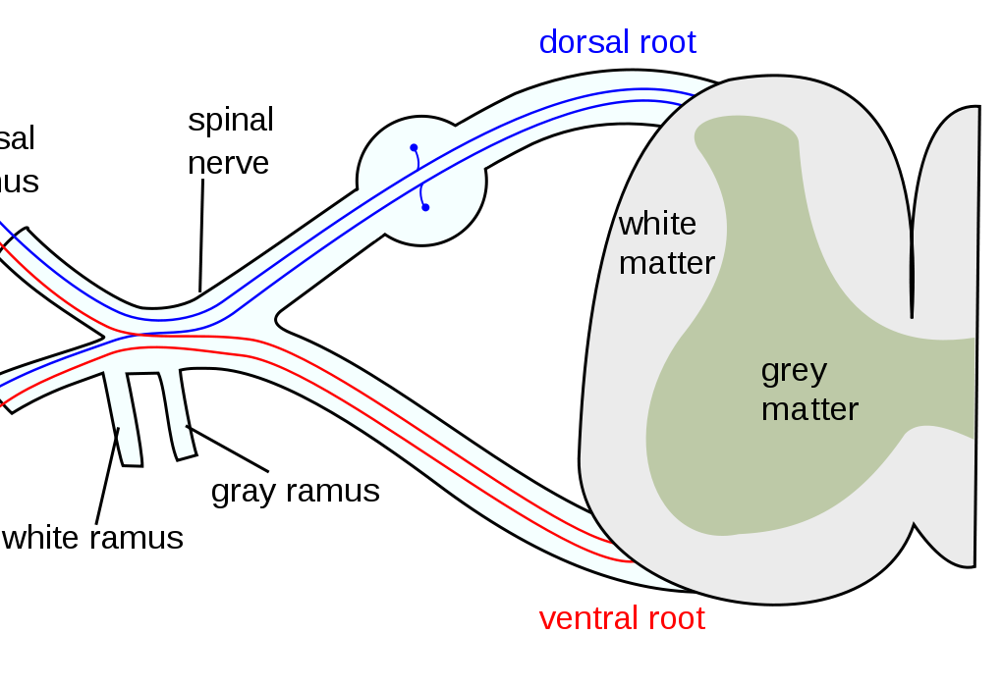
SPINAL CORD
Groups of afferent fibers enter on the dorsal side of the cord via the dorsal roots.
The axons of efferent neurons leave the spinal cord on the ventral side via the ventral roots.
A short distance from the cord, the dorsal and ventral roots from the same level combine to form a spinal nerve, one on each side of the spinal cord.
The 31 pairs of spinal nerves are designated by the four vertebral levels: from which they exit: cervical, thoracic, lumbar, and sacral

Slide 4
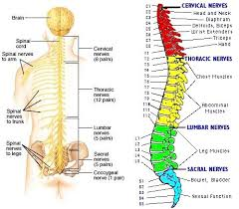
PERIPHERAL NERVOUS SYSTEM
Nerve fibers in the peripheral nervous system transmit signals between the CNS and receptors and effectors in all other parts of the body.
The nerve fibers are grouped into bundles called nerves.
The peripheral nervous system consists of 43 pairs of nerves: 12 pairs of cranial nerves and 31 pairs that connect with the spinal cord as the spinal nerves.

Slide 5
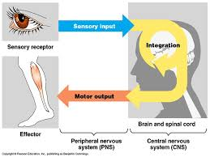
PERIPHERAL NERVOUS SYSTEM
A nerve contains nerve fibers that are the axons of efferent neurons or afferent neurons or both.
Accordingly, fibers in a nerve may be classified as belonging to the efferent or the afferent division of the peripheral nervous system .

Slide 6
PERIPHERAL NERVOUS SYSTEM
Afferent neurons convey information from sensory receptors to the central nervous system.
The long part of their axon is outside the CNS and is part of the peripheral nervous system.
Efferent neurons carry signals out from the central nervous system to muscles or glands.
The efferent division of the peripheral nervous system is more complicated than the afferent: being subdivided into a somatic nervous system and an autonomic nervous system.

Slide 7
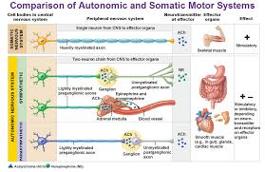
PERIPHERAL NERVOUS SYSTEM
The simplest distinction between the somatic and autonomic systems is that the neurons of the somatic division innervate skeletal muscle,
The autonomic neurons innervate smooth and cardiac muscle, glands, and neurons in the gastrointestinal tract.

Slide 8
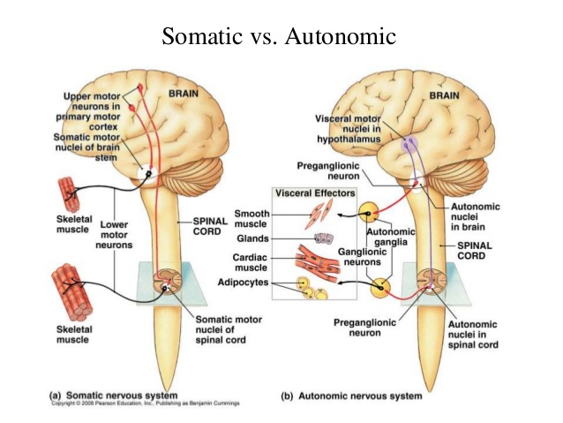
SOMATIC NERVOUS SYSTEM
The somatic portion of the PNS is made up of all the nerve fibers going from the central nervous system to skeletal muscle cells.
The cell bodies of these neurons are located in groups in the brainstem or spinal cord.
Their large diameter, myelinated axons leave the central nervous system and pass without any synapses to skeletal-muscle cells.

Slide 9
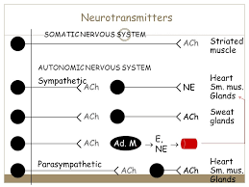
SOMATIC NERVOUS SYSTEM
The neurotransmitter released by somatic neurons is acetylcholine.
Because activity in the somatic neurons leads to contraction of the innervated skeletal-muscle cells, these neurons are called motor neurons.
Excitation of motor neurons leads only to the contraction of skeletal-muscle cells; there are no somatic neurons that inhibit skeletal muscles.

Slide 10
DIFFERENCES BETWEEN SOMATIC AND AUTONOMIC DIVISIONS
Somatic:
1. Consists of a single neuron between central nervous system and skeletal-muscle cells
2. Innervates skeletal muscle
3. Can lead only to muscle excitation
Autonomic:
1. Has two-neuron chain (connected by a synapse) between central nervous system and effector organ
2. Innervates smooth and cardiac muscle, glands, and GI neurons
3. Can be either excitatory or inhibitory

Slide 11
AUTONOMIC NERVOUS SYSTEM
The efferent innervation of all tissues other than skeletal muscle is by way of the autonomic nervous system.
A special case occurs in the gastrointestinal tract, where autonomic neurons innervate a nerve network in the wall of the intestinal tract.
This network, termed the enteric nervous system

Slide 12
AUTONOMIC NERVOUS SYSTEM
In the autonomic nervous system, parallel chains connect the central nervous system and the effector cells
The first neuron has its cell body in the central nervous system.
The synapse between the two neurons is outside the central nervous system, in a cell cluster called an autonomic ganglion.
The nerve fibers passing between the central nervous system and the ganglia are called preganglionic fibers; those passing between the ganglia and the effector cells are postganglionic fibers.

Slide 13
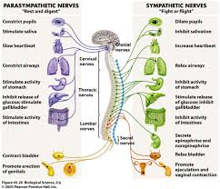
AUTONOMIC NERVOUS SYSTEM
Anatomical and physiological differences within the autonomic nervous system are the basis for its further subdivision into sympathetic and parasympathetic components
The nerve fibers of the sympathetic and parasympathetic components leave the central nervous system at different levels;
the sympathetic fibers from the thoracic (chest) and lumbar regions of the spinal cord,
and the parasympathetic fibers from the brain and the sacral portion of the spinal cord
Therefore, the sympathetic division is also called the thoracolumbar division, and the parasympathetic is called the craniosacral division

Slide 14
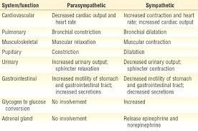
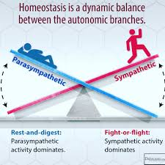
AUTONOMIC NERVOUS SYSTEM

Slide 15
AUTONOMIC NERVOUS SYSTEM
In both sympathetic and parasympathetic divisions, acetylcholine is the major neurotransmitter released between pre- and postganglionic fibers in autonomic ganglia
In the parasympathetic division, acetylcholine is also the major neurotransmitter between the postganglionic fiber and the effector cell.
In the sympathetic division, norepinephrine is usually the major transmitter between the postganglionic fiber and the effector cell.

Slide 16
AUTONOMIC NERVOUS SYSTEM
A useful generalization is that the sympathetic system increases its response under conditions of physical or psychological stress.
Indeed, a full-blown sympathetic response is called the fight-or-flight response, describing the situation of an animal forced to challenge an attacker or run from it.
All resources are mobilized: heart rate and blood pressure increase; blood flow to the skeletal muscles, heart, and brain increase; the liver releases glucose; and the pupils dilate.
Simultaneously, activity of the gastrointestinal tract and blood flow to the skin are decreased by inhibitory sympathetic effects.

Slide 17
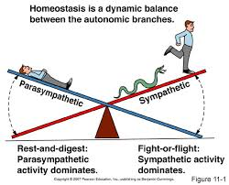
AUTONOMIC NERVOUS SYSTEM
The two divisions of the autonomic nervous system rarely operate independently, and autonomic responses generally represent the regulated interplay of both divisions.
Autonomic responses usually occur without conscious control or awareness, as though they were indeed autonomous

Slide 18
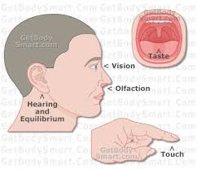
THE SENSORY SYSTEM
A sensory system is a part of the nervous system that consists of:
sensory receptors that receive stimuli from the external or internal environment,
the neural pathways that conduct information from the receptors to the brain, and
those parts of the brain that deal primarily with processing the information.

Slide 19
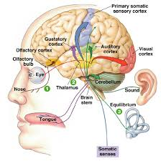
Properties of Sensory Systems
Stimulus - energy source
• Internal
• External
Receptors
• Sense organs - structures specialized to respond to
stimuli
• Transducers - stimulus energy converted into
action potentials
Conduction
• Afferent pathway
• Nerve impulses to the CNS
Translation
• CNS integration and information processing
• Sensation and perception – your reality

Slide 20
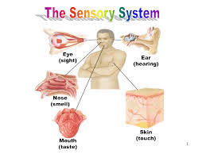
THE SENSORY SYSTEM
Information processed by a sensory system may or may not lead to conscious awareness of the stimulus.
Regardless of whether the information reaches consciousness, it is called sensory information.
If the information does reach consciousness, it can also be called a sensation.
A person’s understanding of the sensation’s meaning is called perception

Slide 21
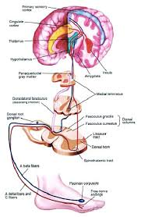
THE SENSORY SYSTEM
For example, feeling pain is a sensation, but my awareness that my tooth hurts is a perception.
Perceptions are the result of the neural processing of sensory information.

Slide 22
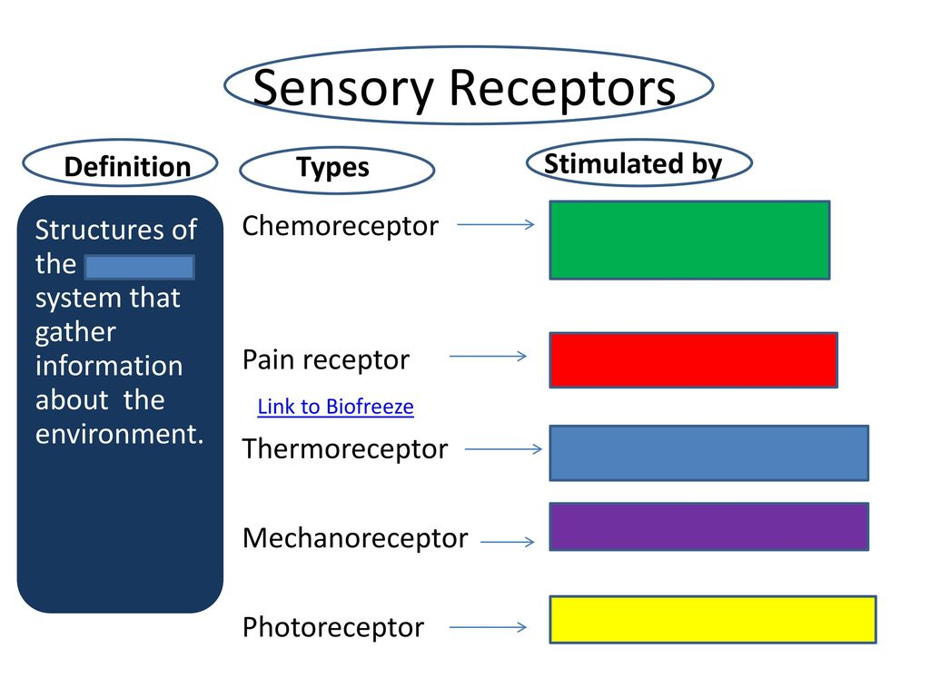
Receptors
Receptors respond to changes in environment
A photon of light or the mechanical stretch of a tissue transformed into an electrical response is known as stimulus transduction.
There are many types of sensory receptors, each of which is specific; that is, each type responds much more readily to one form of energy than to others.
The type of energy to which a receptor responds in normal functioning is known as its adequate stimulus.

Slide 23
Classification by Function (Stimuli)
Mechanoreceptors – respond to touch, pressure, vibration, stretch, and itch
Thermoreceptors – sensitive to changes in temperature
Photoreceptors – respond to light energy (e.g., retina)
Chemoreceptors – respond to chemicals (e.g., smell, taste, changes in
blood chemistry)
Nociceptors – sensitive to pain-causing stimuli
Osmoreceptors – detect changes in concentration of solutes, osmotic activity
Baroreceptors – detect changes in fluid pressure

Slide 24
Classification by Location
Exteroceptors – sensitive to stimuli arising from outside the body • Located at or near body surfaces • Include receptors for touch, pressure, pain, and temperature
Interoceptors – (visceroceptors) receive stimuli from internal viscera • Monitor a variety of stimuli
Proprioceptors – monitor degree of stretch • Located in musculoskeletal organs

Slide 25
The Generator Potential
The transduction process in all sensory receptors involves the opening or closing of ion channels that receive—either directly or through a second-messenger system—information about the outside world.
The ion channels occur in a specialized receptor membrane and not on ordinary plasma membranes.
The gating of these ion channels allows a change in the ion fluxes across the receptor membrane, which in turn produces a change in the membrane potential there.
This change in potential is a graded potential called a generator potential.

Slide 26
ANY QUESTIONS?

