Slide 1
National Expansion
AKE 117 AMERICAN HISTORY
DR. GAMZE KATI GÜMÜŞ

Slide 2
THE war of 1812
Between England and the US.
It proved to Americans the necessity to possess Spanish Florida as the British used it to provoke Native Americans and the slaves against the US.

Slide 3
Slavery and expansion
Due to Napoleonic Wars the institution of slavery was declining in the New World, especially in the Spanish territories.
Florida was annexed to the US in 1821, and Texas was annexed in 1845. Both states entered the US as slave states, since the production of cotton and sugar were pivotal elements for the economy of these states.

Slide 4
Slavery and expansion
Americans believed that the country could only be safeguarded against its domestic and foreign enemies by expanding its territory.
Anglophobia: The fear of Americans about the imperial intentions of Britain in regard to its former colonies. Americans were afraid that the British would acquire the Spanish territories. This probable acquisition, together with the anti-slavery attitude of the British, would have devastating effects on the US.

Slide 6
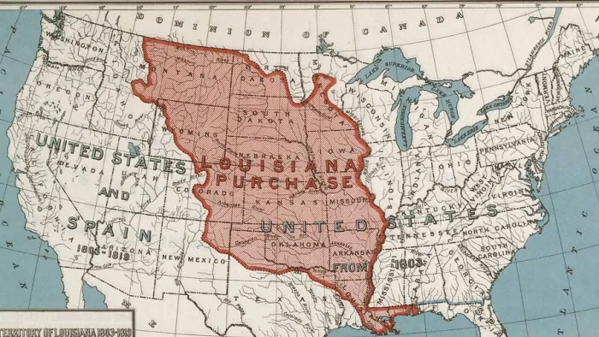
LOUiSIANA PURCHASE
Louisiana was purchased from the French in 1803 for $15 million.
Notes:
http://werehistory.org/louisiana-purchase/

Slide 7
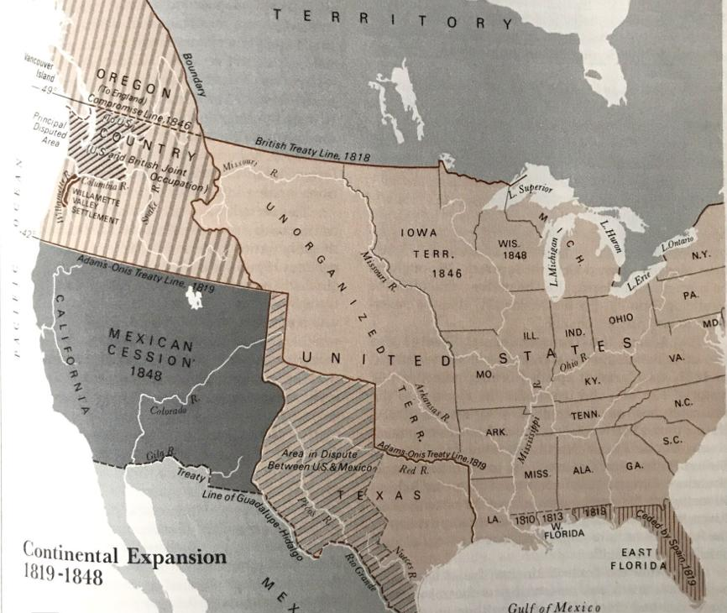
THE CROSSCONTINENTAL TREATY
OF 1819 (ADAMS-ONÍS TREATY)
This treaty ceded the Floridas to the US in return for American acknowledgement that Texas was not part of the Louisiana purchase.

Slide 8
THE MONROE DOCTRINE (1823)
When Mexico gained its independence from Spain in September 1821, it became susceptible to European attempts of colonization. President James Monroe proclaimed the Monroe Doctrine:
the United States would not interfere in the internal affairs of or the wars between European powers;
the United States recognized and would not interfere with existing colonies and dependencies in the Western Hemisphere;
the Western Hemisphere was closed to future colonization; and
any attempt by a European power to oppress or control any nation in the Western Hemisphere would be viewed as a hostile act against the United States.
This doctrine also prevented U.S. from expansion.
Notes:
https://www.britannica.com/event/Monroe-Doctrine

Slide 9
THE ANNEXATION OF TEXAS
In 1829, Mexico had abolished slavery in all its provinces, providing loopholes for slave-holding Anglo-American settlers in Texas.
There was a growing proslavery sentiment in Texas and Texans were planning to overthrow the Mexican government.
In 1836, Texans proclaimed independence and legalized black slavery in their constitution. They petitioned for annexation; an offer that was rejected with the efforts of former president John Quincy Adams.

Slide 10
THE ANNEXATION OF TEXAS
This rejection led Texan leaders to look to Britain and France for support.
British was about to accept their call for help on the condition that slavery be abolished in Texas, a move that was almost impossible for the Texan economy as it depended on slave labor.
Americans saw this British move as a tactic to destroy the Union, and took the opportunity to annex Texas to the US.

Slide 11
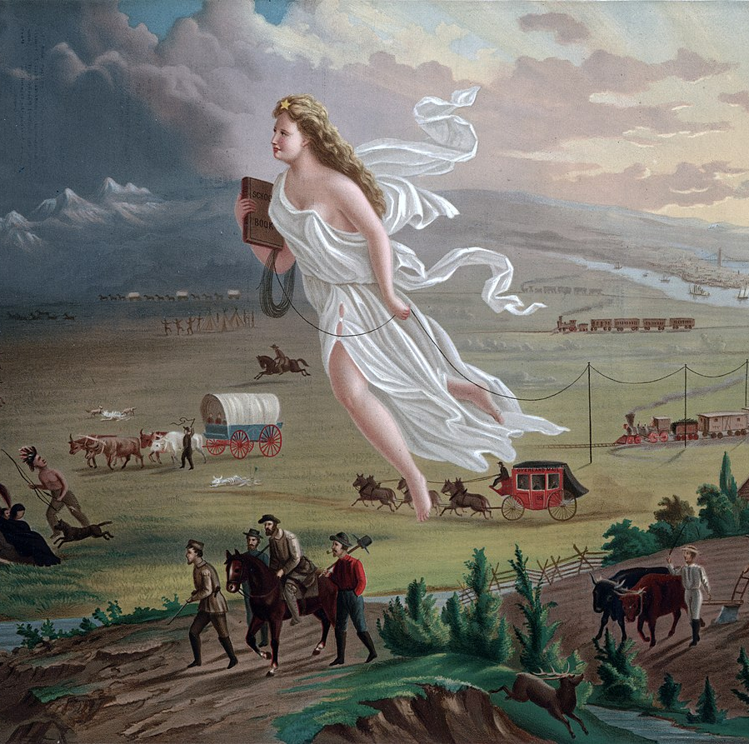
MANIFEST DESTINY
Democracy
Religious freedom
Progress
Mission given by God
This Photo by Unknown Author is licensed under CC BY-SA

Slide 12
The Mexican War (1846)
Texas was annexed to the US in 1845 as a slave state.
In the meantime, the question of who would acquire the Oregon territory and California remained a controversial matter between England and the US.
When President James K. Polk’s plans to purchase New Mexico and California failed, he tricked the Congress into declaring war against Mexico. According to him, the Mexican government was an invader and brutal power:
“Notwithstanding all our efforts to avoid it [war] exists by the act of Mexico herself. [Mexico] has passed the boundary of the United States, has invaded our territory and shed American blood upon the American soil.”

Slide 13
The Mexican war
The North viewed the Mexican War as a means to extend slavery and secure control over the free states.
The war came to an end with the Treaty of Guadalupe Hidalgo. According to the treaty, the US would pay $15 million to Mexico as well as Mexican debts to Americans in exchange for California, New Mexico and the Rio Grande boundary.

Slide 14
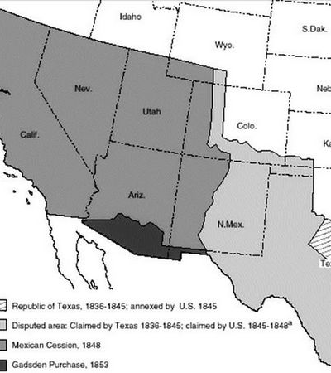
MEXICAN CESSION

Slide 15
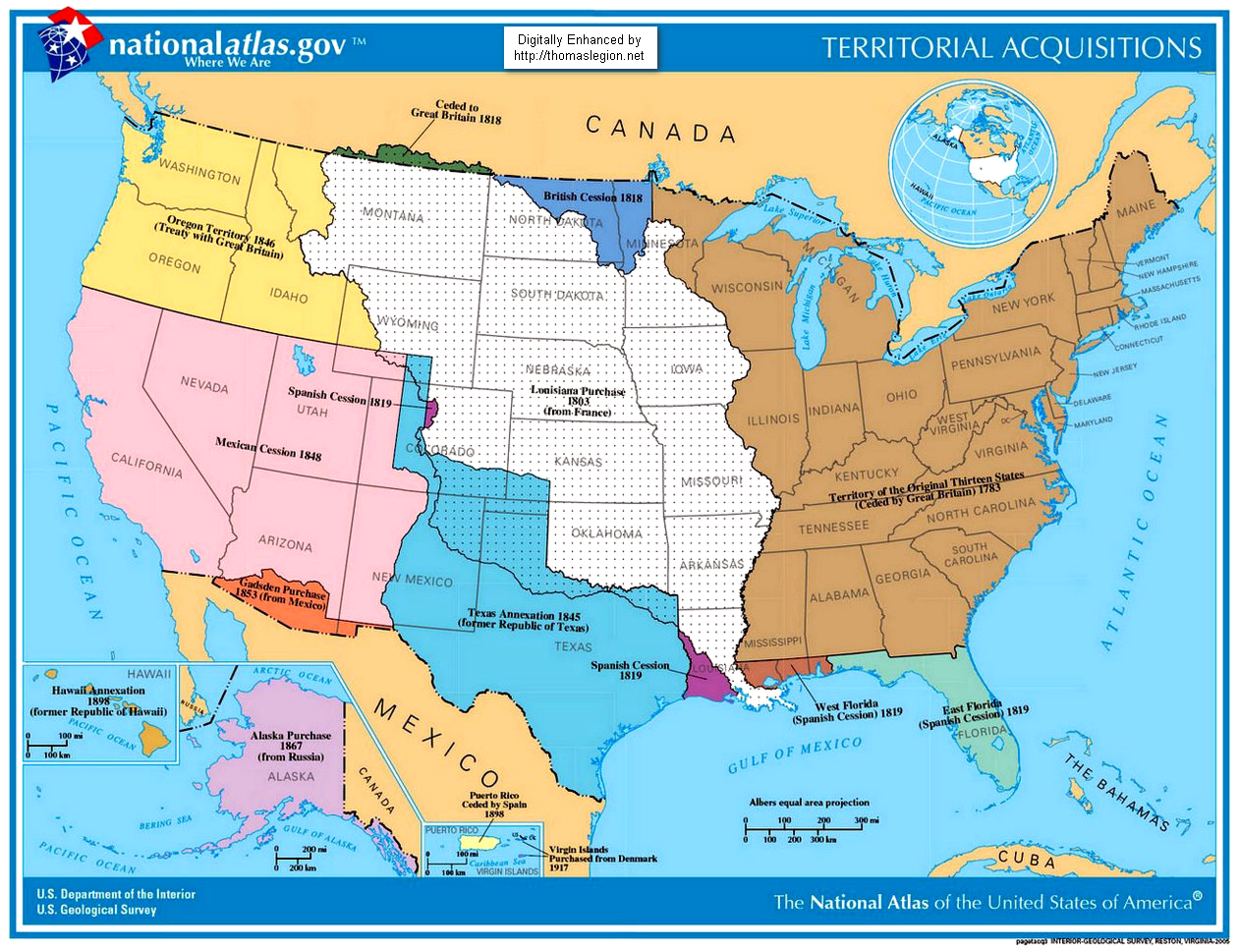
Notes:
http://www.thomaslegion.net/americancivilwar/mexicancessionlessonstudentsandkids.html

Slide 16
chronology
1812
The War of 1812
1819
Transcontinental (Adams-Onis) Treaty
1823
Monroe Doctrine
1845
Annexation of Texas
1846
Mexican war begins
1848
Treaty with Britain over Oregon territory
1848
Treaty of Guadalupe Hidalgo marks the end of the Mexican war.

