Slide 1
ANKARA UNIVERSITY DEPARTMENT OF ENERGY ENGINEERING NUMERICAL METHODS
INSTRUCTOR
DR. ÖZGÜR SELİMOĞLU

Slide 2
CONTENTS
Finding roots of equations
a) Incremental Search Method
b) Method of Bisection

Slide 3
FINDING ROOTS OF EQUATIONS
A common problem encountered in engineering analysis is as follows: Given a function f (x), determine the values of x for which f(x) = 0. The solutions (values of x) are known as the roots of the equation f (x) = 0, or the zeroes of the function f (x).
The equation;
The equation y = f (x) contains three elements: an input value x, an output value y, and the rule f for computing y. The function is said to be given if the rule f is specified. It may be a function statement, such as
As long as the algorithm produces an output y for each input x, it qualifies as a function.
The roots of equations may be real or complex. The complex roots are seldom computed, because they rarely have physical significance. An exception is the polynomial equation
Find the solutions of f (x) = 0, where the function f is given

Slide 4
where the complex roots may be meaningful (as in the analysis of damped vibrations, for example). First we will concentrate on finding the real roots of equations. Complex zeros of polynomials are treated near the end of this chapter.
In general, an equation may have any number of (real) roots or no roots at all. For example,
has a single root, namely x = 0, whereas
has an infinite number of roots (x = 0, ±4.493, ±7.725, . . .).
All methods of finding roots are iterative procedures that require a starting point (i.e., an estimate of the root). This estimate is crucial; a bad starting value may fail to converge, or it may converge to the “wrong” root (a root different from the one sought). There is no universal recipe for estimating the value of a root. If the equation is associated with a physical problem, then the context of the problem (physical insight) might suggest the approximate location of the root. Otherwise, you may undertake a systematic numerical search for the roots.

Slide 5
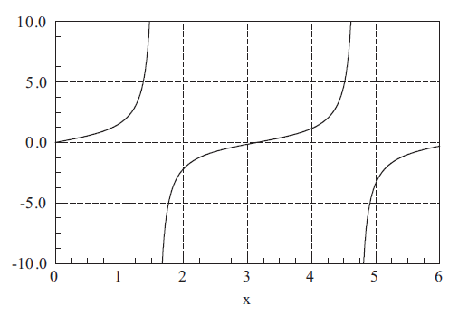
The approximate locations of the roots are best determined by plotting the function. Often a very rough plot, based on a few points, is sufficient to provide reasonable starting values. Another useful tool for detecting and bracketing roots is the incremental search method.
The basic idea behind the incremental search method is simple: If f(x₁) and f(x₂) have opposite signs, then there is at least one root in the interval (x₁, x₂). If the interval is small enough, it is likely to contain a single root. Thus the zeros of f (x) can be detected by evaluating the function at intervals $∆$x and looking for a change in sign.
Figure 1: Plot of tan x.
INCREMENTAL SEARCH METHOD
There are several potential problems with the incremental search method:
• It is possible to miss two closely spaced roots if the search increment x is larger than the spacing of the roots.
• A double root (two roots that coincide) will not be detected.
• Certain singularities (poles) of f (x) can be mistaken for roots. For example, f (x) = tan x changes sign at x = ±$\frac{n}{2}$π, n = 1, 3, 5, . . ., as shown in Figure 1.
However, these locations are not true zeroes, because the function does not cross the x-axis.

Slide 6
Example 1:A root of x ³ − 10x ² + 5 = 0 lies in the interval (0, 1). Use incremental search method to calculate the minimum section of this root. ($∆$x=0,1)
Solution: x₁=0 , f(x₁)=f(0)=5 x₂=1 , f(x₂)=f(1)=-4 f(x₁).f(x₂)<0 The root is in this section.
 | x+$∆$x | f (x..)=x³-10x²+5 | f(x..)
x₁ | 0 | f(x₁)=(0)³-10(0)²+5 | f(x₁)=5
x₂ | 0,1 | f(x₂)=(0,1)³-10(0,1)²+5 | f(x₂)=4,991
x₃ | 0,2 | f(x₃)=(0,2)³-10(0,2)²+5 | f(x₃)=4,608
x₄ | 0,3 | f(x₄)=(0,3)³-10(0,3)²+5 | f(x₄)=4,1
x₅ | 0,4 | f(x₅)=(0,4)³-10(0,4)²+5 | f(x₅)=3,464
x₆ | 0,5 | f(x₆)=(0,5)³-10(0,5)²+5 | f(x₆)=2,625
x₇ | 0,6 | f(x₇)=(0,6)³-10(0,6)²+5 | f(x₇)=1,616
x₈ | 0,7 | f(x₈)=(0,7)³-10(0,7)²+5 | f(x₈)=0,443
x₉ | 0,8 | f(x₉)=(0,8)³-10(0,8)²+5 | f(x₉)= -0,888
The root section from 0.7 to 0.8.

Slide 7
Graphical Methods
A simple method for obtaining an estimate of the root of the equation f (x) = 0 is to make a plot of the function and observe where it crosses the x axis. This point, which represents the x value for which f (x) = 0, provides a rough approximation of the root.
Example 2: Use the graphical approach to determine the drag coefficient c needed for a parachutist of mass m = 68.1 kg to have a velocity of 40 m /s after free-falling for time t = 10 s. Note: The acceleration due to gravity is 9.8 m /s².
Solution: This problem can be solved by determining the root of Eq. using the parameters t = 10, g = 9.8, v = 40, and m = 68.1.
Various values of c can be substituted into the right-hand side of this equation to compute
These points are plotted in Fig. 2 The resulting curve crosses the c axis between 12 and 16. Visual inspection of the plot provides a rough estimate of the root of 14.75. The validity of the graphical estimate can be checked by substituting it into Eq. to yield

Slide 8
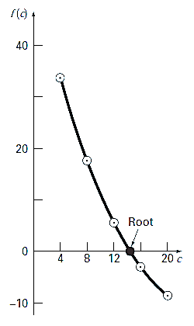
which is close to zero. It can also be checked by substituting it into Eq. along with the parameter values from this example to give
which is very close to the desired fall velocity of 40 m /s.
Figure 2: The graphical approach for determining the roots of an equation.

Slide 9
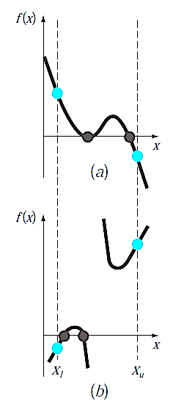
Aside from providing rough estimates of the root, graphical interpretations are important tools for understanding the properties of the functions and anticipating the pitfalls of the numerical methods. For example, Fig. 3, shows a number of ways in which roots can occur (or be absent) in an interval prescribed by a lower bound x_{l} and an upper bound x _{u}. Figure 3b depicts the case where a single root is bracketed by negative and positive values of f (x). However, Fig. 3 d, where f (x_{l}) and f (x _{u}) are also on opposite sides of the x axis, shows three roots occurring within the interval. In general, if f (x_{l}) and f (x_{u}) have opposite signs, there are an odd number of roots in the interval. As indicated by Fig.3a. and c, if f (x_{l}) and f (x _{u}) have the same sign, there are either no roots or an even number of roots between the values.
Although these generalizations are usually true, there are cases where they do not hold. For example, functions that are tangential to the x axis (Fig. 4a) and discontinuous functions (Fig. 4b) can violate these principles. An example of a function that is tangential to the axis is the cubic equation
f(x) = (x − 2)(x − 2)(x − 4). Notice that x = 2 makes two terms in this polynomial equal to zero. Mathematically, x = 2 is called a multiple root.
Figure 3: Illustration of a number of general ways that a root may occur in an interval prescribed by a lower bound x_{l} and an upper bound x _{u}. Parts (a) and (c) indicate that if both f (x_{l}) and f (x_{u}) have the same sign, either there will be no roots or there will be an even number of roots within the interval. Parts (b) and (d ) indicate that if the function has different signs at the end points, there will be an odd number of roots in the interval.
Figure 4 : Illustration of some exceptions to the general cases depicted in Fig. 5.2. (a) Multiple root that occurs when the function is tangential to the x axis. For this case, although the end points are of opposite signs, there are an even number of axis intersections for the interval. (b) Discontinuous function where end points of opposite sign bracket an even number of roots. Special strategies are required for determining the roots for these cases.

Slide 10
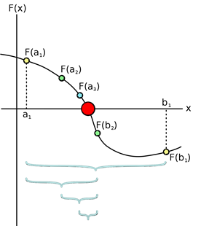
Method of Bisection
After a root of f (x) = 0 has been bracketed in the interval (x₁, x₂), several methods can be used to close in on it. The method of bisection accomplishes this by successively halving the interval until it becomes sufficiently small. This technique is also known as the interval halving method. Incremental search methods capitalize on this observation by locating an interval where the function changes sign. Then the location of the sign change (and consequently, the root) is identified more precisely by dividing the interval into a number of subintervals. Each of these subintervals is searched to locate the sign change.
The method of bisection uses the same principle as incremental search: If there is a root in the interval (x₁, x₂), then f (x₁) and f (x₂) have opposite signs. To halve the interval, we compute f (x₃), where x₃ = $\frac{1}{2}$(x₁ + x₂) is the midpoint of the interval. If f (x₂) and f (x₃) have opposite signs, then the root must be in (x₂, x₃), and we record this by replacing the original bound x₁ by x₃. Otherwise, the root lies in (x₁, x₃), in which case x₂ is replaced by x₃. In either case, the new interval (x₁, x₂) is half the size of the original interval. The bisection is repeated until the interval has been reduced to a small value ε, so that
It is easy to compute the number of bisections required to reach a prescribed ε. The original interval $∆$x is reduced to $∆$x/2 after one bisection, $∆$x/2² after two bisections, and after n bisections it is $∆$x/2^{n}. Setting $∆$x/2^{n} = ε and solving for n, we get
Since n must be an integer, the ceiling of n is used (the ceiling of n is the smallest integer greater than n).

Slide 11
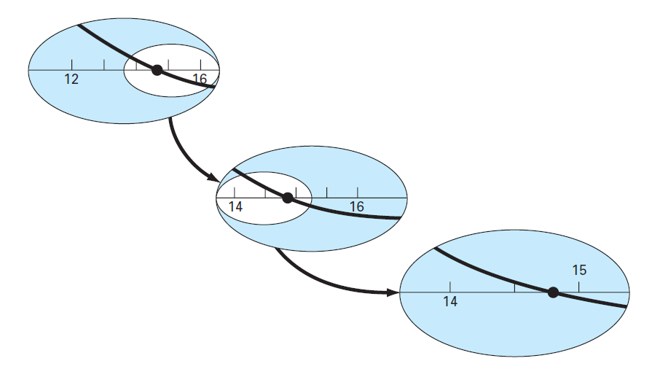
The bisection method, which is alternatively called binary chopping, interval halving, or Bolzano’s method, is one type of incremental search method in which the interval is always divided in half. If a function changes sign over an interval, the function value at the midpoint is evaluated. The location of the root is then determined as lying at the midpoint of the subinterval within which the sign change occurs. The process is repeated to obtain refined estimates.
Step 1: Choose lower x_{l} and upper x _{u} guesses for the root such that the function changes sign over the interval. This can be checked by ensuring that f(x _{a})f(x _{b})< 0.
Step 2: An estimate of the root x _{c} is determined by x _{c} → x_{c}=$\frac{Xa+Xb}{2}$
Step 3: Make the following evaluations to determine in which subinterval the root lies:
(a) If f(x_{a})f(x_{c}) < 0, the root lies in the lower subinterval. Therefore, set x _{b}= x _{c} and return to step 2.
(b) If f(x_{a})f(x_{c}) > 0, the root lies in the upper subinterval. Therefore, set x _{a} = x _{c} and return to step 2.
(c) If f(x_{a})f(x_{c}) = 0, the root equals x_{c} ; terminate the computation.
Figure 5 : A graphical depiction of the bisection method. This plot conforms to the first three iterations from Example 4.

Slide 12
Example 3: Use bisection to solve the same problem approached graphically in Example 2. Determine the process steps. (The function changes sign between values of 12 and 16)
Solution: The first step in bisection is to guess two values of the unknown (in the present problem, c) that give values for f (c) with different signs. From Fig. 2, we can see that the function changes sign between values of 12 and 16. Therefore, the initial estimate of the root x _{r} lies at the midpoint of the interval
This estimate represents a true percent relative error of ε_{t} = 5.3% (note that the true value of the root is 14.7802). Next we compute the product of the function value at the lower bound and at the midpoint:
which is greater than zero, and hence no sign change occurs between the lower bound and the midpoint. Consequently, the root must be located between 14 and 16. Therefore, we create a new interval by redefining the lower bound as 14 and determining a revised root estimate as

Slide 13
which represents a true percent error of ε _{t} = 1.5%. The process can be repeated to obtain refined estimates. For example,
Therefore, the root is between 14 and 15. The upper bound is redefined as 15, and the root estimate for the third iteration is calculated as
which represents a percent relative error of ε _{t} = 1.9%. The method can be repeated until the result is accurate enough to satisfy your needs.

Slide 14
Error Estimates for Bisection
The statement that the method could be continued to obtain a refined estimate of the root. We must now develop an objective criterion for deciding when to terminate the method.
An initial suggestion might be to end the calculation when the true error falls below some prespecified level. We might decide that we should terminate when the error drops below, say, 0.1 percent. This strategy is flawed because the error estimates in the example were based on knowledge of the true root of the function.
Therefore, we require an error estimate that is not contingent on foreknowledge of the root.
An approximate percent relative error ε_{a} can be calculated;
(a)
where x _{r} $new$ is the root for the present iteration and x _{r} ^{old} is the root from the previous iteration. The absolute value is used because we are usually concerned with the magnitude of ε_{a} rather than with its sign. When ε_{a} becomes less than a predefined stopping criterion ε_{s} , the computation is terminated.

Slide 15
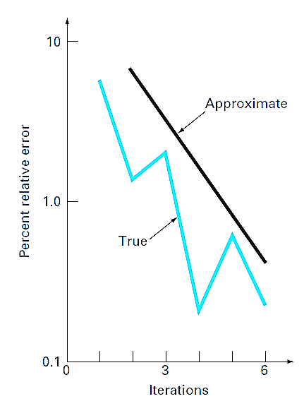
Example 4: Continue Example 3 until the approximate error falls below a stopping criterion of ε _{s} = 0.5%. Use Eq. (a) to compute the errors.
Solution: The results of the first two iterations for Example 3 were 14 and 15. Substituting these values into Eq. (a) yields
Recall that the true percent relative error for the root estimate of 15 was 1.5%.
Therefore, ε_{a} is greater than ε_{t} . This behavior is manifested for the other iterations:
Thus, after six iterations ε_{a} finally falls below ε_{s} = 0.5%, and the computation can be terminated.
These results are summarized in Fig. 6. The “ragged” nature of the true error is due to the fact that, for bisection, the true root can lie anywhere within the bracketing interval. The true and approximate errors are far apart when the interval happens to be centered on the true root. They are close when the true root falls at either end of the interval.
Figure 6 : Errors for the bisection method. True and estimated errors are plotted versus the number of iterations.

Slide 16
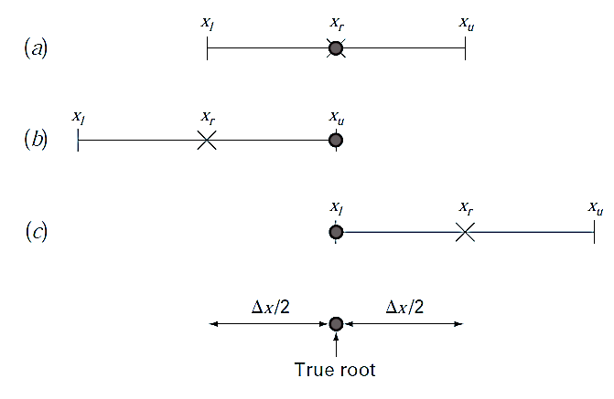
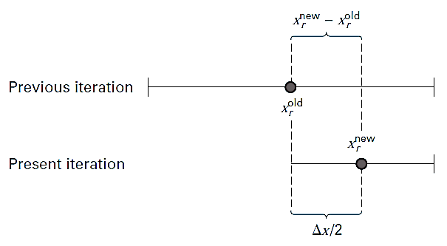
Although the approximate error does not provide an exact estimate of the true error, Fig. 6 suggests that ε _{a} captures the general downward trend of ε _{t} . In addition, the plot exhibits the extremely attractive characteristic that ε _{a} is always greater than ε _{t} . Thus, when ε _{a} falls below ε _{s}, the computation could be terminated with confidence that the root is known to be at least as accurate as the predetermined acceptable level.
Although it is always dangerous to draw general conclusions from a single example, it can be demonstrated that ε_{a} will always be greater than ε_{t} for the bisection method. This is because each time an approximate root is located using bisection as
x_{r} = (x_{l} + x_{u})/2, we know that the true root lies somewhere within an interval of (x_{u} − x_{l})/2 = $∆$x/2. Therefore, the root must lie within $∆$±x/2 of our estimate (Fig. 7). For instance, when Example 2 was terminated, we could make the definitive statement that
Because $∆$x/2 = x_{r}^{new} − x_{r}^{old} (Fig. 5.9), Eq. (5.2) provides an exact upper bound on the true error. For this bound to be exceeded, the true root would have to fall outside the bracketing interval, which, by definition, could never occur for the bisection method.
Figure 7: Three ways in which the interval may bracket the root. In (a) the true value lies at the center of the interval, whereas in (b) and (c) the true value lies near the extreme. Notice that the discrepancy between the true value and the midpoint of the interval never exceeds half the interval length, or $∆$x/2.
Figure 8: Graphical depiction of why the error estimate for bisection ($∆$x/2) is equivalent to the root estimate for the present iteration (x_{r}^{new}) minus the root estimate for the previous iteration (x_{r} ^{old}).

Slide 17
Although bisection is generally slower than other methods, the neatness of its error analysis is certainly a positive aspect that could make it attractive for certain engineering applications.
Another benefit of the bisection method is that the number of iterations required to attain an absolute error can be computed a priori—that is, before starting the iterations. This can be seen by recognizing that before starting the technique, the absolute error is
where the superscript designates the iteration. Hence, before starting the method, we are at the “zero iteration.” After the first iteration, the error becomes
If E_{a,d} is the desired error, this equation can be solved for
(b)
Let us test the formula. For Example 3, the initial interval was x₀ = 16 − 12 = 4. After six iterations, the absolute error was
We can substitute these values into Eq. (b) to give
Thus, if we knew beforehand that an error of less than 0.0625 was acceptable, the formula tells us that six iterations would yield the desired result.

Slide 18
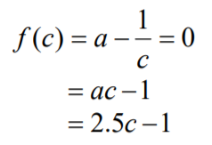
Example 5: To find the inverse of the value a , one can use the equation
where c is the inverse of a . Use the bisection method of finding roots of equations to find the inverse of a =2.5. Conduct three iterations to estimate the root of the above equation. Find the absolute relative approximate error at the end of each iteration and the number of significant digits at least correct at the end of each iteration.
Solution:
Let us assume
Check if the function changes sign between c_{l} and c_{u} .
Hence
So there is at least one root between c_{l} and c_{u}, that is, between 0 and 1.

Slide 19
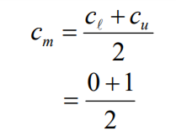
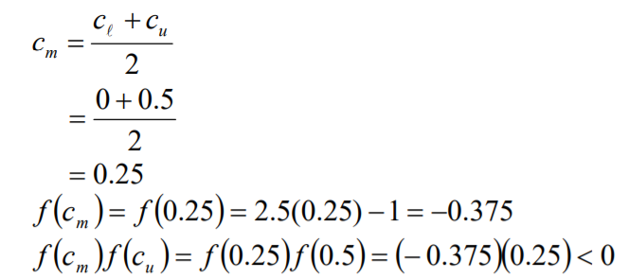
Iteration 1 : The estimate of the root is
Hence the root is bracketed between c_{m} and c_{l} , that is, between 0 and 0.5. So, the lower and upper limits of the new bracket are
At this point, the absolute relative approximate error $\left|∈a\right|$ cannot be calculated as we do not have a previous approximation.
Iteration 2: The estimate of the root is
Hence, the root is bracketed between c_{m} and c_{u} , that is, between 0.25 and 0.5. So the lower and upper limits of the new bracket are

Slide 20
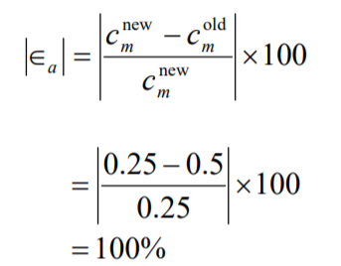
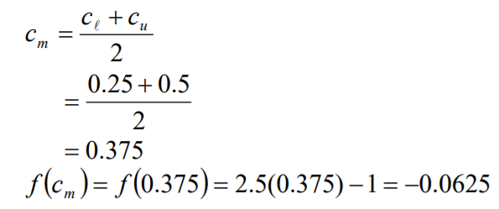
The absolute relative approximate error $\left|∈a\right|$ at the end of Iteration 2 is
None of he significant digits are at least correct in the estimated root of c_{m}= 0.25 as the absolute relative approximate error is greater that 5%.
Iteration 3:
Hence, the root is bracketed between c_{m} and c_{u} , that is, between 0.375 and 0.5. So the lower and upper limits of the new bracket are

Slide 21
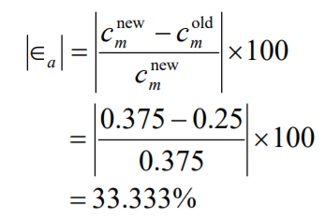
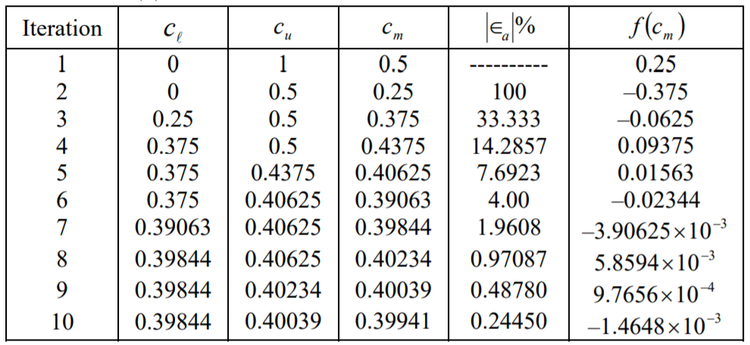
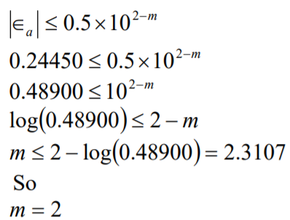
The absolute relative approximate error $\left|∈a\right|$ at the end of Iteration 3 is
Still none of the significant digits are at least correct in the estimated root of the equation the absolute relative approximate error is greater than 5%. Seven more iterations were conducted and these iterations are shown in the table below.
At the end of the 10th iteration,
Hence the number of m significant digits at least correct is given by the largest value of for which
The number of significant digits at least correct in the estimated root 0.39941 is 2

Slide 22
REFERENCES
Jaan Kiusalaas, “Numerical Methods in Engineering with Python 3”,3rd Edition, Cambridge, NY, 2013
S.C. Chapra and R.P. Canale, “Numerical Methods for Engineers”, 6th ed., McGraw-Hill,, NY, 2010

