Slide 1
GGY 334
Afet Yönetimi ve Politikaları
12. HAFTA
Türkiye’de Afet Yönetimi Sistemi
Dr. Öğr.Üyesi Md Moynul AHSAN
Ankara Üniversitesi UBF Gayrimenkul Geliştirme ve Yönetimi Bölümü

Slide 2
Giriş
A collection of ICTs, Disasterm Management Organisations, relationships among the DMOs, and operational procedures/business processes of the DMOs, of which objective is to prevent, mitigate, and minimize the impact of disasters.
For example:
In Queensland, Australia,
The Queensland’s disaster management system refers to the legislation, regulations, plans, standards, policies, technology systems, guidelines and associated publications in place to facilitate effective disaster management across the four phases of prevention, preparedness, response and recovery.

Slide 3
Türkiye’de Afet Yönetiminin Tarihsel Gelişim Süreci
Türkiye’de doğal afet zararlarının azaltılması konusundaki mevzuatı, önemli politika değişiklikleri göstermeleri açısından, dört dönemde incelemek olanaklıdır. Bu dönemler; 1944 öncesi, 1944–1958 arası, 1958- 1999 arası ve 17 Ağustos 1999 (Marmara Depremi) olduktan sonraki dönemdir

Slide 4
Türkiye’de Afet Yönetiminin Tarihsel Gelişim Süreci
Pre-1944 period: There were no effective policies for DM
1944 – 1958 period: Period with feeble countermeasures:
Government declared Law No: 4623 in 1944 for the foundation of DM activities in Turkey. In this period ‘’Development Law (Law No: 6785) and Civil Defense Law (Law No: 7126) were also enacted.
1959 – 1999 period: National Assembly passed Law No. 7269 (Disaster Law) and established a new Ministry which is responsible for the coordination and implementation of states obligations according to Law 7269 and 6785.
Post 1999: Awakening Period: The enormity of the losses from 1999’s two big earthquakes forced the government to promulgate 7 new laws and 32 decree laws to improve the national disaster management system.

Slide 5
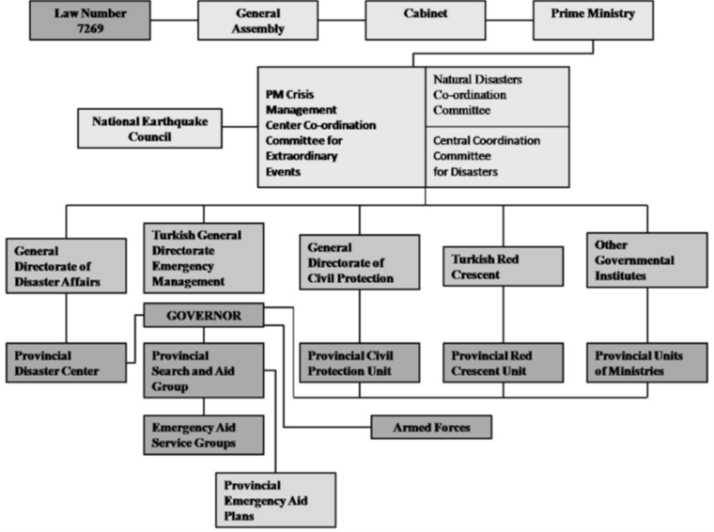
National Disaster Management chart of Turkey before Marmara earthquakes
Figure: National Disaster Management chart of Turkey before Marmara earthquakes.

Slide 6
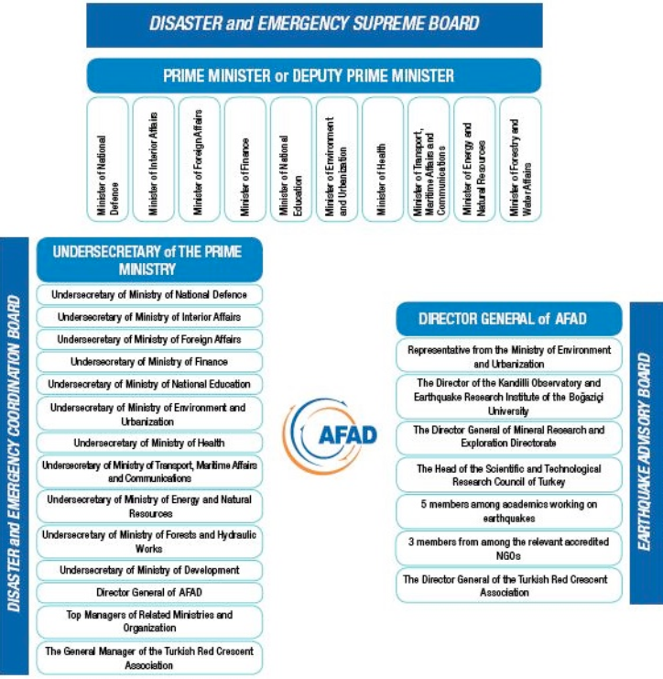
Afet Yönetimi Sistemi
Disaster Management system of Turkey changed from centralized system to decentralized system.

Slide 7
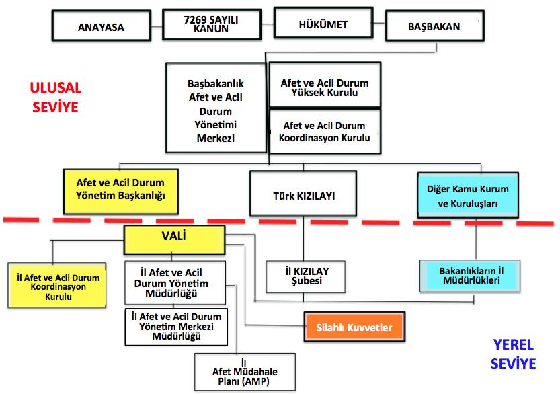
Afet Yönetimi Sistemi

Slide 8
AFAD Teşkilat Şeması

