Slide 1
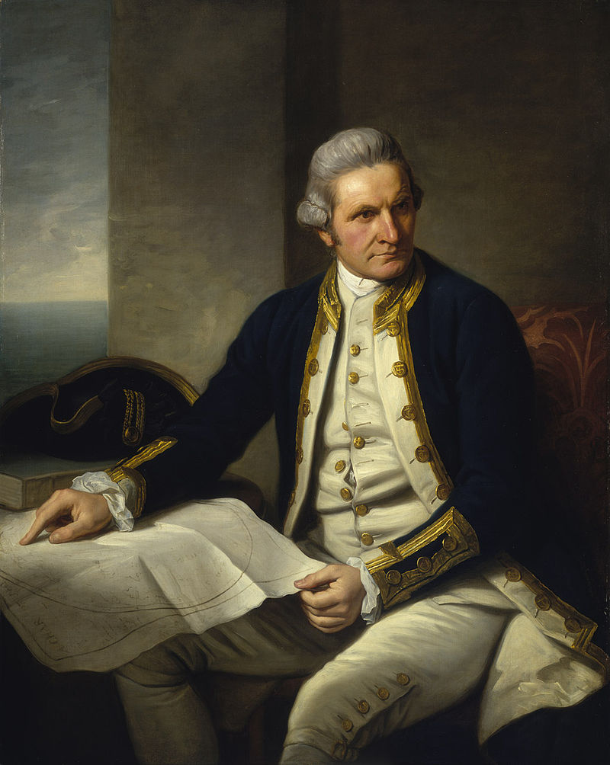
AUSTRALIA
Although Australia was first discovered by the Dutch sailors, in 1770, British sailor James Cook mapped the east coast and called the region New South Wales. After this discovery, Britain sent a fleet in order to establish a penal colony.
PENAL COLONY: It is a kind of colony to which prisoners in Great Britain were exiled. These convicts were used for the economic development of the colonies by forcing them to work in farms and roadbuilding.
Britain continued to send convicts to Australia
until 1868 and a great deal of population of British and Irish origin accumulated in the continent until then.

Slide 2
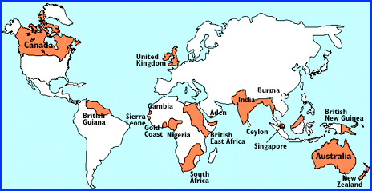
AUSTRALIA
In the second half of the 19th century, the idea of being a separate nation and an independent country gained popularity among those living in Australia. The necessity of being a new nation is further enhanced by the location of the continent which is far away from United Kingdom. British Empire, 1900

Slide 3
Australia
However, the problem was who would be the Australians. Among the different groups of people living in the continent
Aborigines (the indigenous Australians) were «too primitive» to be the founder of this new nation.
When the GOLD RUSH began, lots of Chinese arrived in Australia, but the Chinese groups were so reluctant to interact with other ethnic groups of Australia that it was unlikely that they would be a component of the new nation.
The convicts from Europe were another option, but they were the “residues” of the old world which was seen as a source of evil.
However, their children from Anglo-Celt origin and free emigrants began to form the Australian identity.

Slide 4
Australia
In 1901, the Commonwealth of Australia was founded as an independent state.
Commonwealth: refers to the union of the former British colonies under British monarch. Today, in Australia, there is a prime minister and above him there is a governor-general appointed by the Queen. Governor-general is the representative of the Queen in Australia. And today, there are 53 sovereign states under the banner of Commonwealth.

Slide 5
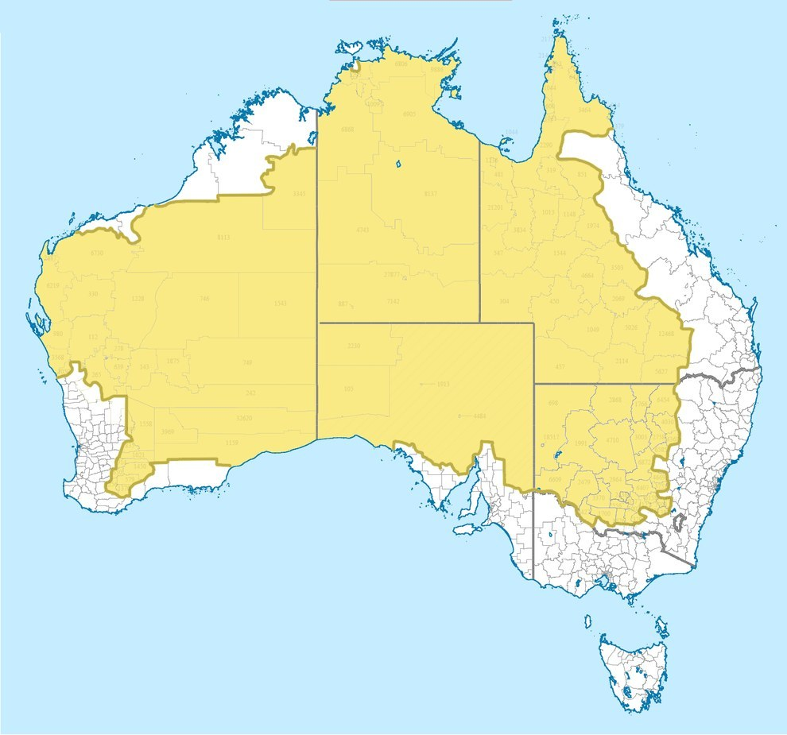
What do a community need to be a nation?
In order to be a nation, people need to share a common culture and they need to have a common myth. The source of this culture and myth had to be different from those of the mother country, Britain and it had to be peculiar to Australia. It had to emanate from the Australian soil itself.
In order to understand nation-building process of Australia, a demographic&geographic information related to the country may be useful.
Only %2 of the overall population live in the yellow area indicated on the map.
The reason of this unbalanced distribution of population is the massive BUSH inside the country.

Slide 6
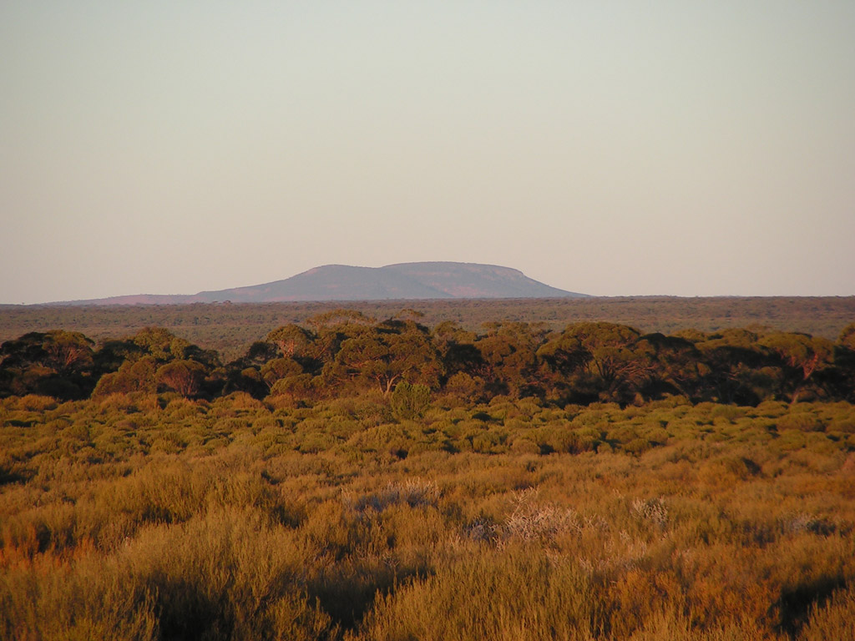
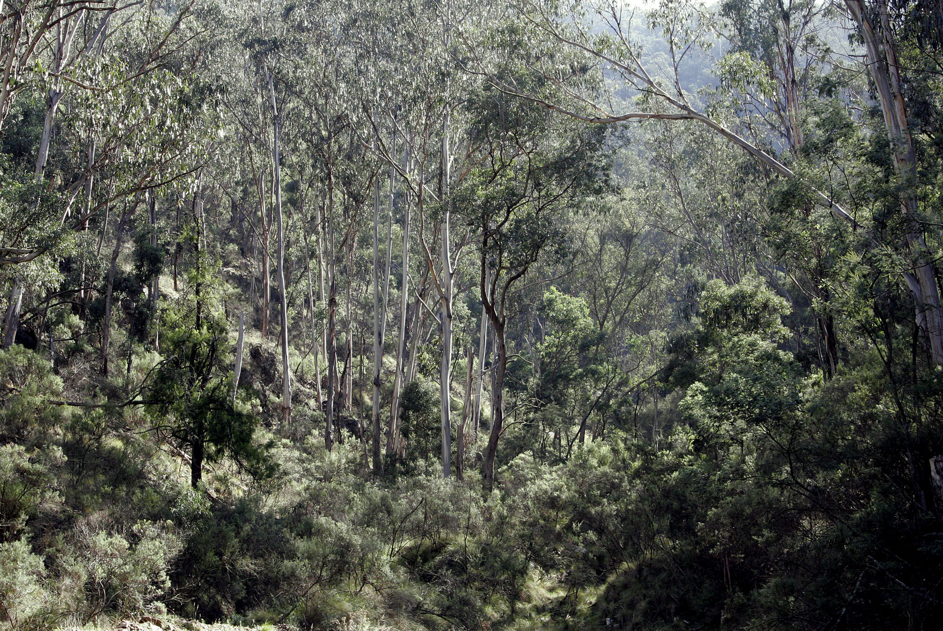
BUSH
BUSH is simply a place which has a scarce population.
It can be a place filled with different plants. However, it usually refers to arid and barren regions. If the BUSH is an arid one, it is also known as OUTBACK.

Slide 7
BUSH
Despite Nature’s hostility and despite Australian’s preference to live in the cities on the coastline, bush has some kind of alluring aspect for the Australians. It was regarded as a threat to be mastered and something to be possessed.
That’s why, we can say that the attitude of the Australians to BUSH is a bit contradictory.
Henry Lawson: Bush is «everlasting maddening sameness of the stunted trees [which] makes man want to break away»
Stop and think: What can be said of the woman in the story when we consider Lawson’s notion about the Bush?

Slide 8
BUSH
The contradictiory attitude of the Australian to the Bush can be resembled to an attitude towards an UNLOVELY MOTHER.
However, the challenging/the demanding characteristic of the Bush created an understainding that bush is «no place for a woman»; it represents Australian masculinity and Australian men’s maturity.
Feminine is associated with negative connotations.
Masculine is associated with positive connotations.

Slide 9
BUSH
As it is seen, bush occupies a central place in Australian mind, be it positive or negative. This place became the source of a shared culture and myth with its demanding conditions, bushmen, bushwomen and bushrangers. For instance, the bushrangers have an importance in this national myth. They are essentially outlaws some of whom usually attacked rich masters to help the poor.

Slide 10
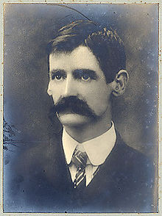
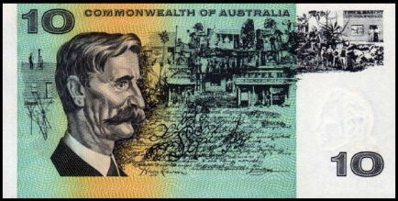
HENRY LAWSON
*His is father is a Norwegian (Niels Hertzberg) who came to Australia for Gold Rush.
*The family was later Anglicized and Niels was re-named as Peter. (Anglo-Saxon dominance)
* Henry Lawson: acknowledged as the greatest short story writer of Australia
*An Australian nationalist who tried to form a national identity. (But, not a romantic who idealizes bush life)

Slide 11
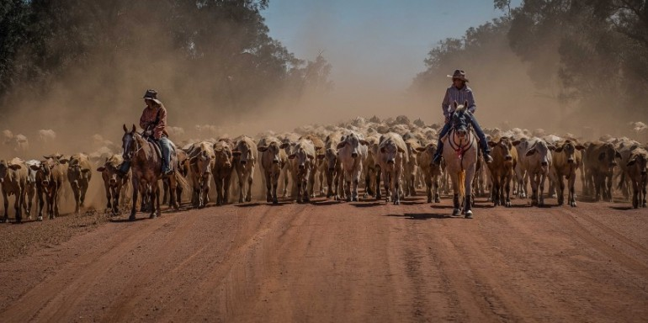
DROVING
*Transporting livestock (sheep, cow, calf etc.) over long distances by walking them.
*It might take for months.

Slide 12
Description of the house
It is built of «round timber» and «slabs»
Round timber: unprocessed wood
Slab: processed wood
What does it imply?

Slide 13
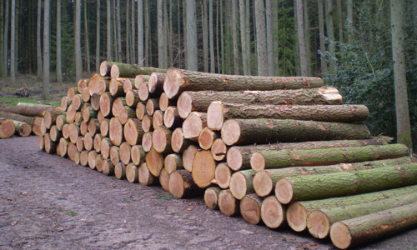
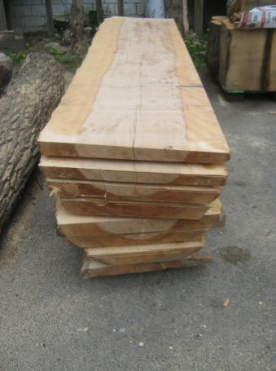
Binary Opposition: Wild vs. Civilized
The materials used in the construction of the house reflects man’s relation to the Bush.
While the «round timber» indicates the uncomprimising and untameable aspect of the Bush,
«Slabs» stand for the part of nature which has been taken under controll by mankind.
As a result, the house is suggestive of the fight between MAN and NATURE.

Slide 14
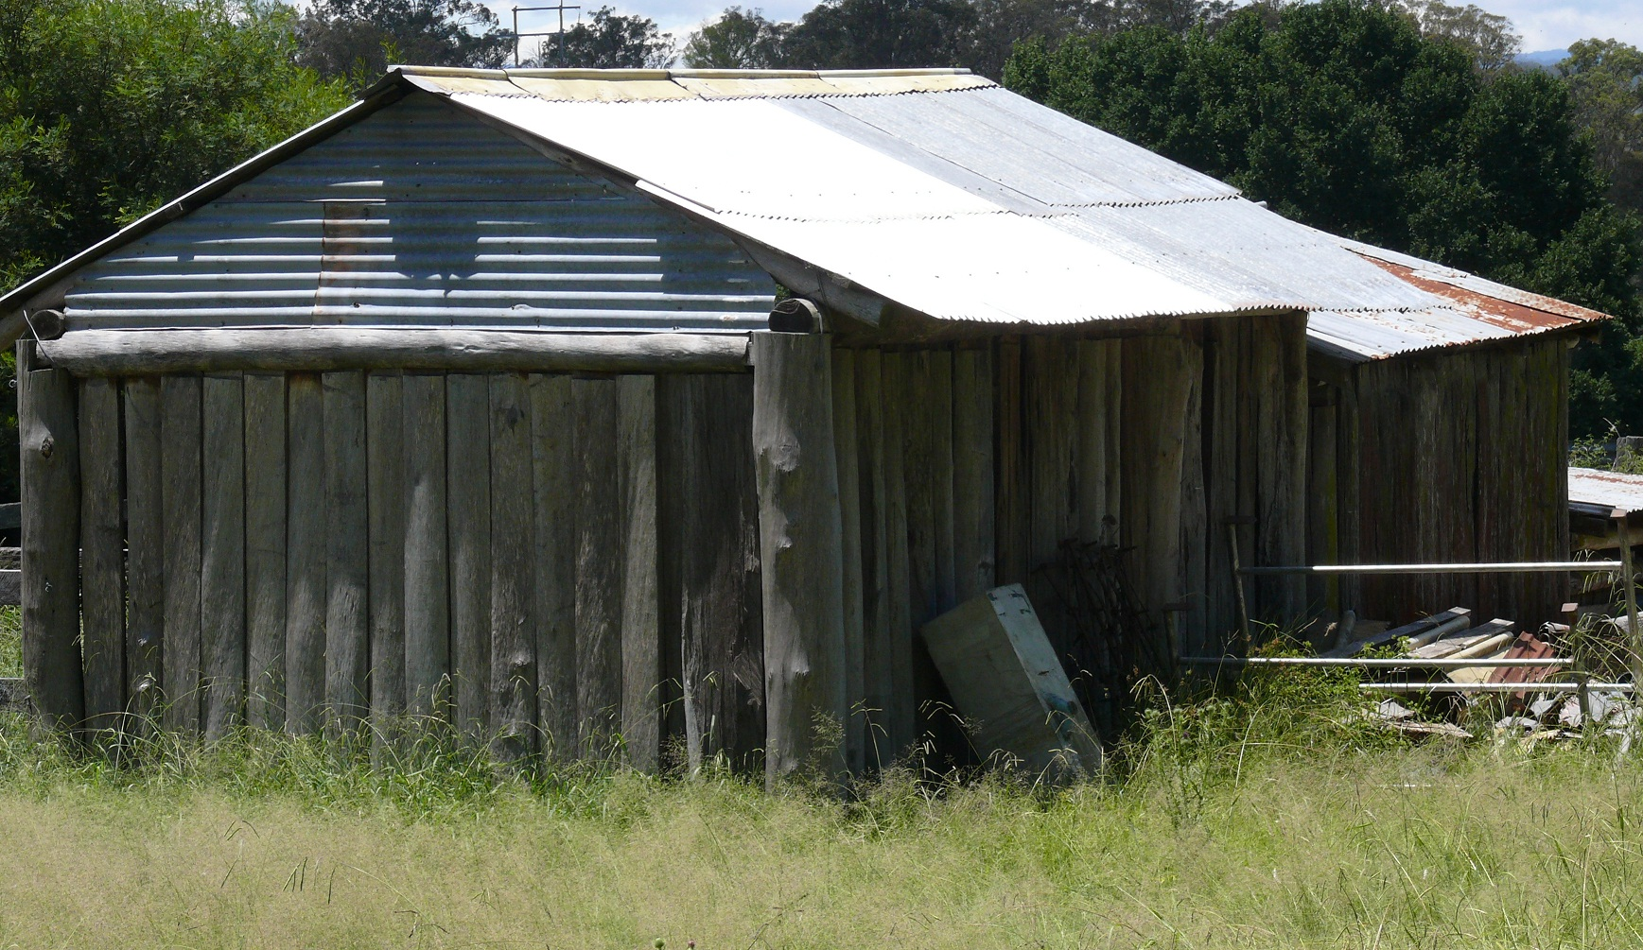
Shanty in the Bush

Slide 15
A Paradox
A house is essentially a protection from the threats of nature.
However, the material used in the construction of the shanty is a part of Nature.
Paradox: Using nature to protect from the dangers of nature.

Slide 16
Binary Opposition: Inside vs. Outside
In terms of space, inside is usually associated with safety and protection; while outside is usually a source of danger.
The author challenges this understanding in two different ways in order to give the message that BUSH is unlike any conventional place.
When the snake goes under the house, all the members of the family rush to the outside. So that, the conventional understanding of «inside» and «outside» in terms of safety in reversed. Now, «inside» is the source of danger, while «outside» is secure.

Slide 17
Binary Opposition: Inside vs. Outside
The second way by which Lawson undermines the «seemingly» secure position of both inside and outside is the approaching THUNDERSTORM.
There is a snake inside the house and there is a thunderstorm in the outside, which means that the mother and the children do not have a safe place in the bush environment.

Slide 18
Characterization (Drover’s Wife)
She does NOT have a name, which may have means:
She is not an individual.
She is the representative of all bushwomen.

Slide 19
Characterization (Drover’s Wife)
She immediately snatches the baby, when Tommy warns her of the snake.
Protective
She waits for her husband during his long term droving business.
«They are used to being apart, or at least she is. <No use fretting>, she says
Patient
She is «gaunt and sun-browned».
Industrious

Slide 20
Note that:
One of the main characteristics of the drover’s wife is her LONELINESS. However, the wives of the drovers were not the only ones suffering from loneliness and isolation.
Lots of men (both from urban and rural places) joined Gold Rush in the second half of the 19th century by leaving their families behind. Henry Lawson’s father left his family to seek gold, too.

Slide 21
Characterization (Drover’s Wife)
As a lonely woman, the drover’s wife has to be like a man and assume masculine characteristics in order to survive and protect her children from the dangers. That’s one of the key messages which the story aims to convey.
Consider the dangers she had to cope with: bush-fire, flood, pneumonia, mad bullock, crows and eagles, swagman ( or sundowner) (man vs. man) and finally the snake.

Slide 22
Characterization (Drover’s Wife)
The cases of bush-fire and crows&eagles are especially significant in understanding the problematic gender role in the story.
During bush-fire «she put on an old pair of her husband’s trousers and beat out the flames».
The shows that she needs a man’s garment, in other words, she needs to be masculinized in order to fight the bush-fire.
She uses a broomstick as if it were a rifle to frighten the predator birds.
A broomstick is a domestic instrument that is associated with women, but in this case it turns to be a rifle that is associated with men.

Slide 23
Characterization (Drover’s Wife)
«She seems contented with her lot. She loves her children but has no time to show it. She seems harsh to them. Her surroundings are not favorable to the development of the <womanly> or sentimental side of nature.»
This quotation shows that NATURE has an active role/is determinant one’s character. In the story, the wife replaces the absent father figure.
YET, there is also a textual proof of her tendency to keep her feminine identity.
«She finds all the excitement and recreation she needs in _Young Ladies’ Journal_, and Heaven help her! takes a please in the fashion-plates.»
The expression written in italics belongs to the narrator. The narrator is aware of the fact that if she begins to engage with «womanly» habits, she can hardly survive the ruthless conditions of the bush life.

Slide 24
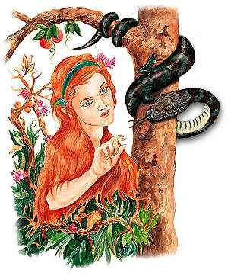
Biblical References of the Story
Towards the end of the story, it is stated that «[alligator] shakes the snake as though he felt the original curse in common with mankind» and this is a clear allusion to Genesis section of Bible.
According to Bible, Lucifer disguised as a snake to trick Eve into eating the forbidden apple. And, after being exiled from the Garden of Eden, mankind is in a constant endeavor to return there. Yet, Lucifer/Devil obstructs this will.
Where does the wife want to go in the story?
City. So that <city> becomes some kind of Garden of Eden for the bushwoman, for she will not have to deal with danger of Nature when she goes there.
However, she has to overcome the present threats (symbolized by snake) in order to reach her goal, just like mankind who has to overcome Devil in order to go back to the Garden of Eden.

Slide 25
Biblical References of the Story
In the story, we have a mother figure and a baby. (Mary and Christ)
We also have an absent father figure. We are aware of that he exists, but we cannot see him. (God)
The baby is, in a way, forsaken by the father figure. (On the cross, Christ exclaims: Father! Why have you forsaken me?)
In story, the snake is a threat to the baby. (The Devil is Christ’s enemy)
In the story, we have a struggle between woman and snake. (In Genesis, God says to the serpent that «I will put enmity between you and woman» and also informs that woman shall crush the serpent) In some representations of Mary, she is depicted standing victoriously over a snake.
So that, alongwith the literal meaning of the story, it is also possible to read it as a Christian allegory.

Slide 27
Style
Are the sentences in the story decorated or plain?
The author aims to use statements as plain as possible. Firstly because, he wants to reflect the daily speech of the Australians and secondly because, he wants to create a parallelism between the plain life of bush and and the statements.
Although the case of snake may seem as an unusual occurence, it is actually one of the routines of bush life. The exposition of the dangers she confronted in the past serves to show that the life is cyclical: danger turns up and the woman copes with it each time. That’s why, the list of the past dangers also serves as a foreshadowing effect for the end of the story.

Slide 28
Plot structure of the novel
Exposition:
Description of the house and environment
Rising Action:
The snake appears and goes under the house, the wife gathers the children together and she stands on the nightwatch to protect the children.
The Falling Action and the End:
By the help of their dog, she catches the snake and throws it into the fire.

Slide 29
Climax?
A story usually has a climactic point in which the hero or heroine pass through a psychological or physical change. Does the wife change, at all?
The danger she confronts does not change her, at all. It is important to note that the story conveys a message that as long as she stays in the bush, she will have to deal with the same problems again. At the end of story, she still in the bush and she has to perform her roles both as a woman and a man, as before.

Slide 30
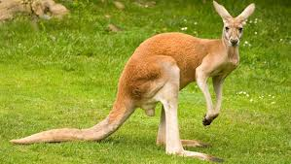
THANK YOU

