Slide 1
Dinural and Annual Motion

Slide 2
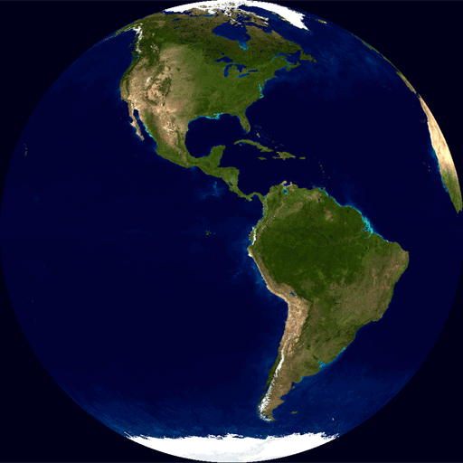
Daily Motion
Öğle Vakti
Sabah
Akşam
Gece Yarısı
Notes:
https://en.wikipedia.org/wiki/Earth%27s_rotation#/media/File:Globespin.gifhttps://en.wikipedia.org/wiki/Earth%27s_rotation#/media/File:Globespin.gif

Slide 3
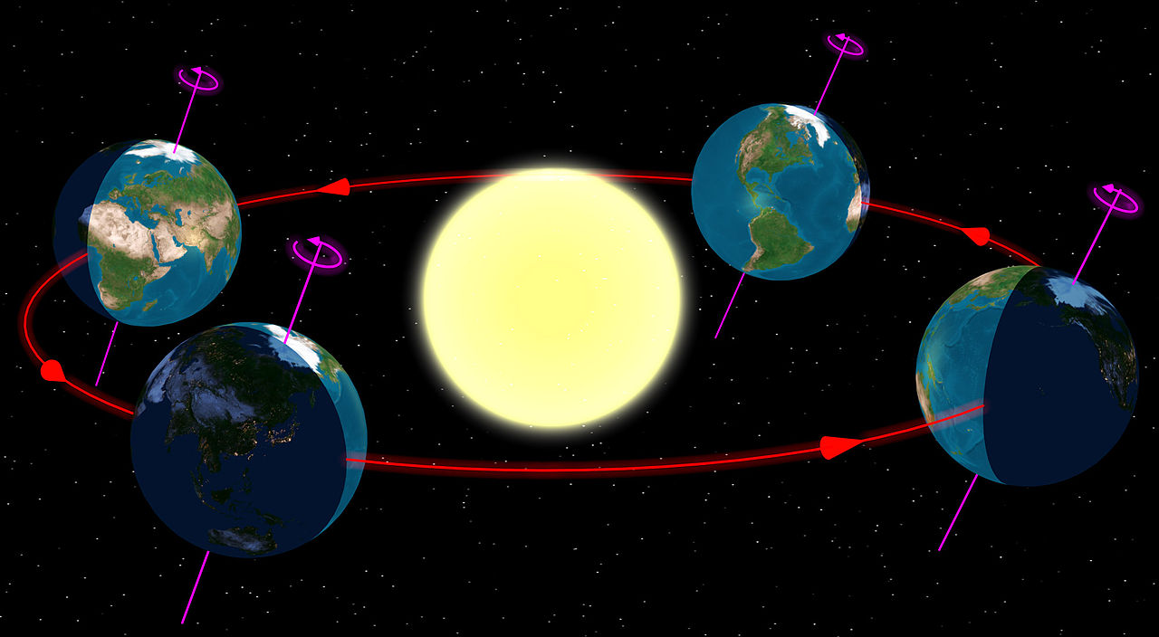
Annual Motion
Notes:
https://en.wikipedia.org/wiki/Earth%27s_orbit#/media/File:North_season.jpg

Slide 4
Star’s projected on the sky
Uzay
Sky
Notes:
https://www.kisspng.com/png-palm-islands-travel-arecaceae-illustration-coconut-322246/

Slide 5
Zenith
North Celestial Pole
Celestial Equator
West
South
North
East
Horizon
South Celestial Pole
Nadir

Slide 6
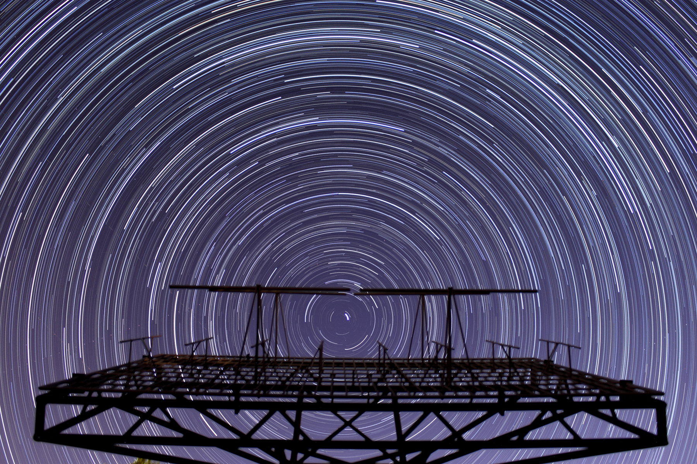
Circumpolar Stars
Notes:
Doç. Dr. Tolgahan Kılıçoğlu’nun fotoğrafı

Slide 9
Sun’s Daily Motion

Slide 10
Zenit
Celestial Equator
North Celestial Pole
Batı
South
North
Horizon
Doğu
22 June
South Celestial Pole
21 March & 23 September
Nadir
22 December

Slide 11
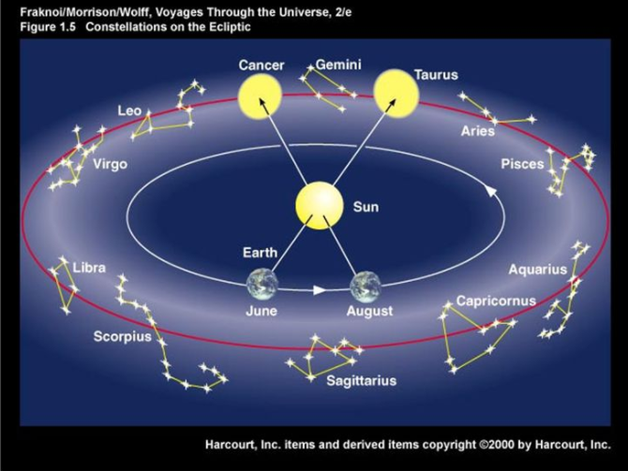
Notes:
Ankara’nın enlemi 39 55

Slide 12
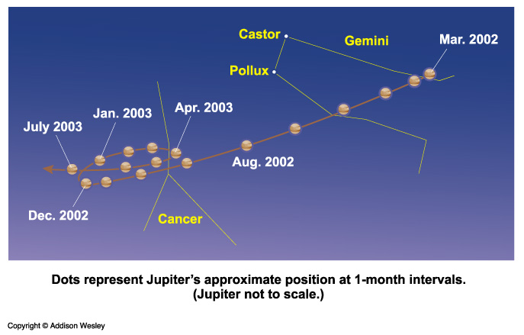
Motion of the Planets
Retrograt
East
West

Slide 13
