Slide 1
Strength of Materials
• Stress and strain
• Elastic behavior/Plastic behavior
• Toughness and ductility
Hardness
Design/Safety Factor

Slide 2
Hardness
Hardness - Measures the resistance of a material to localized plastic deformation.
It represents resistance to scratching/indentation and a qualitative measure of the strength of the material.
Hardness Tests:
Simple and inexpensive
Nondestructive
It allows to estimate other mechanical properties (tensile strength)
TS (MPa) = 3.45 x HB (for most steels)
Brinell hardness number

Slide 3
Hardness:
Macro-hardness: Hardness of materials measured using loads > 2 N.
Brinell and Rockwell Tests (Different indenters are used)
$HB=\frac{2F}{πD\left[D−\sqrt{D^{2}−D_{i}^{2}}\right]}$
Micro-hardness: Hardness of materials typically measured using loads less than 2 N
Knoop (HK)
Vickers (HV)
Nano-hardness: Hardness of materials measured at 1–10 nm length scale using extremely small (~100 µN) forces.
HB: Brinell hardness number
F: Applied load (kg)
D: Diameter of indenter (mm)
D_{i}: Diameter of the impression (mm)

Slide 4
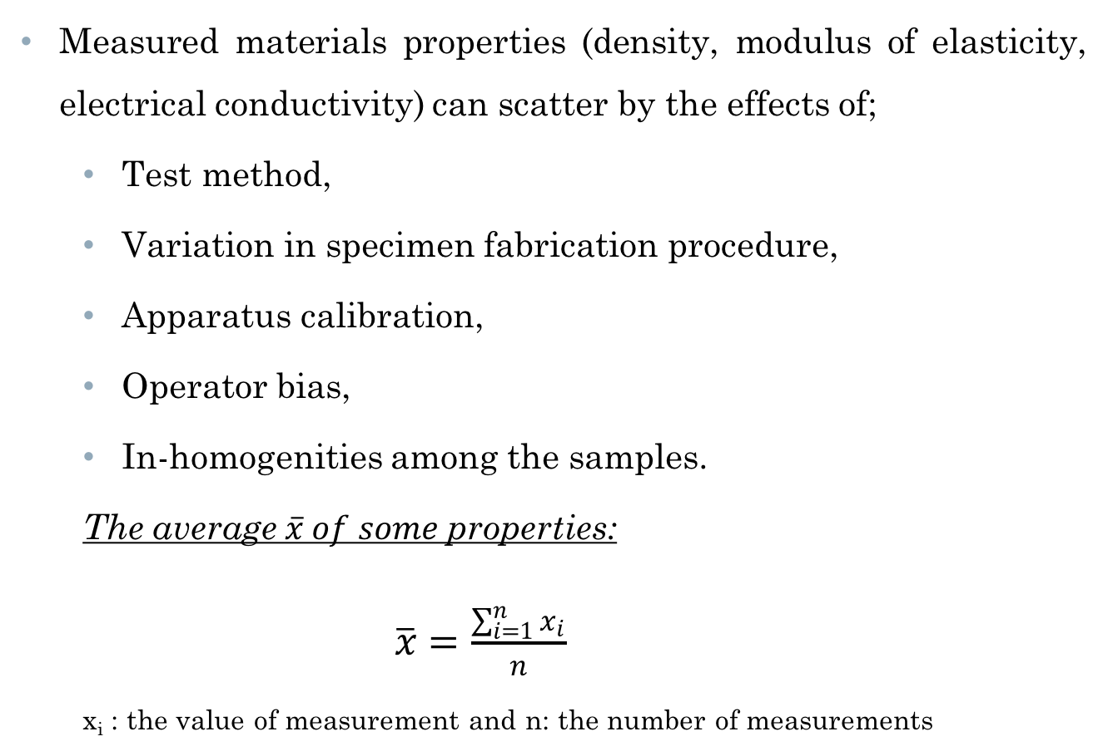
Variability of Materials Properties
Measured materials properties (density, modulus of elasticity, electrical conductivity) can scatter by the effects of;
Test method,
Variation in specimen fabrication procedure,
Apparatus calibration,
Operator bias,
In-homogenities among the samples.
The average $\overline{x} of some$properties:
$\overline{x}=\frac{\sum_{i=1}^{n}{x_{i}}}{n}$
x_{i} : the value of measurement and n: the number of measurements

Slide 5
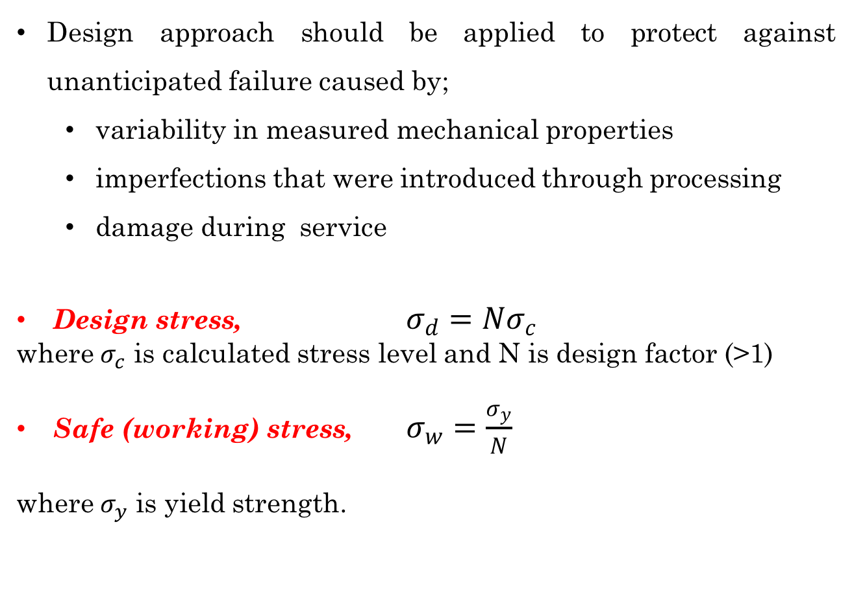
Design or Safety Factor
Design approach should be applied to protect against unanticipated failure caused by;
variability in measured mechanical properties
imperfections that were introduced through processing
damage during service
Design stress, $σ_{d}=Nσ_{c}$
where $σ_{c}$ is calculated stress level and N is design factor (>1)
Safe (working) stress, $σ_{w}=\frac{σ_{y}}{N}$
where $σ_{y}$ is yield strength.

Slide 6
References
Donald R. Askeland, Pradeep P. Fulay, Wendelin J. Wright, The Science and Engineering of Materials, Sixth Edition
William D. Callister, David G. Rethwisch, Materials Science and Engineering, Eighth Edition, Wiley, 2011.

