Slide 1
The Nodulation Process
Chemical recognition of roots and Rhizobium
Root hair curling
Formation of infection thread
Invasion of roots by Rhizobia
Cortical cell divisions and formation of nodule tissue
Bacteria fix nitrogen which is transferred to plant cells in exchange for fixed carbon

Slide 2
Biological NH₃ creation (nitrogen fixation) accounts for
an estimated 170 x 10⁹ kg of ammonia every year.
Human industrial production amounts to some 80 x 10⁹ kg
of ammonia yearly.
The industrial process (Haber-Bosh process) uses an Fe
catalyst to dissociate molecules of N₂ to atomic nitrogen
on the catalyst surface, followed by reaction with H₂
to form ammonia. This reaction typically runs at ~450º C
and 500 atmospheres pressure.
These extreme reaction conditions consume a huge amount
of energy each year, considering the scale at which NH₃ is
produced industrially.

Slide 3
Symbiotic Rhizobia are classified in two groups:
Fast-growing Rhizobium spp. whose nodulation functions
(nif, fix) are encoded on their symbiotic
megaplasmids (pSym)
Slow-growing Bradyrhizobium spp. whose N-fixation and
nodulation functions are encoded on their chromosome.
There are also two types of nodule that can be formed:
determinate
and
indeterminate
This outcome is controlled by the plant host

Slide 4
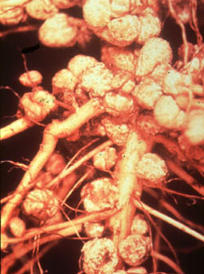
Determinate nodules
Formed on tropical legumes by
Rhizobium and Bradyrhizobium
Meristematic activity not persistent - present only
during early stage of nodule formation;
after that, cells simply expand rather than divide, to
form globose nodules.
Nodules arise just below epidermis; largely internal
vascular system

Slide 5
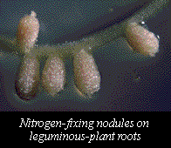
Indeterminate nodules
Formed on temperate legumes
(pea, clover, alfalfa);
typically by Rhizobium spp.
Cylindrical nodules with a persistent meristem;
nodule growth creates zones of different developmental
stages
Nodule arises near endodermis, and nodule vasculature
clearly connected with root vascular system

Slide 6
Rhizobium
establish highly specific symbiotic associations with legumes
form root nodules
fix nitrogen within root nodules
nodulation genes are present on large plasmid

Slide 7
Rhizobium-legume symbioses
Host plant Bacterial symbiont
Alfalfa Rhizobium meliloti
Clover Rhizobium trifolii
Soybean Bradyrhizobium japonicum
Beans Rhizobium phaseoli
Pea Rhizobium leguminosarum
Sesbania Azorhizobium caulinodans
Complete listing can be found at at: http://cmgm.stanford.edu/~mbarnett/rhiz.htm
Both plant and bacterial factors determine specificity

Slide 8
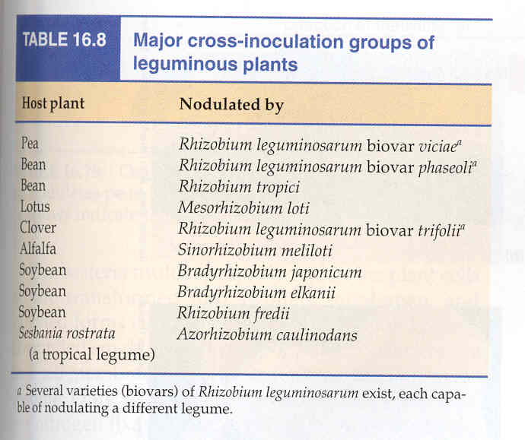

Slide 9
Typical Associations
(cross-inoculation groups)
R.l. biovar viciae
colonizes pea (Pisum spp.) and vetch
(temperate; indeterminate nodules)
R.l. biovar trifolii
colonizes clover (Trifolium spp.)
(temperate; indeterminate nodules)
Rhizobium leguminosarum biovar phaseoli
colonizes bean (Phaseolus spp.)
(tropical; determinate nodules)

Slide 10
Rhizobium meliloti
colonizes alfalfa (Medicago sativa)
temperate; indeterminate nodules
Rhizobium fredii
colonizes soybean (Glycine max)
tropical; determinate nodules
Bradyrhizobium japonicum
colonizes soybean
tropical; determinate nodules
Rhizobium NGR 234
colonizes Parasponia and tropicals;
very broad host range

Slide 11
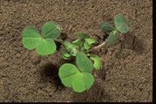
Very early events in the Rhizobium-legume
symbiosis
Flavonoids
nod-gene
inducers
rhizosphere
Nod-factor

Slide 12
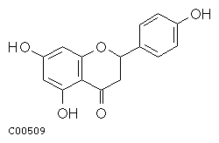
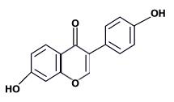
Nodule development process
1. Bacteria encounter root;
they are chemotactically attracted toward specific
plant chemicals (flavonoids) exuding from root tissue,
especially in response to nitrogen limitation
naringenin
(a flavanone)
daidzein
(an isoflavone)

Slide 13
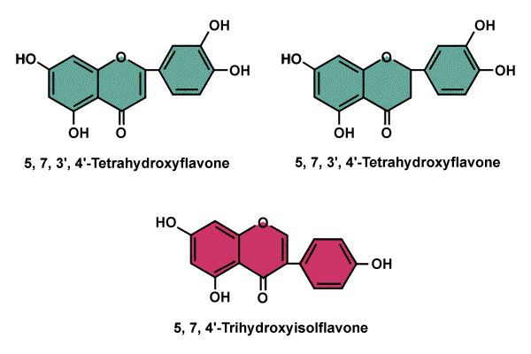
Inducers of nodulation in Rhizobium leguminosarum bv viciae
luteolin eriodictyol
Inhibitor of nodulation
genistein

Slide 14
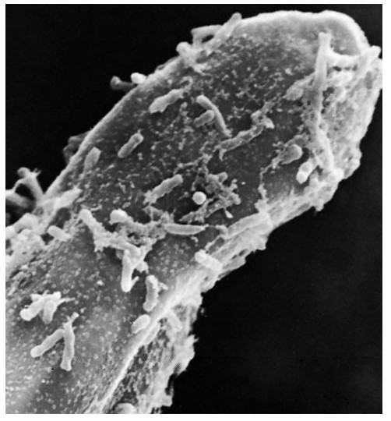
root hair beginning to curl
Rhizobium
cells

Slide 15
Types of bacterial functions involved in
nodulation and nitrogen fixation
nod (nodulation) and nol (nod locus) genes
mutations in these genes block nodule formation or
alter host range
most have been identified by transposon mutagenesis,
DNA sequencing and protein analysis, in R. meliloti,
R. leguminosarum bv viciae and trifolii
fall into four classes: nodD
nodA, B and C (common nodgenes)
hsn (host-specific nod genes)
other nod genes

Slide 16
nif (nitrogen fixation) genes
Gene products are required for symbiotic nitrogen
fixation, and for nitrogen fixation in free-living N-fixing
species
Example: subunits of nitrogenase

Slide 17
Host plant role in nodulation
1. Production and release of nod gene inducers
- flavonoids
2. Activation of plant genes specifically required for
successful nodule formation - nodulins
3. Suppression of genes normally involved in repelling
microbial invaders - host defense genes

Slide 18
Stem-nodulating bacteria
observed primarily with tropical legumes
nodules

Slide 19
NITROGEN FIXATION

Slide 20
NITROGEN CYCLE
NITROGEN FIXATION
Denitrification
Ammonification
Nitrification

Slide 21
NITROGEN FIXATION
Chemical process
Atmospheric nitrogen is assimilated into organic compounds.
Microorganisms are used as the major part of the nitrogen cycle.
Nitrogen gets fixed by combining with oxygen or hydrogen.

Slide 22
CLASSIFICATION :
Atmospheric fixation
Industrial fixation
Biological fixation

Slide 23
Atmospheric fixation
Constitutes 5-8 % of the fixation process.
Lightning breaks nitrogen molecule apart.
Nitrogen atoms combine with oxygen or hydrogen atoms.
Nitrogen Oxides are formed.
Nitrogen Oxides dissolve in rain to form Nitrates.

