Slide 1
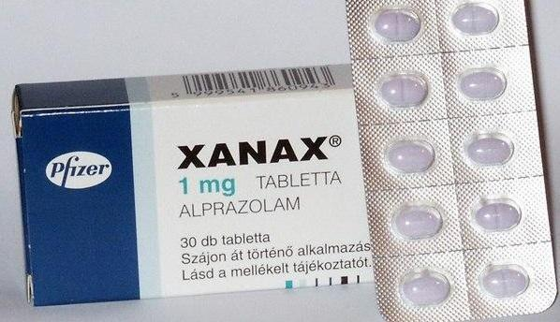
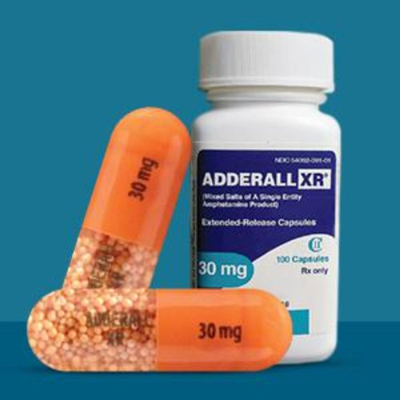
DRUG INTERACTIONS
Adderall and Xanax: Is It Safe to Use Them Together?
Medically reviewed by Alan Carter, Pharm.D. — Written by University of Illinois — Updated on July 23, 2021
Reference: healthline.com – website
NEFHA SADIKOĞLU
16030176

Slide 2
Adderall and Xanax: Is It Safe to Use Them Together?
The active ingredients in Adderall are a combination of amphetamine and dextroamphetamine salts. This drug is a stimulant medication often used to treat attention deficit hyperactivity disorder (ADHD). It can help you pay attention, stay alert, and concentrate.
Xanax contains alprazolam which is in a class of medications called benzodiazepine. It’s used to treat generalized anxiety disorder and panic disorder. Xanax can make you feel calmer, more relaxed, and even drowsy.
These drugs can have dangerous effects when taken together.

Slide 3
Dangers of Combining Adderall and Xanax
Increased Risk Of Addiction
Both Adderall and Xanax are controlled substances. Your doctor would closely monitor your use of either of these drugs. In general, using controlled substances can lead to misuse or dependence and addiction. Taking two controlled substances at the same time raises your risk of misuse or addiction from either drug.

Slide 4
Decreased effectiveness of both drugs
The use of these medications together can make both drugs less effective. Each drug may not work well to treat the condition it’s prescribed for.
Because Adderall is a stimulant, it can make you feel more focused and awake. It can decrease the effects of Xanax. For example, if you have anxiety, Adderall can make you feel more anxious.
On the other hand, Xanax works as a sedative. It reduces anxiety, stress, and excitement levels. It can also cause drowsiness. These effects can counteract the effects of Adderall. Xanax can make you sleepy and make it harder for you to concentrate.

Slide 5
There are several reasons why you may be interested in taking Xanax while you’re taking Adderall. You may feel anxious, or you may have trouble sleeping. You may also have been diagnosed with generalized anxiety disorder or panic disorder.
No matter the reason, the best thing for you to do is to talk with your doctor. Adderall interacts with many drugs. You should get your doctor’s approval before mixing it with any other drugs. These include prescription and over-the-counter medications.

