Slide 1
Stem Cells
Prof.Dr.Asuman Sunguroğlu
Ankara University Medical Faculty
Department of Medical Biology

Slide 2
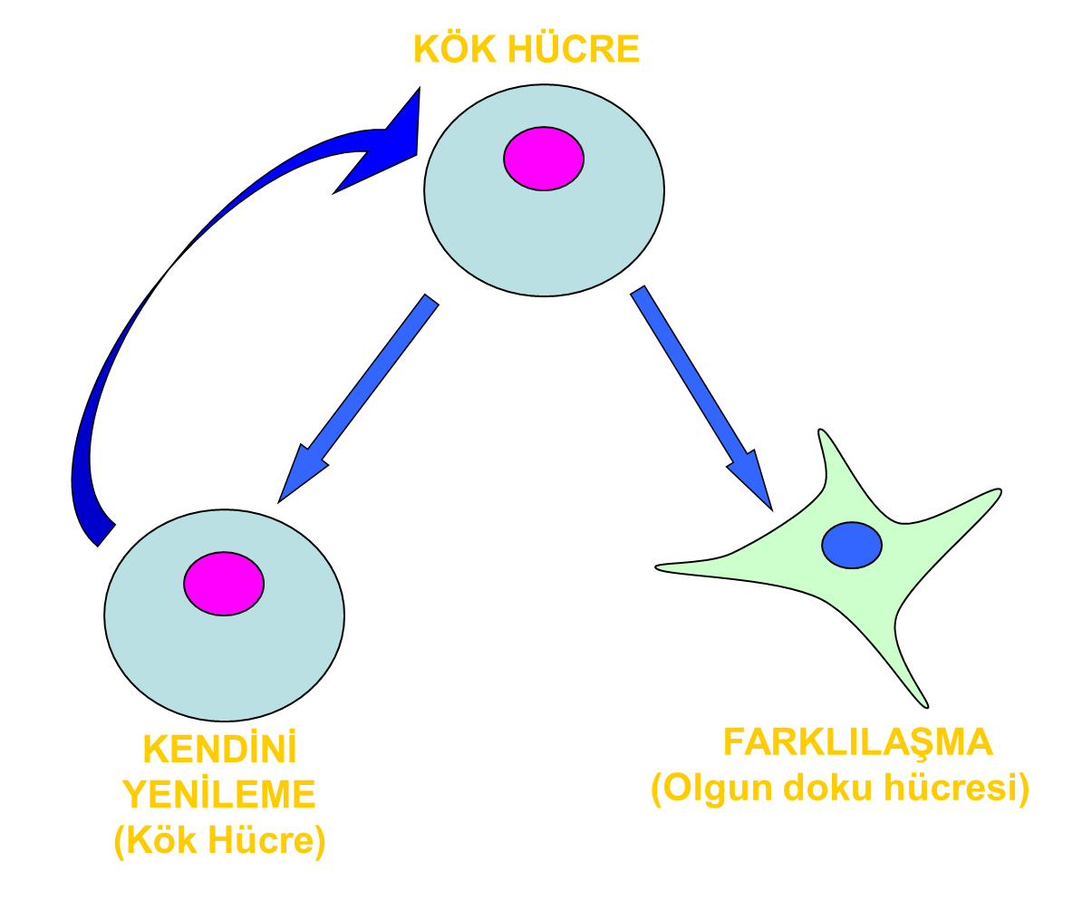
Stem cells undergo an asymmetric type of cell division. When the stem cell divides, it gives rise to two cells that are different from each other.
STEM CELL
SELF RENEWAL
DIFFERENTIATION

Slide 3
Stem Cell-History
1961-Multipotent stem cells discovered (Mc Culough)
1996- Dolly the sheep cloned (Willnut 1997)
1998-Research team from Wisconsin University isolated stem cells from IVF Blastocyts (Thomson et al)
First extraction of stem cells from human embryos
1999-First transplantation insulin producing cells from cadaver
2004- Human Embriyonal stem sells can differantiate 3 germ layer cells(Clark et al)
2006- the discovery that mature cells can be reprogrammed to become pluripotent Yamanaka et al 2007- Generation of human iPSCs (Takakashi et al)
2012- Nobel priseDiscovery and generation of iPSCs Sir jGurdon and S Yamanaka)
2014 First clinical trial with hiPSCs was initiated
2015- CRISPR CAS9 techology was applied to hESCs
Organoids from hESCs - fetal organogenesis (Takasato 2015)
2017- Chimeric pig embriyo with hiPSCs (Wu et al)
2017-iPSC derived Retinal cells transplanted in a patient with Macular degeneration (Mandal et al)
2018-Nuclear transfer stem cells used to clone monkeys (Liu 2018)
2018- CRISPR used for germline editing to genetically alter twins to prevent HIV infection (ethical)

Slide 4
3 basic characteristics of the stem cells
Stem cells have the ability to continuously divide and differentiate into various other kinds of cells of tissues and organs
Stem cells are unspecialized «Blank Cells»
Stem cells have proliferation and renewal capability (dividing and renewing themselves for long periods)
Stem cells have differentiation capacity to give rise to specialized cell types

Slide 5
Stem cells can be classified into 3 main categories based on their ability to differentiate:
Totipotent stem cells: have unlimited capacity and have the ability to form extrembriyonic membrane and tissues. After fertilization, each of the blastomers can form a complete organism
Pluripotent stem cells: are found only in early embryos, have capable of giving rise the most of the cells , but not all, tissue and organism. 5th day blastocyst inner cell mass have almost undifferantiated 100 cells. These cells give rise more than 250 specialized cell.
Multipotent stem cells: are derived from fetal tissue, cord blood and adult stem cells, their ability to differentiate is limited than pluripotent stem cells

Slide 6
Sources of stem cells
1. Embryonic stem cells
2. Fetal stem cells are isolated from the germline tissues that will make up the gonads of aborted fetuses.
3. Umbilical cord stem cells
4. Placenta derived stem cells
5. Adult stem cells

