Slide 1
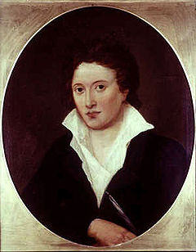
PERCY BYSSHE SHELLEY (4 August 1792 – 8 July 1822 )

Slide 2
Percy Bysshe Shelley was born in Sussex, 4 August 1792.
He was one of the major English Romantic poets and is critically regarded among the finest lyric poets in the English language.
Shelley was famous for his association with John Keats and Lord Byron.
The novelist Mary Shelley was his second wife.

Slide 3
Shelley's unconventional life and uncompromising idealism, combined with his strong disapproving voice, made him an authoritative and much-denigrated figure during his life and afterward.
Shelley never lived to see the extent of his success and influence. Some of his works were published, but they were often suppressed upon publication.
Up until his death, with approximately 50 readers as his audience, it is said he made no more than 40 pounds from his writings.

Slide 4
EDUCATION
In 1802, he entered the Syon House Academy of Brentford.
In 1804, Shelley entered Eton College, where he fared poorly, subjected to an almost daily mob torment his classmates called "Shelley-baits".
On 10 April 1810, he matriculated at University College, Oxford.
He was expelled after only six months , following his writing of a radical pamphlet , The Necessity of Atheism.

Slide 5
His verse covers a wider range of metric stanzaich forms than seen in the work of his contemporaries.
He was a master of traditional verse forms like the Spenserian stanza, the couplet, blank verse and the Dantesque terza rima.
He moved confidently from the political ballad to the classical elegy, but is best remembered for his eloquent, short lyric poetry, which often reached depths of musicality and intensity rarely matched by writers after his death.

Slide 6
He became an idol of the next three or even four generations of poets, including the important Victorian and Pre-Raphaelite poets.
He was admired by Karl Marx, George Bernard Shaw, Bertrand Russell, Isadora Duncan and Jiddu Krishnamurti ("Shelley is as sacred as the Bible.") Henry David Thoreau's civil disobedience and Mohandas Karamchand Gandhi's passive resistance were influenced and inspired by Shelley's nonviolence in protest and political action.

Slide 7
WORKS
His first publication was a Gothic novel, Zastrozzi (1810), in which he vented his atheistic worldview through the villain Zastrozzi.
In 1811, Shelley published his second Gothic novel St. Irvyne; or, The Rosicrucian and a pamphlet called The Necessity of Atheism.

Slide 8
He is most famous for such classic anthology verse works as Ozymandias, Ode to the West Wind, To a Skylar, and The Masque of Anarchy, which are among the most popular and critically acclaimed poems in the English language.
His major works, however, are long visionary poems which included Alastor, Adonaïs, The Revolt of Islam, and the unfinished work The Triumph of Life. The Cenci (1819) and Prometheus Unbound (1820) were dramatic plays in five and four acts respectively.

Slide 9
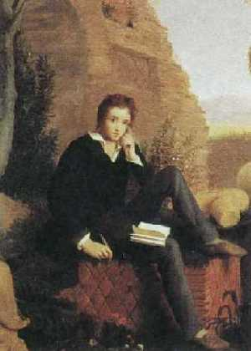
DEATH
In 1822 Shelley’s intense life was cut short by an accident.Whilst sailing near Livorno, Shelley was drowned during a storm.
His body was burnt on the beachg, then laid to rest in the English Protestant cemetery in Rome.

Slide 10
ODE TO THE WEST WIND
It is an ode written by Percy Bysshe Shelley in 1819,Italy.
It was published in 1820.
It can be divided in two parts: the first three cantos are about the qualities of the ‘Wind’ and end each with the invocation ‘Oh hear!’. The last two cantos give a relation between the ‘Wind’ and the speaker.

Slide 11
Structure
The poem consists of five cantos written in terza rima. Each canto consists of four tercets (ABA, BCB, CDC, DED) and a rhyming couplet (EE).
It is written in iambic pentameter.
The poem begins with three cantos describing the wind's effects upon earth, air, and ocean. The last two cantos are Shelley speaking directly to the wind, asking for its power, to lift him like a leaf, a cloud or a wave and make him its companion in its wanderings. He asks the wind to take his thoughts and spread them all over the world so that the youth are awoken with his ideas. The poem ends with an optimistic note which is that if winter days are here then spring is not very far.

Slide 12
O WILD West Wind, thou breath of Autumn's being
Thou from whose unseen presence the leaves dead
Are driven like ghosts from an enchanter fleeing,
Yellow, and black, and pale, and hectic red,
Pestilence-stricken multitudes! O thou
Who chariotest to their dark wintry bed
The wingèd seeds, where they lie cold and low,
Each like a corpse within its grave, until
Thine azure sister of the Spring shall blow
Her clarion o'er the dreaming earth, and fill
(Driving sweet buds like flocks to feed in air)
With living hues and odours plain and hill;
Wild Spirit, which art moving everywhere;
Destroyer and preserver; hear, O hear!

