Slide 1
AYLİN ANT 16030148 PHENELZINE-HALOPERIDOL-MEPERIDINE INTERACTION seratonın syndrome

Slide 2
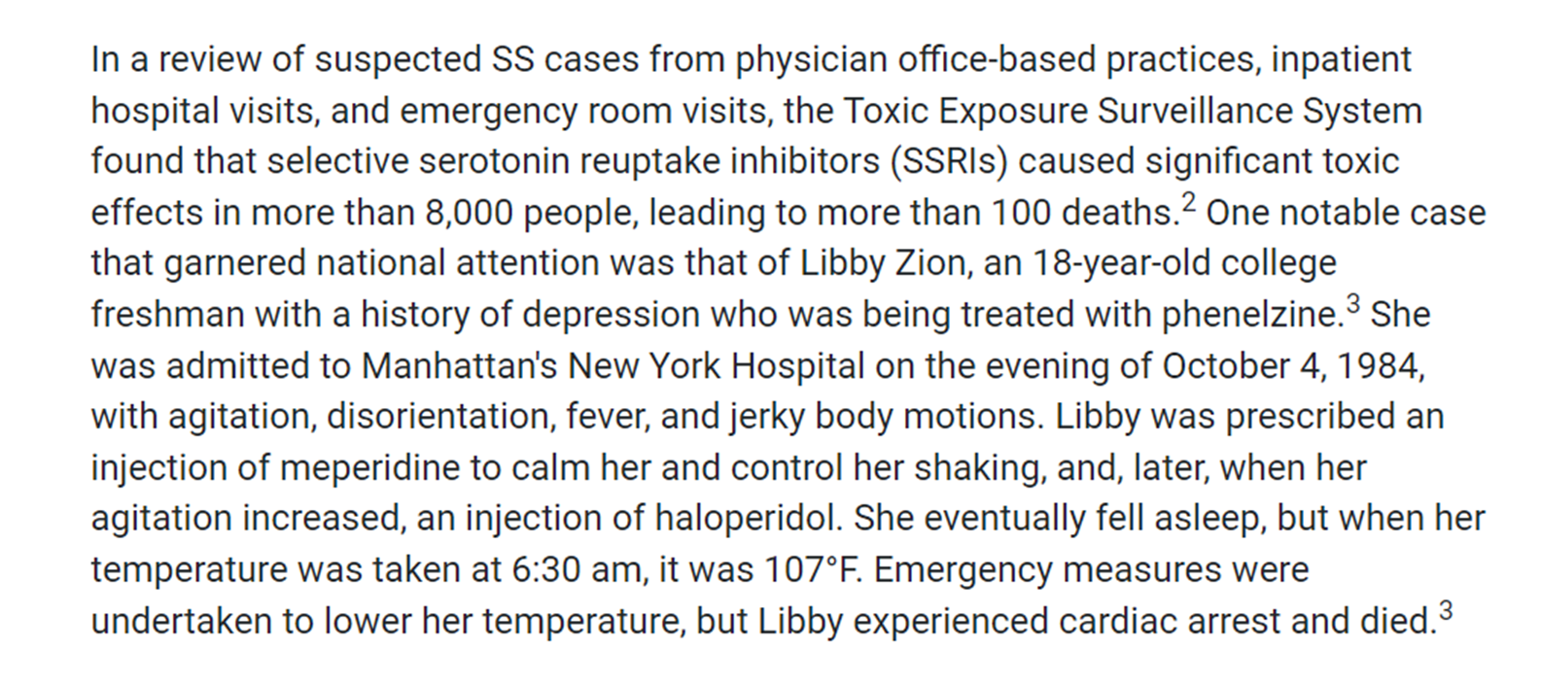

Slide 3
Phenelzine is a monoamine oxidase inhibitor (MAOI) that is used to treat symptoms of atypical depression in adults when other medicines have not been effective.
Haloperidol is an antipsychotic medicine that is used to treat schizophrenia.It is also used to control motor and speech tics in people with Tourette's syndrome.
Meperidine is an opioid medication used to treat moderate-to-severe pain.
Libby Zion died because of Serotonin Syndrome so What is it?
Serotonin syndrome is a potentially life-threatening syndrome that is precipitated by the use of serotonergic drugs and overactivation of both the peripheral and central postsynaptic 5HT-1A and, most notably, 5HT-2A receptors.
This syndrome consists of a combination of mental status changes, neuromuscular hyperactivity, and autonomic hyperactivity.
It can occur via the therapeutic use of serotonergic drugs alone, an intentional overdose of serotonergic drugs, or as a result of a complex drug interaction between two serotonergic drugs that work by different mechanisms. A multitude of drug combinations can result in serotonin syndrome.

Slide 4
DRUG INTERACTIONS:
MAJOR!! MEPERIDINE+HALOPERIDOL= CNS DEPRESSION, including respiratory distress,coma, death.
Also dizziness, drowsiness, difficulty concentrating, and impairment in judgment, reaction speed and motor coordination(don’t drive).
MAJOR!! MEPERIDINE+ PHENELZINE =SEROTONIN SYNDROME (symptoms such as confusion, hallucination, seizure, extreme changes in blood pressure, increased heart rate, fever, excessive sweating, shivering or shaking, blurred vision, muscle spasm or stiffness, tremor, incoordination, stomach cramp, nausea, vomiting, and diarrhea. Severe cases may result in coma and even death)
Also increase the risk of respiratory depression, low blood pressure.
In general, you should wait at least 14 days after stopping phenelzine before you start treatment with meperidine.
MODERATE! HALOPERIDOL+ PHENELZINE= INCREASE SIDE EFFECTS
Dizziness, drowsiness, confusion, and difficulty concentrating.
Especially the elderly, may also experience impairment in thinking, judgment, and motor coordination.
You should avoid or limit the use of alcohol while being treated with these medications. Also avoid activities requiring mental alertness such as driving or operating hazardous machinery.

Slide 5
REFERENCES:
https://www.uspharmacist.com/article/drug-induced-serotonin-syndrome
https://www.drugs.com/mtm/phenelzine.html
https://www.drugs.com/mtm/meperidine.html
https://www.drugs.com/mtm/haloperidol.html
https://www.ncbi.nlm.nih.gov/pmc/articles/PMC3865832/
https://www.drugs.com/interactions-check.php?drug_list=1839-0,1230-0,1557-0

