Slide 1
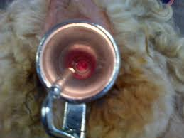
Artificial Insemination
Semen deposition
Cervical insemination:
need basic instruments (a catheter and a speculum)
suitable for fresh, chilled and
frozen semen
success 50-70%

Slide 2
Artificial Insemination
Semen deposition
Trans-cervical Intrauterin insemination:
need complicated instruments (catheter, speculum, forceps, and an experienced technician)
suitable for fresh, chilled and frozen semen
success 70-80%

Slide 3
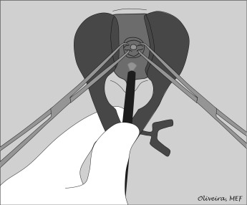
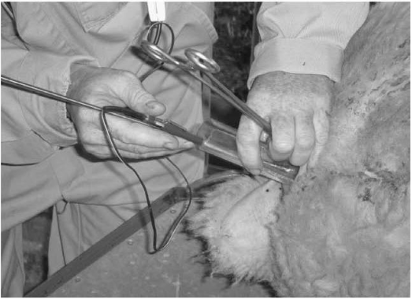
Trans-cervial Intrauterin Insemination

Slide 4
Artificial Insemination
Semen deposition
Laparoscopic-Intrauterin insemination:
need more complicated instruments (anaesthesia-analgesia, laparoscopy equipment, and an experienced technician)
suitable for fresh, chilled and frozen semen
success >80%

Slide 5
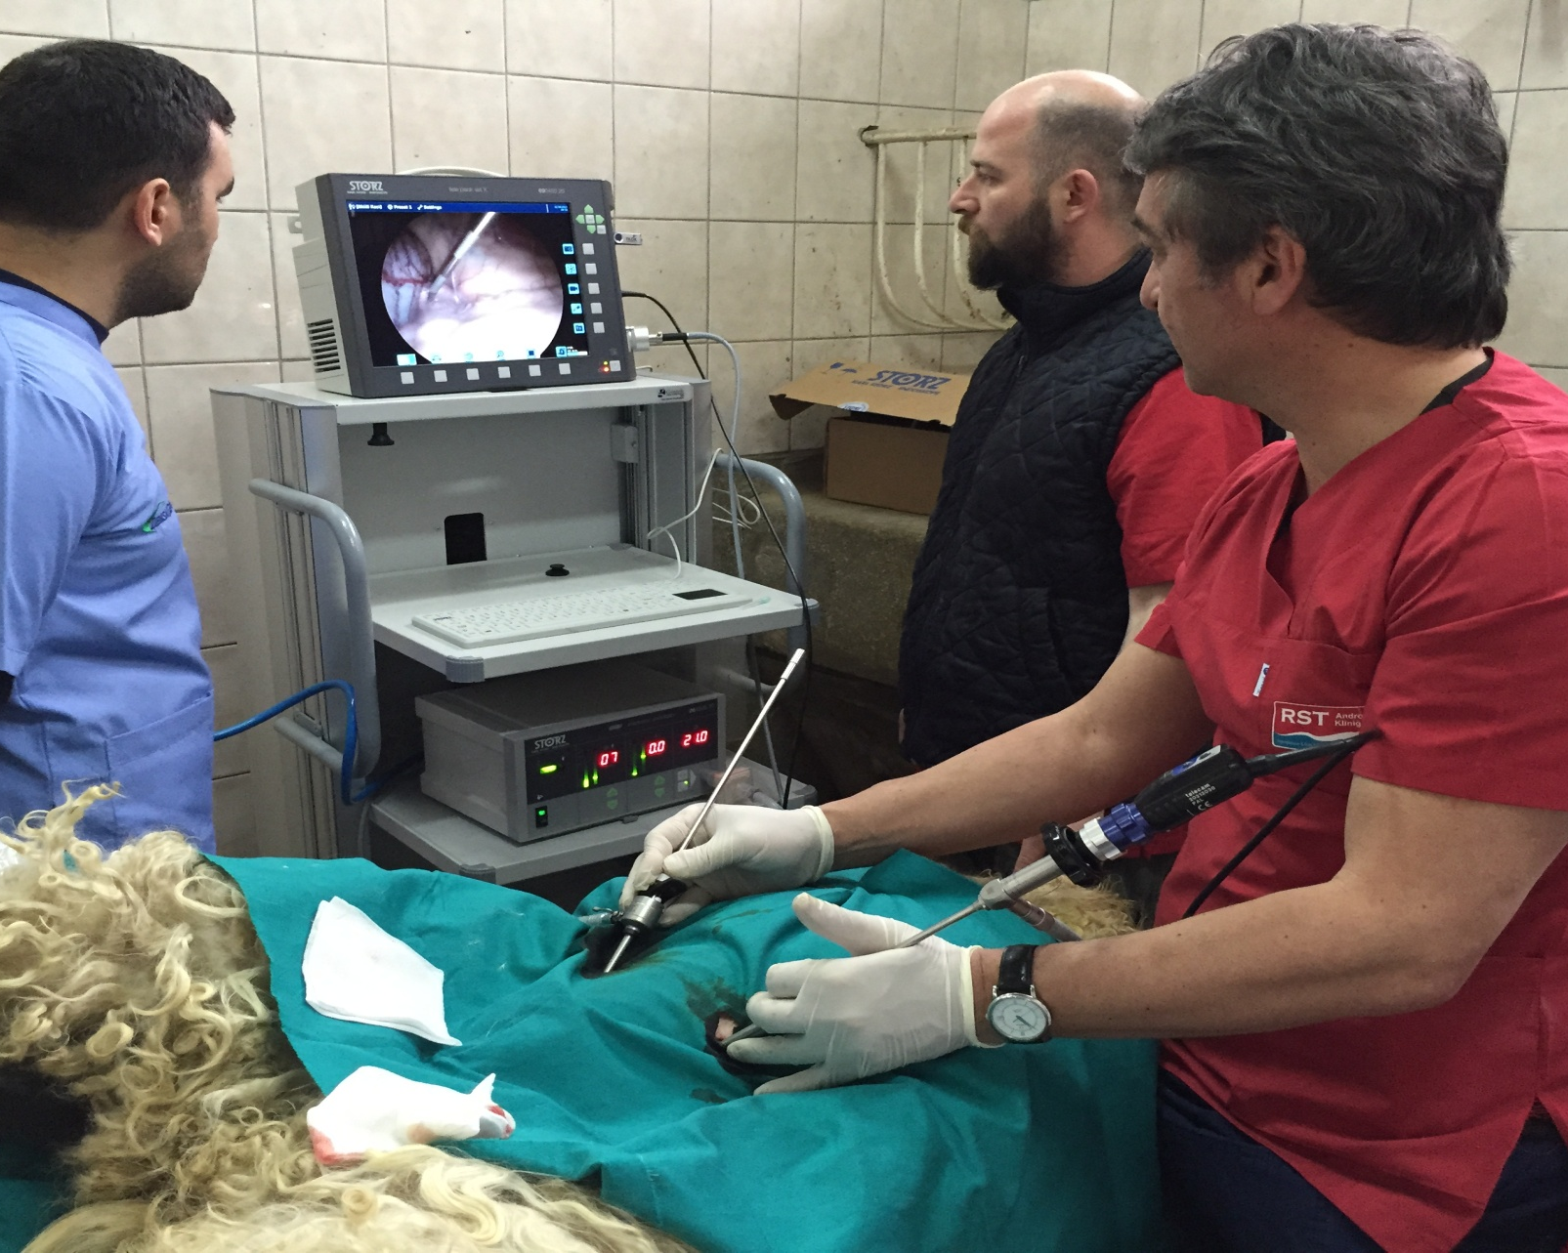
Laparoscopic-Intrauterin insemination

Slide 6
Appropriate Insemination Time
Sheep
Estrus duration | 30-36 hours
Ovulation time | 24 to 30 hours after onset of estrus
Sperm fertile viability | 30-48 hours
Ovum fertile viability | 16-24 hours
Appropriate insemination time | 16 to 24 hours after onset of estrus
Insemination method | Speculum method
Place of semen deposition | Cervix Uteri
Insemination method | Laparoscopic method
Place of semen deposition | Corpus Uteri

Slide 7
Appropriate Insemination Time
Goat
Estrus duration | 36-48 hours
Ovulation time | 30 to 36 hours after onset of estrus
Sperm fertile viability | 30-48 hours
Ovum fertile viability | 16-24 hours
Appropriate insemination time | 16 to 24 hours after onset of estrus
Insemination method | Speculum method
Place of semen deposition | Cervix Uteri
Insemination method | Laparoscopic method
Place of semen deposition | Corpus Uteri

Slide 8
Hints to attent
The more damaged sperm needs the deeper deposition.
The more damaged sperm needs to be inseminated at the sooner time to ovulation

