Slide 1
NUCLEAR CHEMISTRY
The discovery of radioactive transformations began with the discovery of X-rays by Wilhelm Roentgen in 1895. In 1898, Marie Curie observed the same abundance in thorium and realized that this was a feature of atomic structure. Marie Curie then derives the word radioactivity to describe the behavior of these two elements. Rutherford continued experimenting in 1898, finding that there were two types of radiation emitted by uranium. These radiations were alpha and beta rays. Two years after this discovery, Villard discovered a third radiation. This radiation is called gamma ray.

Slide 2
The electronic structures of atoms determine their chemical behavior and nucleus has no role in these behaviors. Nucleus regulates the atomic electron structure because of the load it carries.
Known basic particles of an atom are electron, proton and neutron.
Within the nucleus are proton and neutron and the whole mass of the atom is like the nucleus. Because the mass of electrons is so small that it can be considered as if there are no masses.

Slide 3
Atom number = proton number = electron number
Atomic mass = proton + neutron
As the number of protons in stable nuclei increases, the number of neutrons increases more. The area where the stable nucleus are located in the graph is called the stability zone. Proton equals to neutron state of the stable nucleus continues until Ca, but deviation is observed. Nucleus that do not fall on the stability circle are radioactive. In the majority of naturally stable nucleus, there are a double number of protons and a double number of neutrons. Only 4 of them contain a single number of protons and a single number of neutrons H, Li, B and N. There are up to 10 stable isotopes of nucleus with double atom number, while each single atom numbered nucleus has at most two stable isotopes.

Slide 4
THEORIES ON STRUCTURES OF NUCLEUS
Liquid drop model (Bohr's model): It suggests that protons and neutrons are randomly stacked in the nucleus. Indeed, the fact that the nucleus densities are too high supports this theory.
Layer model (model of Mayer): This model suggests that the particles in nucleus are in the state of being set to the same energy levels as the electrons.

Slide 5
KIND OF RADIOACTIVE BEAMS
Radioactivity means that the nucleus break down and emit particles. This nucleus is called as radioactive nucleus and the emitted beam is called radiation. The reason why the nucleus make this beam is the desire to turn themselves into a stable nucleus. Stable cores do not radiate like this. Of the 92 elements present today, nearly 60 out of 300 isotopes are not stable. The nucleus between atomic numbers 83 and 92 are all undecided. These unstable nucleus are transformed into nucleus which are stable with their proper disruption. They make beams during this conversion.

Slide 6
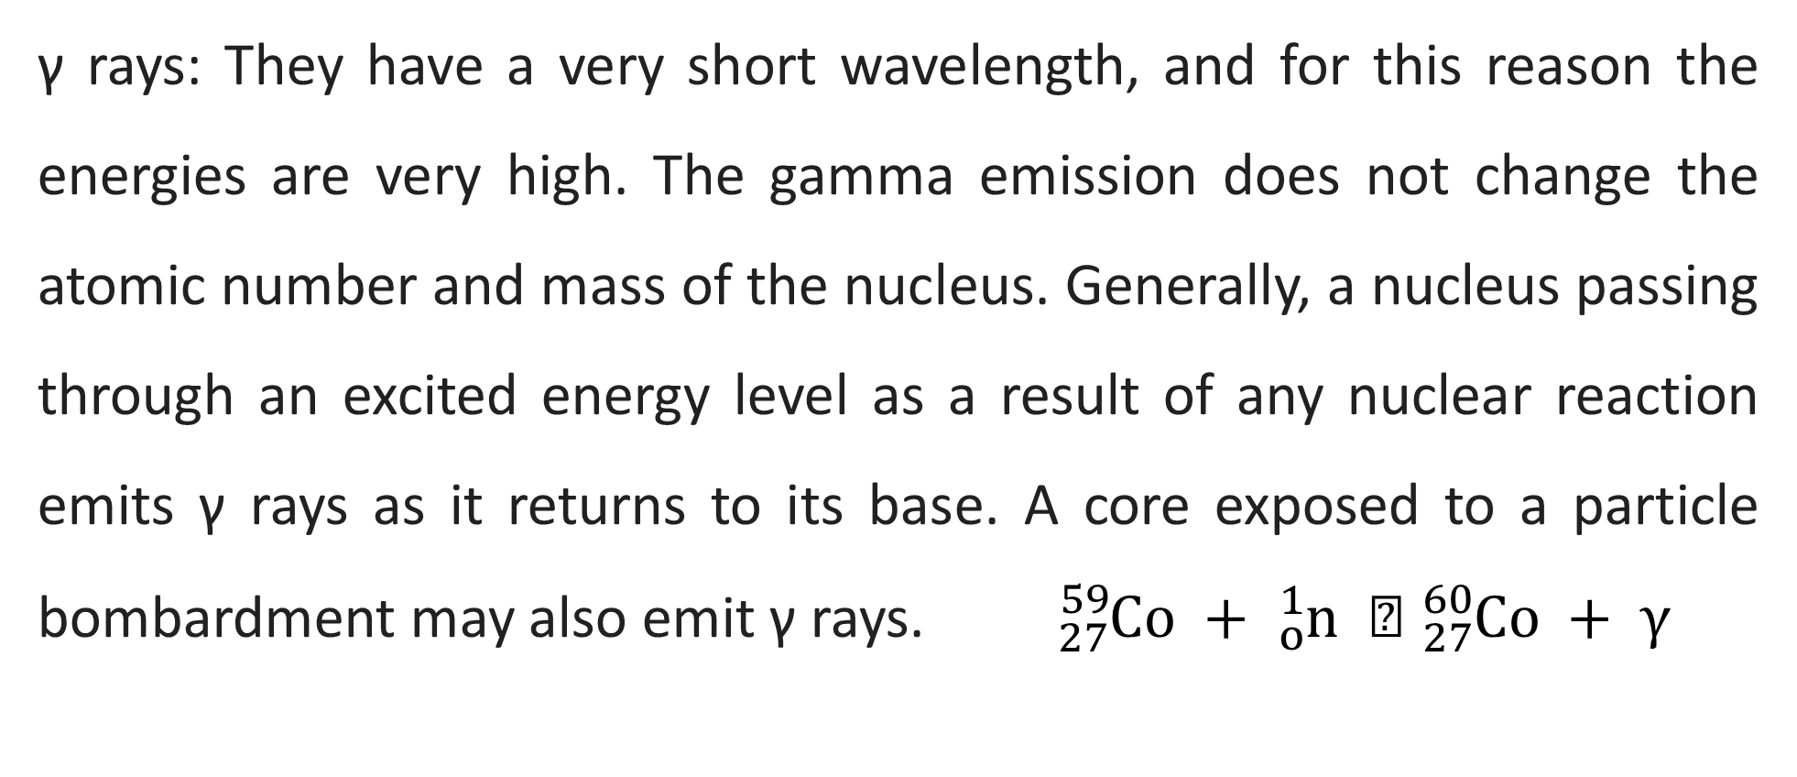
Radiation of radioactive atoms is not about electrons but about the structure of the nucleus. On the basis of a radioactive core; It makes γ (gamma), β - (beta), β + (positron), α (alpha) and n (neutron)
γ rays: They have a very short wavelength, and for this reason the energies are very high. The gamma emission does not change the atomic number and mass of the nucleus. Generally, a nucleus passing through an excited energy level as a result of any nuclear reaction emits γ rays as it returns to its base. A core exposed to a particle bombardment may also emit γ rays. ${}_{27}^{ 59}{Co + }{}_{o}^{1}{n  }{}_{27}^{60}{Co + }γ$

Slide 7
β (beta) rays: This is an electron beam ${}_{–1}^{0}{e or β^{–}}$At the end of this radiation, the mass of the atom does not change, but the atomic number is an increment. If it is bombarded with these rays, atomic mass does not change but atomic number is reduced.
β-beams ocuurs during the neutron to proton transformation in nucleus. 1 neutron, 1 electron (no mass) and 1 antielectron neutrino (n_{e}) that are transformed into 1 proton are launched
n → p + e– + n_{e}
$${}_{12}^{ 27}{Mg → }{}_{13}^{27}{Al + }{}_{–1}^{0}e$$

Slide 8
In neutron radiation; neutron particles are emitted ${}_{0}^{1}{n }$ As a result, the mass of the atom is reduced, the atomic number does not change. By contrast, atom bombardment with neutron particles increases atomic mass but atomic number does not change again.
$${}_{92}^{ 238}{U + {}_{0}^{1}{n } }{}_{92}^{239}{U }$$
In the positron beams, + charged electrons are emitted ( ${}_{1}^{0}{e or β^{+})}$. The positron charge is the inverse of the charge of the beta beams.

Slide 9
At the end of this radiation , atomic mass does not change, atomic number is reduced. On the other hand, the atomic mass remains unchanged as a consequence of the positron bombardment, but the atomic number increases.
$${}_{12}^{ 23}{Mg }{}_{11}^{23}{Na+ }{}_{1}^{0}e$$
$$$$
The transformation of the protons into neutrons leads to the formation of the positron, and therefore the atomic number is reduced when there is no change in the atomic mass
p → n + $β^{+}$ + n_{e}

Slide 10
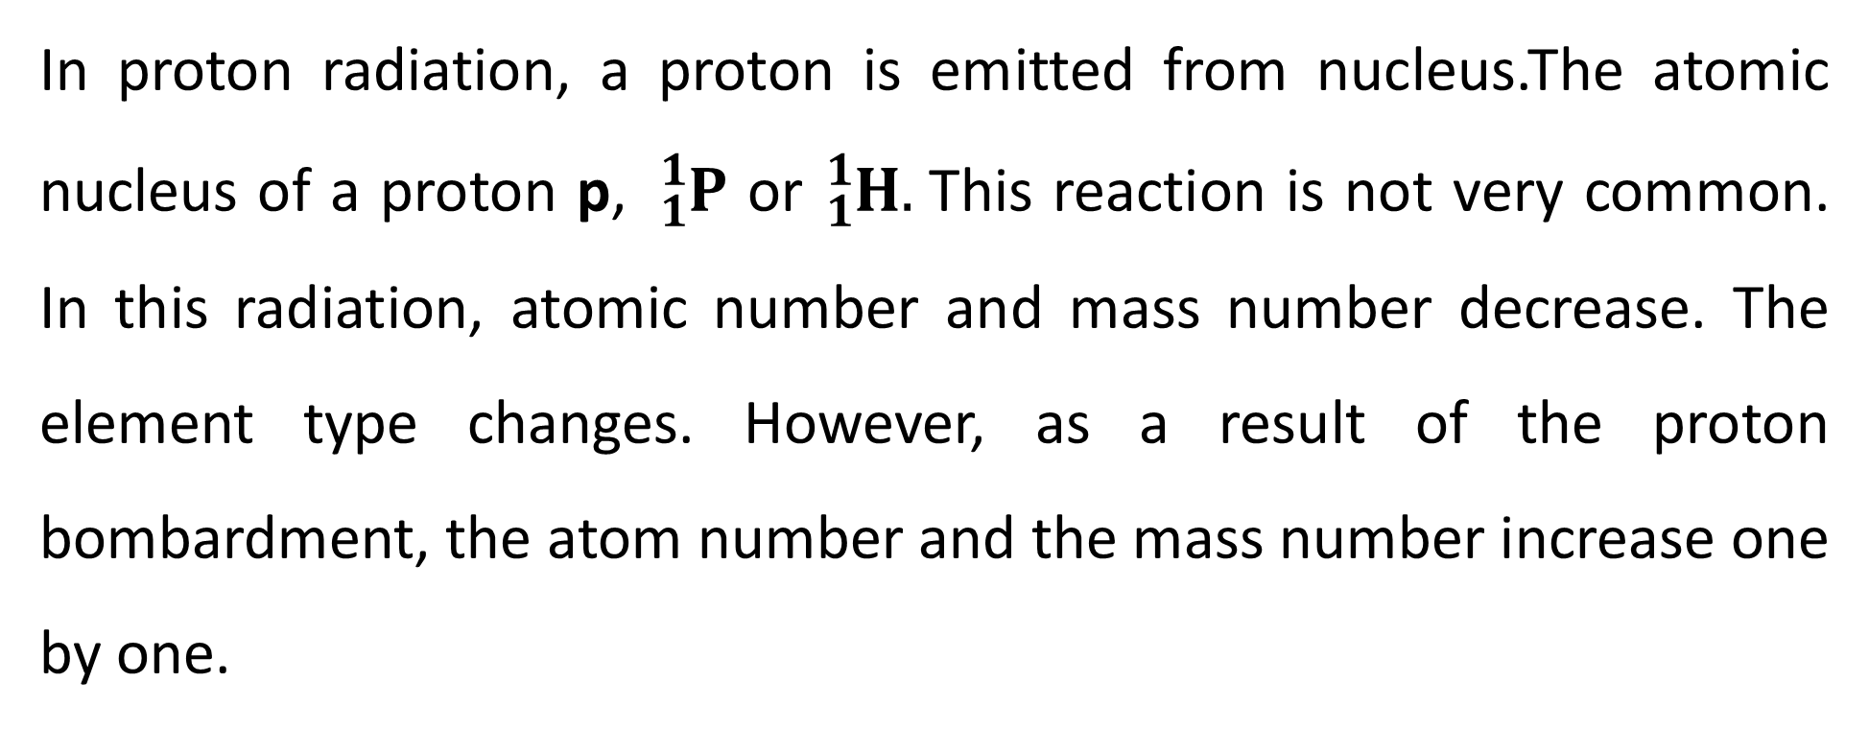
In proton radiation, a proton is emitted from nucleus.The atomic nucleus of a proton p, ${}_{ 1}^{1}P$ or ${}_{1}^{1}H.$This reaction is not very common. In this radiation, atomic number and mass number decrease. The element type changes. However, as a result of the proton bombardment, the atom number and the mass number increase one by one.
$${}_{30}^{ 57}{Zn }{}_{29}^{56}{Cu + }{}_{1}^{1}P$$
$$$$

Slide 11
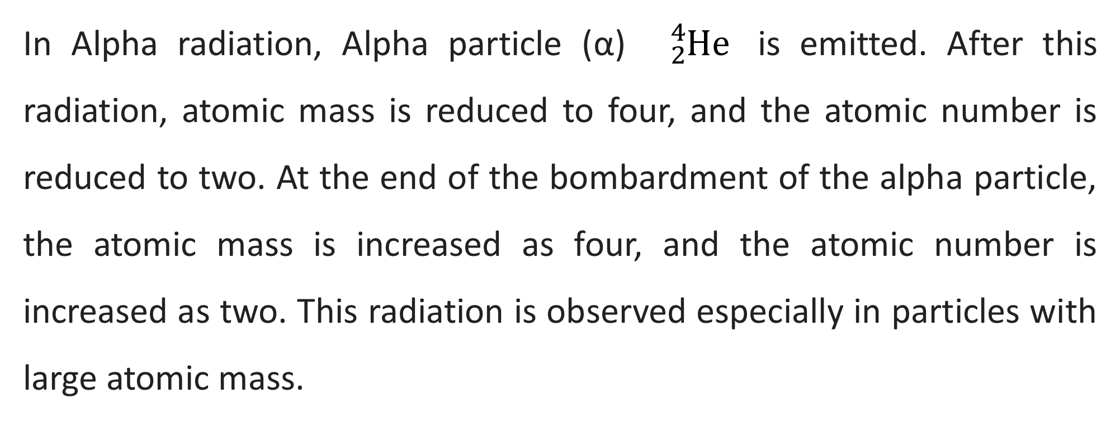
In Alpha radiation, Alpha particle (α) ${}_{ 2}^{4}{He}$ is emitted. After this radiation, atomic mass is reduced to four, and the atomic number is reduced to two. At the end of the bombardment of the alpha particle, the atomic mass is increased as four, and the atomic number is increased as two. This radiation is observed especially in particles with large atomic mass.
$${}_{92}^{ 238}{U }{}_{90}^{234}{Th + }{}_{2}^{4}{He}$$
$$$$

