Slide 1
COM 412
Information Technology and Security Governance
Week 6
Agile-Scrum Project Management

Slide 2
Agile-Scrum Project Management
* SCRUM is an
Agile Project Management Methodology
* Characteristics of an ‘Agile’ methodology are:
ADAPTIVE, not PREDICTIVE
LIGHTWEIGHT, not HEAVYWEIGHT
DESCRIPTIVE, not PRESCRIPTIVE
Notes:
Classical methods have many disadvantages:
huge effort during the planning phase
poor requirements conversion in a rapid changing environment
treatment of staff as a factor of production
Now we have new methods: Agile Methodology
Agile proponents believe that:
Current software development processes are too heavyweight
Too many things are done that are not directly related to software product being produced
Current software development is too rigid
Difficulty with incomplete or changing requirements
Short development cycles (Internet applications)
More active customer involvement needed
Agile methods are considered that they are:
Lightweight
People-based rather than Plan-based

Slide 3
Agile Methods
Agile methods:
Scrum
Extreme Programming
Adaptive Software Development (ASD)
Dynamic System Development Method (DSDM)
…
Agile Alliance (www.agilealliance.org)
A non-profit organization promotes agile development
Notes:
No single agile method
There are several agile methods as seen on the slide.

Slide 4
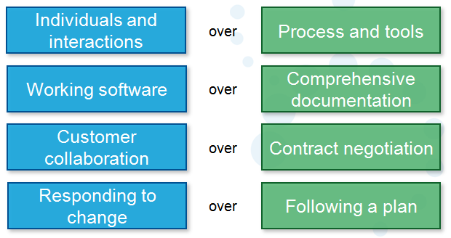
The Agile Manifesto–a statement of values
Notes:
No single definition for agile
Agile Manifesto closest to a definition
It has a set of principles
And developed by Agile Alliance

Slide 5
* What is SCRUM ?
- Scrum is an agile methodology that allows us to focus on delivering the highest business value in the shortest time.
- It allows us to rapidly and repeatedly inspect actual working software (every two weeks to one month).
- The business sets the priorities. Teams self-organize to determine the best way to deliver the highest priority features.
- Every two weeks to a month anyone can see real working software and decide to release it as is or continue to enhance it for another sprint.
Notes:
So what is Scrum?

Slide 6
* Scrum has been used for :
Commercial software
In-house development
Contract development
Fixed-price projects
Financial applications
ISO 9001-certified applications
Embedded systems
24x7 systems with 99.999% uptime requirements
Video game development
Life-critical systems
Satellite-control software
Websites
Mobile phones
Network switching applications
Some of the largest applications in use
Notes:
Here are some examples for what scrum has been used.

Slide 7
* Scrum has been used by :
Microsoft
Yahoo
Google
Electronic Arts
IBM
Lockheed Martin
Philips
Siemens
Nokia
Capital One
BBC
Intuit
Nielsen Media
First American Real Estate
BMC Software
Ipswitch
John Deere
Lexis Nexis
Sabre
Salesforce.com
Time Warner
Turner Broadcasting
Oce
Notes:
Here are some organizations and firms that has used scrum.

Slide 8
* Characteristics of SCRUM :
Product progresses in a series of 1-4 week “sprints”
Self-organizing teams
- Requirements are captured as items in a list of “product backlog”
- No specific engineering practices prescribed
- Uses generative rules to create an agile environment for delivering projects
- One of the “agile methodologies”
Notes:
Scrum projects make progress in a series of “sprints”.
Product is designed, coded, and tested during the sprint.

Slide 9
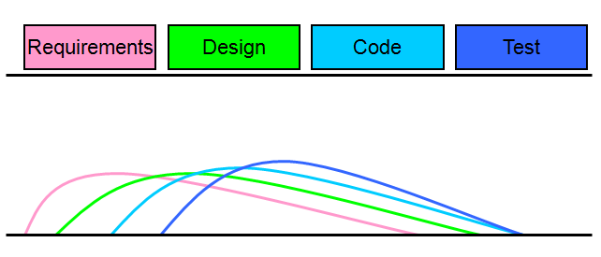
Sequential vs. overlapping development
Notes:
Rather than doing all of one thing at a time...
...Scrum teams do a little of everything all the time.

Slide 10
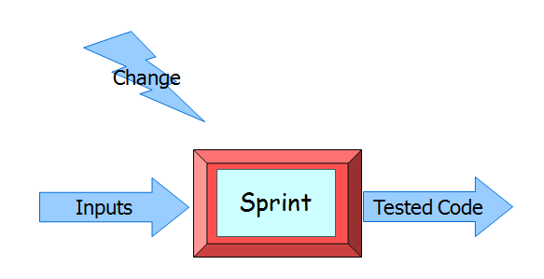
No changes during the sprint
Notes:
No changes should be done during the sprint.
So; plan sprint durations around how long you can commit to keeping change out of the sprint.

Slide 11
Scrum framework
Notes:
Here is the framework of scrum. It will be explained as three topics.

Slide 12
Scrum framework
Notes:
The first topic of the scrum framework is the ‘Roles’

Slide 13
Product owner :
Defines the features of the product
Decides on release date and content
Responsible for the profitability of the product
Prioritizes features according to market value
Adjusts features and priority every iteration, as needed
Accepts or rejects work results
Notes:
Product owner is the first role.

Slide 14
The ScrumMaster :
Represents management to the project
Responsible for enacting Scrum values and practices
Removes impediments
Ensures that the team is fully functional and productive
Enables close cooperation across all roles and functions
Shields the team from external interferences
Notes:
ScrumMaster is the second role.

Slide 15
The Team :
Is all the people who will committed to the delivery of the backlogs
- Is staffed by PMs, Developers, Testers, Support – i.e. ALL the typical project staff
Notes:
Finally the third, scrum team.

Slide 16
The Team :
Typically 5-9 people
Cross-functional: Programmers, testers, user experience designers, etc.
Members should be full-time: May be exceptions (e.g., database administrator)
Teams are self-organizing
Membership should change only between sprints

Slide 17
Scrum framework
Notes:
The second topic of the scrum framework is the ‘Ceremonie’

Slide 18
Sprint Planning Meeting
Product Owner
Scrum Team
Customers
Management
Product Backlog
Sprint Planning
Meeting
Team Capabilities
Sprint Goal
Business Conditions
Technology
Sprint Backlog
Current Product
Notes:
First, sprint planning meeting.
It contains two parts:
In the 1st Part:
Product Backlog is created.
the Sprint Goal is determined.
Participants are Product Owner, Scrum Master, Scrum Team
In the 2nd Part:
Participants are Scrum Master, Scrum Team
Sprint Backlog is created.
A special form of Sprint Planning Meeting is called Pre-Project/Kickoff Meeting.
It is the meeting before the begin of the project.

Slide 19
* Daily Scrum :
Parameters
Daily
15-minutes
Stand-up
Not for problem solving
Whole world is invited
Only team members, ScrumMaster, product owner, can talk
Helps avoid other unnecessary meetings
Notes:
Again, SPRINT is;
A month-long iteration, during which is incremented a product functionality.
No outside influence can interfere with the Scrum team during the Sprint.
Each Sprint begins with the Daily Scrum Meeting, it is the second type of ceremonie.
DAILY SCRUM:
Is NOT a problem solving session
Is NOT a way to collect information about WHO is behind the schedule
Is a meeting in which team members make commitments to each other and to the Scrum Master
Is a good way for a Scrum Master to track the progress of the Team

Slide 20
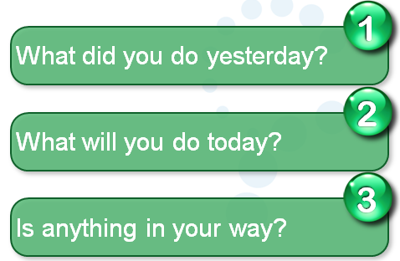
* Daily Scrum :
Notes:
In Daily scrum everyone answers 3 questions:
What did you do yesterday
What will you do today?
What obstacles are in your way?

Slide 21
* Sprint Review Meeting :
- Team presents what it accomplished during the sprint
- Typically takes the form of a demo of new features or underlying architecture
- Informal
2-hour prep time rule, no slides
- Participants
Customers
Management
Product Owner
Other engineers
Notes:
The third, Sprint Review Meeting

Slide 22
* Sprint Retrospective Meeting :
- Periodically take a look at what is and is not working
- Typically 15–30 minutes
- Done after every sprint
- Whole team participates
ScrumMaster
Product owner
Team
Possibly customers and others
Notes:
The fourth one is Sprint Retrospective Meeting
It deals with past events or situations.

Slide 23
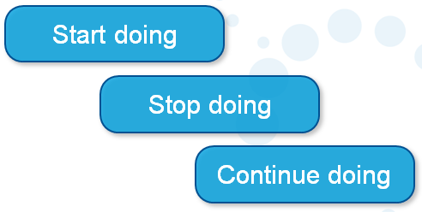
* Sprint Retrospective Meeting :
Notes:
In Sprint Retrospective Meeting whole team gathers and discusses what they’d like to:
Start,
Stop, and
Continue

Slide 24
Scrum framework
Notes:
The third and the last topic of the scrum framework is the ‘Artifacts’

Slide 25
Product Backlog :
- The requirements
- A list of all desired work on the project
- Ideally expressed such that each item has value to the users or customers of the product
- Prioritized by the product owner
- Reprioritized at the start of each sprint
Notes:
Product Backlog contains requirements for a system.
It is managed and owned by a Product Owner.
It is in the form of a spreadsheet (typically).
Usually it is created during the Sprint Planning Meeting.

Slide 26
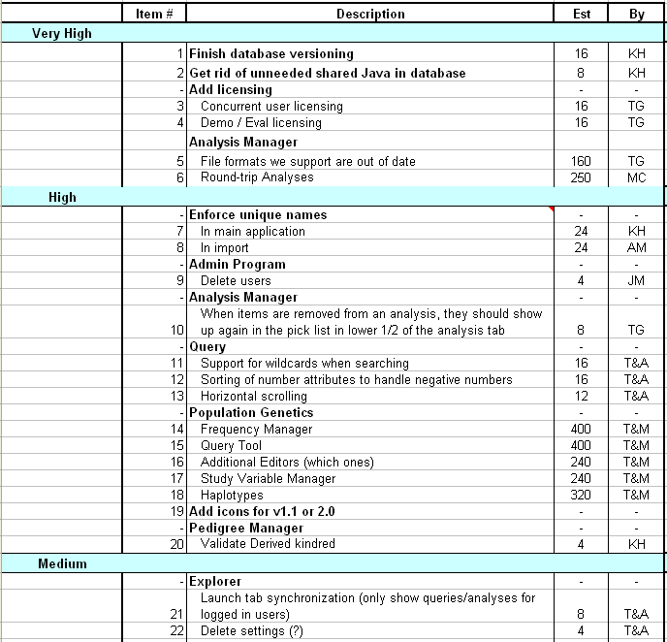
Product Backlog :
Notes:
Here is an example of product backlog.

Slide 27
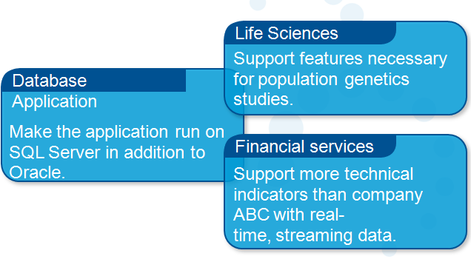
From Sprint Goal to Sprint Backlog :
Sprint Goal: A short statement of what the work will be focused on during the sprint
Notes:
Now sprint backlog.
Scrum team takes the Sprint Goal and decides what tasks are necessary.
Sprint Goal is a short statement of what the work will be focused on during the sprint.
Team self-organizes around how they’ll meet the Sprint Goal, Manager doesn’t assign tasks to individuals.
Managers don’t make decisions for the team.
Finally Sprint Backlog is created.

Slide 28
Sprint Backlog during the Sprint :
- Changes
Team adds new tasks whenever they need to in order to meet the Sprint Goal
Team can remove unnecessary tasks
But: Sprint Backlog can only be updated by the team
- Estimates are updated whenever there’s new information
Notes:
Sprint backlog changes during the sprint.

Slide 29
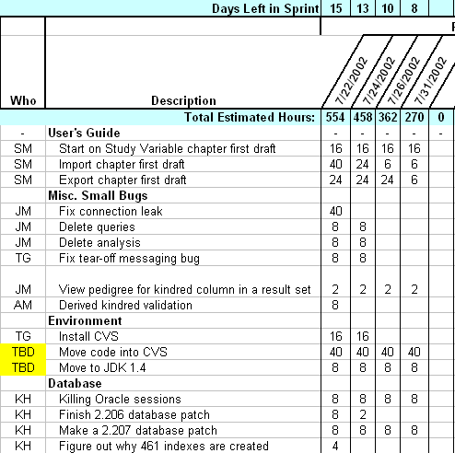
Sprint Backlog :
Notes:
A subset of Product Backlog Items, which define the work for a Sprint.
Is created ONLY by Team members.
Each Item has it’s own status.
Should be updated every day.
No more than 300 tasks in the list.
If a task requires more than 16 hours, it should be broken down.
Team can add or subtract items from the list. Product Owner is not allowed to do it.

Slide 30
Sprint Burn down Chart :
Notes:
The other artifact, Sprint Burn down Chart:
Depicts the total Sprint Backlog hours remaining per day
Shows the estimated amount of time to release
Ideally should burn down to zero to the end of the Sprint
Actually is not a straight line

Slide 31
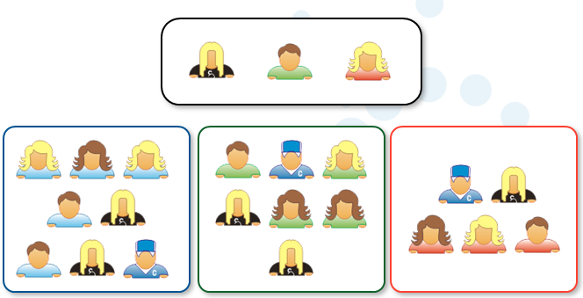
Scalability of Scrum :
Notes:
Typical individual team is 6-10 people,
Scalability comes from teams of teams
Factors in scaling are:
Type of application
Team size
Team dispersion
Project duration
Scrum has been used on multiple 500+ person projects
There is a term "Scrum of Scrums" or what called "Meta-Scrum“

Slide 32
* A model of SCRUM :
Notes:
Eventually we see here how scrum works.

Slide 33
* Pros/Cons
Advantages
Completely developed and tested features in short iterations
Simplicity of the process
Increasing productivity
Self-organizing
Each team member carries a lot of responsibility
Improved communication
Drawbacks
“Undisciplined hacking” (no written documentation)
Violation of responsibility
Notes:
What are the advantages and drawbacks of scrum?

