Slide 1
COM 412
Information Technology and Security Governance
Week 7
IT Portfolio Management

Slide 2
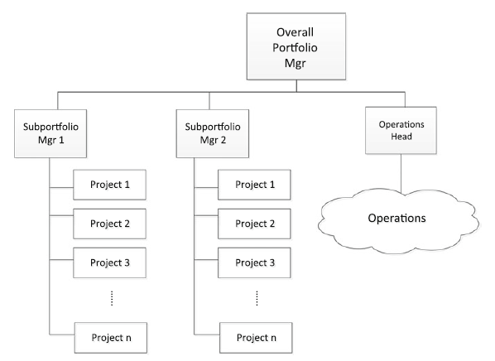
IT portfolio
* Includes:
- a collection of projects
- and IT operations
Maybe the CIO

Slide 3
IT portfolio
* Sub portfolios and operations require these resources:
• Human resources
• Tools and applications (may be limited due to licensing restrictions)
• Hardware (servers, network bandwidth, storage)
• Funding

Slide 4
IT portfolio
* Questions that need to be answered by the portfolio manager:
• How do I assign resources across the different components in an optimized manner?
• How do I prioritize?
• How do I measure the different components’ performance?
• How should performance be reported?
• How do I manage all these?

Slide 5
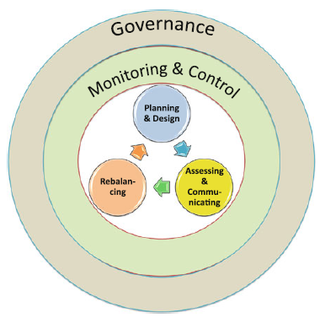
IT portfolio
* IT Portfolio management vs. IT Project Management
• Portfolio management → continuos
• Project management → distinct start and end
Portfolio management
lifecycle

Slide 6
IT portfolio
* Planning and design phase
• the first step is the creation of a portfolio(s) and identifying their components
• these must be identified:
- Portfolio name and description
- Portfolio Manager
- Components (sub portfolios, projects, and operations)
-- Component Name
-- Component Manager
-- Scope
-- Resources allocated
-- Tools and assets allocated
-- Estimate Duration

Slide 7
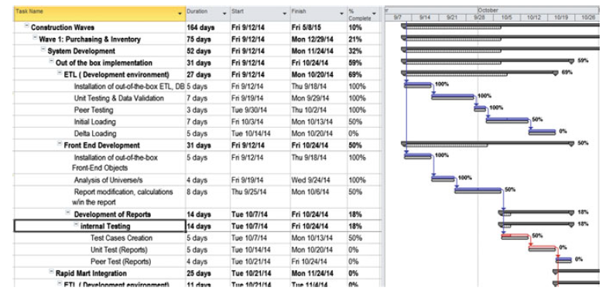
IT portfolio
* Planning and design phase
• Each portfolio component is planned accordingly, mapping their dependencies (if any)
• This may be done using a Gantt chart

Slide 8
IT portfolio
* Portfolio assessment and communicating phase
• Portfolios need to be measured in accordance with some metrics (to ascertain that they are doing well or not)
• these can be:
- % completion
- SPI (indicating schedule delay or advancement)
- CPI (indicating cost overrun or delay)
- Financial indicators
- Tactical indicators:
This tactical indicator may not make much sense until
the project goes live
Can be used after the project goes live, as part of turnover to operations

Slide 9
IT portfolio
* Portfolio assessment and communicating phase
• In communicating results, it is important to identify:
- Stakeholder
- Influence/Involvement of the Stakeholder on the project
- Regularity in communicating results
- Mode of communication

Slide 10
IT portfolio
* Portfolio rebalancing phase
• Conditions change so portfolios change
• Rebalancing of portfolios should be a part of the normal procedure for management
• Changes on conditions maybe:
Changing business strategy of the company
Reorganization within the company
Changing availability of Portfolio Assets

Slide 11
IT portfolio
* Portfolio rebalancing phase
• Portfolio balancing is an optimization of:
- time,
- funding,
- go-live,
- resource availability,
- and resource competencies.
• it is generally complex and requires several iterations until optimality is obtained

Slide 12
IT portfolio
* Portfolio rebalancing phase
• Rebalancing is needed in regular intervals to ensure:
- Portfolio components stay relevant to the company’s business strategy and objectives
- Revised timelines as required by management
- Company organization
- Resource availability
- Funding reallocation

Slide 13
IT portfolio
* Portfolio governance phase
• Portfolio governance refers to all policies and procedures to govern the portfolio and its components
• a higher level than projects and operations
• Projects and operations are guided by the portfolio governance rules
• Aside from general guidelines, some guidelines would be specific for the portfolio

Slide 14
IT portfolio
* Portfolio monitoring and control phase
• the portfolio manager must ensure that the portfolio is:
- Aligned with overall strategy, structure, and objectives of the company
- Has sufficient resources and other assets assigned to each component
- Being undertaken on time
- Being undertaken within budget
- Delivering or will eventually be able to deliver its intended benefits

Slide 15
IT portfolio
* Portfolio monitoring and control phase
• the portfolio manager must also ensure that:
- requests from the PM or Operations manager are being evaluated and approved/rejected on time
- these requests maybe:
-- Request for assets
-- Request for additional funding
-- Change Requests
-- Changes in scope

Slide 16
IT portfolio
* Portfolio monitoring and control phase
• the portfolio manager must also ensure that:
- there is no issue which cannot be handled by the assigned PM and his/her current HR assets
• In case the issue is beyond the PM’s capability, then the portfolio manager needs to step in and facilitate resolution

Slide 17
IT portfolio
* Portfolio monitoring and control phase
• The idea of monitoring and control is:
- to ensure that the different portfolio components are running smoothly
- if not, be able to, detect the issue, and address the root cause of the issue
• includes internal communication between the Portfolio Manager and his Project Managers and Operations Head

