Slide 1
EME 201 Materials Science
Material Classes

Slide 2
Polymers
Polymers are generally organic substances prepared using a process known as polymerization.
Polymeric materials contain rubber type of elastomers and many types of adhesives.
Most of the polymeric materials have very good electrical resistivity.
Polymeric materials can also provide good thermal insulation at the same time.
Although having lower strength, the polymeric materials have a very good strength / weight ratio.
These materials are usually not suitable for use at high temperatures.
On the other hand, many polymers are very resistant to corrosive chemicals.

Slide 3
Polymers
The polymeric materias have thousands of commercial applications, which range from bulletproof vests, compact discs (CDs), ropes and liquid crystal displays (LCDs) to clothes and coffee cups.
The thermoplastic type of polymeric materials, where the long molecular chains are not tightly bonded, have good ductility and formability; On the other hand the thermosetting type of polymeric materials are stronger but more fragile because the molecular chains are tightly linked.
The plastic materials are used in many applications including electronic devices.
Thermoplastics are made by shaping the molten form of the polymeric material.
Thermosetting type of materials are typically cast into molds.

Slide 4
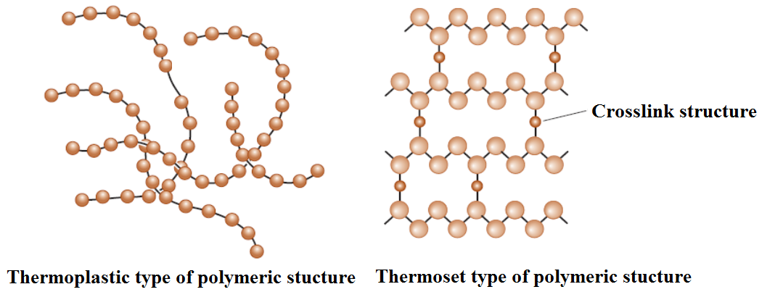
Polymers

Slide 5
Semiconductors
Germanium, gallium arsenide and especially silicon based semiconductors are part of a wider class of materials known as electronic materials.
The semiconducting materials have the electricalconductivity between ceramic insulators and metal conductors.
Semiconducting materials activated the information age.
In semiconductors, conductivity level can be controlled by doping.
In many commercial applications, we need large single crystals of semiconductors, which are not easy to prepare using simple processing techniques.
Single crystal semiconductors are grown from molten substances.
Generally, thin films of semiconducting materials are also made using special processes.

Slide 6
Composite Materials
The basic idea behind the development of composite materials is to blend the properties of different materials.
Composite materals consist of two or more materials, producing properties not found in a single material.
Examples for the composite materials can be illustrated as concrete and fiberglass.
We can produce light, durable, ductile, high heat resistant materials with composites or we can produce hard, impact resistant cutting tools.
Advanced aircraft and spacecrafts rely heavily on compounds such as carbon fiber reinforced polymers.
Sports equipment like bicycles, golf clubs and tennis rackets also benefit from a variety of lightweight and rigid composite materials.

Slide 7
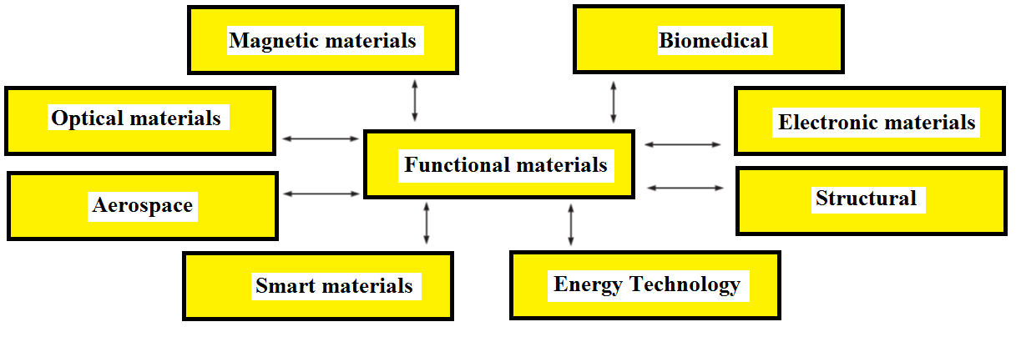
Functional Classification of Materials

Slide 8
Functional Classification of Materials
Aerospace:
Aluminum alloys, polymeri materials, carbon-carbon composites, and many other materials belong to this category.
Biomedical:
A number of artificial organs are made using different polymeric materials, titanium alloys, and nonmagnetic stainless steels.
Electronic Materials:
Semiconductoring materials like silicon are used to make integrated circuits for computer chips.
Aluminum, and other type of metals are used as conductors in power transmission and in microelectronics.

Slide 9
Functional Classification of Materials
Energy Technology:
Battery technology has gained significant importance due to the need for many electronic devices that require longer life and portable power.
Fuel cells, that are a kind of battery, are also being used in some cars.
Magnetic Materials:
Computer accesories make use of many matellic, ceramic, and polymeric materials.
For example, computer hard disks are made using alloys based on cobalt-platinum-tantalum-chromium (Co-Pt-Ta-Cr) alloys.
Certain types of magnetic materials such as ferrites are used to make inductors and components for wireless communications.

Slide 10
Functional Classification of Materials
Photonic or Optical Materials:
Silicon dioxide is widely used to make optical fibers.
Optical materials are utilized to prepare semiconductor type of detectors and lasers, which are used in fiber optic communications systems and other applications.
Smart Materials:
A smart material can be susceptible to and respond to an external stimulus such as changes in temperature, the application of stress, or changes in humidity or the chemical environment.
Lead zirconium titanate, shape-memory alloy can be shown as examples for the smart materials.

Slide 11
REFERENCES
William D. Callister, ‘Materials Science and Engineering: An Introduction’, Seventh edition, John Wiley & Sons, Inc., U.S.A.
Brian S. Mitchell, ‘AN INTRODUCTION TO MATERIALS ENGINEERING AND SCIENCE FOR CHEMICAL AND MATERIALS ENGINEERS’, John Wiley & Sons, Inc., U.S.A, 2004.
J. W. Martin, ‘Materials for Engineering’, Third Edition, WOODHEAD PUBLISHING LIMITED, Cambridge, England.
Donald R. Askeland & Pradeep P. Fulay, ‘Essentials of Materials Science and Engineering’, Second Edition, Cengage Learning, Toronto, Canada.
G. S. Brady, H. R. Clauser, J. A. Vaccari, ‘Materials Handbook’, Fifteenth Edition, McGraw-Hill Handbooks.

