Slide 1
EGE TURU-2

Slide 2
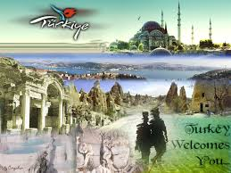
8.GÜN
TURUMUZUN SON GÜNÜ SABAH 8:00 DA ANKARAYA HAREKETE GEÇİYORUZ. BİZİ TERCİH ETTİĞİNİZ İÇİN TEŞEKKÜR EDERİZ. BAŞKA BİR PROĞRAMDA GÖRÜŞMEK ÜZERE…

Slide 3
EPHESOS
FOUNDATION STORY OF EPHESOS
In the year of 10 BC, Androclos, the son of King of Athens-Kodros, was searching a location for establishing a site. Androclos belonged to Akhas, was running from the Dor invasion in Greece. He was leading one of the migration convoys. It was predicted by an Apollon oracle that a fish and a boar would show the location of the new settlement. Days later, parallel to the oracle’s prediction, while frying, a fish fell down from the pan, irritating a hiding boar behind the bushes. The feared boar escaped immediately. Androclos followed the boar and established the city of Ephesus, where he had killed the boar. When Androclos died in the wars with Carians, a mausoleum was built to the memory of the first king of Ephesus. The mausoleum is considered to be placed around THE GATE OF MAGNESİA.

Slide 4
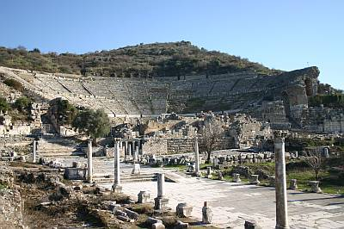
THEATRE
This is the most magnificent structure in Ephesus. The Great Theatre is located on the slope of Panayir Hill, opposite the Harbor Street, and easily seen when entering from the south entrance to Ephesus. It was first constructed in the Hellenistic Period, in the third century BC during the reign of Lysimachos, but then during the Roman Period, it was enlarged and formed its current style that is seen today.
It is the largest in Anatolia and has the capacity of 25,000 seats. The cavea has sixty six rows of seats, divided by two diazoma (walkway between seats) into three horizontal sections. There are three sections of seats. In the lower section, Marble pieces, used for restoration, and the Emperor's Box were found. The seats with backs ,made of marble, were reserved for important people. The audience entered from the upper cavea.
The stage building is three-storied and 18 meters high. The facade facing the audience was ornamented with relieves, columns with niches, windows and statues. There are five doors opening to the orchestra area, the middle one of which is wider than the rest.
The theatre was used not only for concerts and plays, but also for religious, political and philosophical discussions and for gladiator and animal fights.

Slide 5
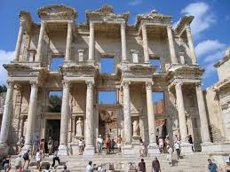
CELSUS LIBRARY
This library is one of the most beautiful structures in Ephesus. It was built in 117 A.D. It was a monumental tomb for Gaius Julius Celsus Polemaeanus, the governor of the province of Asia; from his son Galius Julius Aquila. The capacity of the library was more than 12,000 scrolls. It was the third richest library in ancient times after the Alexandra and Pergamum. The statues in the niches of the columns today are the copies of the originals. The statues symbolize wisdom (Sophia), knowledge (Episteme), intelligence (Ennoia) and valor (Arete). These are the virtues of Celsus. The library was restored with the aid of the Austrian Archaeological Institute and the originals of the statues were taken to Ephesus Museum in Vienna in 1910.

Slide 6
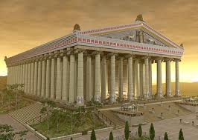
ARTEMIS TEMPLE
It is known as one of the Seven Wonders of the ancient world. If you visit Ephesus today, you can only see the ruins of the foundations of this marvelous construction of the Hellenistic Age, made of marble and full of sculptured columns' capitals and shafts. The most beautiful remaining of this temple are today exhibited in the London British Museum. The oldest remaining found date back till the 6th century BC. It was surrounded by 36 huge columns, later enlarged upon the orders of the Lydia King, Kreisos, during the 6th century BC. Most of the exhibits in the London British Museum belong to this period. The new Artemis has been rebuilt in the 2nd century BC.It had 127 columns of each 17,5 meters high.On the front walls of Artemis Temple is depicted war between Gods and Titans.

Slide 7
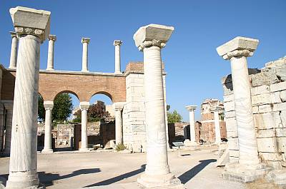
BASILICA OF ST.JOHN
It is believed that the evangelist St.John had spent his last years in the region around Ephesus and buried in the southern slope of Ayosolug Hill. Three hundred years after the death of St.John, a small chapel was constructed over the grave in the 4th century. The church of St.John was changed into a marvelous basilica during the region of Emperor Justinian (527 -565 AD).

Slide 8
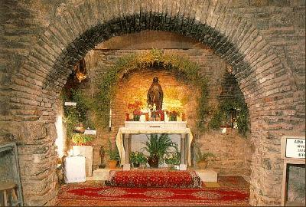
HOUSE OF VIRGIN MARY
It is located on the top of the "Bulbul" mountain 9 km ahead of Ephesus. It is the place where Mary may have spent her last days. Indeed, she may have come in the area together with Saint John, who spent several years in the area to spread Christianity. Mary preferred this remote place rather than living in crowded place. At the beginning of the 19th century Anna Catharina Emmeric dreamed about Virgin Marry and where she lived her last period of life.Clemens Brentano visited Emmeric before she died after then He published a book about Emmeric’s dream. This book helped to find House of Virgin Marry

Slide 9
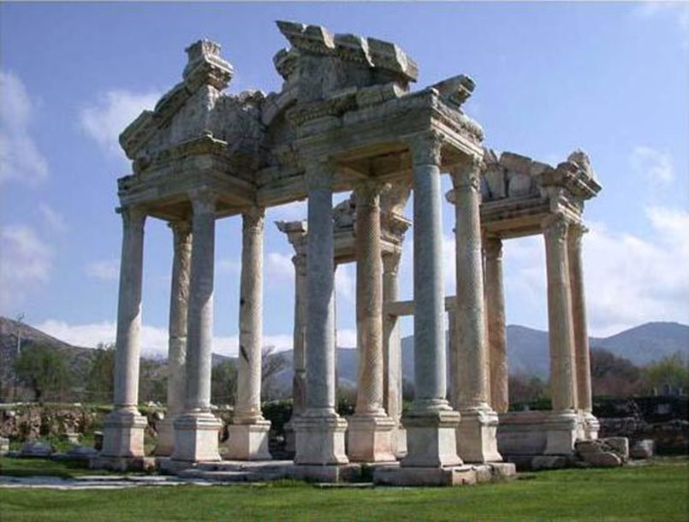
APHRODSIAS
An antique city, situated near the Karacasu-Aydın province, was established in the name of Goddess Aphrodite. It continued to be a great center of inhabitance from the Bronze Age to the Byzantine Period (2800 B.C- 220 A.D).During excavations, the Aphrodite Temple, Odeon, Stadium and agora, and the city baths have been revealed. Aphrodisias was well known during the Early Age as a center of sculpture. The Aphrodisias Stadium is one of the best preserved stadiums among the antique city stadiums in Anatolia

