Slide 1
The fIfteenth century
ENGLISH PROSE

Slide 2
Fifteenth-century events and literature

Slide 3
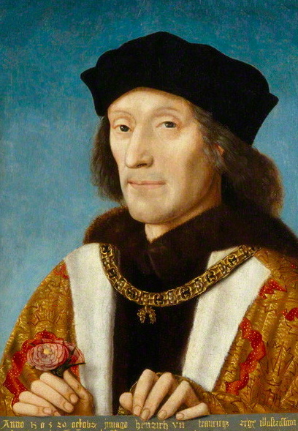
Thomas Malory (? -1471)
Malory fought in the Hundred Years’ War and was elected to Parliament in 1440.

Slide 4
Malory’s book was re-titled Le Morte d’Arthur (Death of Arthur) by William Caxton who produced the first printed edition in 1485.
Malory rewrote the original Latin, French, and English sources of the tales of King Arthur and the knights of his Round Table.

Slide 5
the Morte is the first great work of English prose fiction.
His straightforward narration creates the chivalric world and its conflicting loyalties.
He tells of conflict and loss in a world both marvellous and everyday.

Slide 6
Caxton’s printed version was the only known version of Malory’s text until the discovery of this manuscript in 1934.
Caxton divided Malory’s 8 books into twenty-one books, subdivided into short chapters with summary chapter headings.

Slide 7
What’s the story about?
Morte d’Arthur was written in a time of transition. The feudal order was dying.
Malory, in desire to escape the disorder and uneasiness of his day, tries to recapture lost ideals of the romantic past as recounted in his tale of noble knights, adventurous knights, and damsels in distress.

Slide 8
The manuscript begins with the mysterious birth of Arthur and ends with equally mysterious the death of Arthur and destruction of the Round Table.
The Round Table Knights fight many battles and win much glory, all of which is a credit to the name of King Arthur.

Slide 9
Near the end of the story, Lancelot falls in love with Arthur’s queen, Guinevere, and the lady returns his love.
the weakened kingdom is attacked by force under Sir Mordred.

Slide 10
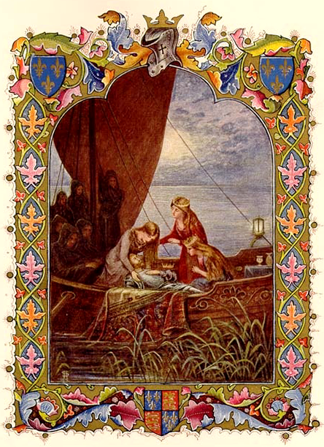
Arthur’s last knight Sir Bedwere (Bedivere) puts Arthur into the barge in which the ladies are to take him away to the vale of Avylyon to heal him of his grievous wound.

Slide 11
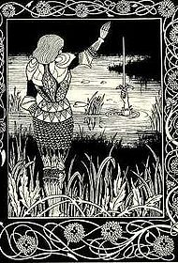
‘Many men say’ that there is written upon Arthur’s tomb: HIC IACET ARTHURUS, REX QUONDAM REXQUE FUTURUS (‘Here lies Arthur, the once and future king’).
Notes:
Malory ended the Arthurian story with its classic form.

Slide 12
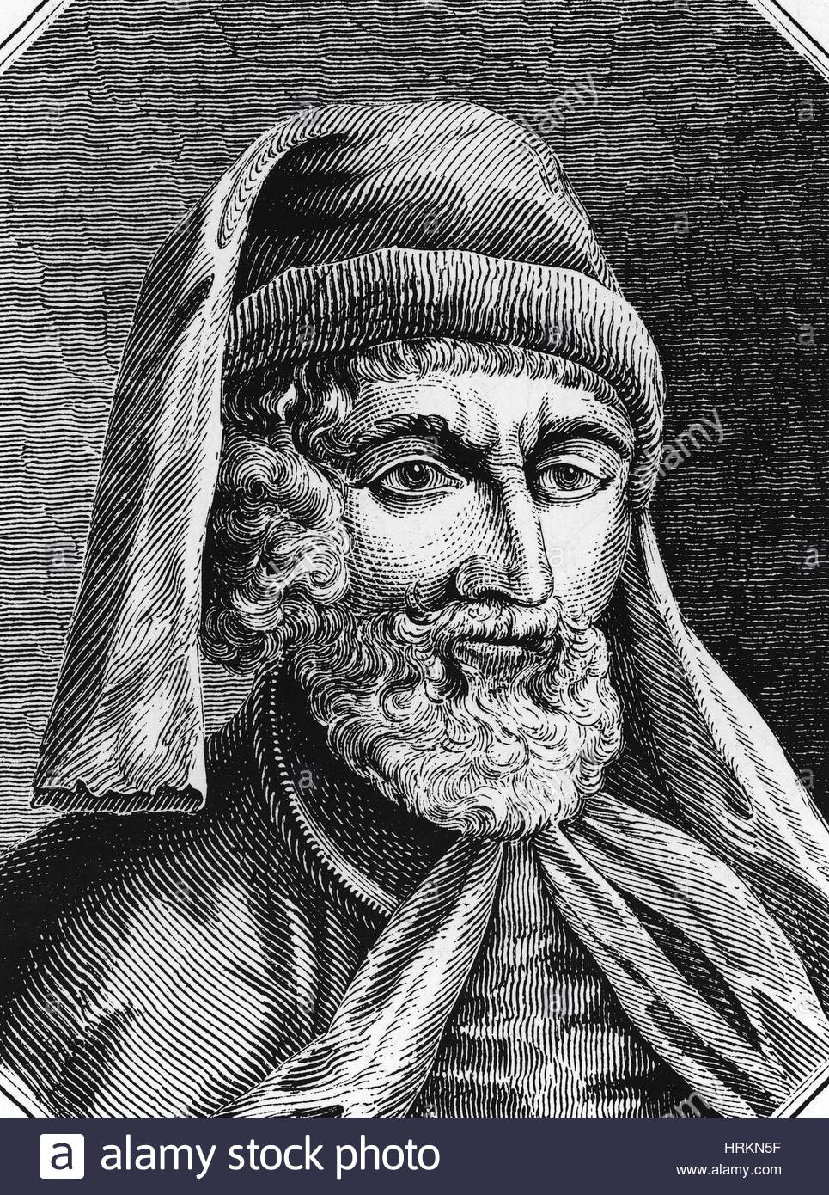
The arrival of printing
William Caxton set up a press near Westminster Abbey in 1476.
Most of the eighty books he printed were religious, but the first was his translation of a history of Troy; he also printed a Canterbury Tales in 1477.
In 1478, he printed Le Morte D’Arthur.

Slide 13
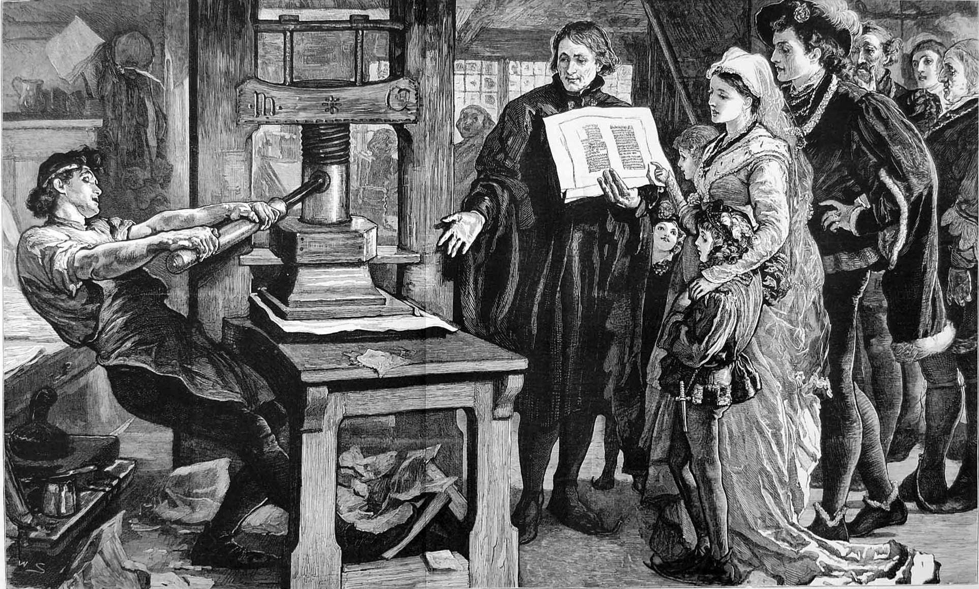
The printing was a technological revolution which transformed both reading habits and the language itself.
Combined with the great improvement in education, printing paved the way for an English Renaissance.

Slide 14
Bibliography
Greenblatt, Stephen, editor. Norton Anthology of English Literature. 8th ed., vol. 1, W. W. Norton & Company, 2006.
Brodey, Kenneth, and Fabio Malgaretti, editors. Focus on English and American Literature. Modern Languages, 2002.

