Slide 1
PLASTIC packagIng MATERIALS
Instructor
Assist. Prof. Dr. Eda Demirok Soncu
E-mail: edemirok@eng.ankara.edu.tr
Phone: +90312 203 3300 (3639 ext.)
Office: 2nd floor #212
Fde 216 food packagıng

Slide 2
Definition of plastics
According to the European Union Directive (2001/62/EC) plastic material is defined as
‘organic macromolecular compounds obtained by polymerisation, polycondensation, polyaddition or any similar process from molecules with a lower molecular weight or by chemical alteration of natural macromolecular compounds’
Monomers are molecules with a lower molecular weight
Polymers are macromolecular compounds

Slide 3
Advantanges of plastic material for food industry
They are flowable and mouldable under certain conditions, to make sheets, shapes and structures
They are generally chemically inert, which means they are not reactive with inorganic chemical such as acids, alkali compounds and organic solvent. This property makes them suitable for food packaging
They do not support the growth of microorganisms
They are cost effective in meeting market needs
They are not prone to breakage

Slide 4
Advantanges of plastic material for food industry
They can be used in the wide temperature changes (e.g. deep frozen food processing (-40°C), frozen storage (-20°C), sterilization (121°C), reheating by microwave (100°C)….)
They provide choices in respect of transparency, color, heat sealing, heat resistance and barrier
They can be coloured, printed, decorated or labelled in several ways, depending on the type of packaging concerned
They are light in weight

Slide 5
Disadvantanges of plastic material for food industry
Some plastics may absorb some food constituents, such as oils and fats
Gases such as oxygen, carbon dioxide and nitrogen together with water vapour and organic solvents permeate through plastics. This means that they are not impermeable

Slide 6
PLASTIC MATERIALS FOR FOOD PACKAGING

Slide 7
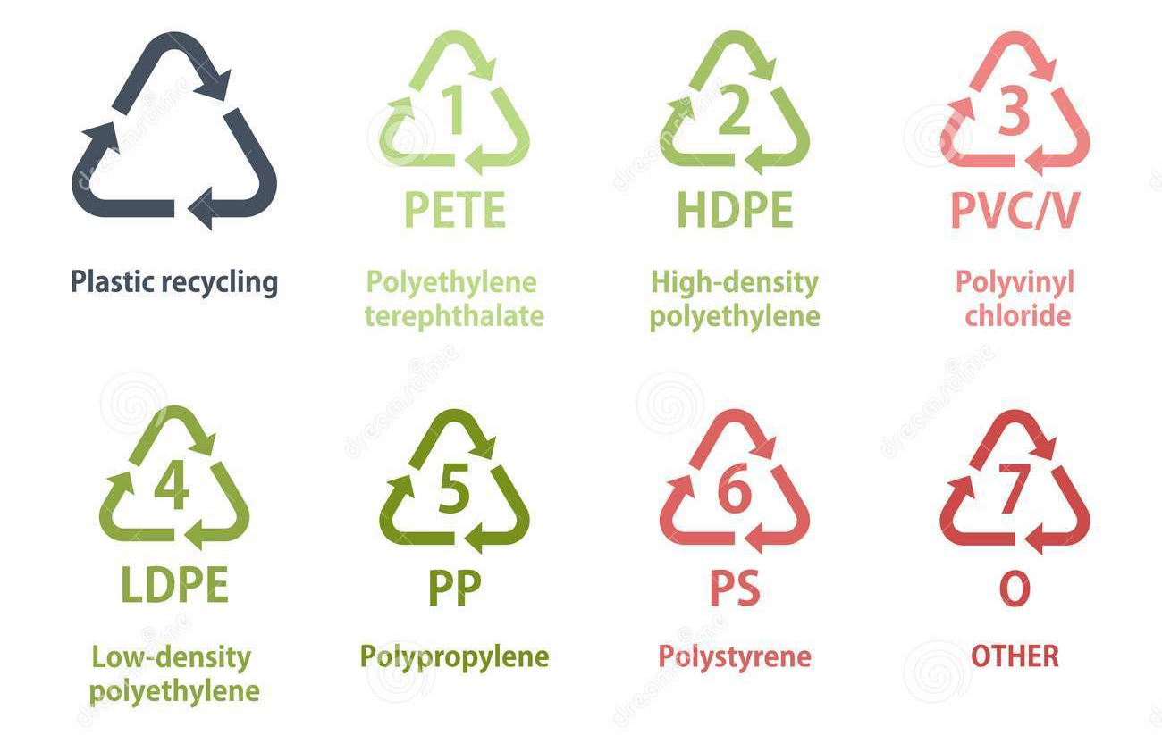
Symbols of plastic material

Slide 8
1) Polyethylene terephthalate (PET)
Properties | Explanation
Water vapor permeability | 32 g/m² day at 38°C, 90% relative humidity, 25 μm thickness
Oxygen permeability | 65 cm³/m² day atm at 23°C, 0% relative humidity, 25 μm thickness
Resistance | Mechanical shock, esters, aromatics, alcohols, fats, dilute acids and alkalis, oxidation, light
Other properties | It is glossy, printable, more heat resistant and transparent or opaque
Application area | Blowmolded containers (replaces PVC) for liquids (alcohol, water), films and trays

Slide 9
2 or 4) Polyethylene (PE)
Polyethylene is the most used plastic material. It constitutes 50% of total plastic usage
The most common polyethylene types used in food packaging are
high density polyethylene (HDPE)
low density polyethylene (LDPE)
linear low density polyethylene (LLDPE)

Slide 10
High density polyethylene (HDPE)
Properties | Explanation
Water vapor permeability | 5 g/m² day at 38°C, 90% relative humidity, 25 μm thickness
Oxygen permeability | 2100 cm³/m² day atm at 23°C, 0% relative humidity, 25 μm thickness
Resistance | Mechanical shock, sterilization
Other properties | It is rigid, opaque and printable Compares to LDPE, HDPE has better chemical resistance, a higher melting point (135°C), greater tensile strenght, and hardness
Application area | Bottles, tubes, caps

Slide 11
Low density polyethylene (LDPE)
Properties | Explanation
Water vapor permeability | 10 g/m² day at 38°C, 90% relative humidity, 25 μm thickness
Oxygen permeability | 7000 cm³/m² day atm at 23°C, 0% relative humidity, 25 μm thickness
Resistance | UV, nonoxidizing acids and bases, polar solvents
Other properties | It is soft, flexible, printable and stretchable It has good clarity (transparent) and heat sealability Its melting point is 110°C
Application area | Sacks, bags, boxes, tubes, bottles, shrink film, stretch film, trays, seals

Slide 12
3) Polyvinyl chloride (PVC)
PVC is produced by polymerisation of the vinyl chloride monomer
The monomer has been recognised as a powerful human carcinogen substance mainly by inhalation and its residual content in the polymer is carefully checked

Slide 13
3) Polyvinyl chloride (PVC)
Properties | Explanation
Water vapor permeability | 35 g/m² day at 38°C, 90% relative humidity, 25 μm thickness
Oxygen permeability | 120 cm³/m² day atm at 23°C, 0% relative humidity, 25 μm thickness
Resistance | Chemical products, fats
Susceptibility | Heat, light and oxidation
Other properties | It is rigid, glossy, and transparent It shows poor thermal processing stability It has a very good processability, which means various kinds of packages can be easily produced
Application area | Films, bottles (oil, vinegar, wine, syrup), trays, boxes

Slide 14
5) Polypropylene (PP)
Properties | Explanation
Water vapor permeability | 6 to 10 g/m² day at 38°C, 90% relative humidity, 25 μm thickness
Oxygen permeability | 1800 to 3600 cm³/m² day atm at 23°C, 0% relative humidity, 25 μm thickness
Resistance | Mechanical and thermal stress (microwave, sterilization), mineral aqueous solutions, dilute acids and alkali compounds
Susceptibility | UV, oxidation
Other properties | It is rigid. Compared to PE, it has higher tensile strenght, hardness, and a higher melting point (165°C)
Application area | Films, boxes, trays (ready meals), blister trays (biscuits), tubs (yoghurt), stoppers, tubes

Slide 15
6) Polystyrene (PS)
Properties | Explanation
Water vapor permeability | 140 g/m² day at 38°C, 90% relative humidity, 25 μm thickness
Oxygen permeability | 4000 cm³/m² day atm at 23°C, 0% relative humidity, 25 μm thickness
Resistance | Dilute acids, aqueous and alcohol solutions
Susceptibility | UV, oxidation and organic solvents
Other properties | It has low gas barrier, intermediate water vapour barrier, and quite low impact strength (consequently, PS is a fragile material) It has low melting point (88°C); therefore, it has high processability that allows it to be easily converted into various food containers
Application area | Boxes (eggs), tubs (yoghurt), disposable cups, caps, wrapped trays (meat)

Slide 16
7) Polyamide (PA)
Properties | Explanation
Water vapor permeability | 50 to 170 g/m² day at 38°C, 90% relative humidity, 25 μm thickness
Oxygen permeability | 3 to 50 cm³/m² day atm at 23°C, 0% relative humidity, 25 μm thickness
Resistance | Chemical products
Susceptibility | Acids, amines, light
Other properties | It is flexible It has good gas barrier, puncture resistance, heat resistance
Application area | Wide range (more than 30 PA currently used)

Slide 17
Minor polymers-PVDC
Polyvinylidene chloride (PVDC), a copolymer of vinylidene chloride (85–90 %) and vinyl chloride, is commercialised under the trade name ‘Saran’
It is mostly used in multilayer films and containers coating
It has excellent oxygen and moisture barrier properties

Slide 18
Minor polymers-EVOH
Ethylene vinyl alcohol (EVOH) is produced with the combination of ethylene and vinyl alcohol
It has good oxygen or moisture barrier properties depending on the molar proportions of components
Oxygen barrier is reduced when ethylene content increases
Oxygen barrier is increased whereas moisture barrier is decreased in the case of increasing vinyl content

Slide 19
Minor polymers-PC
Polycarbonate (PC) is the amorphous polyester obtained by transesterification from bisphenol A (BPA) and diphenyl carbonate
PC is a very clear and tough polymer that allows the production of light and infrangible alternatives to glass containers
PC may be considered as an ovenable material because it withstands temperatures above 200 °C.
Currently, there is a big concern about the possible migration of BPA, which is believed an endocrine disruptor

Slide 20
MANUFACTURE OF PLASTIC PACKAGING MATERIALS

Slide 21
Components of plastic packaging materials
Polymers, a main component
Fillers, an inert organic or inorganic compounds, are dispersed in the polymer matrix
spherical fillers (powder or flour) that improve the flowability of resins and their resistance to compression
fibrous fillers (cellulose, glass) that increase tensile strength and rigidity
mineral fillers (chalk, silica) that improve electrical properties, resistance to heat and moisture and increase density

Slide 22
Components of plastic packaging materials
Plasticizers to improve the mechanical properties of plastics by insertion between the molecular chains
Stabilizers to prevent deterioration of the material during manufacture or use
antioxidants for PP, PE, PS that are particularly susceptible to oxidation
anti-UV for PET, PS and PA that absorb ultraviolet light and can thus photodegrade or photooxidize

Slide 23
Components of plastic packaging materials
Lubricants to facilitate workability during process and reduce resin/metal friction
Antistatic agents to reduce or eliminate the build-up of static electricity
Flame retardants that inhibit or resist the spread of fire
Colorants that help meet the light stability requirements of the product and that give printability property

Slide 24
Production process of plastics
The plastic raw material, also known as resin, is usually supplied by the polymer manufacturer in the form of pellets
The first major step in the conversion of plastic resin into films, sheets, containers etc., is to change the pellets from solid to liquid or molten phase in an extruder
The plastic is melted by a combination of high pressure, friction and externally applied heat

Slide 25
Molten plastic production

Slide 26
Production of plastic film and sheet
In the manufacture of film and sheet, the molten plastic is then forced through a narrow slot or die
There are two methods of processing the molten plastic
Cast film process
Blown (or tubular) film process

Slide 27
Cast film process
The molten plastic is extruded through a straight slot die onto a cooled cylinder, known as the chill roll

Slide 28
Blown film process
The molten plastic is continuously extruded through a die in the form of a circular annulus, so that it emerges as a tube. The tube is prevented from collapsing by maintaining air pressure inside the tube or bubble

Slide 29
Production of plastic film and sheet
In both the processes, the molten polymer is quickly chilled and solidified to produce a film which is reeled and slit to size
Films, which have thickness less than 100μm, is used to wrap product, to overwrap packaging, to make sachets, bags and pouches, and is combined with other plastics and other materials
Plastic sheets in thicknesses up to 200 μm are used to produce semi-rigid packaging such as pots, tubs and trays

Slide 30
Production of rigid plastic packaging

Slide 31
Production of rigid plastic packaging
Bottles are made by extrusion blow moulding
A thick tube of plastic is extruded into a bottle mould which closes around the tube, resulting in the characteristic jointed seal at the base of the container
Air pressure is then used to force the plastic into the shape of the mould
After cooling, the mould is opened and the item removed
Blow moulding is used for milk bottles (HDPE) and wide mouth jars

Slide 32
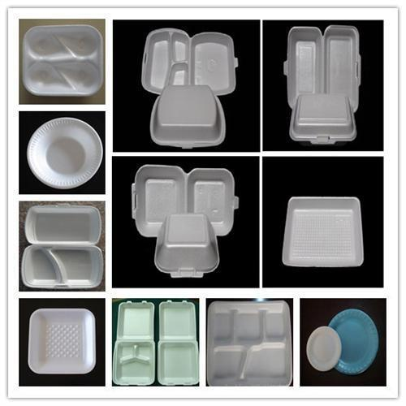
Foamed plastics and food trays
Foamed plastics are formed by dispersing a gas in the molten polymer
Food trays are made from extruded foam sheet by thermoforming
Thermoforming means forming a material by using heat

Slide 33
How properties of plastic materials are changed?
To give a white appearance, the technique of pigmenting is applied by using white compounds such as calcium carbonate or, more usually, titanium dioxide (e.g. pots and dished for dairy-based products)
Metallising with a very thin layer of aluminium is an alternative way to achieve opaque property. This technique has the added benefit of improving light- barrier properties in order to reflect the light and provide the light-sensitive foods

Slide 34
How properties of plastic materials are changed?
The surface of a film needs to be as smooth as possible to enhance the surface for printing
Smooth suface is obtained by incorporating food grade additives in the film
Waxes, such as carnauba wax, or silica is used to produce smooth surface

Slide 35
References
Coles R. et al. (2003). Food Packaging Technology. Blackwell Publishing and CRC Press. (in Chapter 7 pages 174-240)
Piergiovanni, L. & Limbo, S. (2016). Food Packaging Materials. Springer. (in Chapter 5 pages 32-49)
Jeantet, R. et al. (2016). Packaging (Part 5) In Handbook of Food Science and Technology 2/Food Process Engineering and Packaging. John Wiley&Sons, Inc. USA. (pages 301-308)

