Slide 1
AMERICAN REVOLUTION
Dr. GAMZE KATI GÜMÜŞ

Slide 2
The attitude of England towards its American colonies
Notes:
King George III from https://www.historyisfun.org/learn/learning-center/what-changed-for-the-american-colonies-when-king-george-iii-took-the-throne/

Slide 3
The French and Indian War (The Seven Years’ War, (1756-1763)
Colonists in British America reaped many benefits from the British imperial system and bore few costs for those benefits.
Until the early 1760s, the British mostly left their American colonies alone. The Seven Years' War (known in the United States as the French and Indian War) changed everything.
Although Britain eventually achieved victory over France and its allies, victory had come at great cost. A staggering war debt influenced many British policies over the next decade. Attempts to raise money by reforming colonial administration, enforcing tax laws, and placing troops in America led directly to conflict with colonists.*
Notes:
From https://www.loc.gov/classroom-materials/united-states-history-primary-source-timeline/american-revolution-1763-1783/overview/

Slide 4
The Sugar Act (1764)
A series of regulations designed to tighten the navigation system in order to control the colonists’ smuggling.
The use of search warrants was enlarged (to look for smuggled goods in private homes as well as private businesses).
The colonies could only export to England or to Biritish colonial ports.
Items subjected to duty were sugar, tobacco, ginger, cotton, indigo, certain dyes, certain wood products, rice, molasses, copper, fur, naval stores (produced from pine sap and used for timber, tan, resin, shoe polish, soap, paint)

Slide 5
The Stamp Act (1765)
Put a tax on legal documents, almanacs, newspapers and nearly every form of paper used in the colonies.

Slide 6
Why were these duties mattered?
Many depended on trade with the French and West Indies.
The colonies needed to import sugar products to sustain rum industry.
The export trade in fish and foodstuffs to the Caribbean would be curtailed.
In the end, the colonies would not be able to pay for its British imports.

Slide 7
1760s
Economic crisis followed by business failures and banktrupcies.
Victims kept the distant government in England responsible.
In 1764, eight colonies sent formal petitions to the royal authorities in England about the problems the Sugar Act caused.
This was followed by a more organized uprising by merchants and the population.

Slide 8
Tension b/w England and colonies
The colonies believed that they were not represented enough in the Parliament, but taxed heavily.
As a result, in 1765 the Virginia House of Burgesses adopted some resolves denouncing the parlimentary taxation, saying that only the elected representatives could tax the colonists.

Slide 9
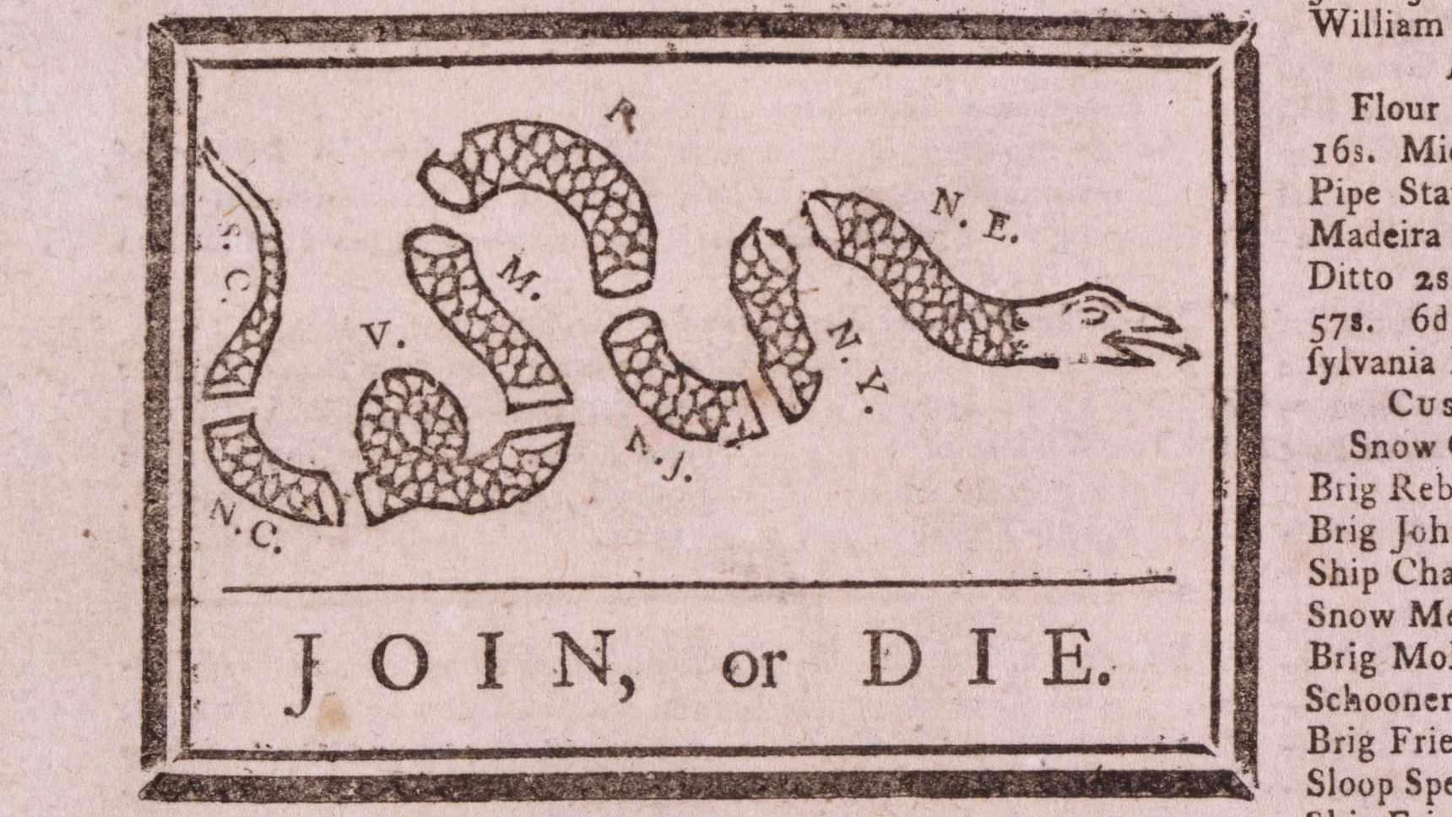
JOIN OR DIE!
In 1754, Benjamin Franklin published a cut up snake (it was believed that a cut up snake could come back to life if various parts were reunited before sunset) in a political cartoon to call attention to the importance of union among colonies during the French and Indian War.
After the Stamp Act, colonists repurposed the cut-up snake as a symbol for the colonies to unify in opposition to unfair taxation.
Notes:
https://www.history.com/news/ben-franklin-join-or-die-cartoon-french-indian-war

Slide 10
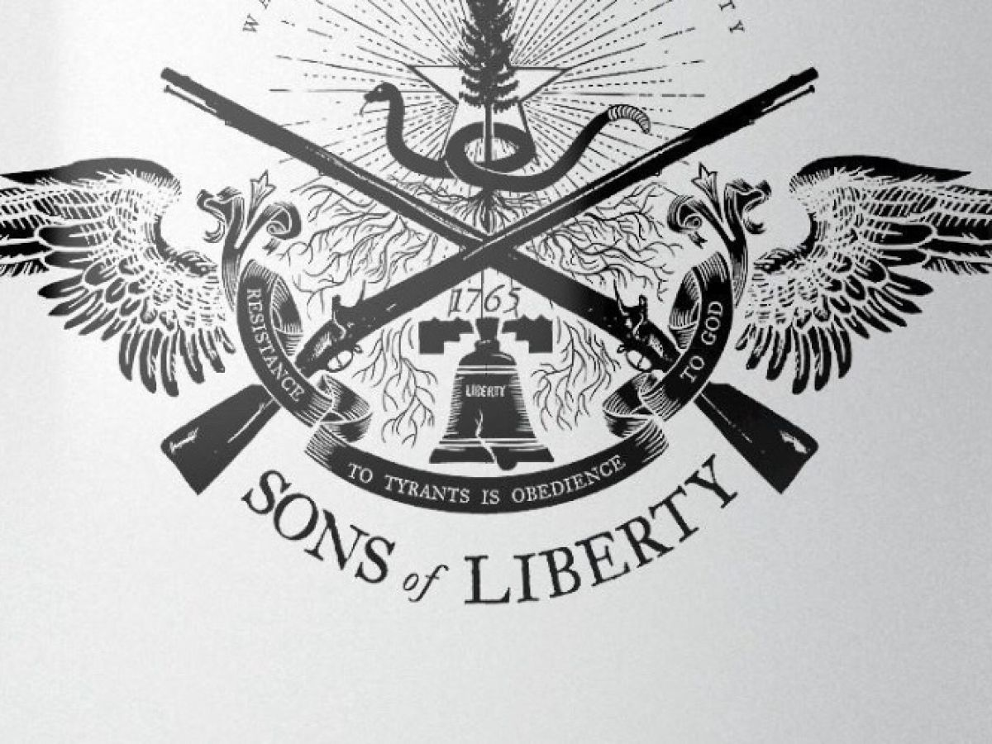
SONS OF LIBERTY
Led by members of middle class in general, they forced Andrew Oliver-official collector of stamps- to resign.
Motto: ”No taxation without representation”

Slide 11
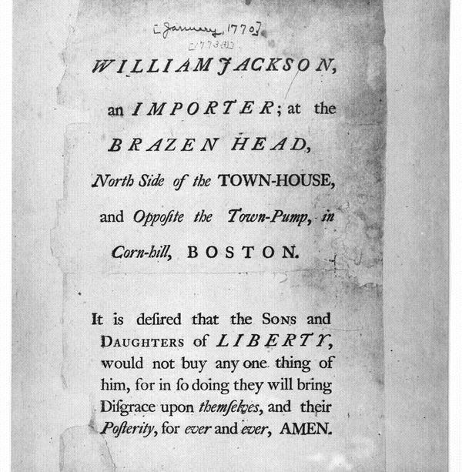
1770
Notes:
https://www.loc.gov/resource/rbpe.0370020a/

Slide 12
British Reaction
In 1766, the Stamp Act was repealed by the British Parliament.
However, they passed the Declaratory Acts on the very same day, stating that the British government had free and total legislative power over the colonies.
The Americans lost respect for British authority, and the colonists started to unite and form resistance against the imperial rule with constitutional discussions.

Slide 13
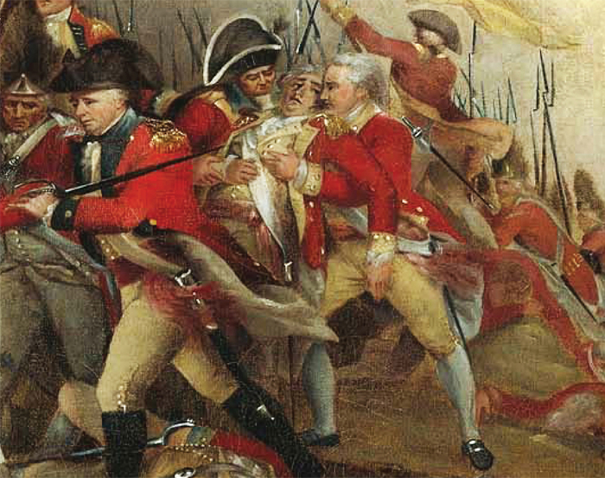
The Problem of the British Army
In 1765, the British government decided to pull back much of the army to the coastal cities in order to eceonomize.
The colonists would be responsible for the army’s housing and supply.
However, this withdrawal from the French and Indians contributed to the chaos in the Western territory.
Moreover, the presence of a standing army in peacetime amid civilians raised concerns among the colonists.
Notes:
Image from https://allthingsliberty.com/2013/02/top-10-facts-about-british-soldiers/

Slide 14
Tension arises between the Crown and Americans in 1768
When the Massachusetts House of Representatives denouncing Townshend duties as unconstitutional, Governor Francis Bernard dissolved the Massachusetts assembly.
As a result, Boston ordered its inhabitants to arm and called for a convention of town delegates.
Attacked by mobs and unable to enforce navigation regulations, custom officials pleaded for military help.
A British warship arrived at Boston and seized John Hancock’s ship Liberty—Hancock was deeply associated with the resistance.

Slide 15
1769
Rising tension led to the reinforcement of the British Army in the colonies
4.000 British soldiers (known as Redcoats)
15.000 inhabitants

Slide 16
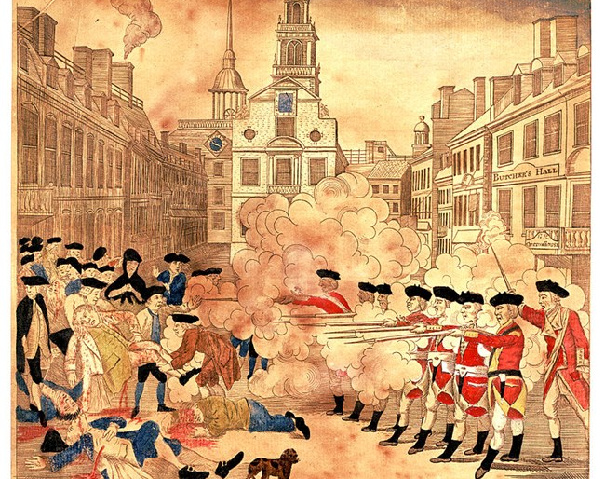
The Boston Massacre
March 5, 1770
Notes:
https://www.nps.gov/articles/250th-anniversary-of-the-boston-massacre.htm

Slide 17
The Boston Massacre
One British soldier, who was on guard duty in front of the Custom House on King Street (the King’s money was stored there) had a quarrel with a Boston citizen.
More citizens gathered after the churh’s bells rang to signal people to observe the commotion.
The private, named White, called for reinforcements. Captain Preston ordered his men to load their muskets and told the mob to disperse.
The mob started throwing snowballs, ice and oyster shells at the soldiers.
Private Montgomery was struck with an object, and then he fired at the crowd without any order to do so. Other soldiers followed his lead.
Five men were killed. Crispus Attucks (of African and Native American descent), James Caldwell, Samuel Gray died at the scene. Samuel Maverick and Patrick Carr died in the following days.
Montgomery and another soldier were represented at the court by future President John Adams. Upon witness testimony, he said that the soldiers were defending themselves from the mob. They were found guilty of manslaughter, branded on the thumb, and released.
Notes:
From https://www.nps.gov/articles/250th-anniversary-of-the-boston-massacre.htm

Slide 18
The Votes and Proceedings (1772)
Bostonians published some of the British violations of American rights:
Taxing and legislating without their consent
Introducing standing armies in peacetime
Extending the power of vice-admiralty courts (no jury trials)
Restricting colonial manufacturing
Threatening to establish Anglican bishops in America

Slide 19
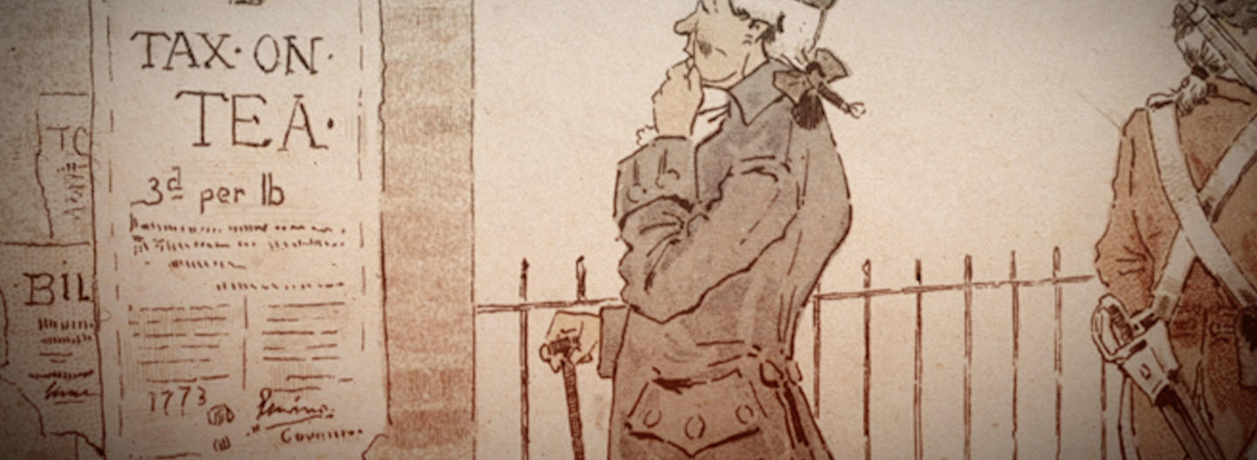
The Tea Act (1773)
This Act granted the East India Company the privilege of selling tea in America, it was intended to save the company from banktrupcy. However;
Colonists’ attention was turned again to the tax on tea
Angered American traders who were excluded from selling tea
Notes:
Image from https://www.history.com/topics/american-revolution/boston-tea-party

Slide 20
Boston Tea Party (1773)

Slide 21
Boston Tea Party (1773)
Tea ships arrived at the Boston Harbor, but the colonists stopped them from landing the tea.
Governor Thomas Hutchinson, whose merchant family had the right to sell tea, did not allow the ships to leave the harbor.
On December 16, 1773, a group of patriots-some of them were members of the Sons of Liberty-disguised as Indians dumped the tea aboard the ships into Boston Harbor.
It took nearly three hours for more than 100 colonists to empty the tea into Boston Harbor. The chests held more than 90,000 lbs. (45 tons) of tea, which would cost nearly $1,000,000 dollars today.*
Notes:
https://www.history.com/topics/american-revolution/boston-tea-party

Slide 22
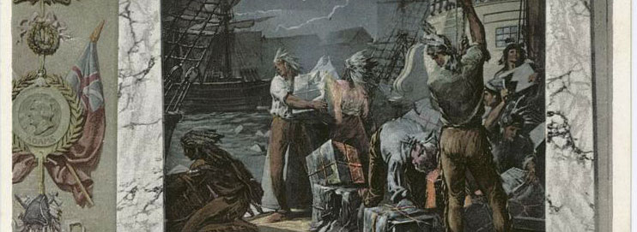
Aftermath
While some important colonist leaders such as John Adams (2nd US President) were thrilled to learn Boston Harbor was covered in tea leaves, others were not.
In June of 1774, George Washington (1st US President) wrote: “the cause of Boston…ever will be considered as the cause of America.” But his personal views of the event were far different. He voiced strong disapproval of “their conduct in destroying the Tea” and claimed Bostonians “were mad.” Washington, like many other elites, held private property to be sacrosanct.
Benjamin Franklin (one of the Founding Fathers) insisted the British East India Company be reimbursed for the lost tea and even offered to pay for it himself.
No one was hurt, and aside from the destruction of the tea and a padlock, no property was damaged or looted during the Boston Tea Party. The participants reportedly swept the ships’ decks clean before they left.
Notes:
https://www.history.com/topics/american-revolution/boston-tea-party

Slide 23
Coercive Acts (1774)
The British Parliament passed Coercive Acts in response to the Boston Tea Party. According to these acts:
Boston port was closed until the destroyed tea was paid for.
Massachusetts charter was altered and government was reorganized. Council members were to be appointed by the royal governor rather than elected.
Royal officials could be tried in England and other colonies.
Private property could be seized for the use of the British Army.
extended freedom of worship to French-Canadian Catholics under British rule, which angered the mostly Protestant colonists.
Moreover, the Commander in chief of the British Army, Thomas Gage, was appointed the governor of Massachusetts.

Slide 24
Virtual vs. Actual
Virtual Representation
Actual Representation
No election
“believed” to be represented
Distant government
Election
Have a say in the parliament
Representatives should live in the locality they represent
Localities should be represented in proportion to their population

Slide 25
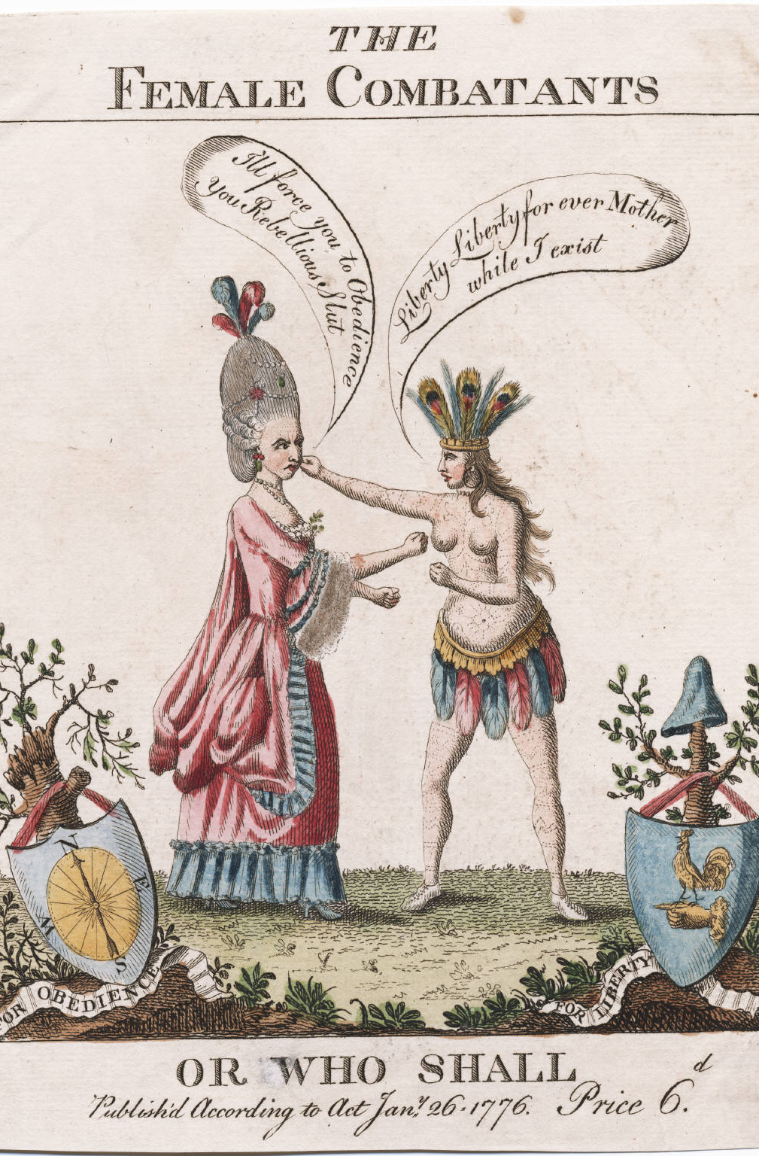

Slide 26
Chronology
1760
George III accedes to throne.
1764
Sugar Act passed.
1765
Stamp Act passed.
1766
Stamp Act repealed by Parliament.
1767
Townshend duties passed.
1770
Townshend duties repealed, except for duty on tea.
1770
Boston Massacre.
1773
Tea Act imposed.
1773
Boston Tea Party.
1774
Coercive Acts.

