Slide 1
General chemıstry laboratory

Slide 2
RULES TO BE APPLIED IN CHEMISTRY LABORATORY:
1- As a danger can always be encountered in chemical laboratories, it should be worked very carefully.
2- It is obligatory to work with white lab coat in the laboratories. To avoid splashes and other effects of acids and bases, do not enter the lab without a gown.
3- The tools and equipment that must be kept with each student in the laboratory are: spatula, forceps, small scissors, notebook, cleaning cloth.
4- Before coming to the laboratory, the preliminary information about the experiment should be learned thoroughly.
5- If any acid or other corrosive chemical substance is spilled anywhere, it should be washed with water immediately.

Slide 3
6- The chemicals used should not be touched by hand.
7- Never taste chemical or solution.
8- If you want to look at the smell of a substance do not do this by bringing your face closer to the container. Stand a little away and send some steam through the container to your nose, fan by hand.
9- Throw away the paper and other solid materials in the waste basket. Never dispose of in places and sinks.
10- Do not use more than the amount specified in the experiment and empty the materials back to the container without polluting.
11- Before taking the material from a container, pay attention to the label on the container and make sure you get the correct container.
12- Keep the table, tools and glass materials you use clean. At the end of the laboratory, leave all materials and table clean.
13- If the materials you use are broken, cracked, damaged or lost, do not forget the difficulty of replacing them and the obligation you will have on this matter.

Slide 4
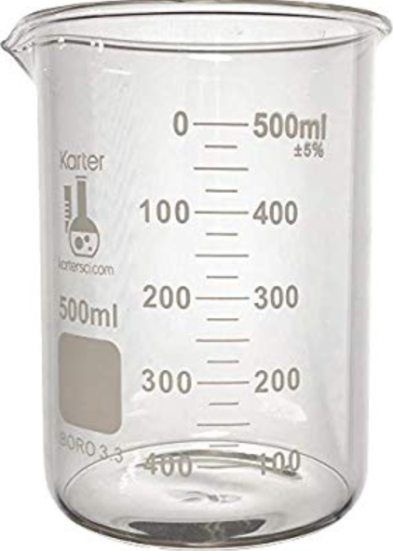
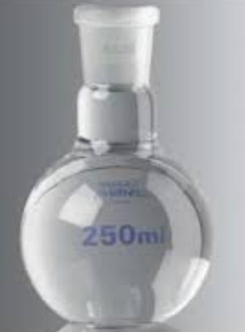
Some materials to be used in the laboratory:
Balloon
Beaker
Stirring rod
Test tube

Slide 5
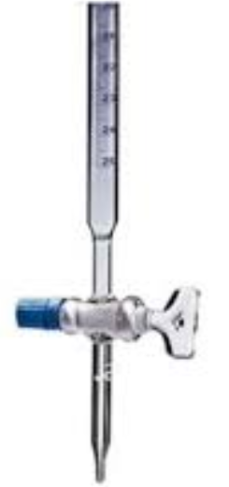
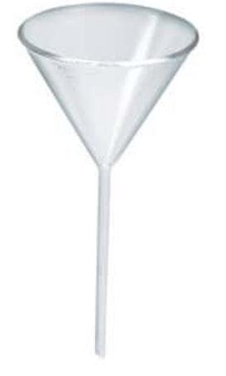
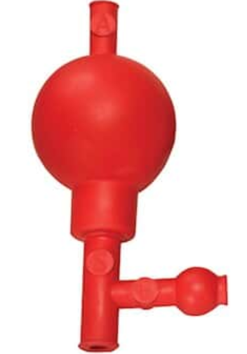
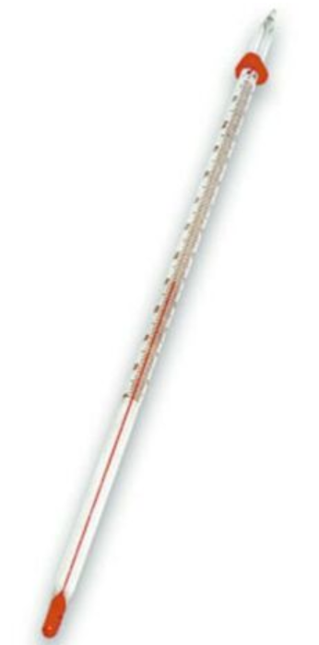
Buret
Funnel
Pipet Bulb
Thermometer
Pipet

Slide 6
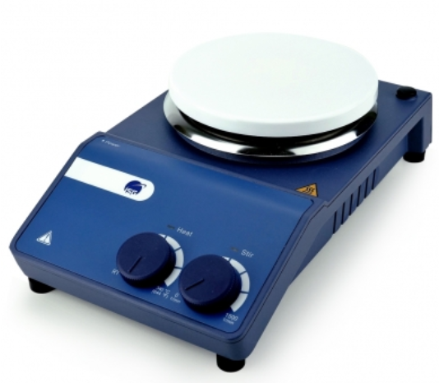
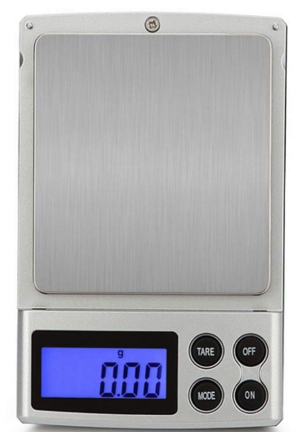
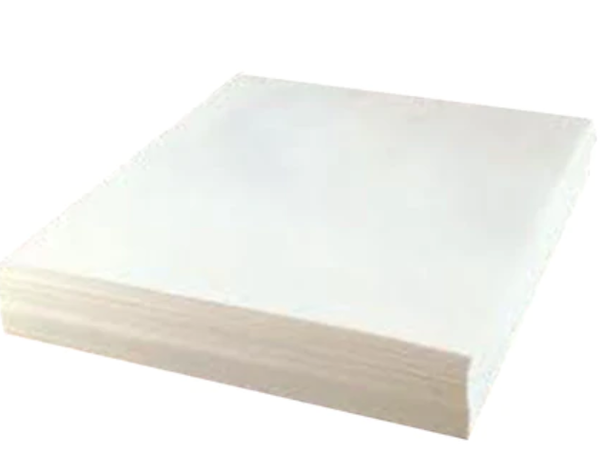
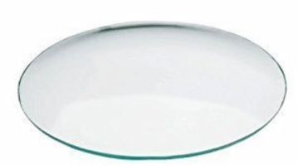
Filtered paper
Magnetic heater stirrer
Laboratory balance
Watch glass

Slide 7
PHYSICAL AND CHEMICAL BASIC PROCESSES
Heating
Filtration
Precipitation
Crystallization
Centrifugation

Slide 8
TOPICS IN GENERAL CHEMISTRY LABORATORY
pH Concept and Measurement
Qualitative Analysis of Anions
Acid-Base Reactions
Distillation
Electrolysis
Stoichiometry

Slide 9
7. Dissolution and Preparation of Solution
8. Qualitative Analysis of Cations
9. Redox Reactions
10. Chemical Equilibrium

