Slide 1
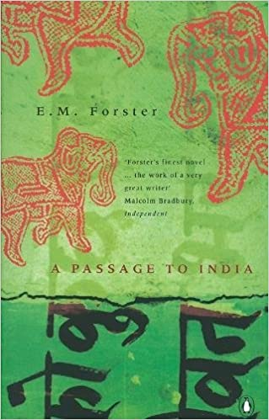
a passage to ındıa
E. M. Forster

Slide 2
Before the Novel (1924)
East India Company
1914-1918 World War I
1916 Easter Rising – 1921 Irish Independence
After the novel was published:
1947 Indian Independence (together with the division of Pakistan)
Gandhi’s doctrine of non-violent resistance

Slide 3
Important Characters
Aziz
Mrs Moore
Mr Fielding
Professor Godbole
Adela
Ronny

Slide 4
Important Scenes
The Mosque
The Bridge Party
Mr Fielding’s Tea Party
The Caves
The Trial
Mrs Moore’s voyage
The Celebrations

Slide 5
Themes
Prejudice
Friendship
Unity
Togetherness
Love

Slide 6
Relationships
British – Indian
Christian – Non-Christian
Hindu – Muslim
Mrs Moore – Aziz
Mr Fielding – Aziz
Mr Fielding – Professor Godbole
Adela – Ronny
Mrs Moore - Ronny

Slide 7
The Mosque
The meeting of Mrs Moore and Aziz
Prejudice (Aziz against non-Muslims & against women)
“Madam, this is a mosque, you have no right here at all; you should have taken off your shoes; this is a holy place for Moslems.”
“I have taken them off.”
“You have?”
“I left them at the entrance.”
“Then I ask your pardon.”

Slide 8
Symbolic Meaning
“If I remove my shoes, I am allowed?”
“Of course, but so few ladies take the trouble, especially if thinking no one is there to see.”
”That makes no difference. God is here.”
…
“I shall tell our community – my friends – about you. That God is here – very good, very fine indeed. I think you are newly arrived in India.”
“Yes – how did you know?”
“By the way you address me.”
They sat down side by side in the entrance, and slipped on their evening shoes.

Slide 9
How Aziz is treated by the British
Mr & Mrs Callendar
“She has just taken my tonga without my permission – do you call that being charming? – and Major Callendar interrupts me night after night from where I am dining with my friends and I go at once, breaking up a most pleasant entertainment, and he is not there and not even a message. Is this charming, pray? But what does it matter? I can do nothing and he knows it. I am just a subordinate, my time is of no value, the veranda is good enough for an Indian, yes, yes, let him stand, and Mrs Callendar takes my carriage and cuts me dead…”
“Indians are not allowed into the Chandrapore Club even as guests,” he said simply.

Slide 10
Mrs Moore
religious woman (“God is here”)
“She listened” (to Aziz’s complaints)
“She had proved her sympathy by criticizing her fellow countrywoman to him”
“You understand me, you know what I feel. Oh, if others resembled you!”

