Slide 1
“Eveline” by James Joyce
AKE 107/ING 109/DING 109 Textual Analysis: Prose and Short story
Dr. Gamze Katı Gümüş

Slide 2
Setting
Urban Ireland
Late 19th / early 20th century

Slide 3
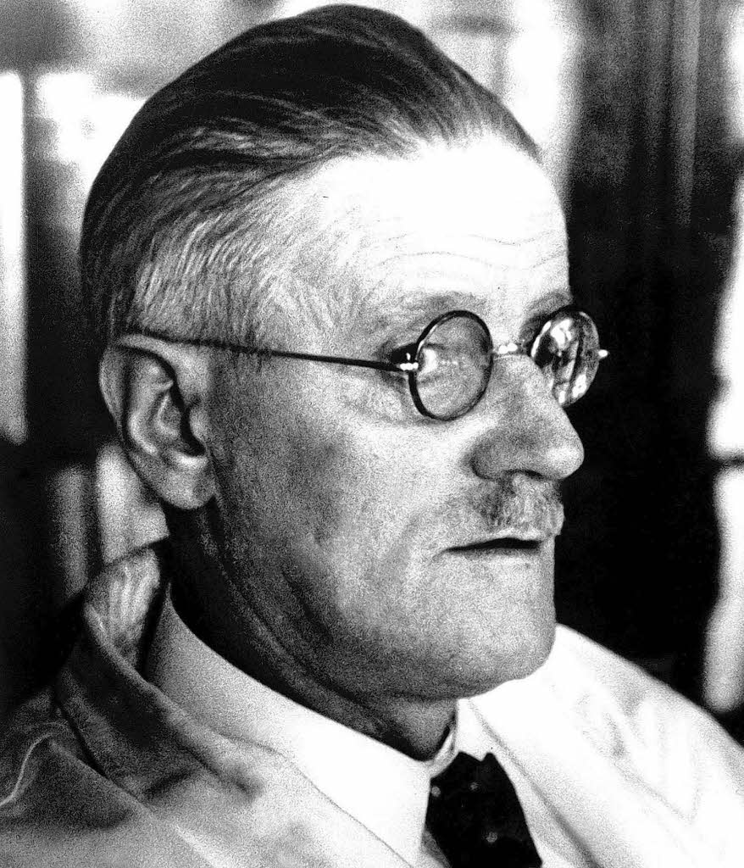
Characters
This Photo by Unknown Author is licensed under CC BY-NC-ND

Slide 4
The Irish Stereotype
Catholic
Strictly religious household
Family:
Crowded families
Drunk and/or violent father
One or both parents might be dead or missing from the picture
Filial duty to parents

Slide 5
The room as micro setting
Dust symbolism
Religious elements

Slide 6
Inertia

Slide 7
The twelve promises of jesus to st. Margaret mary
1. I will give them all the graces necessary in their state of life. 2. I will establish peace in their homes. 3. I will comfort them in all their afflictions. 4. I will be their secure refuge during life, and above all, in death. 5. I will bestow abundant blessings upon all their undertakings. 6. Sinners will find in My Heart the source and infinite ocean of mercy. 7. Lukewarm souls shall become fervent. 8. Fervent souls shall quickly mount to high perfection. 9. I will bless every place in which an image of My Heart is exposed and honored. 10. I will give to priests the gift of touching the most hardened hearts. 11. Those who shall promote this devotion shall have their names written in My Heart. 12. I promise you in the excessive mercy of My Heart that My all powerful love will grant to all those who receive Holy Communion on the First Fridays in nine consecutive months the grace of final perseverance; they shall not die in My disgrace, nor without receiving their sacraments. My divine Heart shall be their safe refuge in this last moment.
Notes:
From https://welcomehisheart.com/12-promises

