Slide 1
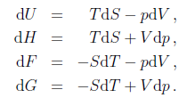
Combined formulations of the first and second laws of thermodynamics
We will assume that every system referred to is closed and homogeneous, that it exchanges only volume work with its surroundings, and that all the occurring processes are reversible.
Now that we have defined all independent energy quantities in terms of p, V, T, and S, we summarize them in terms of their natural variables:
Gibbs equations
The thermodynamic functions H, F, G we obtain relations which are called the combined formulations of the first and second laws of thermodynamics, or the Gibbs equations:

Slide 2
Internal energy is a function of variables S and V . Variables S and V will be called the natural variables of function U. The natural variables of enthalpy are S and p, those of the Helmholtz energy are T and V , and those of the Gibbs energy are T and p.
Derivatives of U, H, F, and G with respect to natural variables
If we consider the internal energy U as a function of S and V , its total differential is
These equations are important because when the behaviors of these energies on their natural variables are known, all thermodynamic properties of the system can be determined.
For example, consider the internal energy, U. Its natural variables are S and V; that is, the internal energy is a function of S and V:

Slide 3
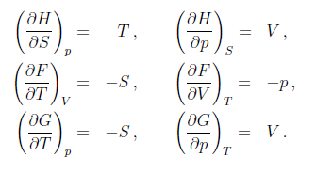
The change in internal energy as the entropy changes at constant volume equals the temperature of the system.
The change in internal energy as the volume changes at constant entropy equals the negative of the pressure.
Maxwell relations
By applying the equalities of mixed derivatives to the Gibbs equations through to the total differentials of the functions U, H, F, G, we obtain the so-called Maxwell relations

Slide 4
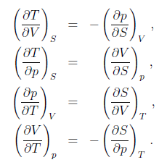
The equations involving partial derivatives of the thermodynamic energies can be taken a step further.
In other words, the change in a state function depends only on the initial and final conditions.
Maxwell relations rank among the major thermodynamic relations. They are used to derive many other equations.

Slide 5
The Maxwell relationships are useful for two reasons. First, all of them are generally applicable. They are not restricted to ideal gases, or even just gases. Second, they express certain relationships in terms of variables that are easier to measure.
For example, it might be difficult to measure entropy directly and determine how entropy varies with respect to volume at constant temperature.
If we measure the change in pressure with respect to temperature at constant volume, (p/T)V, we know (S/V)T. The Maxwell relationships are also useful in deriving new equations that we can apply to thermodynamic changes in systems, or in determining the values of changes in state functions that might be difficult to measure directly by experiment. The following examples use the same Maxwell relationship in two different ways.

Slide 6
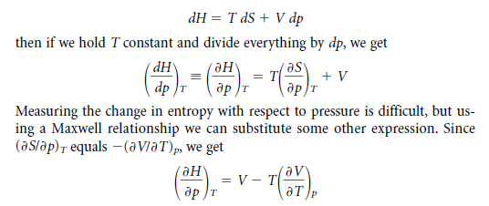
Using Maxwell Relationships
The Maxwell relationships can be useful in deriving other equations for thermodynamics.
Why is this equation useful?
Because, we can use that information to calculate how the enthalpy varies with pressure at constant temperature.

Slide 7
Total differential of entropy as a function of T, V and T, p
The total differential of entropy as a function of temperature and volume, S = f(T, V ), is
For the differentiation of entropy with respect to volume, Maxwell relation applies.
At a fixed volume it follows
In the same way we obtain for entropy as a function of temperature and pressure

Slide 8
and using Maxwell relation
Conversion from natural variables to variables T, V or T, p
Internal energy may be converted from the function of natural variables to the function of
variables T, V using equation, into which we substitute relation for dS.
In the same way, H = f(S, p) may be converted to H = f(T, p). By combining equations and we arrive at

Slide 9
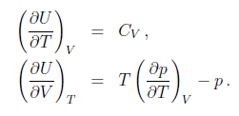
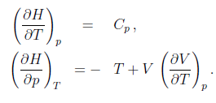
The total differential of the function U = f(T, V ) is equal to the expression
By comparing
Similarly we obtain the respective partial derivatives of the dependence H = f(T, p)

