Slide 1
CaCO₃ Purity Determination
Calcium carbonate (CaCO3) cannot be directly titrated since it’s not soluble in water. At this point, it can be analyzed using the back titration method.
In back titration, a sample solution (A) reacts with excess amount of standard solution “B”. As a result of the reaction, a portion of the solution B remains in the erlenmeyer flask in excess. A titration is then performed with a titrant (standard solution) “C” to react with the remaining B solution. This whole process is called as “Back titration”.
(A)
(B)
(C)

Slide 2
Experimental Procedure:
Carefully weigh 0.1-0.2 g of solid CaCO₃ sample into an erlenmeyer flask and note the exact amount.
Add 50 mL of standard HCl solution from a buret into the erlenmeyer flask.
A portion of the added acid reacts with CaCO₃.
CaCO₃ + 2HCl CaCl₂ + H₂O + CO₂
Heat the erlenmeyer on wire gauze for 2-3 minutes in order to remove the CO₂.
Add 1-2 drops of phenolphthalein and titrate the remaining acid in the erlenmeyer flask with standard NaOH until a permanent pink color is observed.
HCl + NaOH NaCl + H₂O

Slide 3
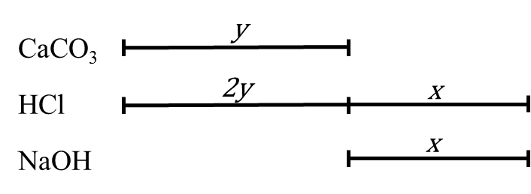
Calculation
Moles of NaOH consumed during titration : $n_{NaOH}=M_{NaOH}×V_{NaOH}$
According to the reaction equation:
If 1 mol NaOH reacts with 1 mol HCl
n_{NaOH} mol NaOH reacts with x mol HCl
Total HCl added into the erlenmeyer flask: $n_{HCl(total)}=M_{HCl}×V_{HCl}$
When we subtract the moles of HCl, which neutralized the NaOH, from the total moles of HCl, we find the moles of HCl, which reacted with CaCO₃.
moles of HCl, which reacts with CaCO₃ $=n_{HCl(toplam)}−x$
According to the reaction equation:
If 2 moles HCl reacts with 1 mol CaCO₃
$n_{HCl(total)}−x$ mol HCl reacts with y mol CaCO₃
The moles of CaCO₃ found from this ratio (y) is the moles of CaCO₃ in the erlenmeyer flask, which means the moles of CaCO₃ in the weighed solid. The mass of CaCO₃ in the weighed sample can be calculated using y. (${MW}_{{CaCO}_{3}}=100 g/mol$)
$$m_{CaCO_{3}}=y ×{MWt}_{CaCO_{3}}$$
The amount of pure CaCO₃ is calculated as the % of the sample weighed.
$$\% purity=\frac{m_{CaCO_{3}}}{m_{weighed}}×100$$
Reference: Analitik Kimya Pratikleri – Kantitatif Analiz (Ed. Feyyaz ONUR), 2014

