Slide 1
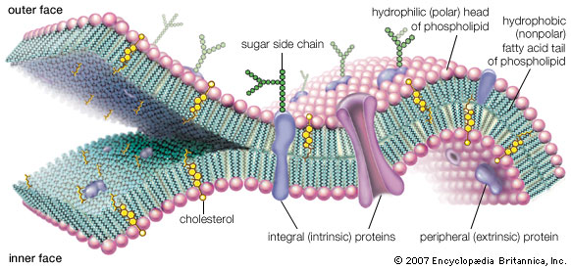
Membranes, CHANNELS AND TRANSFER WEEK 3
Dr. C. Etkin ŞAFAK
Ankara University
Department of Physiology

Slide 2
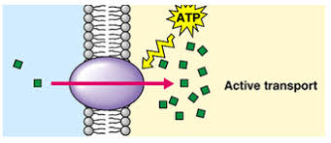
ACTIVE TRANSPORT
It uses energy to move a substance uphill across a membrane.
Requires binding of a substance to the transporter in the membrane
Because these transporters move the substance uphill, they are often referred to as “pumps.”
Transporters exhibit specificity and saturation
The flux via the transporter is maximal when all transporter binding sites are saturated.

Slide 3
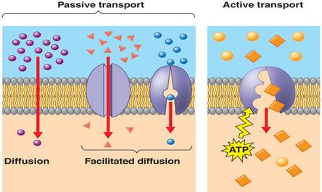
ACTIVE TRANSPORT
The net movement and the maintenance of a higher steady-state concentration can be achieved by the continuous input of energy.
This energy can;
(1) alter the affinity of the binding site on the transporter;
(2) alter the rates at which the binding site on the transporter is shifted from one surface to the other.

Slide 4
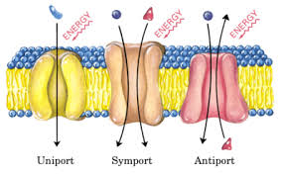
ACTIVE TRANSPORT
Active transport mechanisms can be divided into two categories.
Primary active transport: directly uses a source of chemical energy (e.g., ATP) to move molecules across a membrane against their gradient.
Secondary active transport (cotransport): uses an electrochemical gradient – generated by active transport – as an energy source to move molecules against their gradient,
does not directly require a chemical source of energy such as ATP.

Slide 5
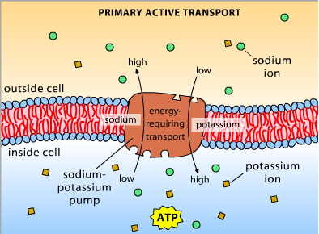
PRIMARY ACTIVE TRANSPORT
One of the most important pumps in animal cells is the sodium-potassium pump, which moves Na​+ out of cells, and K+ into them.
The transport process uses ATP as an energy source - primary active transport.
the sodium-potassium pump maintain correct concentrations of Na+ and K+ in living cells,
it plays a major role in generating the voltage across the cell membrane in animal cells.
Pumps like this, which are involved in the establishment and maintenance of membrane voltages, are known as electrogenic pumps.

Slide 6
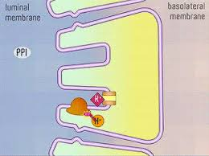
PRIMARY ACTIVE TRANSPORT
The sodium-potassium pump transports sodium and potassium - three sodium ions exit the cell, while two potassium ions enter.
This results in the net transfer of positive charge to the outside of the cell
H,K-ATPase is in the plasma membranes of the acid-secreting cells in the stomach and kidneys
Ca-ATPase is found in the plasma membrane and several organelle membranes, including the membranes of the endoplasmic reticulum

Slide 7
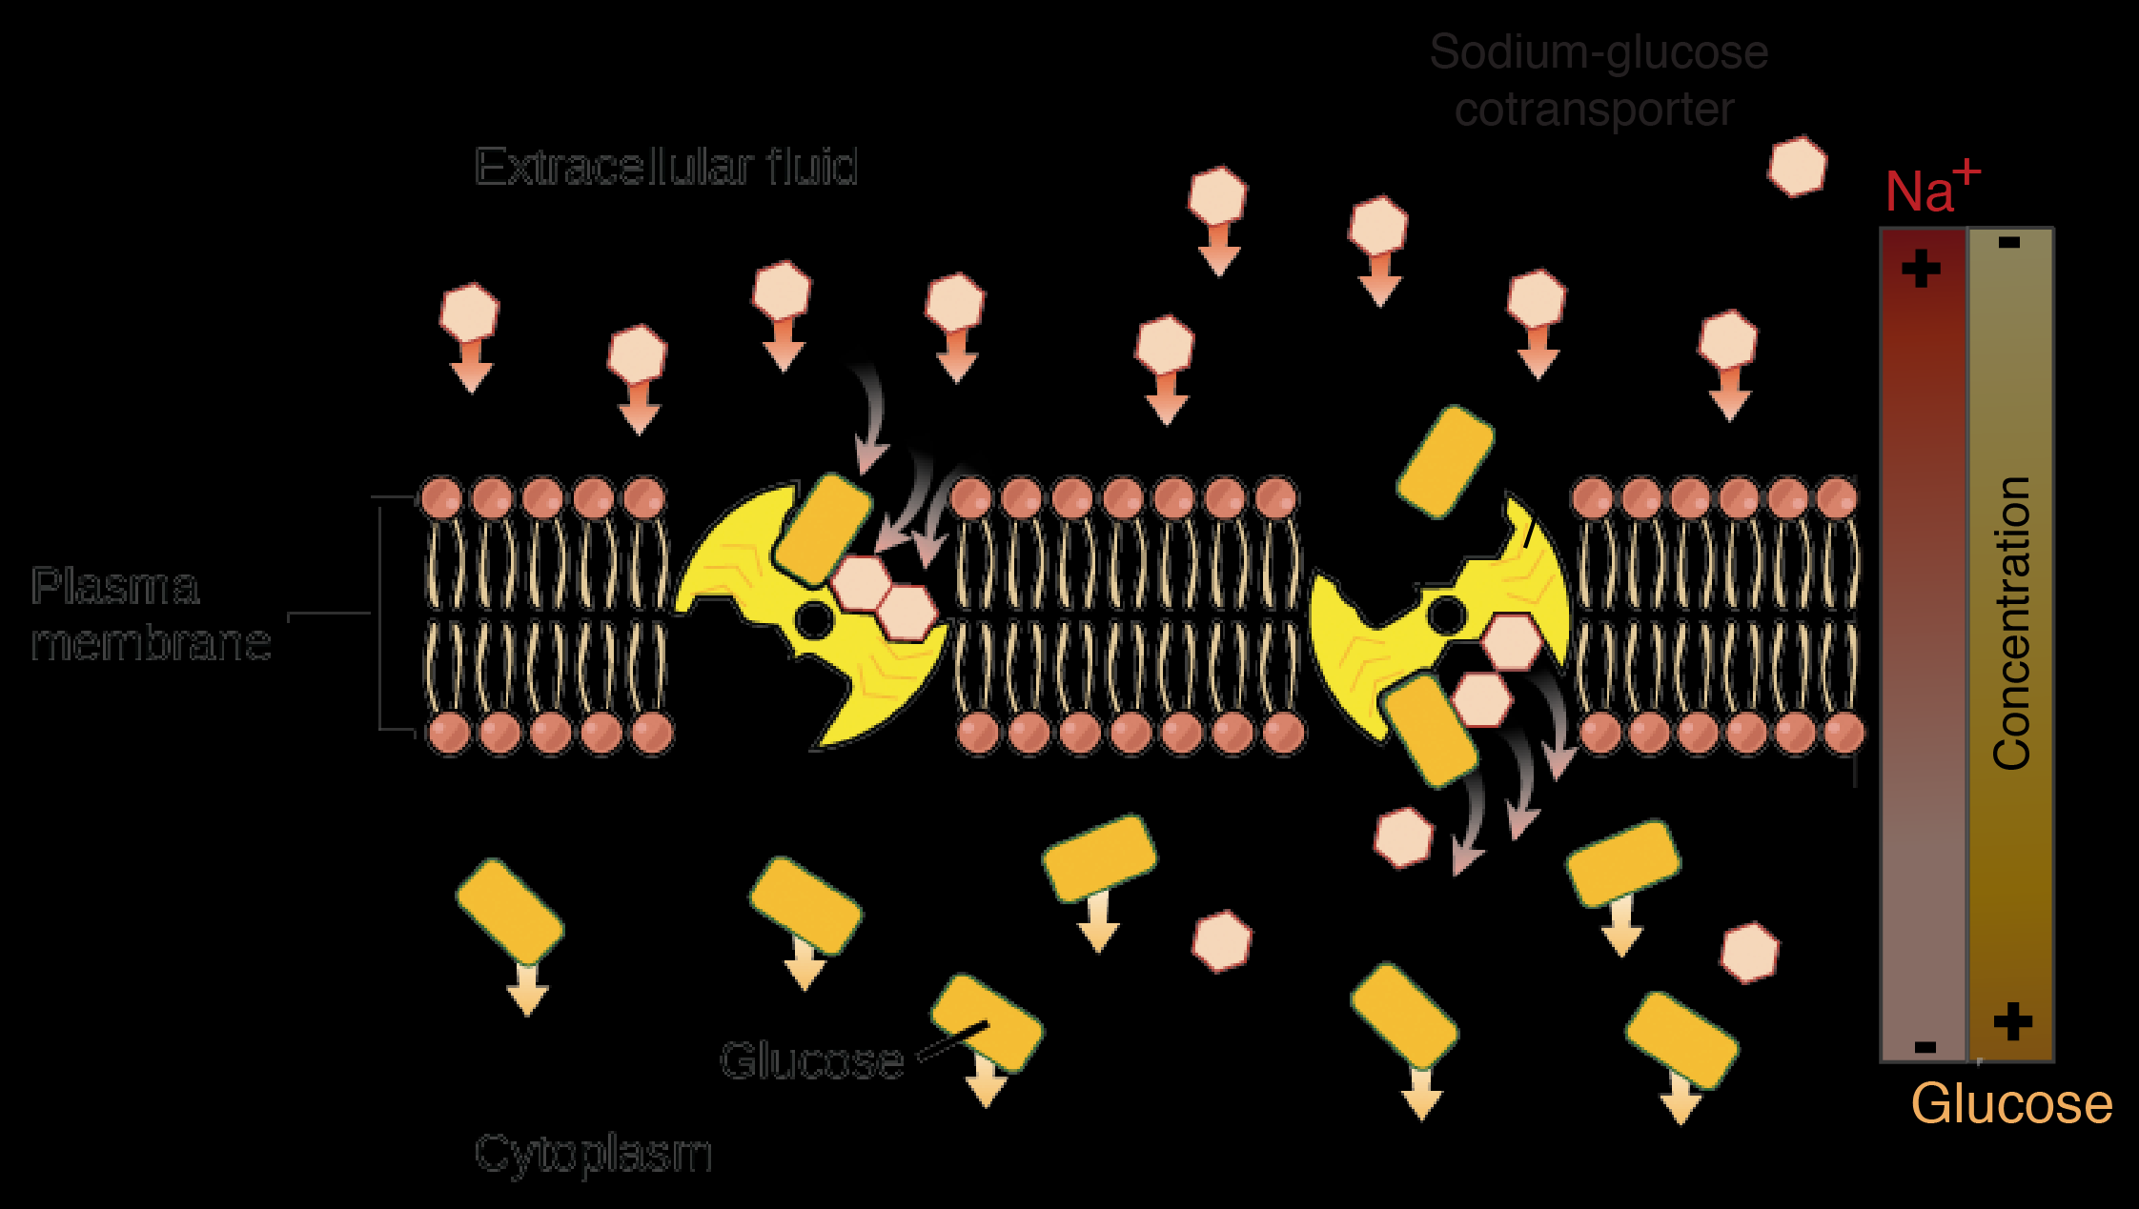
SECONDARY ACTIVE TRANSPORT
The flow of ions from a higher concentration to a lower concentration provides energy for the uphill movement of the actively transported solute.
In addition to having a binding site for the actively transported solute, the transport protein also has a binding site for an ion - This ion is usually sodium
The energy for secondary active transport is derived from metabolism in the form of the ATP that is used by the Na,K-ATPase to create the sodium concentration gradient.
Molecules being transported may move either in the same direction or in opposite directions
When they move in the same direction, the protein that transports them is called a symporter, while if they move in opposite directions, the protein is called an antiporter.

Slide 8
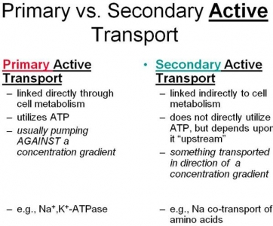
SECONDARY ACTIVE TRANSPORT

Slide 9
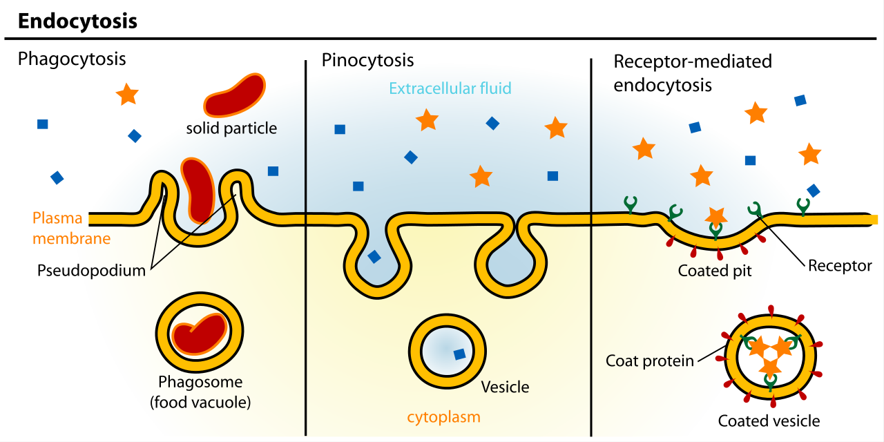
ENDOCYTOSIS
Endocytosis is the movement of larger particles (too large to move through transport proteins) into the cell by use of membrane vesicles.
Phagocytosis - “cell eating”- Larger molecules or particles are brought into the cell by engulfing them into a plasma membrane vesicle.
Pinocytosis - “cell drinking”- Dissolved molecules are brought into the cell by engulfing them into a plasma membrane vesicle
Receptor Mediated Endocytosis - Receptor mediated- Receptors on the outside of cell membrane allow for the attachment of a particular molecule.
When a certain number of receptor sites are filled, endocytosis occurs.

Slide 10
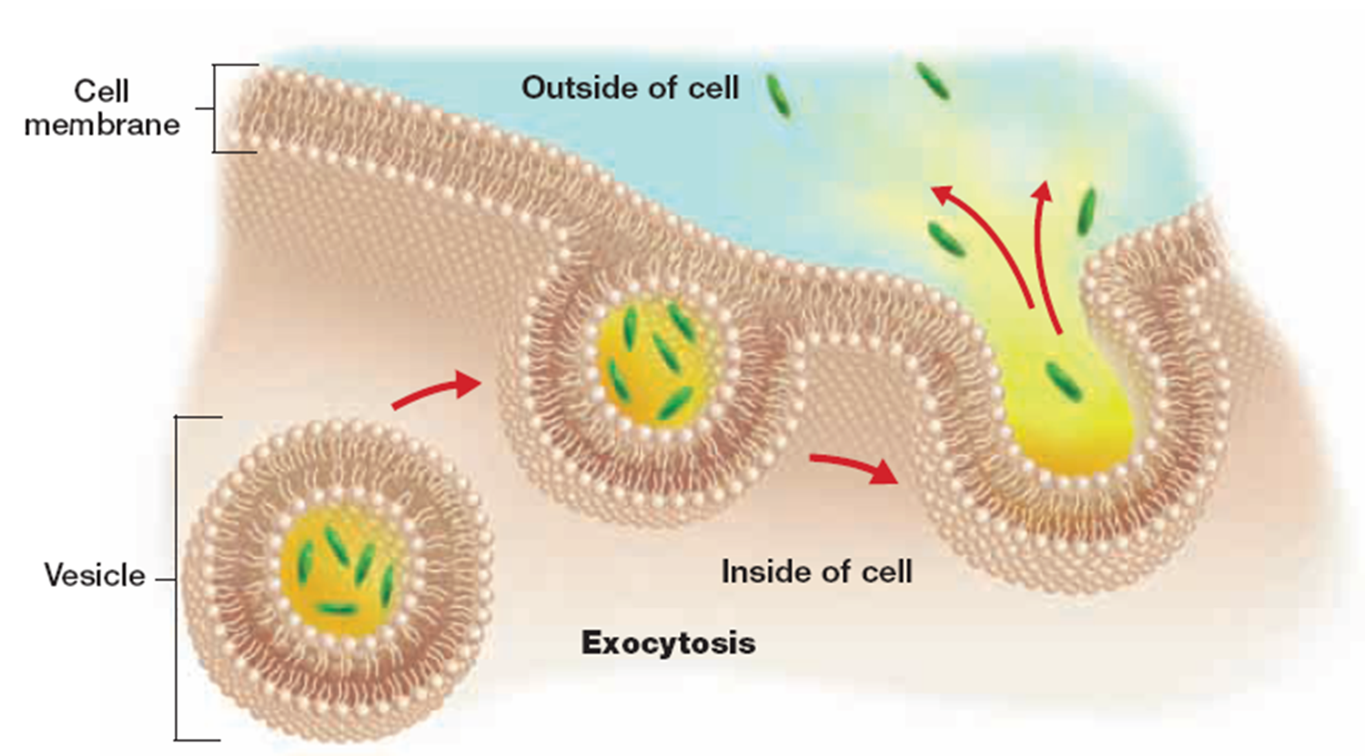
EXOCYTOSIS
Exocytosis is just the opposite of endocytosis.
Material to be secreted usually moves through the compartments of the Golgi apparatus where it may be modified.
The material is then surrounded by membrane forming a vesicle.
Release toxins and waste products
Release proteins
Control activity of other cells

Slide 11
ACTIVE TRANSPORT

Slide 12
ANY QUESTIONS?
Any Questions?

