Slide 4
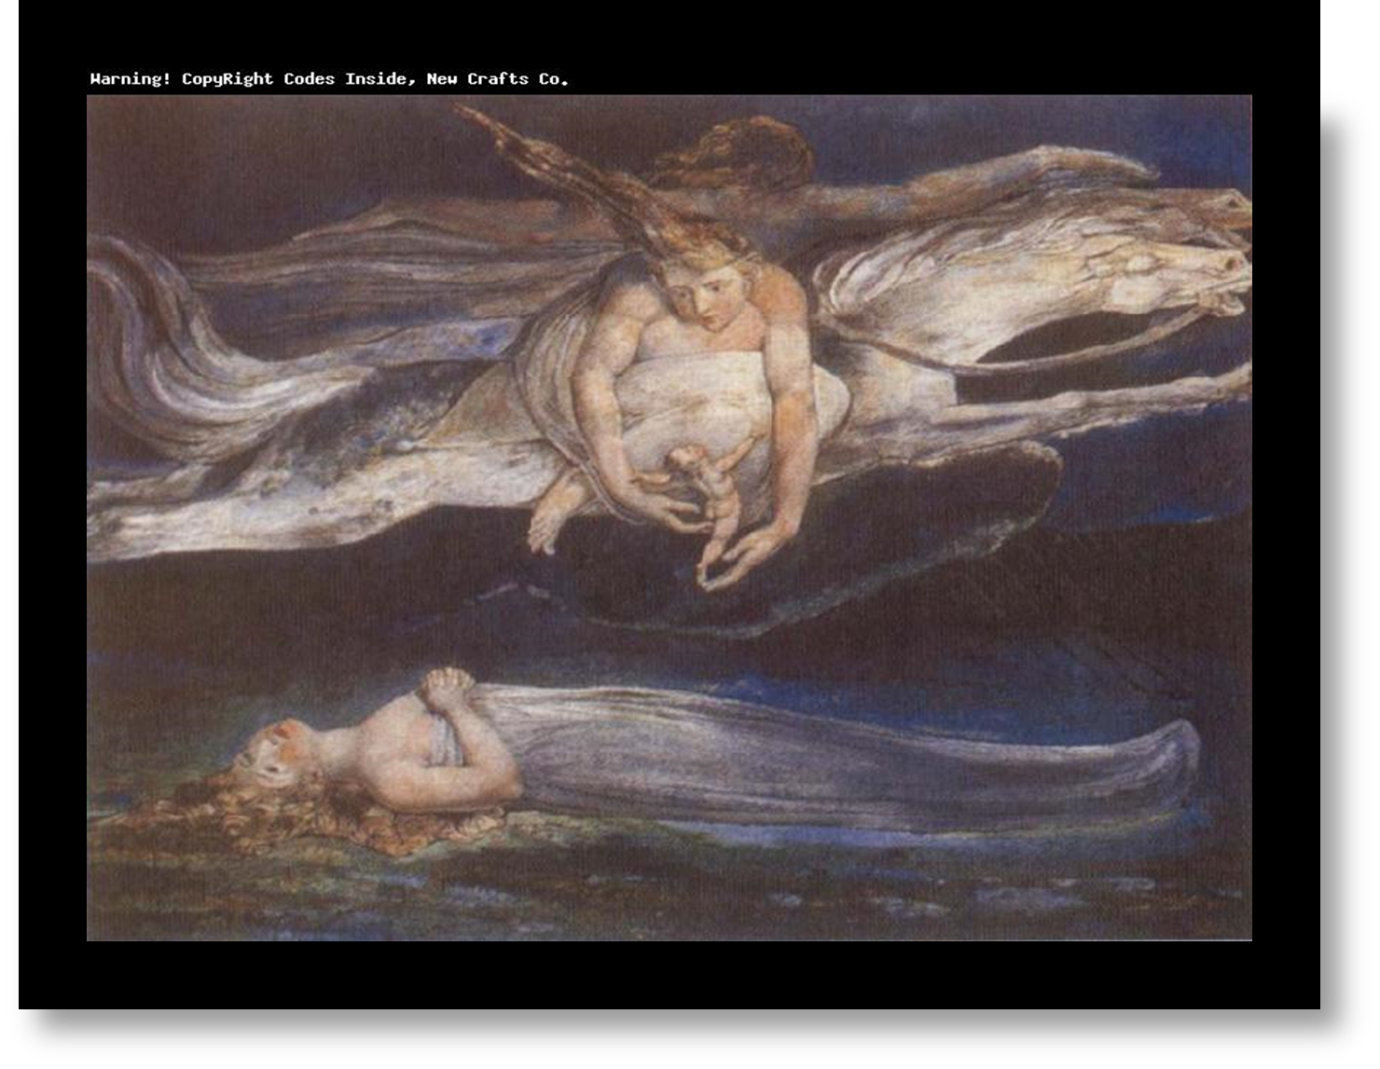

Slide 6
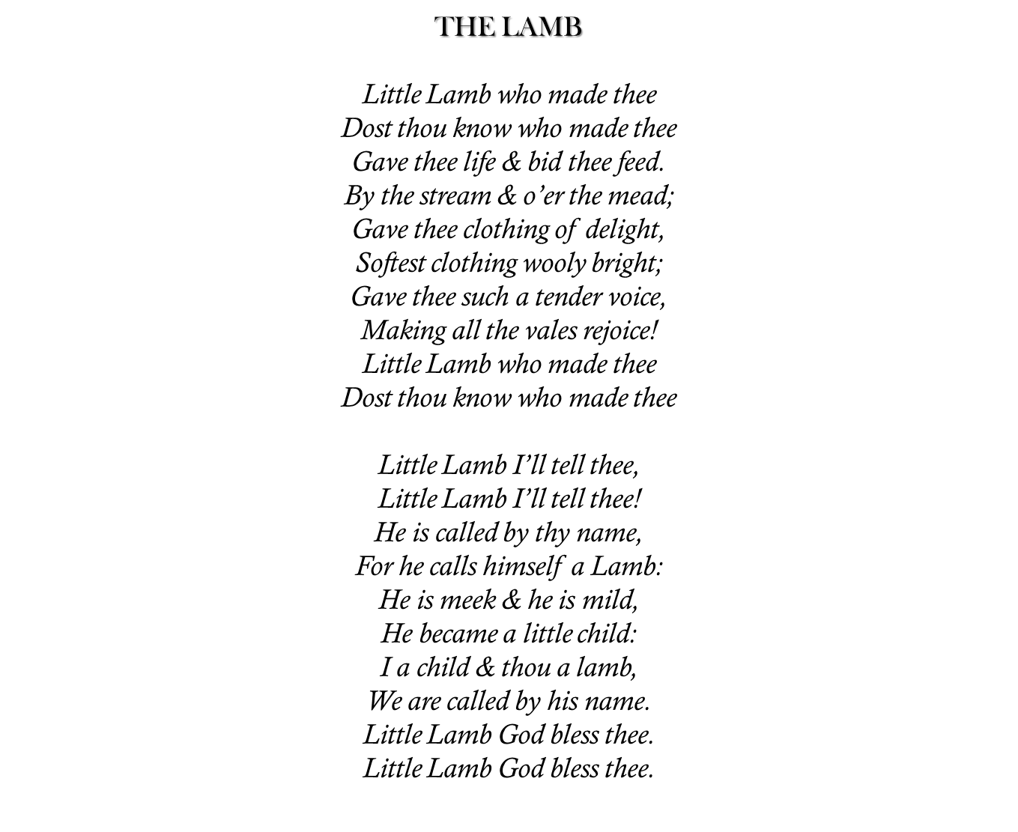

Slide 7
In the poem “The Lamb”, William Blake incorporates his unique style through the use of religious symbolism, creative lines, and simple patterns.
“The Lamb” was a part of a series of poems called the “Songs of Innocence” that was published in 1789. Poems that were more simplistic in style and nature became more contrition and prophetic in Songs of Experience. Through simplistic structure, he chose the narrator of a child, as in this poem, told through childlike eyes, speaking of the innocence in all of human life, and that the lamb is Christ, marveling over God’s creations.
Blake utilizes his rhetoric genius by symbolically expressing the appearance of the lamb to that of the nature of God. Within the poem, Blake brings up an interesting concept by stating, “He is called by thy name / For he calls himself a Lamb”, the lamb not only suggest innocence and the meaning of life, but at the same time conveys the theme that Christ is the lamb (Blake 662). The poem comments on how “he is meek and he is mild”, thus giving God the characteristics of goodness and purity (Blake 662). This gives a varying contrast to Blake’s poem “The Tyger” as it advocates the speculation of evil.

Slide 8
The Tyger
Tyger Tyger, burning bright,
In the forests of the night;
What immortal hand or eye,
Could frame thy fearful symmetry?
In what distant deeps or skies.
Burnt the fire of thine eyes?
On what wings dare he aspire?
What the hand, dare seize the fire?
And what shoulder, & what art,
Could twist the sinews of thy heart?
And when thy heart began to beat,
What dread hand? & what dread feet?
What the hammer? what the chain,
In what furnace was thy brain?
What the anvil? what dread grasp,
Dare its deadly terrors clasp!
When the stars threw down their spears
And water'd heaven with their tears:
Did he smile his work to see?
Did he who made the Lamb make thee?
Tyger Tyger burning bright,
In the forests of the night:
What immortal hand or eye,
Dare frame thy fearful symmetry?

Slide 9
William Blake’s, “The Tyger”, is the poetic counterpart to the Lamb of Innocence from his previous work, Songs of Innocence, thus creating the expression of innocence versus experience “What immortal hand or eye / Dare frame thy fearful symmetry” (Blake 770).
“The Tyger” is part of the continued series of lyrics titled Songs of Experience that was published in 1794, as a response to the Songs of Innocence. The Songs of Experience are interpreted as the child, conveyed in Songs of Innocence, matures to adulthood and is molded by the harsh experiences and negative forces that reality has on human life, thus shows the destructiveness of the tiger.
Blake utilizes his deceptively complex ideas, symbolism, and his allusiveness to portray the essence of “evil” in “The Tyger”. Blake uses “tyger” instead of tiger because it refers to any kind of wild, ferocious cat. The symbolism of the “hammer”, “chain”, “furnace”, and “anvil” all portray the image of the blacksmith, one of the main central themes in this poem (Blake 769). William Blake personifies the blacksmith to God, the creator, and Blake himself.

Slide 14
I Wandered Lonely as a Cloud
I wandered lonely as a cloud
That floats on high o'er vales and hills,
When all at once I saw a crowd,
A host, of golden daffodils;
Beside the lake, beneath the trees,
Fluttering and dancing in the breeze.
Continuous as the stars that shine
And twinkle on the milky way,
They stretched in never-ending line
Along the margin of a bay:
Ten thousand saw I at a glance,
Tossing their heads in sprightly dance.
The waves beside them danced; but they
Out-did the sparkling waves in glee:
A poet could not but be gay,
In such a jocund company:
I gazed—and gazed—but little thought
What wealth the show to me had brought:
For oft, when on my couch I lie
In vacant or in pensive mood,
They flash upon that inward eye
Which is the bliss of solitude;
And then my heart with pleasure fills,
And dances with the daffodils.

Slide 15
As this poem is about the captivating beauty of nature, it has been written from the subjective point of view. It details the poet’s encounters with the majestic daffodils in the field beside the lake. The expression of wonder can be felt throughout the poem. The feeling of enjoying the spellbinding beauty of nature and its impacts on the human mind can leave the reader desiring to spend more time with nature.

Slide 18
The ancient mariner is the only survivor of the disasters.
As a punishment, he is compelled to wander the world forever telling his story and conveying the moral message of the poem: one does not have the right to destroy any of God’s creatures.
The combination of the supernatural and the ordinary creates an atmosphere of mystery in the poem.
The poem illustrates Coleridge’s idea of the dramatic truth and the suspension of disbelief.
Many features of ballads can be seen in this poem:
The combination of dialogue and narration
The four-line stanza
Frequent repetition
Alliteration
Internal rhyme

Slide 19
The Rime of the Ancient Mariner
[…]
'God save thee, ancient Mariner!
From the fiends, that plague thee thus!—
Why look'st thou so?'—With my cross-bow
I shot the ALBATROSS.
[…]
Day after day, day after day,
We stuck, nor breath nor motion;
As idle as a painted ship
Upon a painted ocean.
Water, water, every where,
And all the boards did shrink;
Water, water, every where,
Nor any drop to drink.

Slide 26
Ode to the West Wind
[StanzaV]
Make me thy lyre, even as the forest is:
What if my leaves are falling like its own!
The tumult of thy mighty harmonies
Will take from both a deep, autumnal tone,
Sweet though in sadness. Be thou, Spirit fierce,
My spirit! Be thou me, impetuous one!
Drive my dead thoughts over the universe
Like wither'd leaves to quicken a new birth!
And, by the incantation of this verse,
Scatter, as from an unextinguish'd hearth
Ashes and sparks, my words among mankind!
Be through my lips to unawaken'd earth
The trumpet of a prophecy! O Wind,
If Winter comes, can Spring be far behind?

Slide 27
The poem begins with three cantos describing the wind's effects upon earth, air, and ocean. The last two cantos are Shelley speaking directly to the wind, asking for its power, to lift him like a leaf, a cloud or a wave and make him its companion in its wanderings. He asks the wind to take his thoughts and spread them all over the world so that the youth are awoken with his ideas. The poem ends with an optimistic note which is that if winter days are here then spring is not very far.

Slide 30
Ode on a Grecian Urn
[Last stanza]
O Attic shape! Fair attitude! with brede
Of marble men and maidens overwrought,
With forest branches and the trodden weed;
Thou, silent form, dost tease us out of thought
As doth eternity: Cold Pastoral!
When old age shall this generation waste,
Thou shalt remain, in midst of other woe
Than ours, a friend to man, to whom thou say'st,
"Beauty is truth, truth beauty,—that is all
Ye know on earth, and all ye need to know."

Slide 31
The ode contains a narrator's discourse on a series of designs on a Grecian urn.
The poem focuses on two scenes: one in which a lover eternally pursues a beloved without fulfillment, and another of villagers about to perform a sacrifice.
Critics have focused on other aspects of the poem, including the role of the narrator, the inspirational qualities of real-world objects, and the paradoxical relationship between the poem's world and reality.
This ode contains the most discussed two lines in all of Keats's poetry - '"Beauty is truth, truth beauty," - that is all/Ye know on earth, and all ye need to know.'
"Ode on a Grecian Ode" is based on a series of paradoxes and opposites:
the discrepancy between the urn with its frozen images and the dynamic life portrayed on the urn,
the human and changeable versus the immortal and permanent,
participation versus observation,
life versus art.

