Slide 1
COM 412
Information Technology and Security Governance

Slide 2
IT & Security Governance
AIM:
To provide;
* an introduction to information technologies and security management,
* an understanding of principles, standards, operations, and phases of management.

Slide 3
IT & Security Governance

Slide 4
IT & Security Governance

Slide 5
IT & Security Governance
TEXTBOOKs:
* F. Castillo, Managing Information Technology, Springer International Publishing, Switzerland 2016
* T. Campbell, Practical Information Security Management: A Complete Guide to Planning and Implementation, Apress, Australia 2016

Slide 6
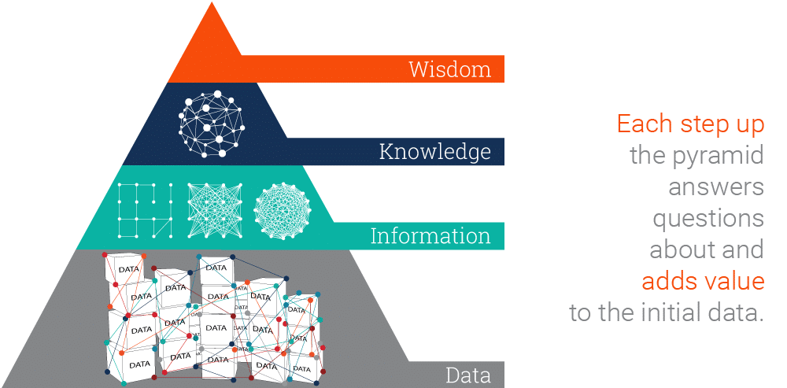
Data, Information, Knowledge, and Wisdom

Slide 7
Data, Information, Knowledge, and Wisdom
Data
PROCESS
Information
MAKE USE OF
Knowledge
Notes:
Turning data into information is a process.

Slide 8
Data, Information, Knowledge, and Wisdom
Data 09/01 18:29:45: Message from InterMapper 5.8.1
Event: Critical Name: http://website-host.leeds.ac.uk Nagios Plugin Document: Unix: Webhosting Address: 129.11.1.1 Probe Type: Nagios Plugin Condition: CRITICAL – Socket timeout after 10 seconds
Time since last reported down: 39 days, 3 hours, 12 minutes, 47 seconds Device’s up time: N/A
Information This alert relates to one of our website servers. This is not normal behaviour.
Knowledge
There is a planned network upgrade in one of our data centres between 18:00 – 19:00 which is expected to cause network outages. The server is part of a clustered pair with only one node affected, so service to end users will not be interrupted.
Wisdom No action is required.

Slide 9
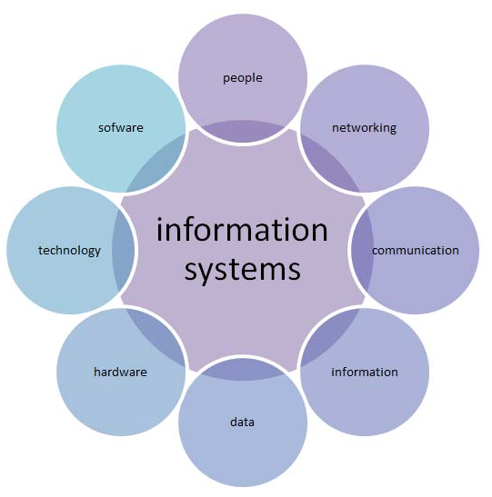
IS vs. IT
Notes:
A computer-based information system (CBIS) is a single set of hardware, software, databases, networks, people, and procedures that are configured to collect, manipulate, store, and process data into information.
Information systems refers to the management of an entire set of information, and it includes not only the technology components involved, but the people and processes as well.
Information technology is the study, design, implementation, support, or management of computer-based information systems.

Slide 10
IT & Security Governance
IT functions:
* Day-to-day (O&M)
Internal or external?
* Projects
Notes:
IT refers to anything related to computing technology, such as networking, hardware, software.
Operations & Maintenance
Deals with maintaining all of the IT services available
Keeping things running,
Dealing with the request for changes that are raised by the different users of the IT systems,
Projects
refer to new deployments of IT services in the form of systems, applications and infrastructure.

Slide 11
IT & Security Governance
O&M vs. Projects
* Distinct start and finish - continuous
* Initiate-plan-execute and close phases - no distinct phases

Slide 12
IT & Security Governance
O&M vs. Projects
* Creates its own charter, organization, and goals
* Semi-permanent charter, organization, and goals
* Purpose of status quo, Purpose of change
* Unique product or service, Predefined and approved product or service
* Heterogeneous team
* Fully known process deliverables, Progressively elaborated process deliverables

Slide 13
IT & Security Governance
O&M vs. Projects
* IT project outputs may lead to additional services, which will then need to be supported by O&M.
* O&M can also request and initiate a project as part of its effort to continuously improve.

Slide 14
IT & Security Governance
Systems, Processes, and People
* Applications, infrastructure, and other assets which execute and automate particular business functions.
* Way in which the systems are setup to conduct a particular business function.
* IT Department’s staff and all end users.
Notes:
IT is related to three main components: systems, processes, and people.

Slide 15
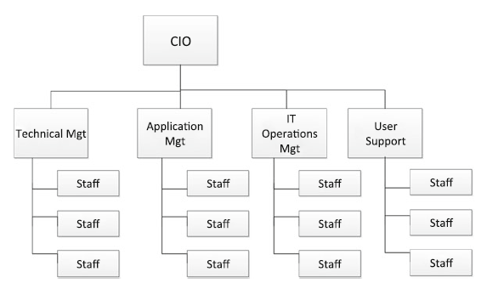
IT & Security Governance
IT Organization
Notes:
From the point of view of operations versus projects, there are several variations on the type of organizations.
This is a typical operations-focused IT structure.
CIO: chief info. officer
TM: is in charge of the general upkeep of all infrastructure components.
AM: handles everything that affects processes and their behavior, while TM handles all technical aspects (business analysis, coding …)
IT Op.M.: responsible for the day to day management and maintenance of the IT Infrastructure

Slide 16
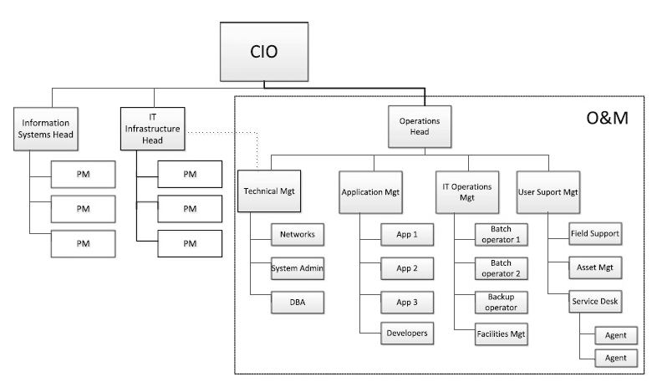
IT & Security Governance
IT Organization
Notes:
Project and operations combined IT structure.
the head for IS is in charge of strategy and new projects.

Slide 17
IT & Security Governance
Managing Operations
ITSM
* ensures that the right processes, people, and technology are in place so that the organization can meet its business goals through the service provided by IT.
* craft of implementing, managing, and delivering IT services to meet the needs of an organization.
* is the art of making a business run.
Notes:
We will discuss the specific and detailed roles and responsibilities of each team in the organization according to ITSM framework.

Slide 18
IT & Security Governance
ITSM
* ITIL (IT Infrastructure Library) - the ITSM Best Practice Framework
* BiSL – A framework used for information management
* COBIT (Control Objectives for Information and Related Technology) – A framework for the governance and management of enterprise IT
* ISO/IEC 20000 – A service management system standard from the International Organization for Standardization (ISO)
* MOF – the Microsoft Operations Framework
* Six Sigma – a methodology with tools and techniques for process improvement
* TOGAF – an enterprise architecture methodology and framework
* USMBOK – a series of publications and references for professionals working in service provider organizations
Notes:
ITIL is a view on how to do ITSM. It is the well-known and the most common framework for ITSM.

Slide 19
IT & Security Governance
Service:
* something that meets a need or fulfills a demand,
* a means of delivering value to customers by facilitating outcomes that customers want to achieve without the ownership of specific costs and risks
Value:
* is generated through exchange of knowledge, information, goods or services,
* of a service comes from what it enables someone to do.

Slide 20
IT & Security Governance
Value:
* The main purpose of a service provider is creating value to its customers with its services.
* The customer perceives the value of a service not only in financial dimensions.

Slide 21
IT & Security Governance
Value:
* Let’s imagine that you need a car.
* There are several brands, several features, and options in the market, e.g. Ferrari, Mercedes, and Opel.
* They are all cars but depending on your needs and budget, you would select the optimum option.
* And if you buy a Ferrari, you wouldn’t think “Opel is a Car, and Ferrari is a Car as well but I paid a lot!”.
Value perception is shaped with the quality of the services and price of the service together.

Slide 22
IT & Security Governance
Output:
* What a service provider delivers.
“A raised play area for my kid’s swing set”
Outcome:
* the results of carrying out an activity, following a process, or delivering an IT service etc. The term is used to refer to intended results as well as to actual results.
“My child plays daily in his outside play area, enjoys it, and the outcome I want is for him to be happy, which in turn makes me happy”

Slide 23
IT & Security Governance
Service Desk (Part of User Support Mngt.)
* Single point of contact for all users within an organization with IT for any request or incidence.
* Channels: Phone, Email, Web, App
* First Call Resolution
* Tickets may be resolved (closed) or escalated to App. or Tech. Mngt.
Notes:
Teams of an IT organization.

Slide 24
IT & Security Governance
Service Desk
* Tickets
- Incident: event which impairs the use of a service
- Request: User’s request for information, advice, for change, or for access to an IT Service

Slide 25
IT & Security Governance
Service Desk
* Necessary information for a ticket
- Complete description of the incidence or request
- Understanding who is requesting for the ticket
- Classifying the ticket correctly (the team to which the ticket should be escalated)

Slide 26
IT & Security Governance
Service Desk
* Ticket criticality changes according to
- Impact on services (severity)
- User
- Type of incident or request

Slide 27
IT & Security Governance
Tech. Mngt.
* In charge of the IT infrastructure
- System administration (OS & apps)
- DB administration
- Network management
- Management of servers and storage

Slide 28
IT & Security Governance
Tech. Mngt.
* Head of tech. mngt. is responsible for:
- Making sure skills are up-to-date and relevant
- HR resource capacity management
- Overall understanding of the technical architecture
- ITSM documentation custodian and overall Quality Assurance supervisor
- Monitoring of team’s compliance to the SLAs
Notes:
A service-level agreement (SLA) is a contract between a service provider and its customers that documents what services the provider will furnish and defines the service standards the provider is obligated to meet.

Slide 29
IT & Security Governance
App. Mngt.
* In charge of all CIs (conf. items – code files, drivers, docs, etc.) related to software
* Act as the bridge translating business requirements into technical specifications

Slide 30
IT & Security Governance
App. Mngt.
* Head of app. mngt. is responsible for:
- Making sure skills are up-to-date and relevant
- HR resource capacity management
- ITSM documentation custodian and overall Quality Assurance supervisor
- Monitoring of team’s compliance to the SLAs
- Maintaining coding standards
- Maintaining configuration standards and guidelines
- Assignment of tasks to developers

Slide 31
IT & Security Governance
IT Op. Mngt.
* Manages all aspects that directly concern the end-users
* The day-to-day activities that ensure to the users the
availability of the different IT services
* Two main func.:
- IT operations control (backup and restore, print and output, report generation, data investigation …)
- Facilities management (data centers, recovery sites)

Slide 32
IT & Security Governance
IT Services Lifecycle
Notes:
In general, IT services are planned, designed, created, released, maintained and operated, then retired, so these can be broken down into four distinct phases.

Slide 33
IT & Security Governance
Planning and Design Phase:
• What need will it address?
• What service level must be guaranteed?
• What is the needed infrastructure?
• What resources are needed?
• What will be the approximate duration to deliver the service?
• Will this be treated as a change request for O&M to handle or a new project? (anything beyond a certain number of man-days or anything requiring a new system or major infrastructure would be treated as a project.)
Notes:
Services are created for the purpose of servicing a demand by the users.
These are the questions to be asked at this phase.
O&M or new project decision would depend on IT’s policy.

Slide 34
IT & Security Governance
Release Phase:
refers to the different tasks and aspects that need to be undertaken before and during the release of the change into production.
Maintenance Phase:
refers to the day-to-day activities that are conducted in order to meet the defined Service Levels.
Notes:
Release phase: modification of configuration, testing, release approval, documentation (KB)
Maintenance Phase: Managing the infrastructure, receiving and processing any requests for changes, Analyzing and proactively managing events

Slide 35
IT & Security Governance
Retirement Phase:
• Advisory to all concerned users on the retirement of the service
• Final backup of the complete application (just in case there is a need to revert),
• Decommissioning of the application and related software and infrastructure components.

Slide 36
IT & Security Governance
IT strategy:
* The overall aim - to ensure that IT services are aligned and contribute to the overall company direction and objectives.
* Provides the guidance on how to design, develop, implement and improve service management.
* Plan of action to create an information technology capability for maximum, and sustainable value for an organization.
* It helps maximize the return on IT investments.
Notes:
For example, according to ITIL framework, you have to prepare a strategy charter.

Slide 37
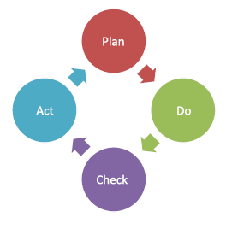
IT & Security Governance
Continual Service Improvement:
Notes:
management method used in business for the control and continuous improvement of processes and products.
-Plan for the improvement
-Do the action
-Check the results
-Act to adjust the plan based on the results

