Slide 1
Fundamentals of thermodynamics
The first postulate relates to the transition of a system to the state of equilibrium and is called zeroth law. The second postulate states that the internal energy of a system is an extensive quantity and is called first law. These and the remaining two postulates are called the laws of thermodynamics.
The zeroth law of thermodynamics
The zeroth law of thermodynamics is sometimes called the postulate on the existence of temperature as a thermodynamic quantity. It allows us to find out whether two systems that are not in thermal contact have the same temperature.

Slide 2
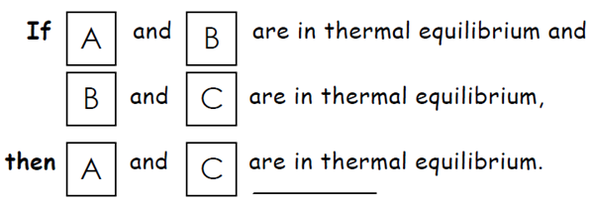
In that case, according to zeroth law of termodynamics, foloowing results is given

Slide 3
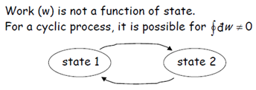
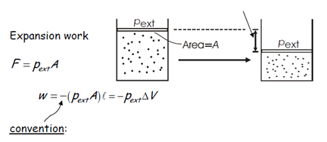
The first law of thermodynamics

Slide 4
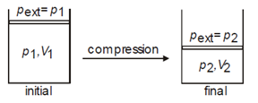

Slide 5
Heat

Slide 6
With this law it is defined new function of state called internal energy U. For its total differential dU we write
dU = dQ + dW
Equation does not apply to open systems
where the symbols dQ and dW are not total differentials but represent infinitesimal values of heat Q and work W supplied to the system.
ΔU = Q +W

Slide 7
Isothermal gas expansion

Slide 9
