Slide 1
ANAMNESIS PHYSICAL EXAMINATION AND LAB TESTS IN PATIENTS WITH UROLOGIC DISEASES
Assoc.Prof.Dr. Evren Süer
Department of Urology
Ankara University Faculty of Medicine

Slide 2
MEDICAL HISTORY
A complete history includes
Chief Complaint
History of present illness
Past medical and surgical history
History of allergic reactions
Social and family history
Review of systems

Slide 3
SYSTEMİC MANIFESTATIONS
Fever
Simple acute cystitis is essentially an afebrile disease
Acute prostatitis or pyelonephritis causes high tempratures
Renal carcinomas sometimes causes fever that may reach 39 degrees
Absence of fever does not rule out renal infection (e.g. Chronic pyelonephritis)

Slide 4
SYSTEMİC MANIFESTATIONS
Weight loss
Usually expected in the advanced stages of cancer
May be noticed secondary to renal insufficiency due to obstruction or infection

Slide 5
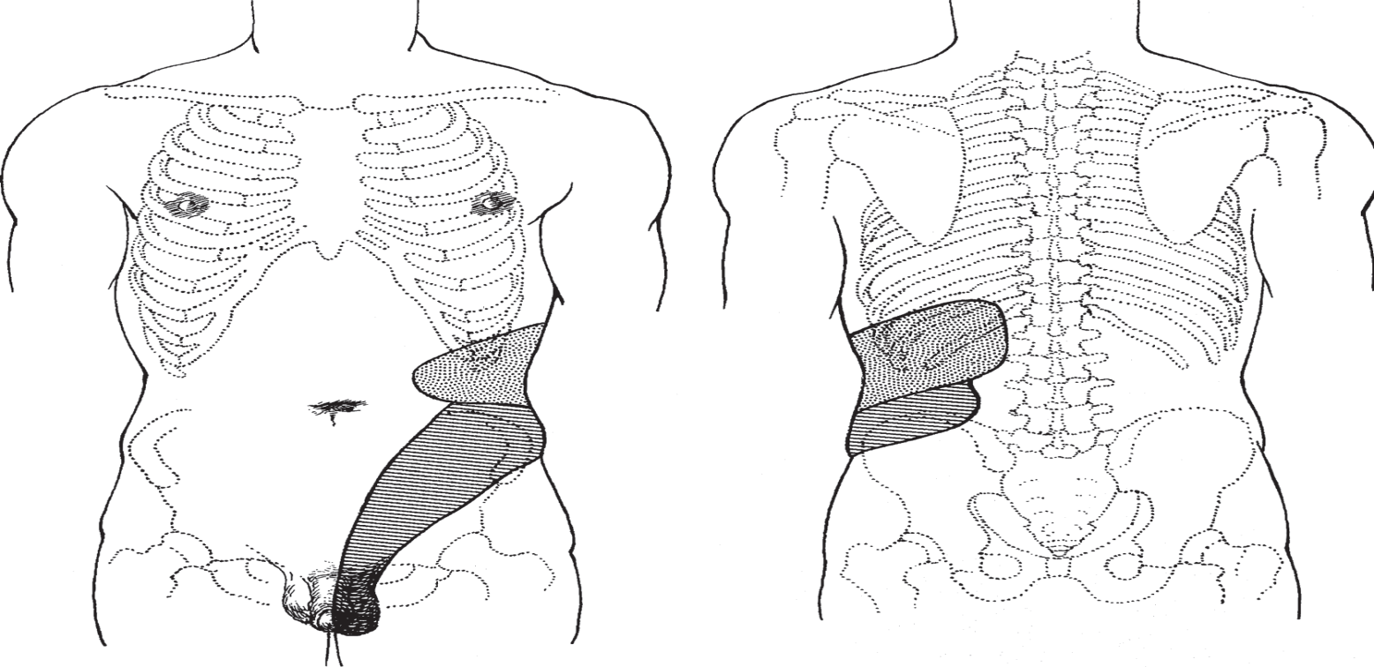
PAIN
Local pain is felt in or near the involved organ
Referred pain originates in a diseased organ but is felt at some distance from that organ

Slide 6
KIDNEY PAIN
Typical renal pain is felt as a dull and constant ache in the costovertebral angle just lateral to the sacrospinalis muscle and just below the 12th rib
Pain often spreads along the subcostal area toward the umbilicus or lower abdominal quadrant
Many urologic renal diseases are painless because their progression is so slow that sudden capsular distention does not occur (e.g. cancer, chronic pyelonephritis,staghorn calculus…)

Slide 7
URETERAL PAIN
Ureteral pain is typically triggered by acute obstruction (stone, blood cloth)
Typical back pain due to renal capsular distention
Colicky pain due to renal pelvic and ureteral muscle spasm
Radiates from the costovertebral angle down toward the lower anterior abdominal quadrant, along the course of the ureter

Slide 8
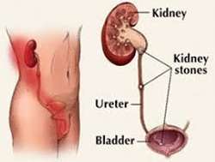
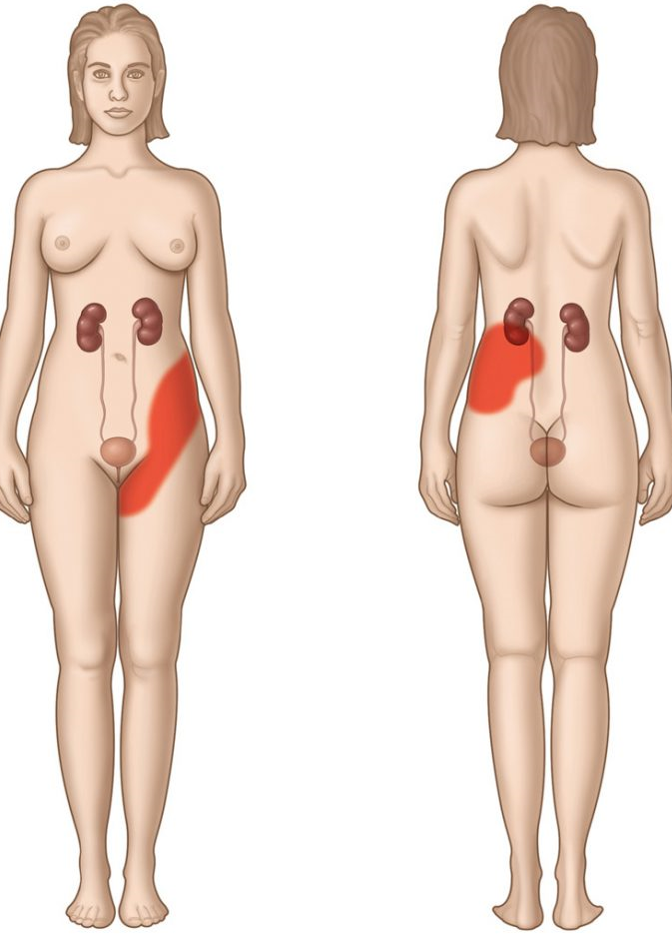
URETERAL PAIN
In men, it may radiate to the bladder, scrotum or testicle
In women it may radiate into the vulva

Slide 9
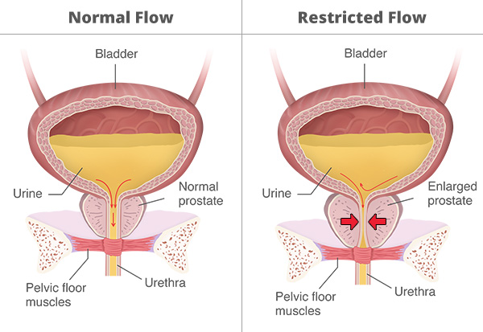
VESICAL PAIN
The most common cause of bladder pain is infection; it is felt over the bladder but is referred to the distal urethra and related to the act of urination
Overdistended bladder in acute urinary retention causes agonizing pain in the suprapubic area (may not be present in neurogenic bladder or chronic urinary retention)
Terminal dysuria may be related to severe cystitis
Urinary urgency and detrusor overactivity can cause vesical pain

Slide 10
PROSTATIC PAIN
Direct pain from the prostate gland is not common
When the prostate is acutely inflamed, the patient may feel discomfort or fullness in the perineal or rectal area (S2–S4)
Inflammation of the gland may cause dysuria, frequency or urgency

Slide 11
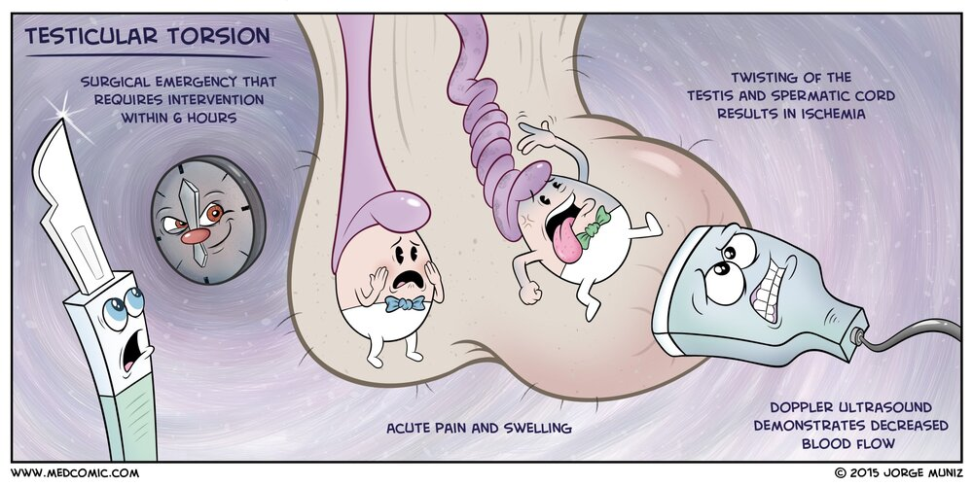
TESTICULAR PAIN
Testicular pain due to trauma, torsion or infection is felt usually locally but may radiate to lower abdomen
Uninfected hydrocele, spermatocele or testicular tumor doesn’t commonly cause pain
Varicocele may cause a dull ache in the testicle
Indirect inguinal hernia may cause testicular pain
Upper ureter stone pain may radiate to the testicle

Slide 12
GIS of urologic diseases
GIS symptoms are often seen in renal/ureteral diseases
Acute pyelonephritis usually presents with localized back pain, vesical irritation symptoms, chills, fever, generalized abdominal pain and distention
Stone disease usually causes nausea and vomiting as well as abdominal distention

Slide 13
LOWER URINARY TRACT SYMPTOMS – STORAGE SYMPTOMS
Frequency
Is need to urinate more than usual
Normal capacity of the bladder is about 400 mL
Residual urine may cause frequency due to the decrease of the functional capacity of the organ
Inflamation causes frequency as a result of decreased capacity of the bladder due to edema and pain
In acute cystitis patients usually can not delay urination because of agony and the patient may urinate involuntarily
I

Slide 14
Frequency
During severe acute infections, the desire to urinate may be constant, and each voiding may produce only a few milliliters of urine
Diseases that cause fibrosis of the bladder are accompanied by frequeny urination (tuberculosis, radiation cystitis, interstitial cystitis and schistosomiasis)
Stones and foreign bodies
Alcohol, caffeine, carbonated beverages, citrus, spicy foods, and chocolate can be bladder irritants that causes frequency

Slide 15
Nocturia
May be a symptom of renal disease related to a decrease in the functioning renal parenchyma with loss of concentrating power
Can occur in the absence of disease in persons who drink excessive amounts of fluid in the late evening
Mild heart failure in elderly may cause nocturia
Diabetes can cause nocturia
the complaint that the individual has to wake at night one or more times for voiding

Slide 16
Urgency
A strong, sudden desire to urinate
Usually caused by hyperactivity and irritability of the bladder as a result of obstruction, inflammation or neuropathic bladder disease
Most of the time the patient can control the sudden need to void temporarily but loss of small amounts of urine may occur (urgency incontinence)

Slide 17
Dysuria
Painful urination is usually due to acute inflammation of the bladder, urethra or prostate
Dysuria often is the first symptom suggesting urinary infection and is often associated with urinary frequency and urgency.

Slide 18
LOWER URINARY TRACT SYMPTOMS – EMPTYING SYMPTOMS
Hesitancy
Hesitancy is one of the early symptoms of bladder outlet obstruction
Prostate obstruction and urethral stricture are common causes of obstruction
Hesitancy is prolonged as the obstruction increases

Slide 19
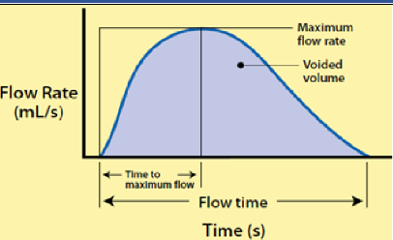
Loss of force and decrease of stream
Despite the increased intravesical pressure and volume urethral resistance causes progressive loss of force and decrease in urinary stream
This can be evaluated by measuring urinary flow rates
In normal circumstances with a full bladder, a maximal flow of 20 mL/s should be achieved
Uroflowmeter

Slide 20
Sense of Incomplete Emptying
The patient often feels that urine is still in the bladder even after urination has been completed.

Slide 21
Intermittent Urinary Stream
Interruption may be abrupt and accompanied by severe pain radiating down the urethra
This type of reaction strongly suggests the complication of vesical calculus or prostate growth

Slide 22
Acute Urinary Retention
A sudden inability to urinate
The patient experiences increasingly agonizing suprapubic pain associated with severe urgency and may dribble only small amounts of urine.

Slide 23
Chronic Urinary Retention
Chronic urinary retention may cause a little discomfort even though there is great hesitancy in starting voiding
Constant dribbling may be seen (overflow incontinence)

Slide 24
INCONTINENCE
True Incontinence
The patient may lose urine without warning; this may be a constant or periodic symptom
Exstrophy of the bladder
Epispadias
Vesicovaginal fistula
Ectopic ureteral orifice

Slide 25
Stress Incontinence
When slight weakness of the sphincteric mechanisms is present, urine may be lost in association with physical strain (eg,coughing, laughing, rising from a chair)
Common in multiparous women who have weakened muscle support of the bladder neck and urethra and in men who have undergone radical prostatectomy
Occasionally, neuropathic bladder dysfunction can cause stress incontinence

Slide 26
Urge Incontinence
Urgency may be so precipitate and severe that there is involuntary loss of urine
Urge incontinence frequently occurs with acute cystitis, particularly in women, since women seem to have relatively poor anatomic sphincters
Urge incontinence is a common symptom of an upper motor neuron lesion

Slide 27
Overflow Incontinence
Paradoxic incontinence is loss of urine due to chronic urinary retention or secondary to a flaccid bladder
The intravesical pressure finally equals the urethral resistance; urine then constantly dribbles forth.

Slide 28
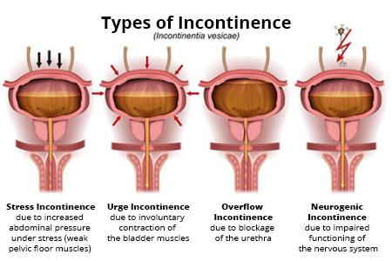

Slide 29
PNEUMATURIA
The passage of gas in the urine strongly suggests a fistula between the urinary tract and the bowel
This occurs most commonly in the bladder or urethra but may be seen also in the ureter or renal pelvis
Carcinoma of the sigmoid colon, diverticulitis with abscess formation, regional enteritis, and trauma
Congenital anomalies account for most urethroenteric fistulas

Slide 30
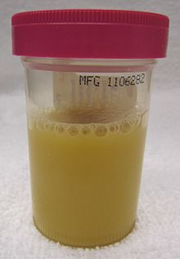
PYURIA
Infection
Cloudy appearance is because of alkaline; this causes precipitation of phosphate

Slide 31
HEMATURIA
Danger signal;
Carcinoma of the kidney or bladder
Calculi
Infection
It should be questioned if urination is painful, whether the hematuria is associated with symptoms of vesical irritability, and whether blood is seen in all or only a portion of the urinary stream
The hemoglobinuria that occurs as a feature of the hemolytic syndromes may also cause the urine to be red

Slide 32
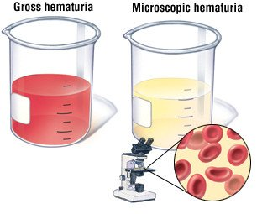
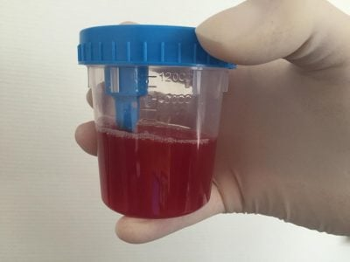
Hematuria associated with renal colic suggests a ureteral stone, although a clot from a bleeding renal tumor can cause the same type of pain
Hematuria is commonly associated with nonspecific, tuberculous, or schistosomal infection of the bladder
Hematuria is often terminal (bladder neck or prostate), although it may be present throughout urination (vesical or upper tract)

Slide 33
Hematuria without other symptoms (silent hematuria) must be regarded as a symptom of tumor of the bladder or kidney until proved otherwise!!!
It is usually intermittent; bleeding may not recur for months
Less common causes of silent hematuria are staghorn calculus, polycystic kidneys, benign prostatic hyperplasia, solitary renal cyst, sickle cell disease,hydronephrosis and acute glomerulonephritis
Joggers and people who engage in contact sports frequently develop transient proteinuria and gross or microscopic hematuria

Slide 34
PALPABLE MASSES
May be seen in renal tumors, hydronephrosis or polycystic kidney
Enlarged lymph nodes in the neck may contain metastatic tumor from the prostate or testis
Lumps in the groin may repressent spread of penile tumor, chancroid, syphilis or lymphogranuloma venereum
Painless masses in the skrotum include hydrocele, varicocele, spermatocele, chronic epididiymitis, hernia, testicular tumor

Slide 35
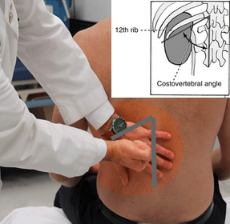
PHYSICAL EXAMINATION OF GENITOURINARY TRACT
Kidneys
Inspection;
Mass
Fullness in the costovertebral angle (CVA)
Indentations due to perinephric abscess

Slide 36
Kidneys
Palpation;
The kidneys are difficult to palpate because of resistance from abdominal muscle tone and fixated position
It is difficult to palpate the left kidney but in thin patients lower part of the right kidney may be palpated
The patient should be lying in supine position on a hard surface
The kidney is lifted by one hand in the CVA

Slide 37
Kidneys
Palpation;
On deep inspiration the kidney moves downward and the other hand is pushed beneath the costal margin to palpate the kidney
If possible the size, shape and consistency of the organ can be palpated

Slide 38
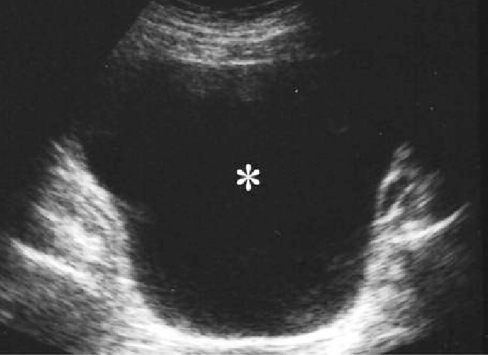
Bladder
To be able to palpate the bladder it needs to contain at least 150 mL of urine
In retention it may reach or even rise above the umbilicus
In male infants hypertrophied bladder secondary to obstruction due to posterior urethral valves can be palpated

Slide 39
Examination of the external male genitalia
Penis
If the patient has not been circumcised, the foreskin should be retracted so that tumor or balanitis as the cause of foul discharge can be inspected
Retraction may not be possible because of phimosis
Venereal warts/scars
Meatal stenosis
The position of the meatus should be inspected

Slide 40
Penis
Micropenis or macropenis
Palpation of the dorsal surface of the shaft may reveal a fibrous plaque involving the tunica albuginea covering of the corpora cavernosa, typical of Peyronie’s disease
Tender areas of induration felt along the urethra may signify periurethritis secondary to urethral stricture

Slide 41
Testis
The testes should be carefully palpated with the fingers of both hands
Tumors are usually palpated as hard masses
Transillumination of scortal masses should be evaluated (hydrocele will cause red glow while a tumor is dark)
About 10% of tumors are associated with a secondary hydrocele
The testis may be absent from the scrotum, and this may be transient (physiologic retractile testis) or true cryptorchidism

Slide 43
PROSTATE
A specimen of urine for routine analysis should be collected before the rectal examination
Avarage length and width 4 cm
Normally, the consistency of the gland is similar to the consistency of the contracted thenar eminence of the thumb
Suspicious lesions of prostate cancer is seldom raised; rather, it is hard and has a sharp edge,it tends to arise in the lateral sulcus
Advanced carcinomas tend to be fixated

Slide 44
PROSTATE
Massage and Prostatic Smear
Should be avoided in;
Acute urethral discharge
Acute prostatitis
Acute prostatocystitis
In men near the stage of complete urinary retention (because it may precipitate complete retention)
In men suffering from obvious cancer of the gland

Slide 45
LAB TESTS

Slide 46
URINE EVALUATION
Evaluation of voided urine includes gross examination, dipstick chemical analysis, and microscopic analyses.
Midstream urine sample is obtained

Slide 47
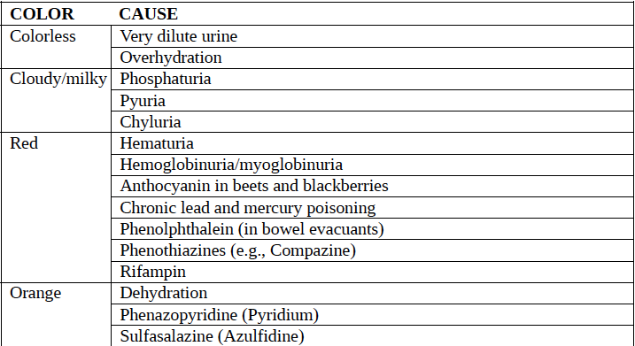
Physical and Gross Examination of Urine

Slide 48
Ph
Urinary pH may vary from 4.5 to 8
A urinary pH between 4.5 and 5.5 is considered acidic, whereas a pH between 6.5 and 8 is considered alkaline
Urinary pH is usually acidic in patients with uric acid and cystine lithiasis. Alkalinization of the urine is an important feature of therapy in both conditions
Alkaline urine with a pH greater than 7.5 suggests infection with a ureasplitting organism, most commonly Proteus

Slide 49
Blood/Hematuria
Hematuria can be distinguished from hemoglobinuria and myoglobinuria by microscopic examination
Identifying the hematuria as nephrologic versus urologic and glomerular versus nonglomerular is one of the first steps in the analysis.
Asymptomatic microscopic hematuria (AMH) “is defined as three or greater RBC/HPF on a properly collected urinary specimen in the absence of an obvious benign cause

Slide 50
Leukocyte Esterase and Nitrite Tests
Leukocyte esterase activity indicates the presence of white blood cells in the urine
The presence of nitrites in the urine is strongly suggestive of bacteriuria
many species of gramnegative bacteria can convert nitrates to nitrites
Leukocyte esterase is produced by neutrophils

Slide 51
URINE CYTOLOGY
Urinary cytology is ordered when urothelial malignancy is suspected
Standart in Urothelial Cancer(UC) Evaluation
Speicific for High Grade UC
Moderate Sensitivity
Lower in Low Grade UC

Slide 52
Serum Laboratory Studies
A serum creatinine and calculated glomerular filtration rate (GFR) is often used to assess baseline or current renal function
BPH
Urologic Cancers
Urolithiasis
Complete blood count (CBC)
WBC in systemic infection and postoperative surveillance
Hb and Htc

Slide 53
SERUM TUMOR MARKERS
PSA, also known as human kallikrein peptidase 3(hK3), is a serine protease and a member of the kallikrein gene family. It is produced by prostatic luminal epithelial cells (Examined in Blood)
Screeining for prostate cancer
High sensitivity
Low Specifity
Organ Specific
Useful in Prostate Cancer Surveillance

Slide 54
SERUM TUMOR MARKERS
alpha-fetoprotein (AFP)
human chorionic gonadotropin (HCG)
lactate dehydrogenase (LDH)
Germ Cell Tumors
Non organ – non tumor specific
Mostly expressed in Non-Seminomas
In 15% of Seminoma cases HCG increases
Utilized in diagnosis, follow-up ad prognostic evaluation

Slide 55
References
Campbell-Walsh Urology (12th Edition-2020)
Smith & Tanagho's General Urology (19th Edition-2020)
Harrison's Principles of Internal Medicine (20th Edition)
EAU Guidelines 2020
AUA Guidlines 2020

