Slide 1
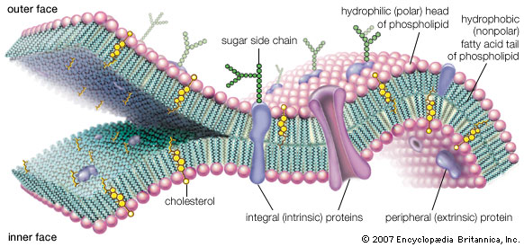
Membranes, CHANNELS AND TRANSFER WEEK 1
Dr. Etkin ŞAFAK
Department of Physiology

Slide 2
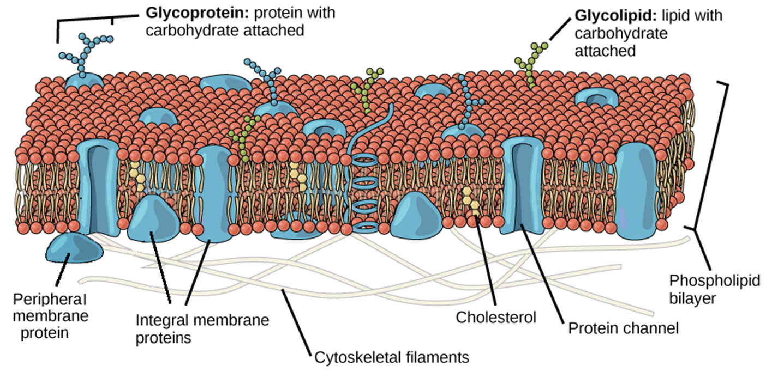
Cell membrane
The complex chemical reactions proceed under restricted conditions
Such constancy is maintained through the action of biological membranes
Every cell has a continous double-layered membrane (ranging 6-23 nm)
Lipid based structure encloses the cytoplasm and the cell nucleus.
The membrane regulates moleculer traffic between the interior of the cell and the external environment

Slide 3
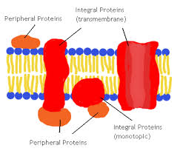
Membrane Proteins and Their Functions
A membrane is a collage of different proteins, often grouped together, embedded in the fluid matrix of the lipid bilayer
Proteins determine most of the membrane’s specific functions
Peripheral proteins are bound to the surface of the membrane
Integral proteins penetrate the hydrophobic core
Integral proteins that span the membrane are called transmembrane proteins
The hydrophobic regions of an integral protein consist of one or more stretches of nonpolar amino acids, often coiled into alpha helices

Slide 4
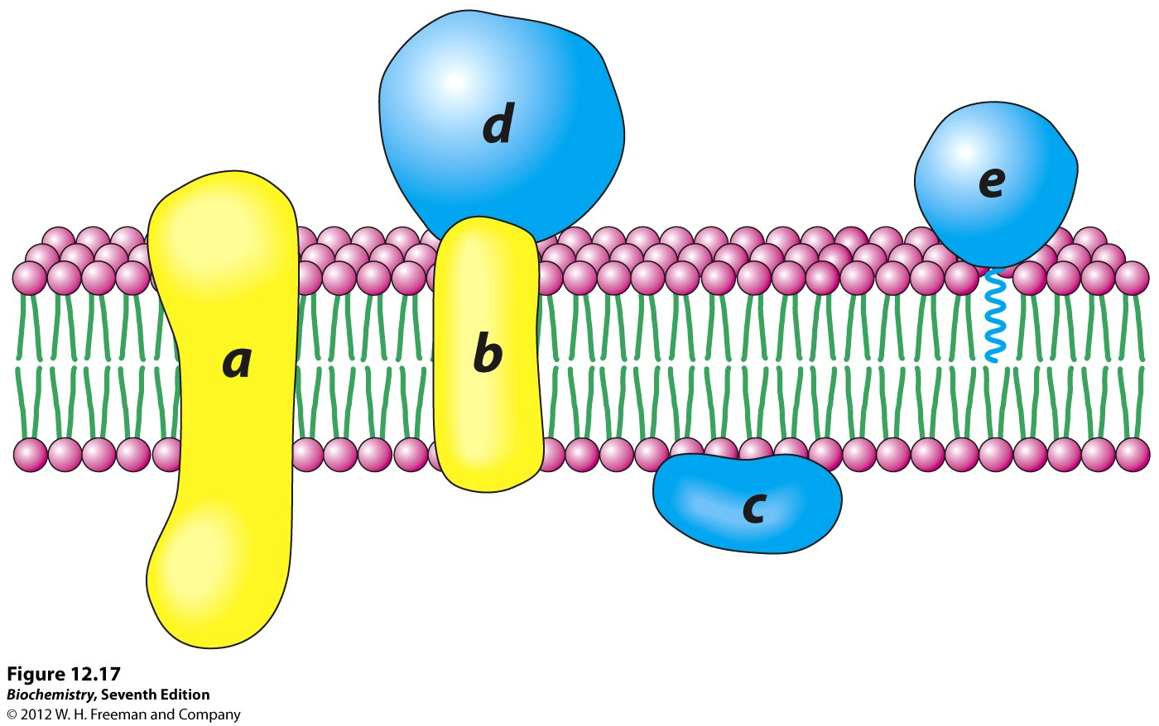
Major functions of membrane proteins
Transport
Enzymatic activity
Signal transduction
Cell-cell recognition
Intercellular joining
Attachment to the cytoskeleton and extracellular matrix (ECM)

Slide 5
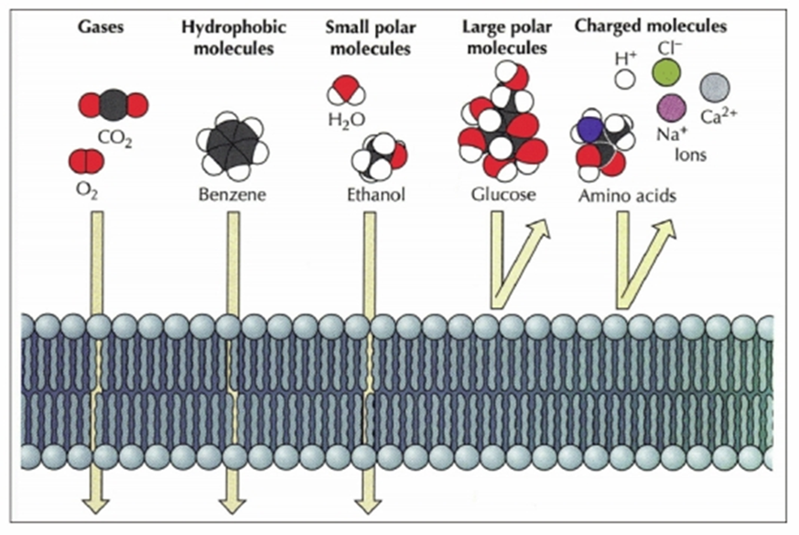
HOW DO CELL MEMBRANES HELP MAINTAIN HOMEOSTASIS WITHIN A CELL?
Plasma membranes are selectively permeable, regulating the cell’s molecular traffic
They control what goes into and out of the cell,
What determines the permeability of a substance across the cell membrane?
Size
Polarity
Hydrophobic vs. hydrophilic
Charge

Slide 6
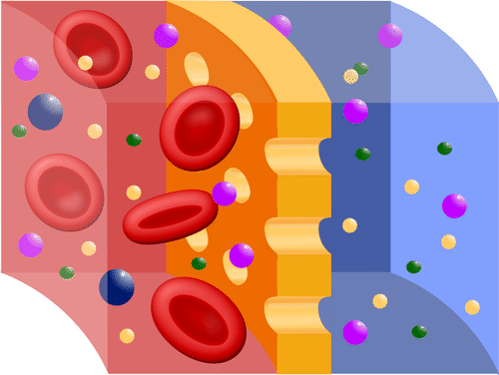
Selectively permeable?
Small molecules (no charge: nonpolar) can easily pass through (oxygen)
Small, polar molecules can easily pass through (H2O, CO2)
Large, uncharged polar molecules cannot pass through (polysaccharides, proteins)
Charged molecules cannot pass through (ions: Ca+, K+, Na+)
Proteins- allow for movement of large and polar, ions across the membrane
Integral membrane proteins- form “channels”; passageways across the cell membrane

Slide 7
CELL MEMBRANE

Slide 8
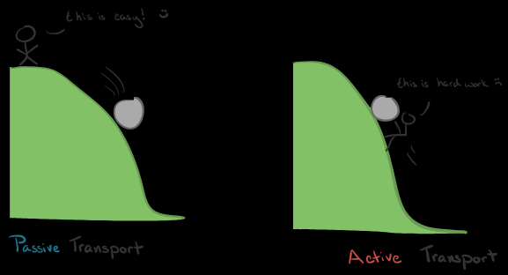
Passıve transport
The movement of substance across a cell membrane WITHOUT the use of energy (ATP).
Three Types:
Diffusion
Osmosis
Facilitated Diffusion

Slide 9
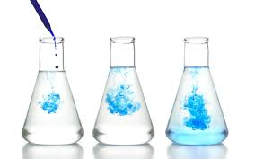
DIFFUSION
The molecules of any substance, be it solid, liquid, or gas, are in a continuous state of movement or vibration – Brownian movement
The warmer a substance is, the faster its molecules move.
The average speed of this “thermal motion” also depends upon the mass of the molecule.
For instance: At body temperature, a molecule of water moves at about 2500 km/h (1500 mi/h), whereas a molecule of glucose, which is 10 times heavier, moves at about 850 km/h.
The random thermal motion of molecules in a liquid or gas will eventually distribute them uniformly throughout the container.

Slide 10
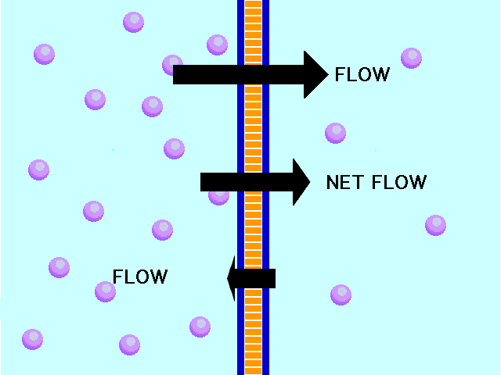
DIFFUSION
Many processes in living organisms are closely associated with diffusion.
For example, oxygen, nutrients, and other molecules enter and leave the smallest blood vessels (capillaries) by diffusion,
Diffusion is process which is NOT due to the action of a force, but a result of the random movements of atoms (statistical problem)

Slide 11
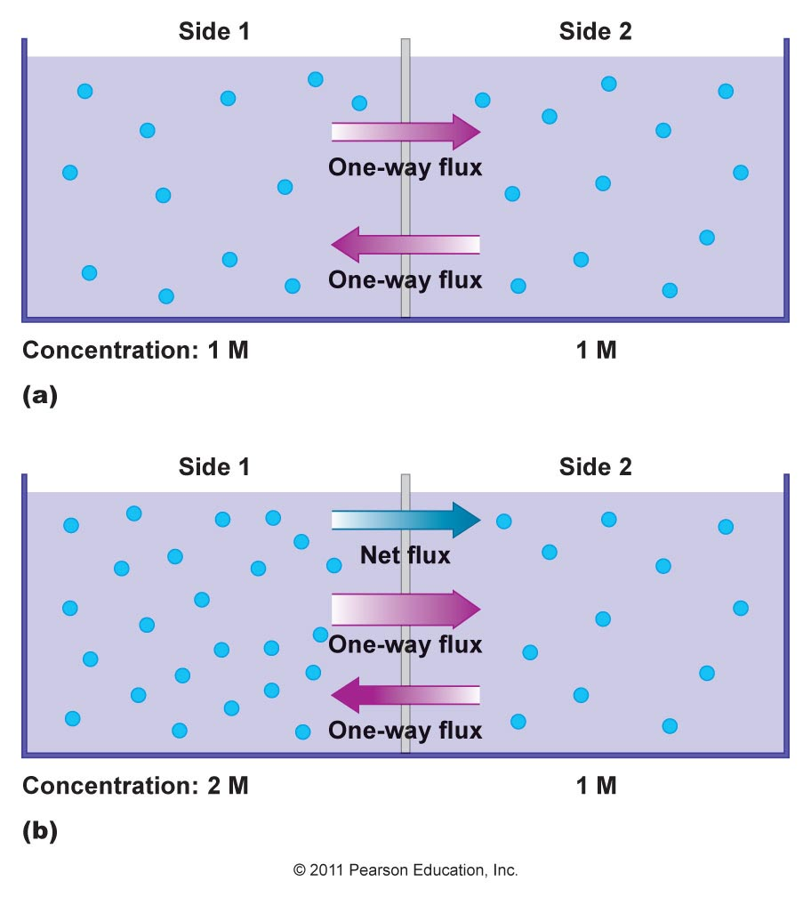
MEMBRANE FLUX
FLUX: The amount of material crossing a surface in a unit of time
NET FLUX: The differences between the two one-way fluxes
Always occur in the direction from higher to lower concentration
Determines the net gain/loss of molecules from compartments seperated by a membrane
DISTRIBUTION EQUILIBRIUM: The two one-way fluxes are equal in magnitude but opposite in direction
Net flux is equal to zero
No further changes in concentration of a substance in the 2 compartments will occur

Slide 12
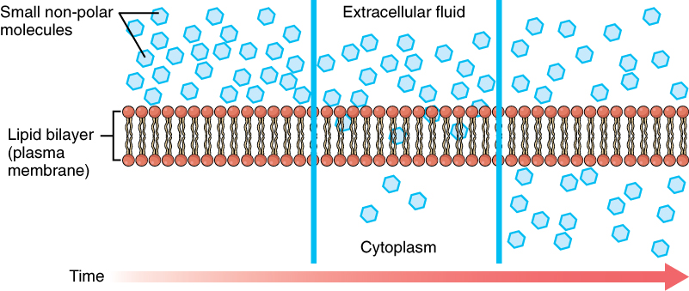
DIFFUSION THROUGH THE LIPID BARRIER
Most polar molecules diffuse into cells very slowly or not at all,
Nonpolar molecules diffuse much more rapidly across plasma membranes — they have large permeability constants.
Why?
nonpolar molecules can dissolve in the nonpolar regions of the membrane—fatty acid chains of the membrane phospholipids
Nonpolar molecules? Oxygen, carbon dioxide, fatty acids, steroid hormones etc.

Slide 13
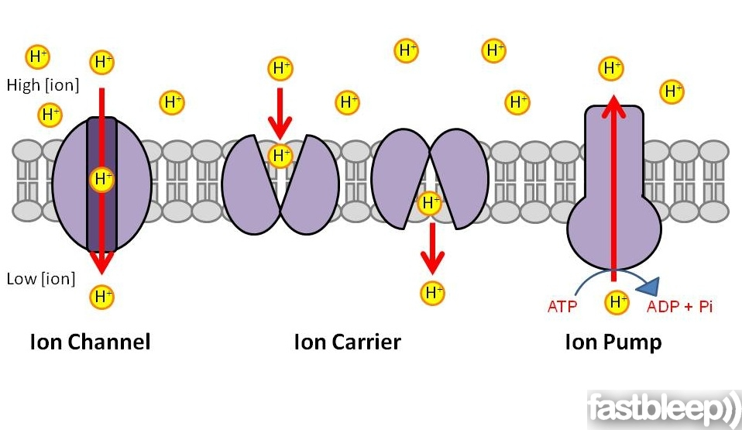
Diffusıon of ions through Protein Channels
Integral membrane proteins can span the lipid bilayer.
Some of these proteins form channels through which ions can diffuse across the membrane.
A single protein may have a conformation similar to that of a doughnut providing the channel for ion movement
The diameters of protein channels are very small - slightly larger than those of the ions that pass through them
Ion channels show a selectivity for the type of ion that can pass through them.

Slide 14
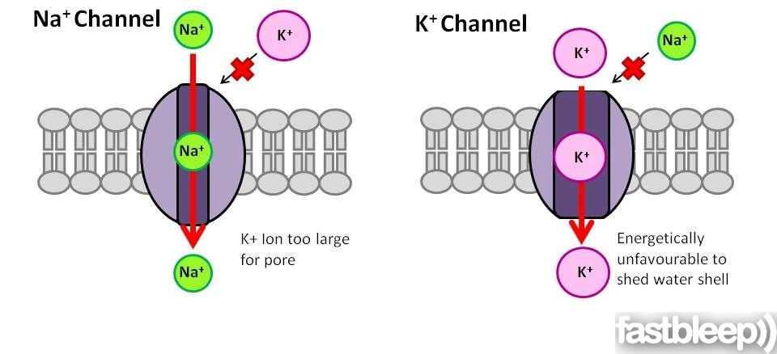
Diffusıon of ions through Protein Channels
The selectivity is based on:
the channel diameter and
The charged and polar surfaces of the protein subunits that form the channel walls
For example, some channels (K channels) allow only potassium ions to pass,
others are specific for sodium (Na channels),
others allow both sodium and potassium ions to pass (Na,K channels)..

Slide 15
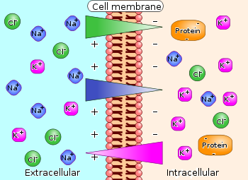
Role of Electric Forces on Ion Movement
One additional factor must be considered: the presence of electric forces
There exists a separation of electric charge across plasma membranes - membrane potential
The membrane potential provides an electric force that influences the movement of ions across the membrane.
Electric charges of the same sign repel each other, while opposite charges attract.
Even if there were no difference in ion concentration across the membrane, there would still be a net movement of because of the membrane potential.
The direction and magnitude of ion depend on the concentration difference and the electrical difference.
These two driving forces are known as the electrochemical gradient

Slide 16
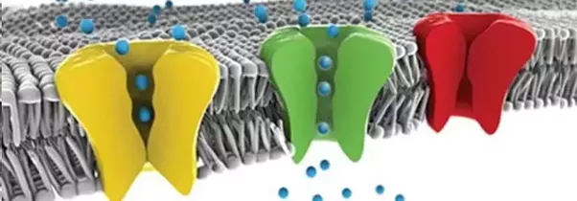
Regulation of Diffusion through Ion Channels
Ion channels can exist in an open or closed state
Changes in a membrane’s permeability to ions can occur rapidly as a result of the opening or closing of these channels.
The process of opening and closing ion channels is known as channel gating
A single ion channel may open and close many times each second,
The total number of ions that pass through a channel depends on how frequently the channel opens and how long it stays open.

Slide 17
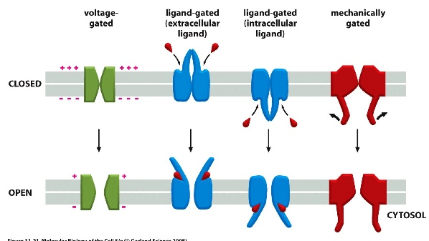
RegulatIon of DiffusIon through Ion Channels
Three factors can alter the channel protein conformations,
(1) The binding of specific molecules to channel proteins may produce change in the shape of the channel protein; ligand-sensitive channels –the ligands that influence them are often chemical messengers.
(2) Changes in the membrane potential can cause movement of the charged regions on a channel protein —voltage-gated channel
(3) Stretching the membrane may affect the conformation of some channel proteins—mechanosensitive channels.

Slide 18
Diffusion

Slide 19
ANY QUESTIONS?

