Slide 1
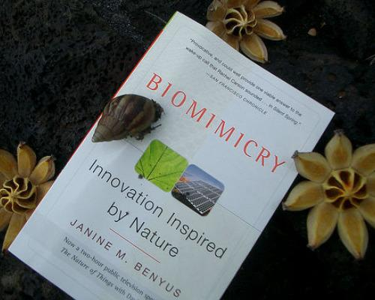
Biomimicry: Learning From Nature
Nature as Model, Measure, and Mentor

Slide 2
BI-O-MIM-IC-RY
Nature as model. Biomimicry is a new science that studies Nature’s models and then imitates or takes inspiration from these designs and processes to solve human problems.
Nature as measure. Biomimicry uses an ecological standard to judge “rightness” of our innovations.
Nature as mentor. Biomimicry is a new way of viewing and valuing Nature.
Notes:
Nature as model: example: a solar cell inspired by a leaf.
Nature as measure: After 3.4 billion years of evolution, nature has learned: what works. What is appropriate. What lasts.
Nature as mentor: It introduces an era based not on what we can extract from the natural world, but what we can learn from it.

Slide 4
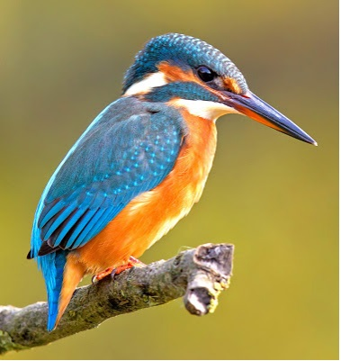
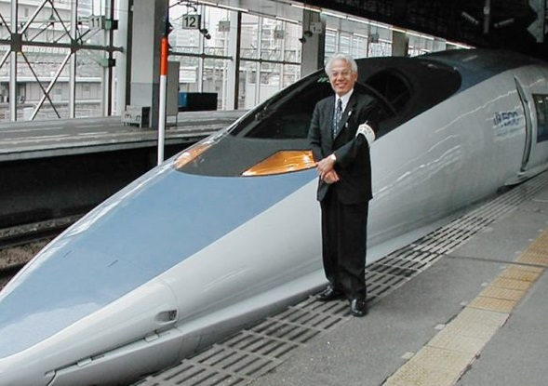
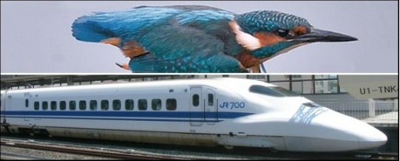
Transportation: How does Nature travel quickly and smoothly?
The Bullet Train in Japan
Notes:
Biomimicry looks to nature and natural systems for inspiration. After millions of years of tinkering, Mother Nature has worked out some effective processes. In nature, there is no such thing as waste — anything left over from one animal or plant is food for another species. Inefficiency doesn't last long in nature, and human engineers and designers often look there for solutions to modern problems.

Slide 5
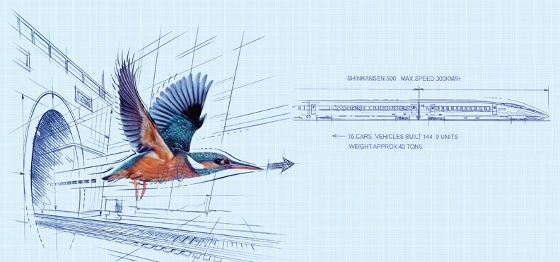

Slide 6
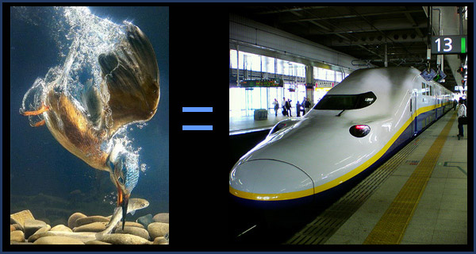
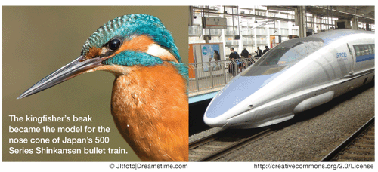
SOLUTION!!
Kingfishers move quickly from air, a low-resistance medium, to water, a high-resistance medium.
The kingfisher's beak provides an almost ideal shape for such an impact.
The beak is streamlined, steadily increasing in diameter from its tip to its head.
This reduces the impact as the kingfisher essentially wedges its way into the water, allowing the water to flow past the beak rather than being pushed in front of it.
Because the train faced the same challenge, moving from low drag open air to high drag air in the tunnel, Nakatsu designed the fore front of the Shinkansen train based on the beak of the kingfisher.
Notes:
The Shinkkansen bullet Train of West Japan Railway Company is the fastest train in the world, traveling 200miles per hour.
The problem? Noise.
Air pressure changes produced large thunder claps every time the train emerged from a tunnel, causing residents ¼ mile away to complain.
Eiji Nakatsu, the train’s chief engineer and an avid bird watcher, asked himself “ Is there something in Nature that travels quickly and smoothly between two very different mediums?”
Modeling the front end of the train after the beak of the kingfisher, which dives from the air into bodies of water with very little splash to catch fish, resulted in a quieter train and 15% less energy use, even while the train travels 10% faster.

