Slide 1
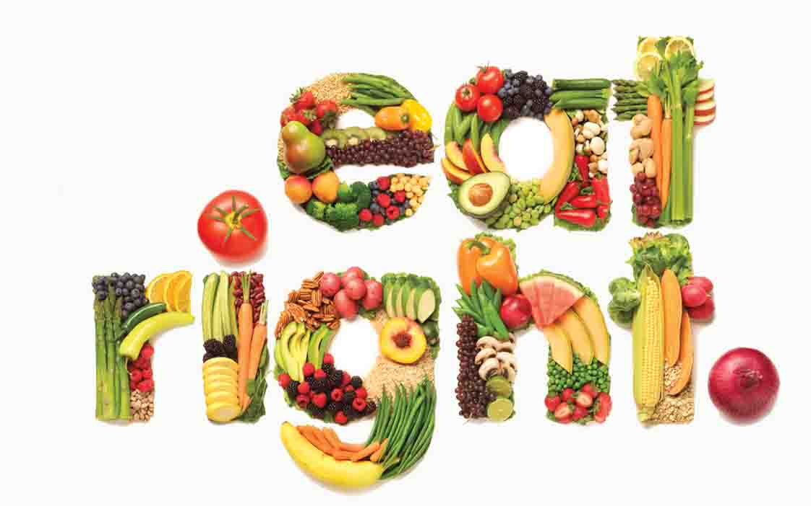
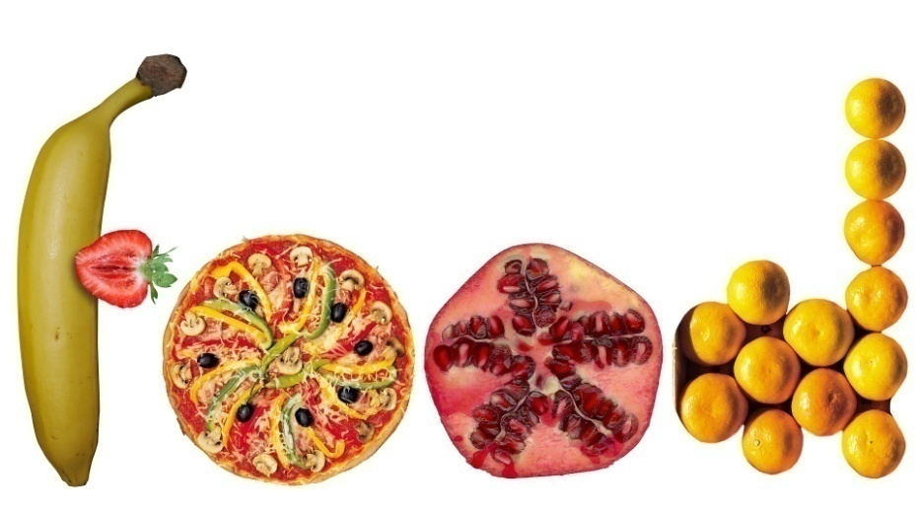
FOOD COMPONENTS AND QUALITY

Slide 2
Definition of food
Foods are described as
a material derived from plants, animals, and single-cell organisms
the group of edible substance which provide energy to the living organisms and repairs the old tissues and builds the new tissues
a material consisting essentially of protein, carbohydrate, and fat used in the body of an organism to sustain growth, repair, and vital processes and to furnish energy
FDE 101-BCFE
02.10.2018

Slide 3
The scientific definition of food
Any substance whether processed, semi-processed or raw which is intended for human consumption, including drinks, chewing gum and any substance which has been used in the manufacture, preparation or treatment of food but excluding cosmetics, tobacco and substances used as drugs
FDE 101-BCFE
02.10.2018

Slide 4
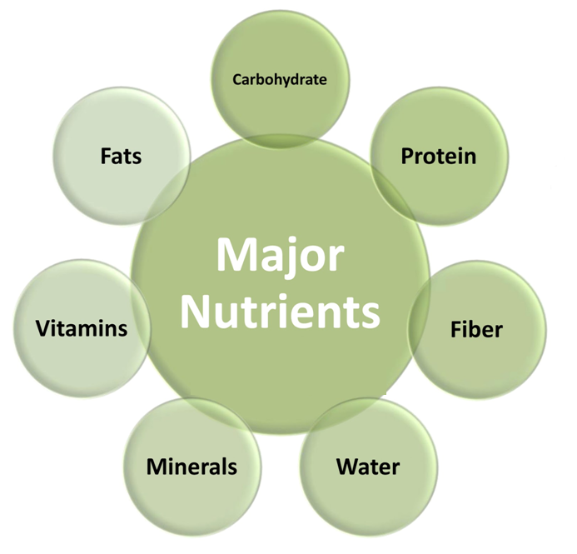
Food components
FDE 101-BCFE
02.10.2018

Slide 5
Table 1 Typical products as rich sources of main food components
FDE 101-BCFE
02.10.2018

Slide 6
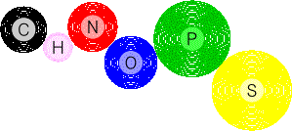
Food components
These components contain following six key atoms as all living organisms
Nitrogen
Carbon
Hydrogen
Phosphorus
Oxygen
Sulfur
FDE 101-BCFE
02.10.2018

Slide 7
Food components and quality
Quality can be defined as a sum of nutritional content, sensory attributes, safety, physical and chemical properties of a product that have significance in determining the degree of acceptability of that product to the consumer.
FDE 101-BCFE
02.10.2018

Slide 8
Nutritional content
Food components are crucial to determine the nutritional value of the product.
The carbohydrate, protein or fat amounts are important to decide what type of product will produce.
11.5-14% protein is desirable for white bread while wholewheat breads require 14-16% protein content. Regarding biscuits, cakes, pastry, noodles, 8-11% protein amount is adequate.
Fat and protein amount of milk is important to determine its suitability for cheese, yoghurt or cream manufacturing.
FDE 101-BCFE
02.10.2018

Slide 9
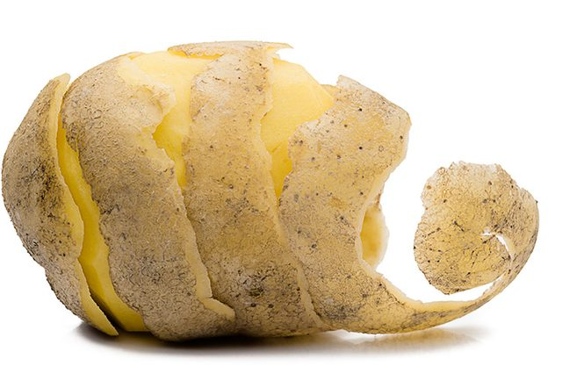
Geometric properties
The uniformity of the raw material is important. Because the more uniform the geometry of raw materials, the less rejection and waste will be produced during preparation operations such as peeling, trimming, slices.
Potatoes of smooth shape are much easier to peel and wash than irregular ones.
FDE 101-BCFE
02.10.2018

Slide 10
Color
Color and color uniformity are one of the curial physical properties of food that affect visual quality and consumer choice.
Color may change markedly during processing.
The color of green vegetables, such as peas, spinach or green beans, is changed from bright green to dull olive green due to the conversion of chlorophyll to pheophytin.
Two main approaches can be suggested to improve the quality of color in food processing.
Selection of appropriate varieties
Sufficient level of maturity
Sorting foods by color
FDE 101-BCFE
02.10.2018

Slide 11
Flavor
Flavor is one of the sensory properties of foods.
It is defined as the combined sense of
taste (salty, sweet, sour, bitter)
odor (aroma) (olfactory perceptions caused by volatile substance)
mouthfeell (juicy, oily, astringency)
The raw material flavor and flavor derived from additives form the final flavor of the product.
FDE 101-BCFE
02.10.2018

Slide 12
Texture
It is defined as the structural properties of a solid and semisolid foods that are sensed by touch in the mouth and with the hands.
Hardness/firmness (cooked meat/peas), crispness (potato chips, biscuits), powdery (baking powder, flour), and springiness (bread dough) can be given as an example of description for the textural properties of some foods.
FDE 101-BCFE
02.10.2018

Slide 13
Sensory attributes
Sensory evaluation is a scientific discipline of evaluating consumer products using the five senses: sight, smell, touch, taste, hearing
FDE 101-BCFE
02.10.2018

Slide 14
Processing conditions and storage
Some desirable or undesirable changes in the composition of raw material take place throughout processing and storage.
Endogenous and microbial enzymes, oxygen, heating, physical and chemical treatment, microbial growth can be listed as reasons for these changes.
Absorption of desirable flavor and taste compounds during salting, seasoning, frying, smoking
Development of typical cheese flavor due to enzyme activity
Leaching of vitamins, minerals and toxins during washing, blanching and cooking
Lipids and pigment oxidation during storage
Dripping after thawing
Formation of undesirable compounds during frying and smoking
FDE 101-BCFE
02.10.2018

Slide 15
References
Sikorski, Z.E. and Piotrowska, B. (2007) Food components and quality (chapter 1) In Chemical and functional properties of food components. (3rd ed.) Pages 1-9. CRC Press Taylor & Francis Group, Florida, USA.
Brennan, J.G. (2006) Food processing handbook. Pages 1-6. WILEY-VCH Verlag GmbH & Co. KGaA, Weinheim, Germany.
Brown, A. (2008) Understanding food principles and preparation. (3rd ed.) Pages 23-25. Thomson Wadsworth, California, USA.
FDE 101-BCFE
02.10.2018

