Slide 1
Sub-Departamento de Língua Portuguesa | Faculdade de Línguas, História e Geografia |
UNIVERSIDADE DE ANKARA
ISP 420 – Portekiz Kültürü | Cultura Portuguesa

Slide 2
Summary
Depois da Glória dos Descobrimentos;
A União Ibérica, Sebastianismo e o Quinto Império, a Inquisição e a Decadência ou Declínio? (XVII-XVIII)
O modernismo.
Portuguese Culture through its Literature
The epic poetry - ‘Lusíadas’ of Luís Camões.
The features of Portuguese Literature: Between the founder of Modern Literature Almeida Garret to Romanticism and Realism (to continue…)
The genius of Eça de Queiroz (to continue…)

Slide 3
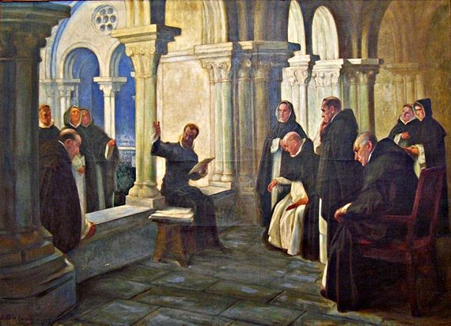
The epic poetry - ‘Lusíadas’ of Luís de Camões.
“I sing of the renowned courage of the Portuguese” (I.3.5)
A late- Rennaissance epic of 1572 in which Camões celebrates Vasco da Gama’s discovery of the sea-route to India in 1498.
A classic Epic (Greek inspiration);
The higher purpose of the ‘Portuguese civilising mission’
Fundamentally patriotic – the national praise of the historical overseas great expansion.
Camões Lendo "Os Lusíadas" aos Frades de São Domingos (1927), de António Carneiro

Slide 4
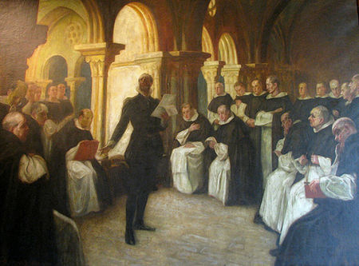
The epic poetry - ‘Lusíadas’ of Luís de Camões.
“As armas e os barões assinalados, Que da ocidental praia Lusitana, Por mares nunca dantes navegados, Passaram ainda além da Taprobana, Em perigos e guerras esforçados, Mais do que prometia a força humana, E entre gente remota edificaram Novo Reino, que tanto sublimaram;”
(estrofe 1, Canto I)
Camões Lendo "Os Lusíadas" aos Frades de São Domingos (1929), de António Carneiro

Slide 5
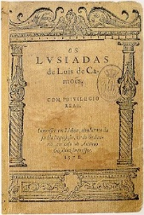
The epic poetry - ‘Lusíadas’ of Luís de Camões.
The thematic plans of the work are:
Plan of the Voyage - where it is the voyage of discovery of the maritime route to India of Vasco da Gama and his sailors;
Plan of the History of Portugal - episodes of the history of the Portuguese are reported;
Plan of the Poet's Considerations - Camões refers to himself as a poet admirer of the Portuguese people and heroes;
Plan of Mythology - the influences and interventions of the gods of Greco-Roman mythology are described in the action of the heroes.

Slide 6
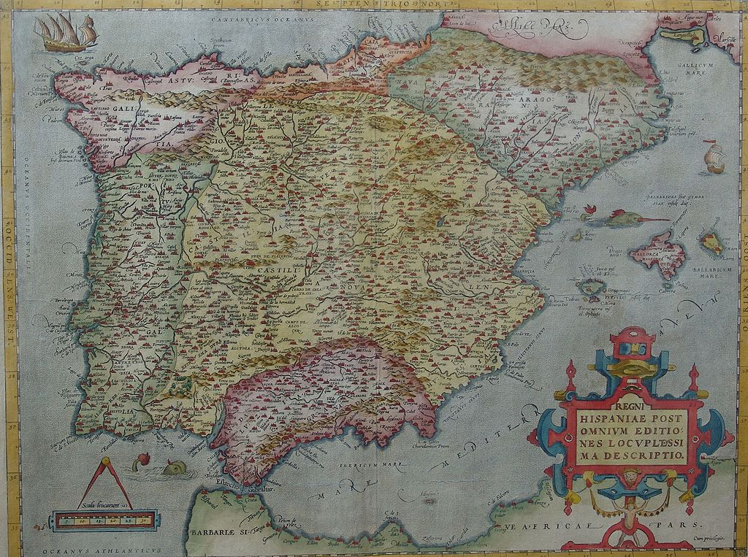
Depois da Glória dos Descobrimentos: União Ibérica (1580-1640)
The Iberian Union was the dynastic union of the Kingdom of Portugal and the Spanish Crown between 1580 and 1640, bringing the entire Iberian Peninsula, as well as Spanish and Portuguese overseas possessions, under the Spanish Habsburg kings Filipe II, Filipe III and Filipe IV.
Political map of the Iberian Peninsula in 1570

Slide 7
União Ibérica (1580-1640)
The Battle of Ksar El Kebir in 1578 saw the death of the young king Sebastião. Sebastião granduncle and successor, Cardinal Henrique, was 66 years old at the time.
Henrique’s death was followed by a succession crisis, with three grandchildren of Manuel I claiming the throne: Infanta Catarina, Duchess of Braganza (married to João, 6th Duke of Braganza), António, Prior of Crato, and King Filipe II of Spain.
Political map of the Iberian Peninsula in 1570

Slide 8
União Ibérica (1580-1640)
“A 13 de Agosto de 1578, Filipe II tem conhecimento do grave desastre sofrido por seu sobrinho, D. Sebastião de Portugal, em Alcácer-Quibir a 4 daquele mês.
Dizem os cronistas que se fechou no seu aposento todo o dia ‘para ver tudo o que era avisado fazer por se ter tornado rei de Portugal”
(Espírito Santo, Introdução)
Political map of the Iberian Peninsula in 1570

Slide 9
União Ibérica (1580-1640)
“(...) vai concebendo um plano pacífico para incorporar o novo reino nos seus vastos domínios, trabalhando no aliciamento da nobreza portuguesa, muito abalada pelo desastre de África (...) e aliciando uma parte do clero”
(Espírito Santo, Introdução)
Political map of the Iberian Peninsula in 1570

Slide 10
União Ibérica (1580-1640)
Philip was recognized as king by the Cortes of Tomar in 1581, beginning the reign of the House of Habsburg over Portugal.
Portugal's status was maintained under the first two kings of the Iberian Union, Philip II and Philip III. Both monarchs gave excellent positions to Portuguese nobles in the Spanish courts, and Portugal maintained an independent law, currency, and government.
Political map of the Iberian Peninsula in 1570

Slide 11
The myth of Sebastianismo for Restauração of 1640
The Portuguese nobility began to lose its importance at the Spanish Cortes, and government posts in Portugal were occupied by Spaniards. Ultimately, Filipe III tried to make Portugal a royal province, and Portuguese nobles lost all of their power.
Spain had failed to prevent the Dutch occupation of several of Portugal's colonial holdings.
Acclamation of John IV as King of Portugal, painting by Veloso Salgado in the Military Museum, Lisbon.

