Slide 1
6. subject
Handicrafts made by using earth
as raw materials

Slide 2
Handicrafts made by using earth as raw materials
Making adobe
Pottery
Making Turkish tile
Making ceramic

Slide 3
Making adobe
Pottery
Pots, bowls, pot cups
Making Turkish tile (çini)
Making ceramic

Slide 4
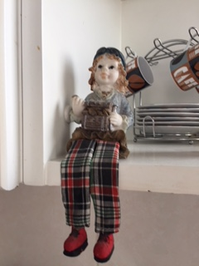
Ceramic bibelots, Ankara, 2018

Slide 5
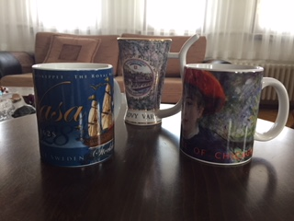
Pottery accessories, ceramic cups, Ankara, 2018

Slide 6
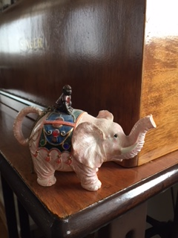
Ceramic bibelots, Ankara, 2018

