Slide 1
Political Geography
Asst. Prof. Merve ALTUNDAL ÖNCÜ

Slide 2
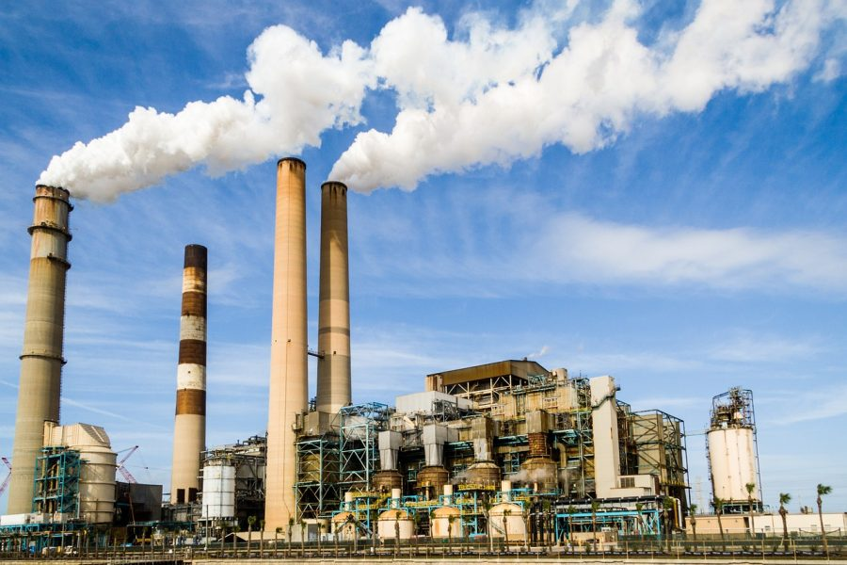
Classification of the degree of availability of resources
1. Power resources available immediately. These include active mines and factories, which are already producing objects with immediate power potential, such as steel sheet and chemical fertilizer.

Slide 3
2. Resources available only after activation. Among such resources would be stand-by equipment and any plant not currently in production.
In a sense, these resources also include the “moth ball” fleet.
The time required for activation varies from a few hours to several weeks, according to the need for “warming up”

Slide 4
3. Resources available only after activation.
Most factories producing consumer goods having power potential only after a considerable time lag.

Slide 5
4. Resources available only after development
Such fuel resources or ore deposits, known to exist, but awaiting the opening up of a mine or the construction of a processing plant.
Such development may well take several years; it is not uncommon for example, for the opening of a new coal mine- particularly a deep one- to cover a period of four or five years.
It is unlikely, therefore, that such undeveloped resources would be taken into consideration in making political decisions.
The decision to resort to war, for example, is likely to be made in the light of only of resources that is already in some phase of development.
On the other hand, if a war should last longer than protagonists at first expected it to, it is likely that resources, undeveloped at the start, would be exploited before the conclusion.
E.g. Germany’s development of domestic iron ores and her use of coal for making petroleum are good examples of wartime development.

Slide 6
5. Hypothetical resources
Coal, petroleum, ore bodies, and other resources whose existence is only presumed but not proved cannot be said to have any power value.
No political authority is likely to count on them unless careful investigation has at least raised them to the level of category 4.
To this category, must also belong the future development of cheap nuclear power, solar energy, the harnessing of the tide and the use of other such potential resources

Slide 7
A country, which cannot produce a needed commodity from its own soil or its factories, must necessarily import.
This in turn imposes two conditions: a market in which it can be obtained and the means to pay for it. The former does not, except in the case of a very few rare commodities, present much difficulty, but the foreign exchange with which to pay for it is often very scarce. Such imports can be paid in three ways:
i) by means of exports,
ii) by means of service performed by the importing country, and
iii) by means of payments in gold, securities, and some other internationally acceptable medium.

Slide 8
Clearly, this last means cannot be employed except in an emergency, and only a few countries are able to perform services on a large enough scale to influence greatly their ability to purchase abroad.
Most of the less developed countries cover the cost of imports by the export of agricultural and mineral raw materials.
The more developed countries customarily export mainly manufactured goods or processed materials.
A country’s natural endowment is of immense importance in determining its rage of exports.
Agricultural exports, which are important to the less developed countries, are subject to considerable price fluctuations, and many are not essential, in so far as other vegetable or even synthetic products can replace them.
Demand thus tends to be very elastic.

Slide 9
Food resources
An adequate supply of foodstuffs is a condition of human welfare, and its assurance is necessarily a primary preoccupation of a government.
No great power is completely self-sufficient in respect to foodstuffs, because in no instance is the area large enough the embrace the variety of environment necessary to produce the range of food now thought desirable. E.g. USA and France perhaps come closest to being self-sufficient. But none is able to produce foodstuffs of equatorial origin without extreme difficulty and high cost. E.g. sugar cane.

Slide 10
By contrast such countries as the UK, Belgium, Switzerland, F.R Germany, and Sweden are very much more dependent on imported foodstuffs.
Under normal condition the UK imports about half the total food consumption required of its population.
There is a certain amount of slack in the agricultural economy, so that food production could in fact be increased for a period.

Slide 11
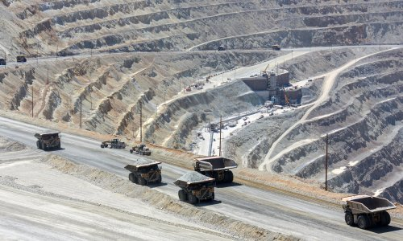
Mineral resources
Mineral resources differs, however, in two major respects from those concerning food resources. In the first place, the soil, given careful management, will go on producing without significant variation.
Mineral resources, on the other hand, are exhaustible, every known deposit, if worked continuously, will run out.
Second, food resources are, by and large, perishable. Most minerals on the other hand, can be stockpiled, and the majorities do not deteriorate if left exposed to the weather.

Slide 12
Fuel resources
Coal of all kinds, as well as petroleum and natural gas- are more widely distributed than most metallic minerals.
But not all states of the world possess it. Such an imbalance necessarily produces grave problems for the states lacking sources of mineral fuels.
It may lead to the development of alternative sources of fuel, usually at much higher cost, or to the import of fuel and thus to a high dependence on the other countries for an essential raw material.

Slide 13
Metal Resources
The distribution of economic minerals is concentrated in a relatively small number of places on the earth’s surface, and this gives each of these areas certain importance.
A handful of countries account for the greater part of the world’s production of each of the important metallic ores, with the exception of only of iron.
This is due partly to the fact that most of the world’s reserves are contained in a few large ore deposits, partly because modern technology makes it undesirable to work small deposits

Slide 15
Manufacturing Industries Manufacturing industries give two power advantages to a state:
They are conducive to a higher standard of living.
The total productivity of a highly mechanized people is, after making all allowances for the creation and maintenance of the machines, greater than that of a people not so equipped.

Slide 16
2. The actual possession of the plant and equipment necessary to turn out the weapons and equipment of war.
The most varied and developed the range of industry; the less will be the degree of dependence on other countries. It is not necessary that the industry should normally engaged in making military items, though it is probable that their manufacture on a small scale would continue, even under the most favourable international circumstances. What is important is that the industry as a whole could be converted to the manufacture of such equipment at a short notice.

Slide 17
The strategic branches of industry:
i) By general consent, the greatest importance attaches to the smelting and refining of metals.
ii) Engineering, metals construction, and ship building industries.
iii) The production of chemicals, including high explosives, fertilizers, and cement.
iv) Manufacture of electrical and other instruments.
v) Textile and clothing.
vi) The food and consumers industries.

