Slide 1
Cancer Stem Cells

Slide 3
https://www.urmc.rochester.edu/MediaLibraries/URMCMedia/life-sciences-learning-center/documents/Stem_Cells_and_Cancer.pdf

Slide 4
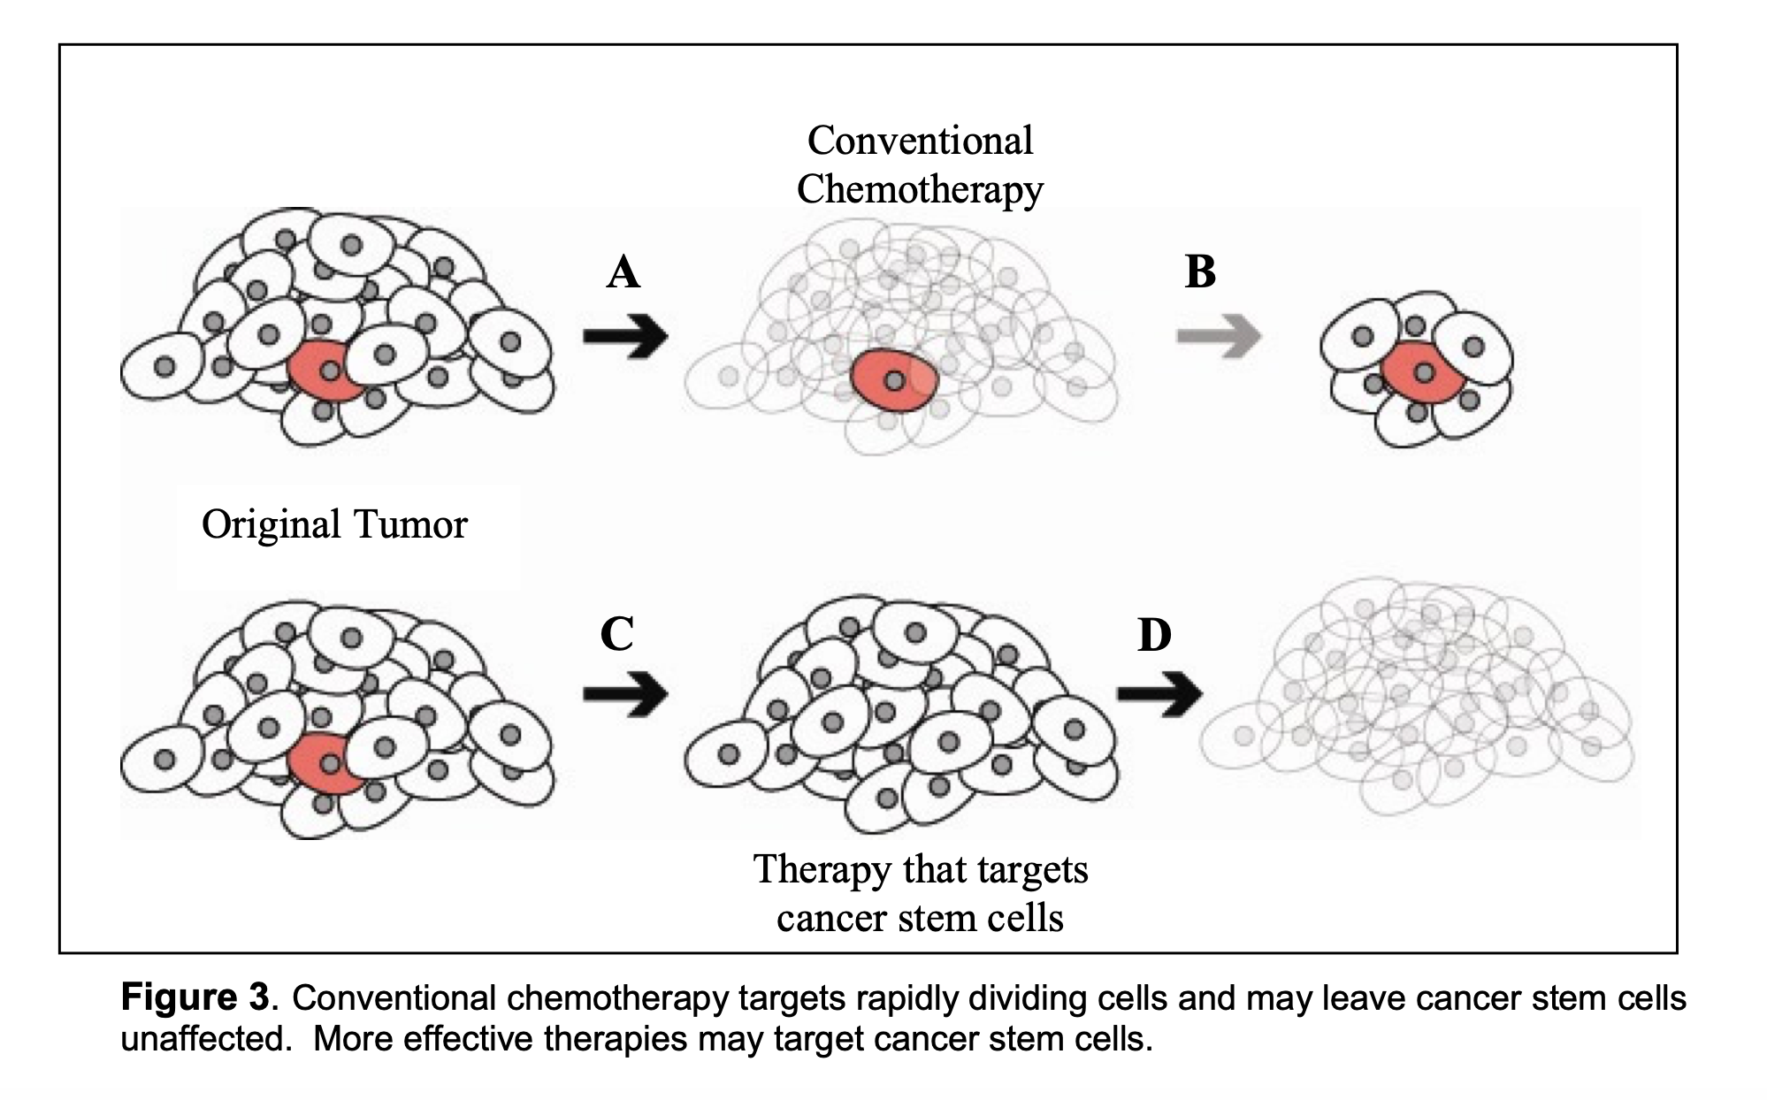
https://www.urmc.rochester.edu/MediaLibraries/URMCMedia/life-sciences-learning-center/documents/Stem_Cells_and_Cancer.pdf

Slide 5
https://doi.org/10.1038/mt.2013.160

Slide 6
The concept of the cancer stem cell (CSC). Tumor cells are heterogeneous which contain a majority of cells are non/poorly tumorigenic, and a small subset of CSCs. The CSCs can be functionally distinguished from other populations by their ability to reconstitute a differentiated tumor upon transplantation into an immunocompromised mouse. Based on this model, CSC specific therapies are proposed in combination with conventional chemotherapies to kill both CSC and other differentiated populations and prevent subsequent relapse.

Slide 7
Antigens found specifically on CSCs versus those on differentiated tumors. Examples of antigen identified in the bulk tumor and CSC populations. Simultaneously targeting both types of antigen is emerging as a successful approach to maximize immune responses to a variety of cancers.

