Slide 1
Yaka yapımı
Flecker, L. Costume mounting. Archetype publications. UK, p.260

Slide 2
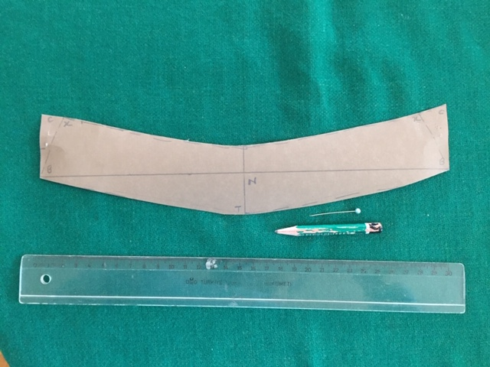
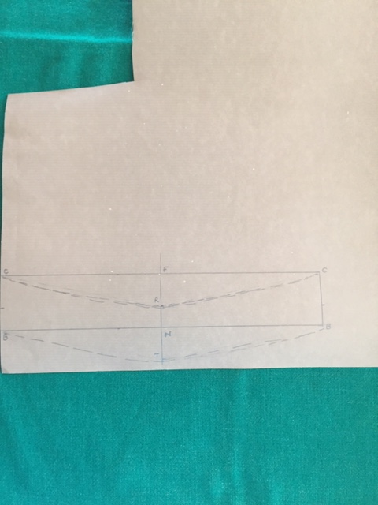
Flecker 2013: 55-56

Slide 3
