Slide 1
DISEASE IN POPULATION
The structure of animal populations is examined in terms of locational characteristics (contiguous and separa) and population movements (open and closed) in a given area
Open populations
Sometimes they are populations of inbound and outbound
Involving bulls outside in a business cattle population
Removing a cattle slide
Introducing the prepared food into the population
Closed populations
Populations whose movement is completely restricted and have no relation to outside
SPF and Gnotobiotic laboratory animal populations

Slide 2
DISEASE IN POPULATION
Population volume and density
Population volume: the number of animals in a population
Population density: the number of animals per unit area in a population
Relative population
A disease or a populated subject
Female in abortion problem, even pregnant animals
Elderly animals in tuberculosis problem
Chickens in Pullorum disease

Slide 3
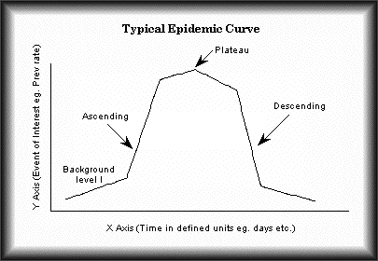
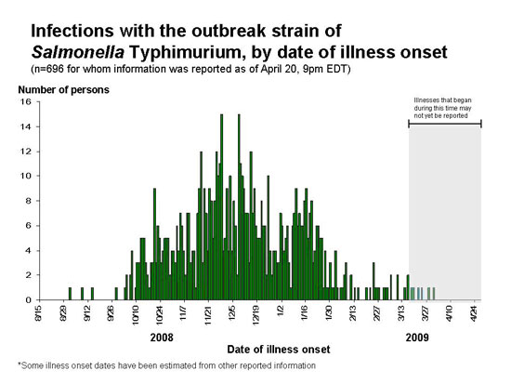
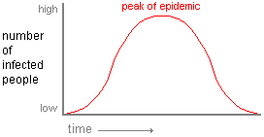
DISEASE IN POPULATION
Disease progression in the population
Epidemic curve
Infection
The incubation period of the disease
Percentage of susceptible animals in the population
Distance between animals
(animal density, population structure)
Sporadic course
Endemic course
Epidemic course
Pandemic course

Slide 4
DISEASE IN POPULATION
Disease progression in the population
Epidemic curve
Infection
The incubation period of the disease
Percentage of susceptible animals in the population
Distance between animals
(animal density, population structure)

