Slide 1
10.subject
Handicrafts made by using thin branches, stalks, tree stripes
as raw materials

Slide 2
Handicrafts made by using thin branches, stalks, tree stripes as raw materials
Handicrafts made by using thin branches ( salix, punica granatum, tamarix)
Handicrafts made by using grain stalks
Handicrafts made by using sedge
Handicrafts made by using tree stripes (populus salix, corylus, quercus)

Slide 3
Basket weaving, furniture making, belonging such as bags, straw mats, beach matting, packsaddles

Slide 4
basket magnet, Ankara, 2018

Slide 5
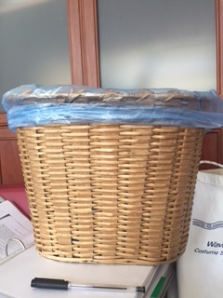
Paper basket, trash basket, Ankara, 2018

Slide 6
Handmade traditional whisk, Ankara, 2018

