Slide 1
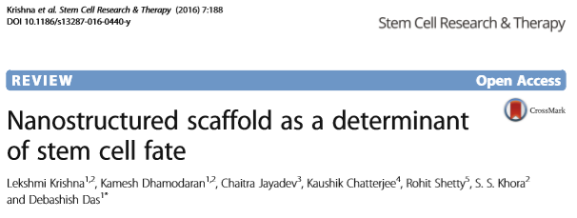
STEM CELL RESEARCH & THERAPY

Slide 2
STEM CELLS AND BIOMATERIALS
The science of biomaterials has evolved to direct cellular differentiation
Biomaterials can now be molded into 3-D scaffolds
Natural Scaffolds
Biodegradability & biologically active nature
Enhanced tissue growth & tissue integration on transplantation
Synthetic Scaffolds
Versatility, malleability, processability

Slide 3
NANOSCALE PLATFORMS
Generating a substrate topography that mimics the in vivo microenvironment
Scaffold generating techniques:
Electrospinning
Soft Lithography
Microfluidics

Slide 4
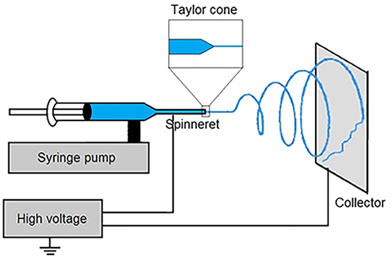
Electrospinning
Obtaining nanofibers mainly as scaffolds for tissues
Nanofibers of sub-microscale diameter are generated by ejecting electrically charged polymer solutions through a needle on to a grounded collector surface

Slide 5
Applications
Tissue engineering, biosensors, filtration, wound dressings, drug delivery, and enzyme immobilization
- Poly-L-lactic acid (PLLA): Human tendon stem cells
- Poly-ε-caprolactone (PCL): Human bone marrow stromal cells
- Polylactic acid (PLA): Differentiating human mesenchymal stem cells
- PCL-gelatin: MSCs for myocardial regeneration
- Polylactic-co-glycolic acid (PLGA): Skin scaffolds

Slide 6
Limitations
Possibility of cells squeezing into smaller pores
Limiting growth potential
Depends on polymer properties:
Viscosity
Surface tension
Conductivity
Diaelectric constant

Slide 7
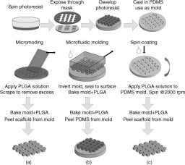
Soft Lithography
Customizing the spatial distribution of polymer molecules placed on the substrate to aid specific outcomes
Conditioned culture method for lineage specifity
3D polyglycolic acid (PGA)

Slide 8
Limitations
Provides a limited and narrow range of ECM signals for the cells to perceive
Distortion in the fabrication of single-layer structures
Formation of a thin film of polymer under the nanometer-sized features
Integration of large and small features in phase shift lithography

Slide 10
Microfluidics
Microfluidic devices make an excellent platform to study cells under various micro environmental conditions
The capillary flow maintains a constant soluble microenvironment

Slide 11
Large surface area to volume ratio similar to biological systems
Used for high-throughput screening because of the capacity to culture a limited number of cells in a controlled manner
There are some main limitations of microfluidics in long-term stem cell cultures

Slide 15
THANK YOU FOR LISTENING
Aycan Bulucu 15290146
Ece Görkemli 15290158
Esin Yiğit 15290196
Pelin Bölükbaş 15290145

