Slide 1
Yapay Zeka 802600715151
Doç. Dr. Mehmet Serdar GÜZEL
Slides are mainly adapted from the following course page:
at http://ai.berkeley.edu created by Dan Klein and Pieter Abbeel for CS188

Slide 2
Lecturer
Instructor: Assoc. Prof Dr. Mehmet S Güzel
Office hours: Tuesday, 1:30-2:30pm
Open door policy – don’t hesitate to stop by!
Watch the course website
Assignments, lab tutorials, lecture notes

Slide 3
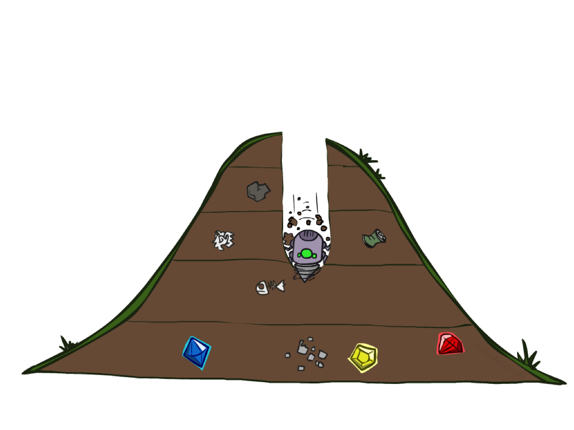
Depth-First Search

Slide 4
Depth-First Search
Depth-first search is a recursive algorithm for traversing a tree or graph data structure.
It is called the depth-first search because it starts from the root node and follows each path to its greatest depth node before moving to the next path.
DFS uses a stack data structure for its implementation.
The process of the DFS algorithm is similar to the BFS algorithm.

Slide 5
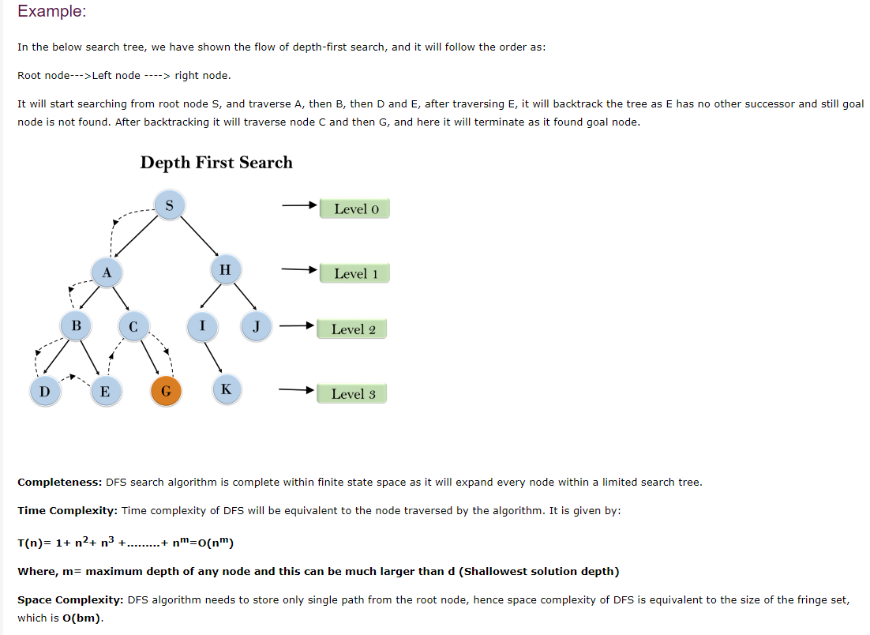
Depth-First Search

Slide 6
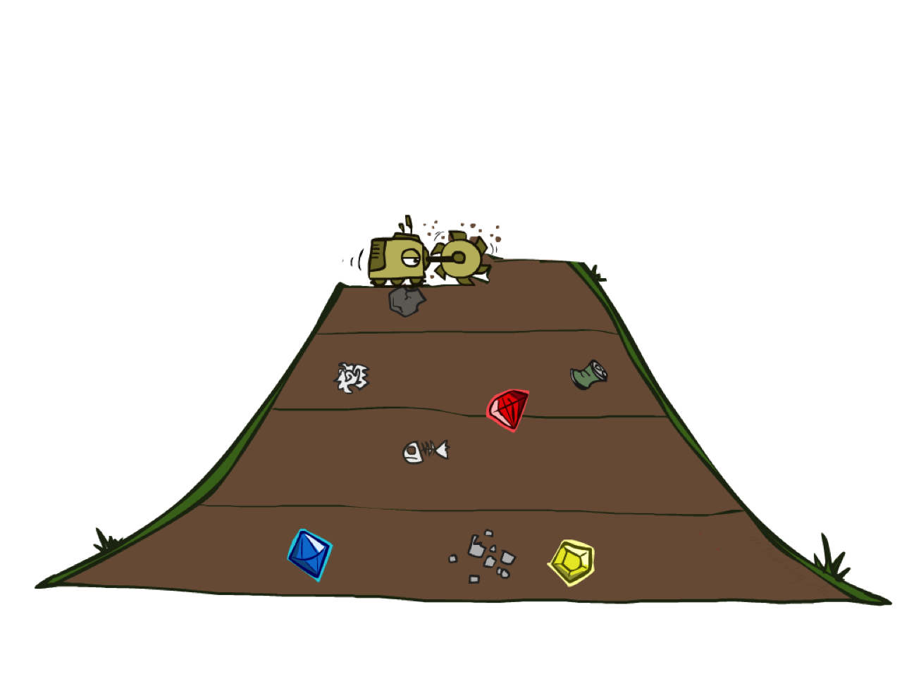
Breadth-First Search

Slide 7
Breadth-First Search

Slide 8
Breadth-First Search
Strategy: expand a shallowest node first
Implementation: Fringe is a FIFO queue
a
G
b
c
d
e
f
S
h
p
q
r
S
d
e
p
Search
Tiers
b
c
e
h
r
q
a
a
h
r
p
q
f
p
q
f
q
c
G
q
c
G
a
a

Slide 9
Breadth-First Search (BFS) Properties
What nodes does BFS expand?
Processes all nodes above shallowest solution
Let depth of shallowest solution be s
Search takes time O(b^{s})
How much space does the fringe take?
Has roughly the last tier, so O(b^{s})
Is it complete?
s must be finite if a solution exists, so yes!
Is it optimal?
Only if costs are all 1 (more on costs later)
1 node
b
…
b nodes
s tiers
b² nodes
b^{s} nodes
b^{m} nodes

Slide 10
DFS vs BFS

Slide 11
Cost-Sensitive Search
a
GOAL
2
2
b
c
3
2
1
8
2
e
d
f
3
9
8
2
START
h
1
4
2
p
4
r
15
q
BFS finds the shortest path in terms of number of actions.
It does not find the least-cost path. We will now cover
a similar algorithm which does find the least-cost path.

