Slide 1
METAL packagIng MATERIALS
Instructor
Assist. Prof. Dr. Eda Demirok Soncu
E-mail: edemirok@eng.ankara.edu.tr
Phone: +90312 203 3300 (3639 ext.)
Office: 2nd floor #212
Fde 216 food packagıng

Slide 2
The importance of container design
The shapes of metal containers are very relevant to their cost, physical performance and compatibility with the filled product
In can design;
metal thickness is determined by the need for physical performance in handling, processing and storage of the filled container
surface area is determined by the volume contents and the chosen shape of the container

Slide 3
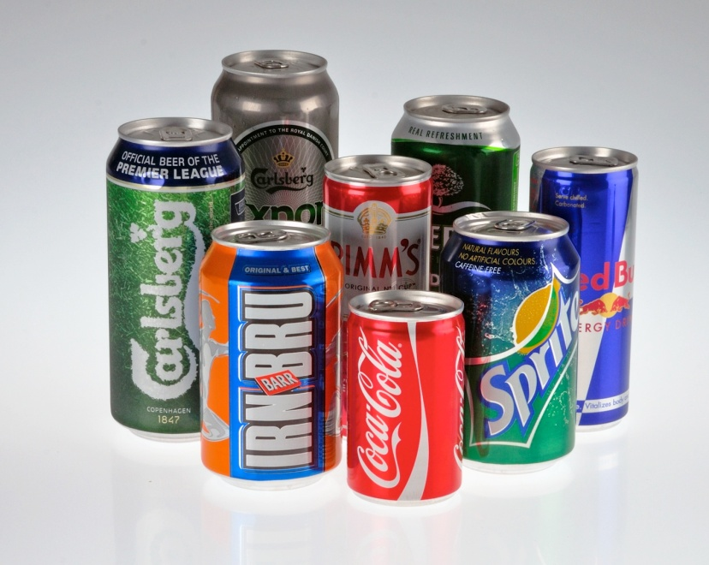
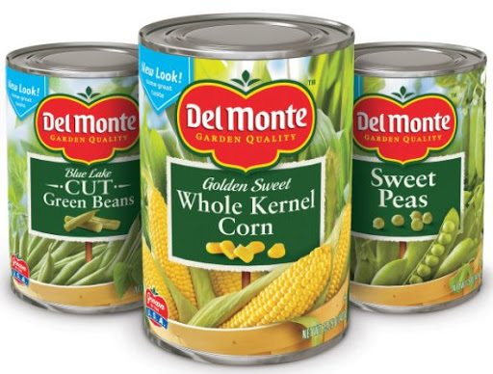
Different types and shapes of metal cans
Most food (vegetables, fruits, tomato paste, soups) and drink cans have a circular cross section

Slide 4
Different types and shapes of metal cans
Non-round cross section containers are typically used for edible oils

Slide 5
Different types and shapes of metal cans
Non-round cross section containers are typically used for fish and meats that are heat processed

Slide 6
What properties should metal packages have?
Metal packages for food products must perform the functions given below
preserve and protect the product
resist chemical actions of product (e.g. after carbonated bevarages are filled, the metal container is closed. Carbonation pressure provides physical support to the container and the container must be durable against to this pressure)
withstand the handling and processing conditions (e.g. after blanched vegetables are filled into metal container, heat process is applied to prolong the shelf life up to 2-3 years. Therefore, metal cans must be durable against to high temperature and pressure conditions

Slide 7
What properties should metal packages have?
Metal packages for food products must perform the functions given below
withstand the external environment conditions
have the correct dimensions for easy transportation
have the required shelf display properties at the point of sale
give easy opening and simple/safe product removal
be constructed from recyclable raw materials

Slide 8
What type of materials are used for can making?

Slide 9
Raw materials used for can making
Steel
Aluminium
Recycling of metal packages: Both aluminium- and steel-based packaging materials are re-melted by the metal producers. Aluminium and steel do not loss its quality during the re-melting process; therefore, they may be reused an unlimited number of times for the production of first-quality packaging material.

Slide 10
Raw materials used for can making
Steel and aluminium are the raw materials which are used for metal containers and metal closing tools
They have some advantages, which are
Low-cost
Non-toxic
Adequate strenght
Suitable for hard material making

Slide 11
A raw material for can making: Steel
In the first stage, low-carbon steel is produced as blackplate
Then, it is converted into tinplate or tin-free steel (TFS) for container and closure manufacture

Slide 12
Tinplate from steel
Tinplate is produced by coating of blackplate with a thin layer of tin (Sn)
Tin coating provides good barrier properties against to corrosion of steel
Tin coating makes the can suitable for direct contact with many food products such as fruits and tomato based product
For most foods and drinks, application of organic coating to the inside surface of tinplate is neccessary to provide an inert barrier between the metal and the product packed

Slide 13
Tin-free steel (TFS) from steel
TFS is produced by coating of blackplate with a thin layer of chromium/chrome oxide
Then, it must be coated with an organic material to provide a resistant surface against to corrosion
As compared to tinplate, TFS is less expensive and have matt surface

Slide 14
A raw material for can making: Aluminium
Aluminium has good mechanical properties, which are
It is the lightest material
It is easy to reduce its thickness
Aluminium has good thermal properties, which are
It has high thermal conductivity, which means heat process applied to Al packages is more effective
Its melting temperature is lower than 700°C and it evaporates at lower pressure. Thanks to these properties, Al can be used as a surface coating material for plastic films or paper material
It resists againts to low or freezing temperatures

Slide 15
Production process of metal cans

Slide 16
Can making process
Making process for can body
Making process for upper (lid) and bottom side of can
Body of can is made by using three methods
Three-piece welded cans
Two-piece single drawn and multiple drawn (DRD) cans
Two-piece drawn and wall ironed (DWI) cans
The process, which is used to produce upper and bottom parts of cans, is called as end-making process

Slide 17
1) Three-piece welded cans

Slide 18
1) Three-piece welded cans
The raw material sheet, which are tin-plate, TFS, aluminium or recycled metals, is rolled to form cylinderic can under electric flow
When the cylinder is formed, the sheet is cut
This electric flow heats the metal and facilitates welding of two edges of cylinder
Welding is a process, which is defined as a combining of two sides

Slide 19
2) Two-piece single drawn and multiple drawn (DRD) cans

Slide 20
2) Two-piece single drawn and multiple drawn (DRD) cans
In order to produce single draw shallow can, the metal sheet is drawn into shallow can as seen in Figure, then the flange is formed
For producing of multiple draw tall can, the metal sheet is drawn three times in order to form the final tall shape

Slide 21
3) Two piece drawn and wall ironed (DWI) cans

Slide 22
3) Two piece drawn and wall ironed (DWI) cans
After the metal sheet is drawn into tall can by multiple times, the wall of the can is thickened by ironing
After the flange is formed, the can body is reshaped by drawing multiple round circle to strenght it
Then the neck followed by flange are formed by using former to finalize the can production

Slide 23
End-making process (Plain end forming)

Slide 24
End-making process (Easy-open end forming)

Slide 25
End-making process (Plain end and easy-open end forming)
The metal sheet is cut and then formed into semi-elliptic round
Then the cover curl is formed by using curling tool
This curling part is used to combine the upper or bottom lid with can body by seaming
After plain end is formed, rivet pin is formed at the centre and the opening tool is fitted over the rivet pin

Slide 26
How canned foods are produced?

Slide 27
Production process of metal canned foods
Quality assurance checks of cans
Filling and exhausting
Seaming
Storage and distribution
Cooling, drying, labeling
Heat processing

Slide 28
1) Quality assurance checks of cans
Before the food product is filled into metal container, the cans should be checked in terms of
seam defect on bottom side
weld defects for three-pieces welded cans
damage/corrosion on internal or external coating
defect in flange
contamination inside the cane
Before filling process, the can should be cleaned by using air jet, steam or water

Slide 29
2) Filling and exhausting
Filling should be carried out carefully. During the filling process, it is important to note that
The filling is performed without damaging the can
Required amount of product should be filled into container and required amount of empty place should be left at the upper side of the can for closing process and vacuum formation
External contamination of flange should be avoided, since it negatively affects the seaming process at closing

Slide 30
2) Filling and exhausting
In order to achieve an effective vacuum, cans may be
(a) hot-filled with product and closed with or without direct steam injection into the headspace during double seaming
(b) filled with product (ambient or hot-fill) and then exhausted prior to double seaming
(c) closed in a vacuum chamber
The choosen of one of these methods depends on cost, product characteristics, production efficiency and vacuum level required

Slide 31
2) Filling and exhausting
Exhausting process is defined as passing filled cans through a steam-heated chamber (in other words, exhaust box) at 90°C
Exhausting serves to remove entrapped air from the product, raise initial temperature of the product prior to heat processing and help ensure that a good vacuum level is achieved

Slide 32
3) Seaming
The most important closure type used for metal containers is the double seam
The seam is formed in two operations from the curl of the can end (lid) and the flange of the can body
For heat-processed foods, the operation of the can seamer is critical control point for process safety
If there is seam defect, the external air enters inside the can and results in chemical and microbiological spoilage during distribution, storage or retail sale

Slide 33
3) Seaming

Slide 34
Seaming process https://www.youtube.com/watch?v=yMgSGgiUO4A

Slide 35
4) Heat processing
Upon seaming, the cans are exposed to sterilization or pasteurization process in order to provide microbial safety
The most important microbial risk for canned foods is the presence of Clostridium botulinum spores
These spores can cause a potentially fatal food poisoning, which is called as botulism

Slide 36
5) Cooling, drying and labeling
Effective washing of cans is often required to minimise external contaminated food/drink components that may contribute to container corrosion at a later process stage
Acid syrups or brine is used in canned foods as a filling solution. External contamination of can with these solutions will cause a corrosion on the external surface

Slide 37
5) Cooling, drying and labeling
After the can temperature is cooled down at 40 °C, the cans is dried to remove residual moisture from the external surface of can
Because the presence of water on can surface results in external corrosion and microbial contamination of external surface
These microorganisms can enter inside through the can seams and cause microbial spoilage
Use of correct label and adhesive is important, since highly acidic/alkaline starch-based adhesive can effect external corrosion

Slide 38
6) Storage and distribution
Canned foods should be stored at ambient temperature
Air temperature and air humidity inside the storage room as weel as canned temperature are important factors for storage conditions
Since potential water condensation in the case of sudden temperature changes results in external corrison
On the other side, damaged cans should be removed immediately, because it can trigger a chain reaction through the spread of moisture and corrosion between other cans

Slide 39
Canned food process https://www.youtube.com/watch?v=IdAlaGqXxQ0

Slide 40
Shelf life of canned food
Hermetic sealing and heat treatment (sterilization/pasteurization) are the methods, which are used to provide long shelf life for canned foods
Therefore, no preservatives are needed
However, some chemical reactions, occur between the can and the food products, limit the shelf life of canned foods
These reactions affect the sensory quality (such as color, flavor, appearance) and safety (some metals have toxic properties) of food products

Slide 41
Factors affecting the shelf life of canned foods
Sulphur staining
Dissolution of iron
Decrease in shelf life
External corrosion
Mechanical damage
Dissolution of tin

Slide 42
Use of lacquers
In order to prevent the chemical reactions between metal can and food, the can is coated with some lacquers such as;
Epoxy phenolic group or oleoresinous group are suitable for meat, fish, vegetable and fruits
Vinyl resins are used for dry products such as biscuits and powders and also some drinks
Organosol groups are found in application for beverage cans

Slide 43
Troubles in canned foods
Mechanical damage caused by poor transportation or manufacturing fault results in cracking of internal lacquer
In the case of damaged lacquer, tin start to dissolve slowly into the product. Dissolution rate increases depending on increased time, increased temperature, exposure area, tin coating with thin thickness, the presence of high acidic foods

Slide 44
Troubles in canned foods
Corrosion in steel base starts towards the end of tin corrosion
Corrosion in steel results in releasing of iron into the food, changes in color and flavor (e.g. metalic taste)
External corrosion is caused by moisture condensation, physically damaged of external coating, poor drying conditions and leakage from neighbouring cans
External corrosion simply begins at the weakest point of the can (seam points and opening tools)

Slide 45
Troubles in canned foods (sulphur staining)
Sulphur staining is formed via a reaction between iron, comes from steel part of a can, and sulphur compounds, comes from protein-rich foods, in the presence of oxygen during processing
This reactions results in the formation of blue-black or brown points inside the can
It is seen in canned peas, sweet corn, meat or fish
It is not harmful for human health, but it affects products appearance and causes consumer complaints
Solution is coating of can with lacquer which resist to sulphur compounds

Slide 46
References
Coles R. et al. (2003). Food Packaging Technology. Blackwell Publishing and CRC Press. (in Chapter 5 pages 120-151)
Piergiovanni, L. & Limbo, S. (2016). Food Packaging Materials. Springer. (in Chapter 3 pages 13-22)
Jeantet, R. et al. (2016). Packaging (Part 5) In Handbook of Food Science and Technology 2/Food Process Engineering and Packaging. John Wiley&Sons, Inc. USA. (pages 298-301)

