Slide 1
Project Management
* Series of actions
* Temporary effort
* Includes constraints
* Includes risks
Notes:
What is a project?
Series of actions to achieve a result.
A project is a temporary effort to create a unique product or service.
Projects usually include constraints and risks regarding cost, schedule or performance outcome.
The aim of a project plan is to go through, document and agree upon important issues that define the work in the project.

Slide 2
Project Management
* Set of principles, practices, and techniques
* Leads project teams
* Controls project schedule, cost, and performance risks
Notes:
Project management
a set of principles, practices, and techniques applied to lead project teams
and control project schedule, cost, and performance risks to result in delighted customers.

Slide 3
Project Management
Project vs. Process ?
Notes:
Project
Take place outside the process world.
Unique and separate from normal organization work.
Process
Ongoing, day-to-day activities.
Use existing systems, properties, and capabilities.

Slide 4
Project Management
* Complex
* Limited
* Clear goal
* Customer-focused
Notes:
Features of Projects
Complex, one-time processes
Limited by budget, schedule, and resources
Developed to resolve a clear goal or set of goals
Customer-focused

Slide 5
Obtaining ISs
* Build your own
* Buy a prepackaged system
* Outsource
* End user development
Notes:
Options for Obtaining Information Systems
- Build your own
- Buy a prepackaged system from a software development company or consulting firm. Example: Payroll system.
- Outsource development to a 3rd party: outside organization custom build a system to an organization’s specifications.
Good option when an organization does not have adequate resources or expertise.
- End user development: Individual users and departments build their own custom systems to support their individuals. Example MS Excel.

Slide 6
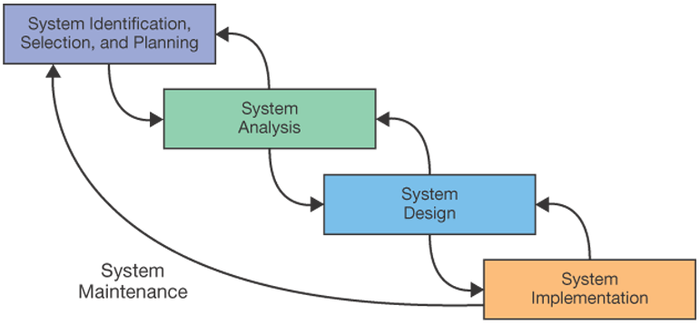
System Development
Notes:
Here is SDLC.

Slide 7
System Development
* System identification, selection, and planning
* System analysis
* System design
* System implementation
* System maintenance
Notes:
Systems Development Life Cycle (SDLC)
describes the life of an information system from conception to retirement.
System identification, selection, and planning
System analysis
System design
System implementation
System maintenance

Slide 8
System Development
1. System Identification, Selection, and Planning
- Undertake only those projects critical to mission, goals, and objectives
- Select a development project from all possible projects that could be performed
- Different evaluation criteria used to rank potential projects
Notes:
An organization can only work on only a limited number of projects at a given time
due to limited resources so care must be taken when selecting the projects to build.
After all possible projects are identified, those deemed most likely to yield significant organizational benefits,
are selected for subsequent development.
Some possible evaluation criteria for ranking potential projects are:
strategic alignment, potential benefits, potential costs and resource availability,
project size and duration, and technical difficulty.

Slide 9
System Development
2. System Analysis
- Collecting System Requirements
- System analysts use a variety of techniques to collect system requirements
* Interviews: analysts interview people
* Questionnaires: analysts design and administer surveys
* Observations: analysts observe workers at selected times
* Document analysis: analysts study business documents
Notes:
Requirement collection is process of gathering and organizing information from users,
managers, business processes, an documents to understand how a proposed system should work.

Slide 10
System Development
System Analysis
- Modeling Organizational Data:
* Entity Relationship Diagram (ERD)
- Modeling Organizational Processes and Logic
* Data flows
* Processing logic
Notes:
To construct an information system, systems analysts must understand what data the information system needs
in order to accomplish the intended tasks.
To do this they use data modeling tools to collect and describe data.

Slide 11
System Development
3. System Design
- Designing forms and reports
- Designing interfaces and dialogues
- Designing databases and files
- Designing processing and logic

Slide 12
System Development
4. System Implementation
- Software programming
- Software testing
* Developmental
* Alpha
* Beta
Notes:
Developmental: Programmers test the correctness of individual modules and the integration of multiple modules.
Alpha: Software tester tests whether it meets design specifications.
Beta: Actual system users test the capability of the system in the user environment with actual data.

Slide 13
System Development
4. System Implementation
- System conversion
- System documentation, training, and support
* User and reference guides
* Training and tutorials
* Installation procedures and troubleshooting guides

Slide 14
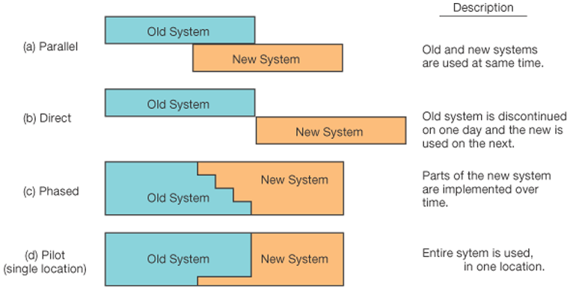
System Development
Notes:
Here are the system conversion types.

Slide 15
System Development
5. System Maintenance
- Maintenance process steps:
* Obtain maintenance request
* Transform requests into changes
* Design changes
* Implement changes

Slide 16
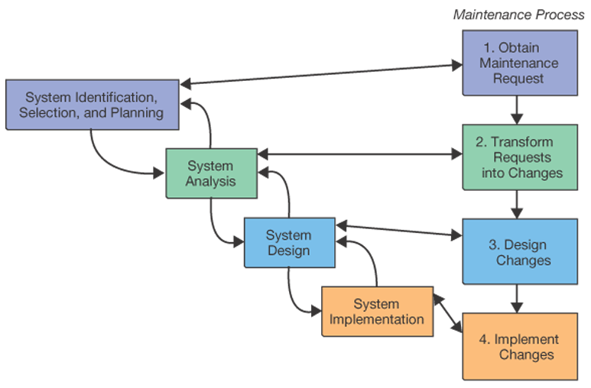
System Development
Notes:
Here is the mapping of maintenance to SDLC.

Slide 17
System Development
5. System Maintenance
- Maintenance types:
* Corrective maintenance
* Adaptive maintenance
* Perfective maintenance
* Preventive maintenance
Notes:
Corrective maintenance deals with the repair of faults or defects found in system functions.
Adaptive maintenance is the implementation of changes in a part of the system, which has been affected by a change that occurred in some other part of the system.
Perfective maintenance mainly deals with implementing new or changed user requirements.
Preventive maintenance involves performing activities to prevent the occurrence of errors.

Slide 18
Need for Alternatives to Building Systems Yourself
* Limited IS staff
* IS staff has limited skill set
* IS staff is overworked
* Problems with performance of IS staff

Slide 19
Common Alternatives to In-house Systems Development
* External acquisition
- System identification, selection and planning
- Systems analysis
- Development of a request for proposal (RFP)
- Proposal evaluation
- Vendor selection

Slide 20
Common Alternatives to In-house Systems Development
* Outsourcing: the practice of turning over responsibility of some to all of an organization’s information systems development and operations to an outside firm

Slide 21
Common Alternatives to In-house Systems Development
* Why Outsource?
- Cost and quality concerns
- Problems in IS performance
- Simplifying, downsizing, and reengineering
- Financial factors
- Organizational culture
- …

